Slide 2
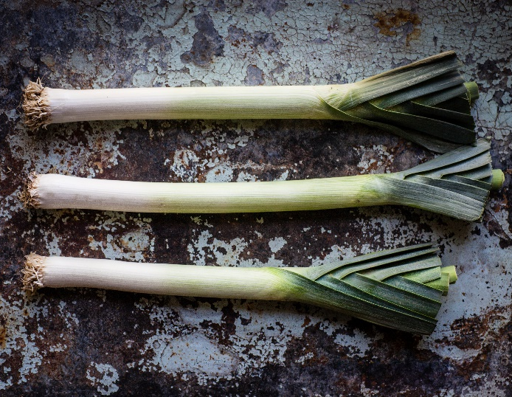
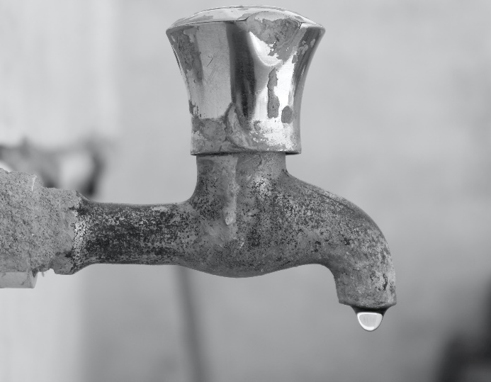
leek
leak
I chopped up a to put in my stew.
The outdoor tap has a .

Slide 3
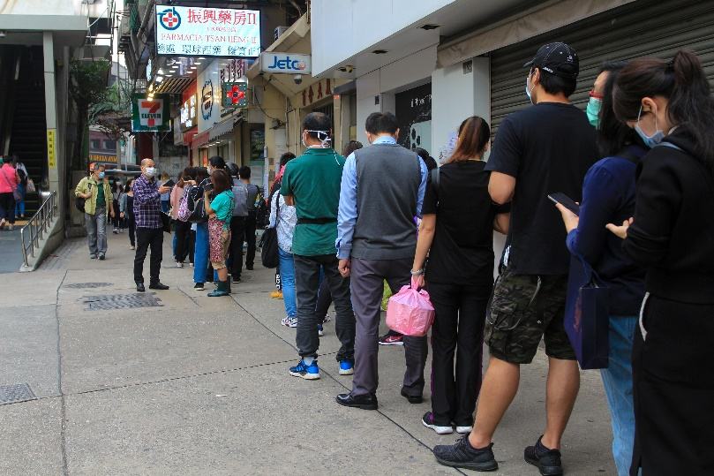
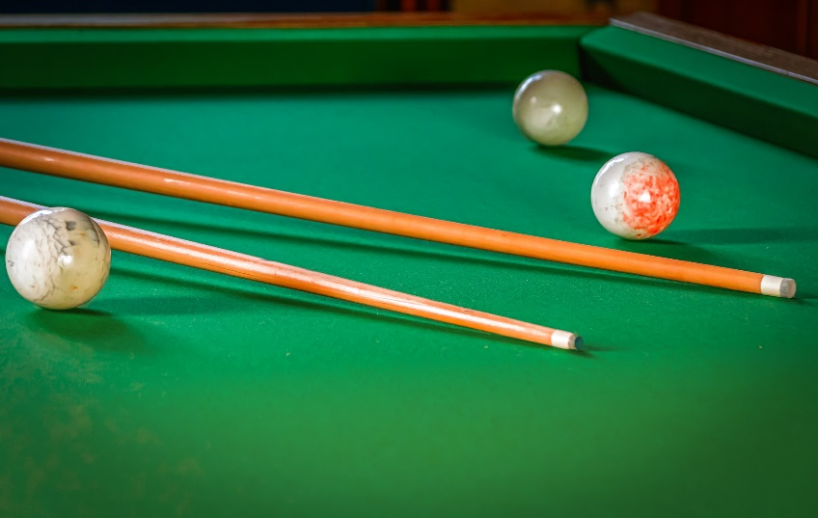
queue
cue
The people formed an orderly .
The snooker player hit the ball with the .

Slide 4
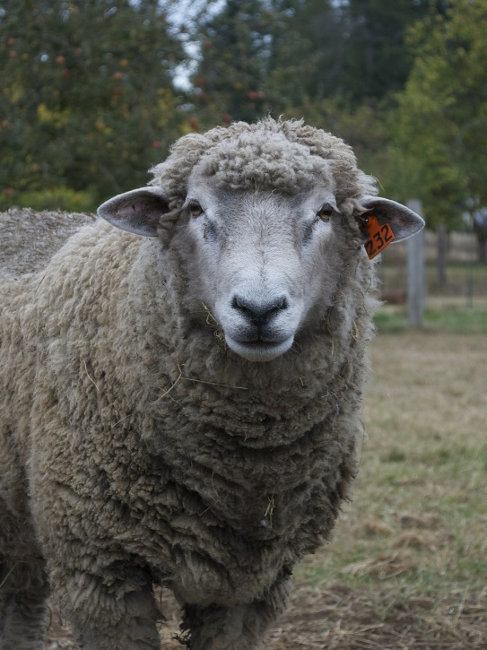
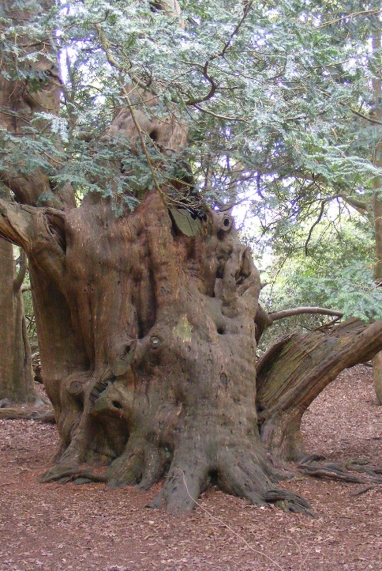
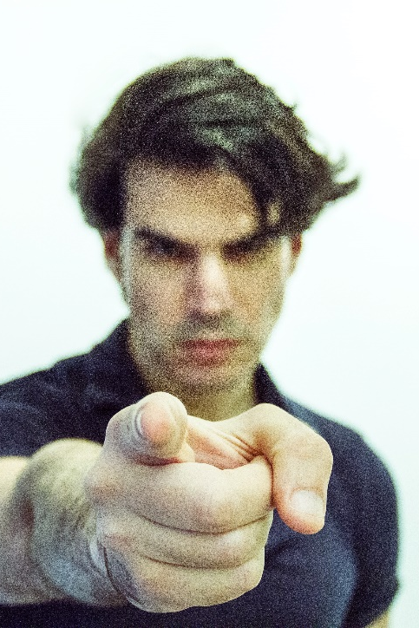
ewe
yew
you
The looked after her new-born lamb.
The great tree swung in the breeze.
I think should volunteer to clean up.

Slide 5
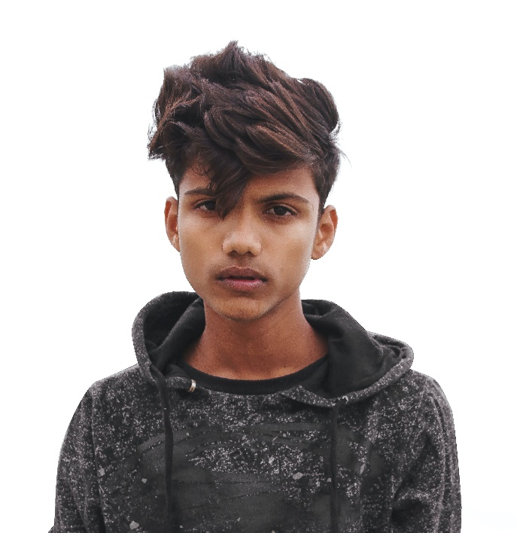
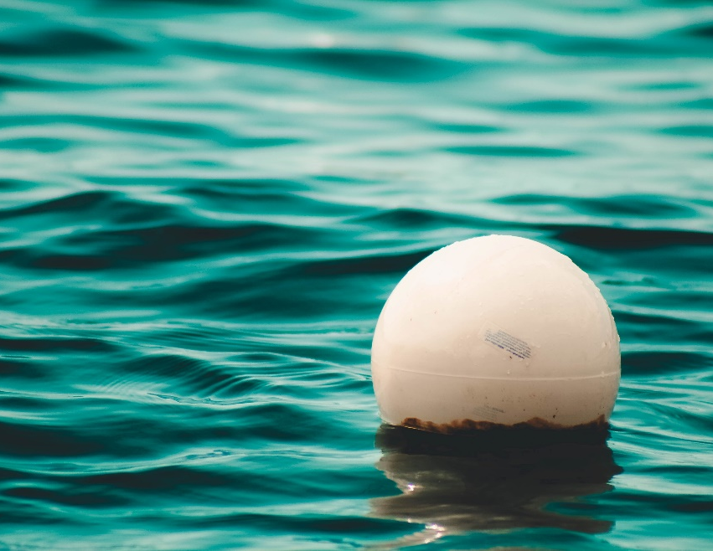
boy
buoy
The was very happy.
The bobbed around in the water.

Slide 6
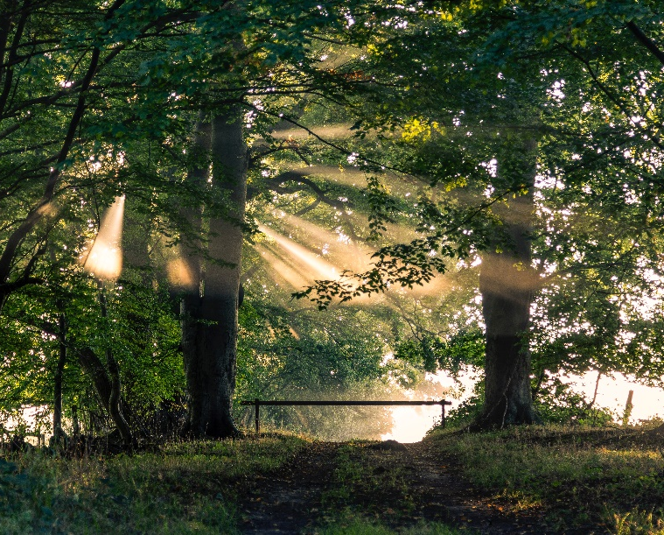
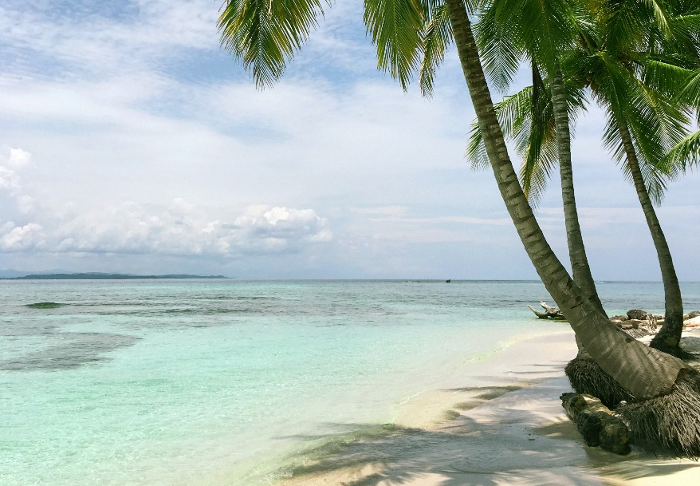
beech
beach
The trees were yellowish in colour.
The waves edged further up the .

Slide 7
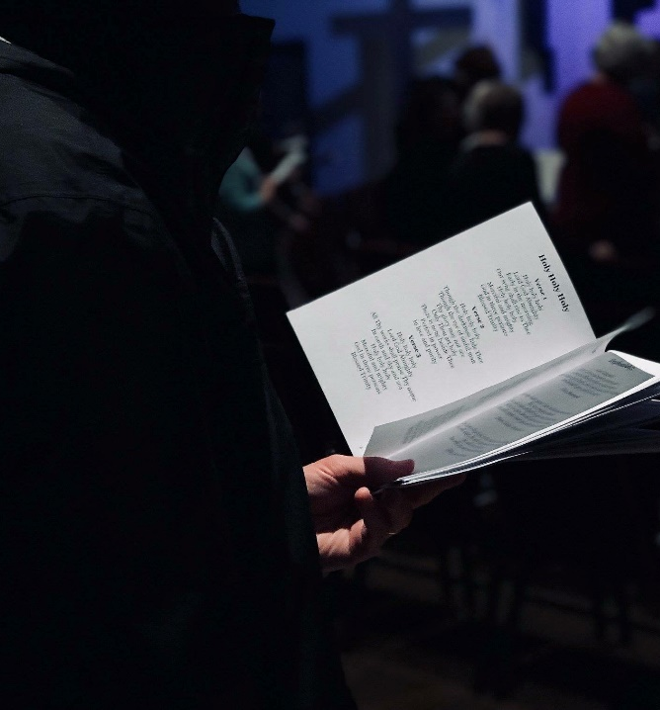
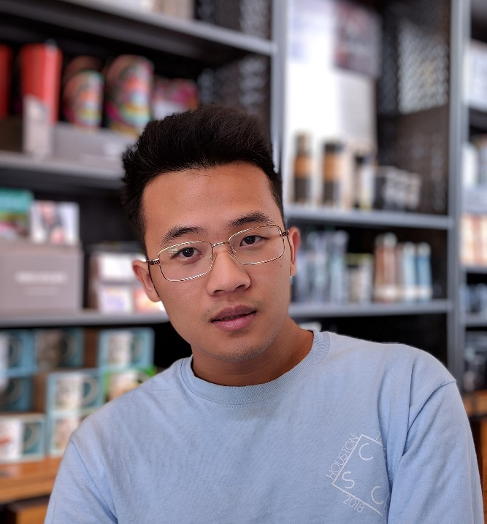
hymn
him
The wedding guests sang a .
The man was sad that his girlfriend had broken up with .

Slide 8
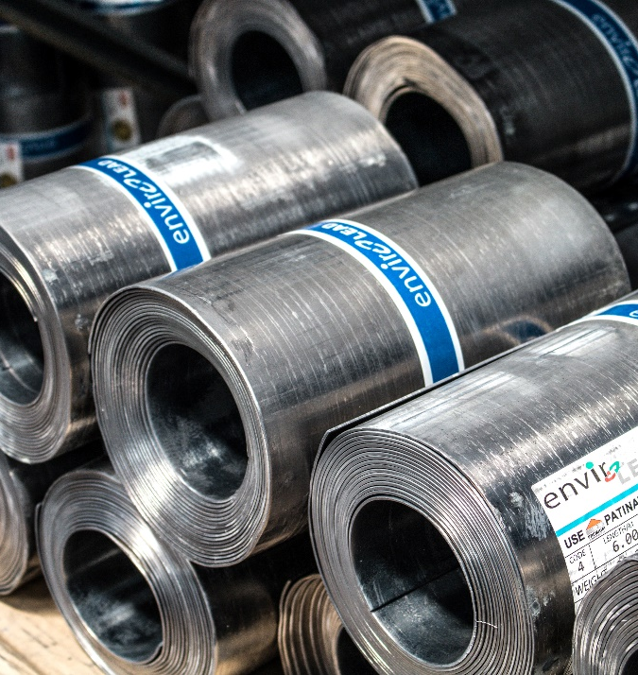
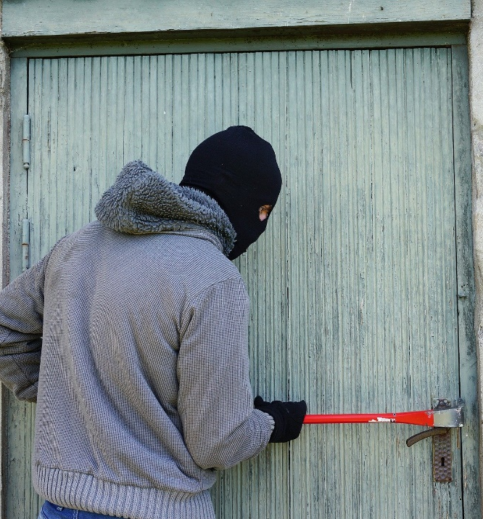
steel
steal
The bars were very strong.
The burglar attempted to the TV.

Slide 9
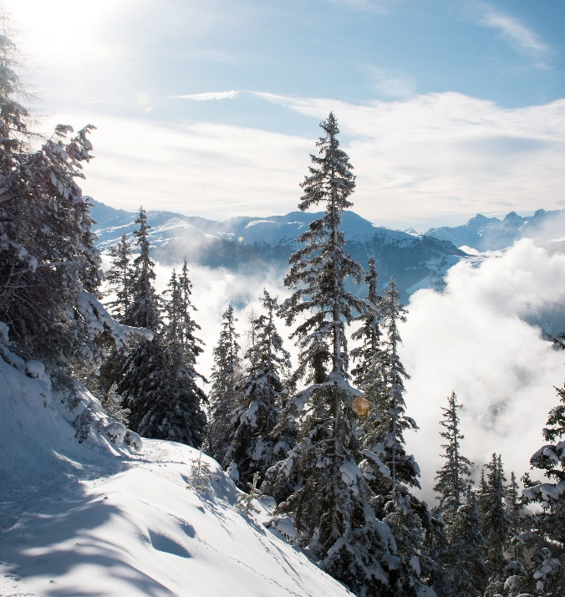
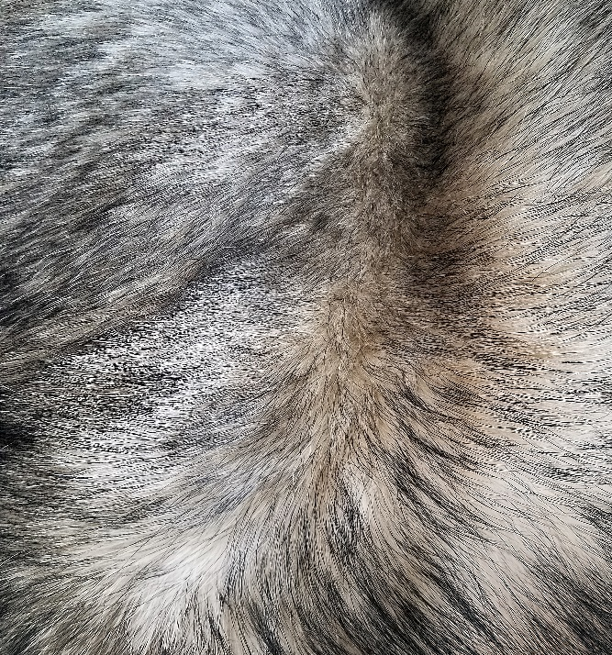
fir
fur
The tree was covered in snow.
My cat has very soft .

Slide 10
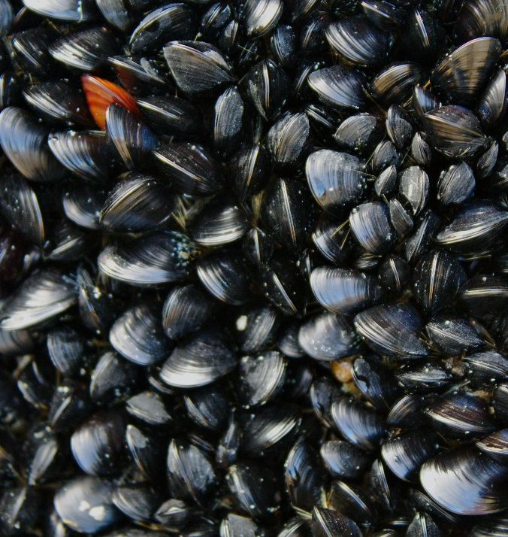
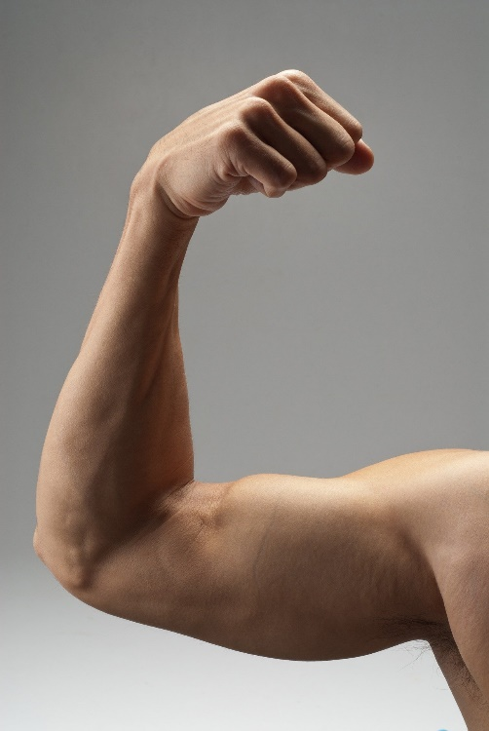
mussels
muscles
The were farmed offshore in the UK.
The man flexed his .

Slide 11
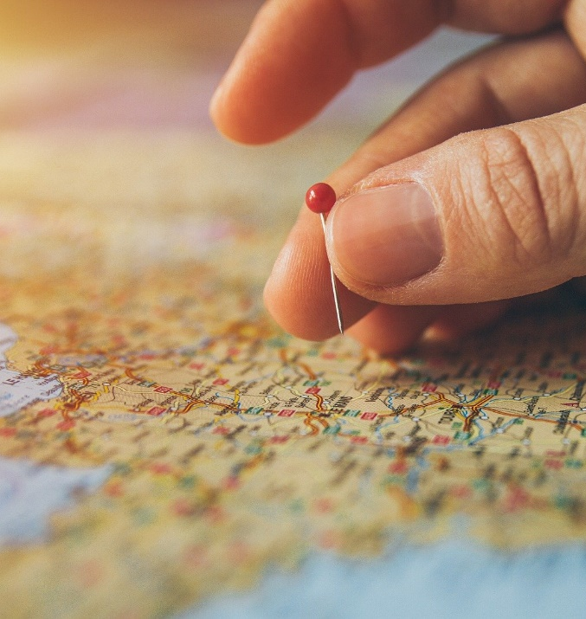
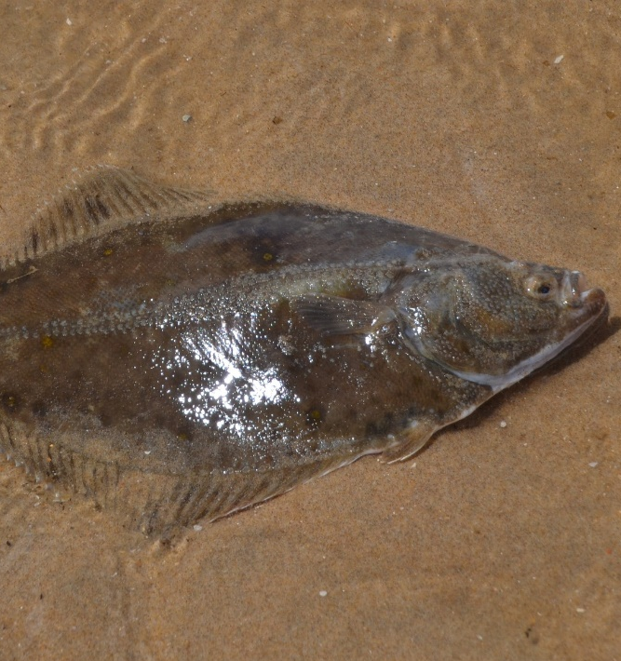
place
plaice
I used a map to find the .
The correct name for flat fish is .

Slide 12
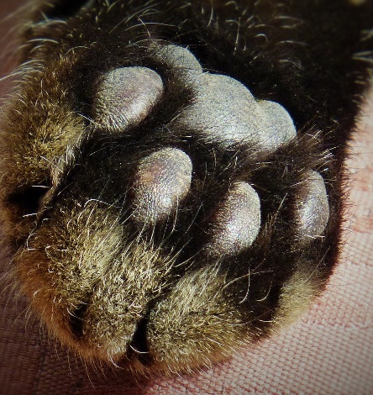
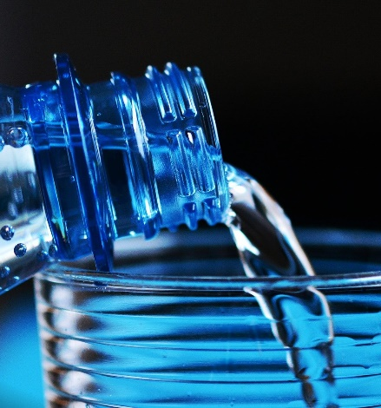
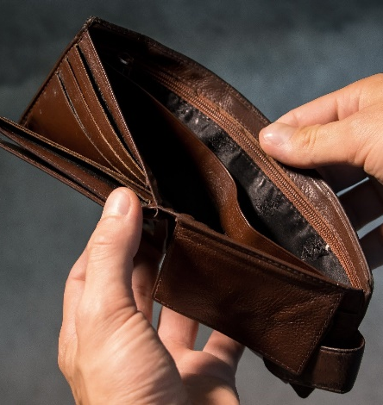
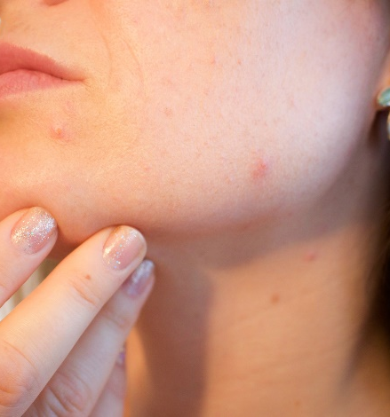
paw
pour
poor
pore
The cat lifted its .
Will you me a drink please?
people don’t have much money.
A small hole in the skin is called a .

Slide 13
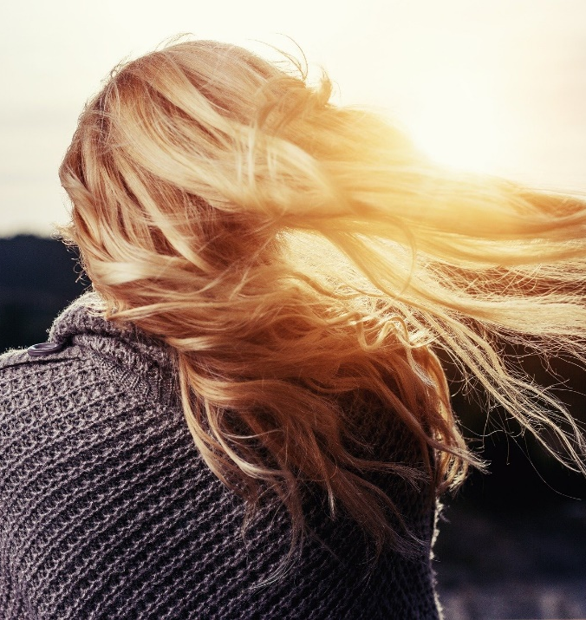
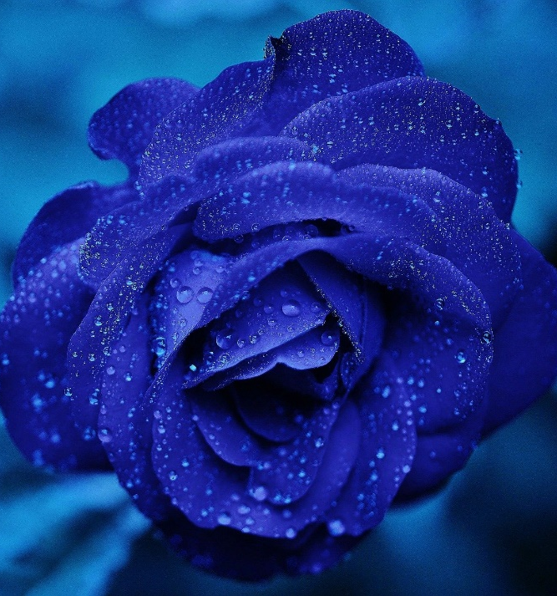
blew
blue
The wind nearly the woman off her feet.
The colour of the flower is .

Slide 14
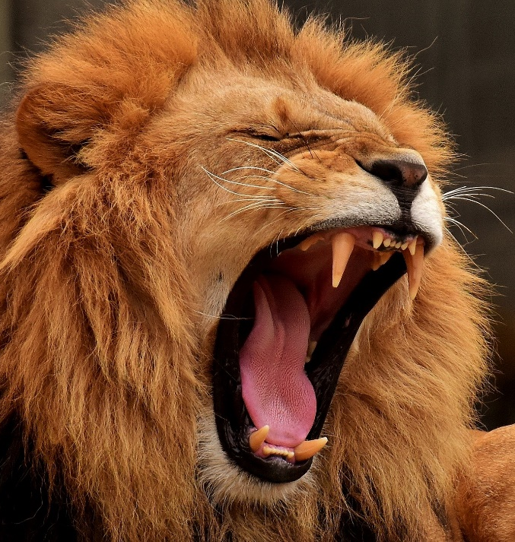
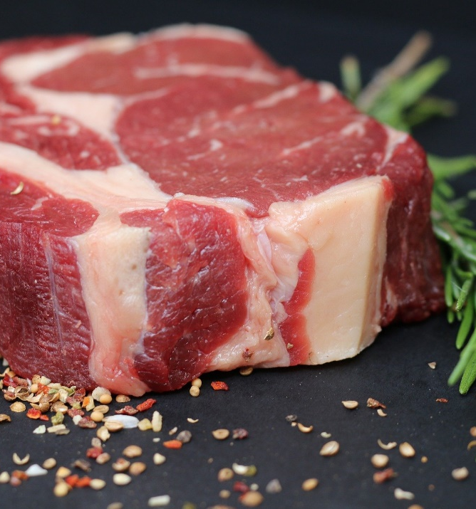
roar
raw
The lion let out a huge .
I bought some steaks to cook for tea.

Slide 15
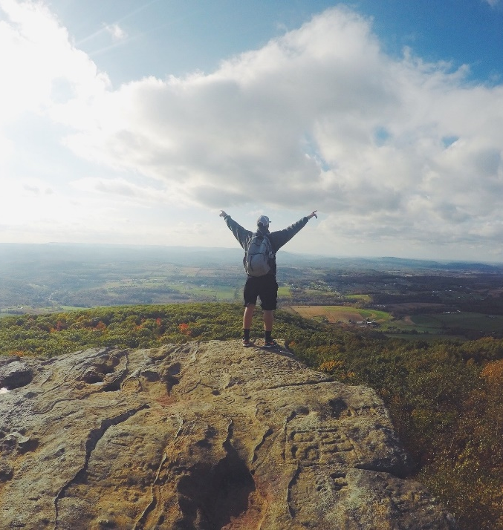
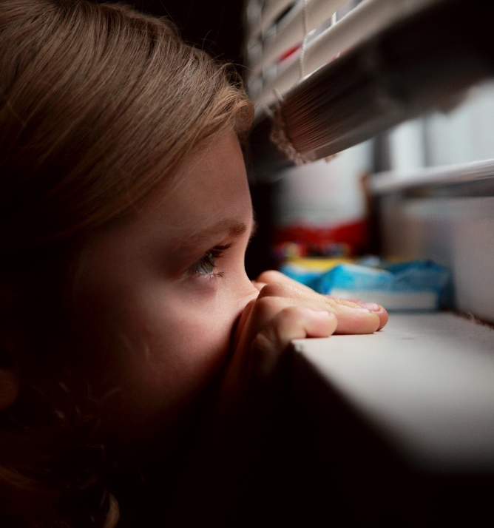
peak
peek
The climber took in the view from the mountain .
The children took a sneaky out of the window.

Slide 16
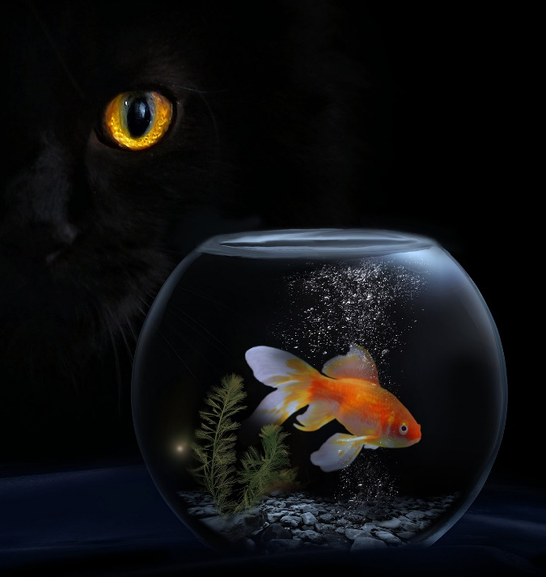
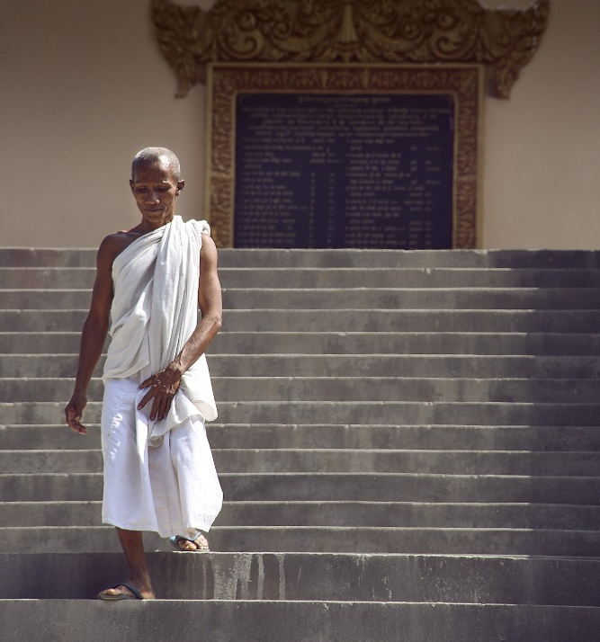
stares
stairs
The cat hungrily at the goldfish.
The man carefully went down the .

Slide 17
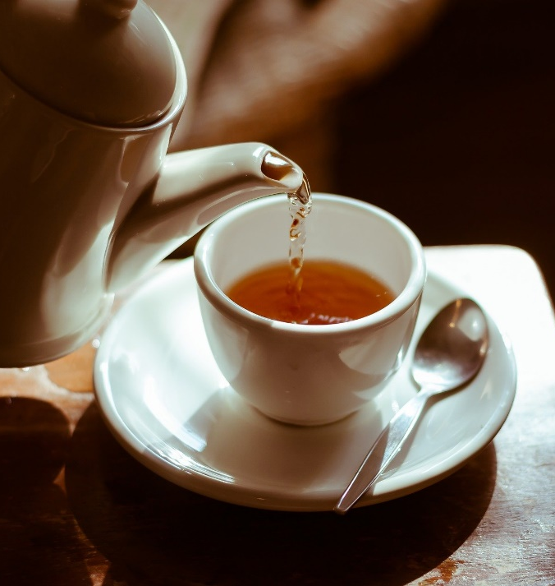
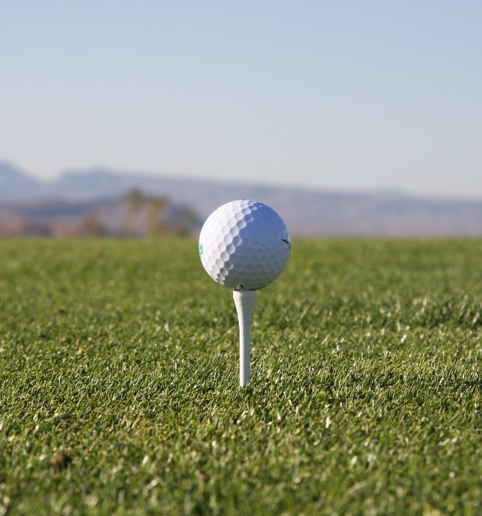
tea
tee
I love a good cup of .
The golfer placed the ball on the .

Slide 18
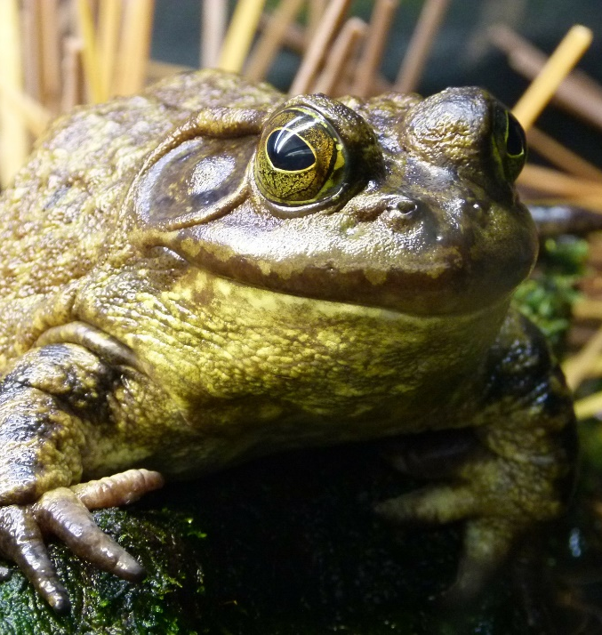
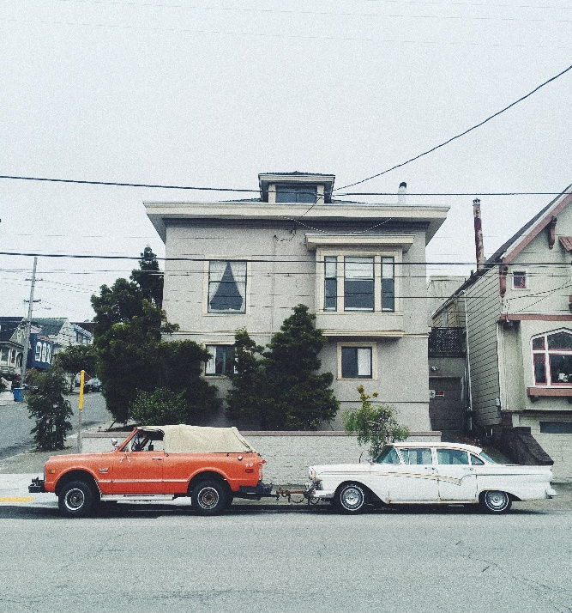
toad
towed
The in the pond croaked.
The car broke down so had to be .

Slide 19

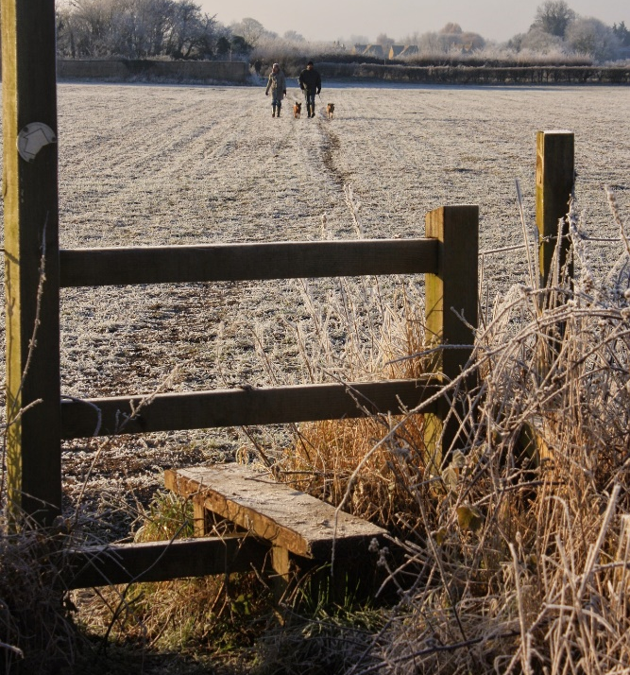
style
stile
The model has a great sense of .
To exit the field of cows, we had to climb over a .

Slide 20
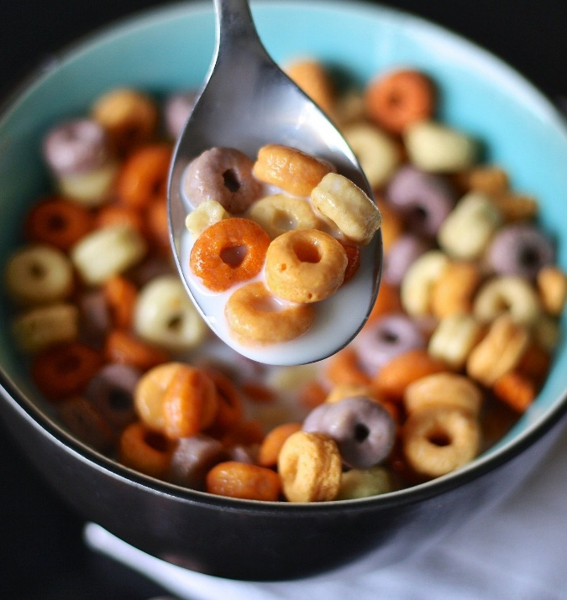
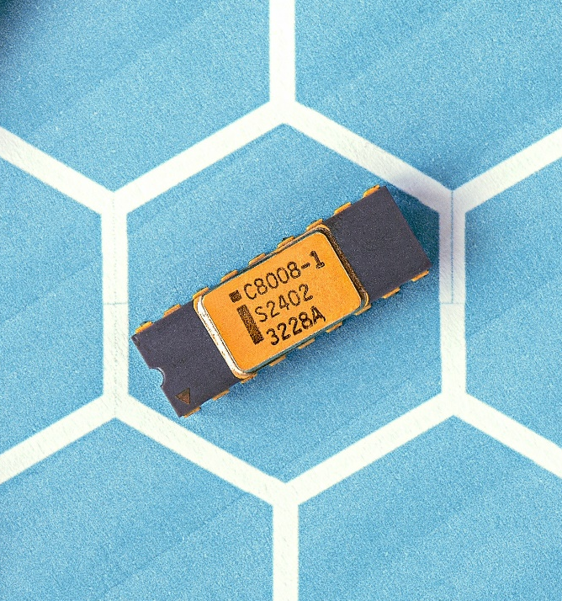
cereal
serial
I ate some for breakfast.
Can you give me the number for the product?

Slide 21
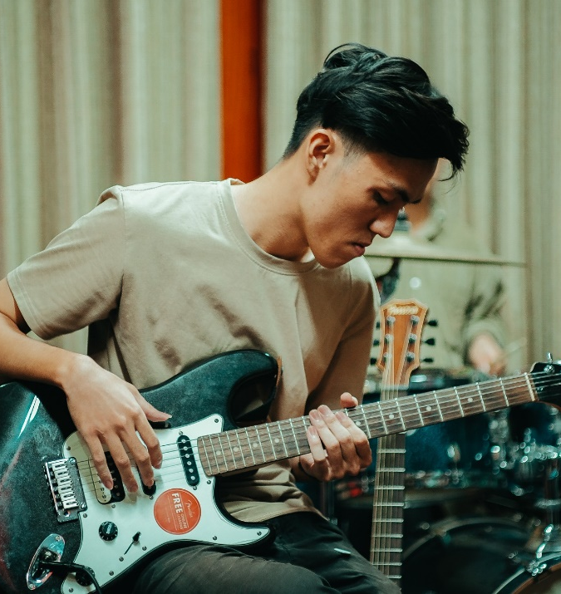
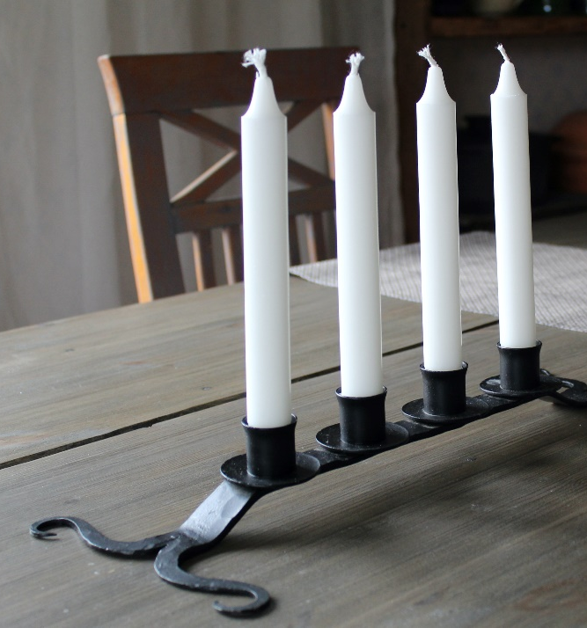
bass
base
Anthony plays guitar.
The of the candlestick had curled feet.

Slide 22
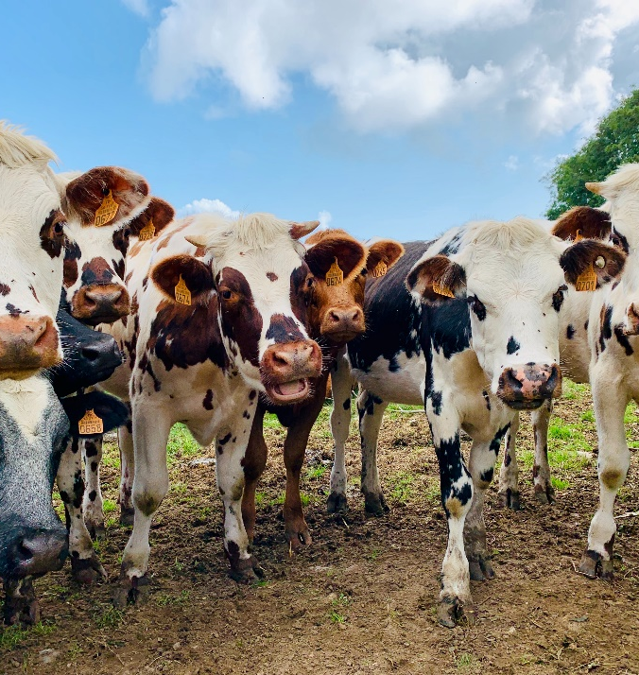
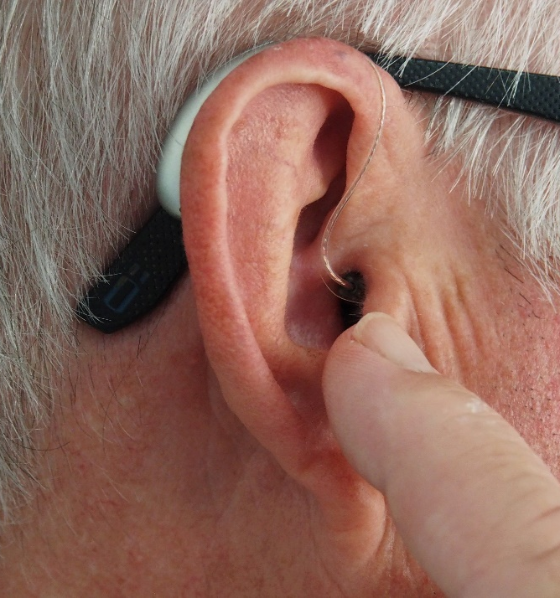
herd
heard
The farmer had a of cows.
The man a strange noise.

Slide 23
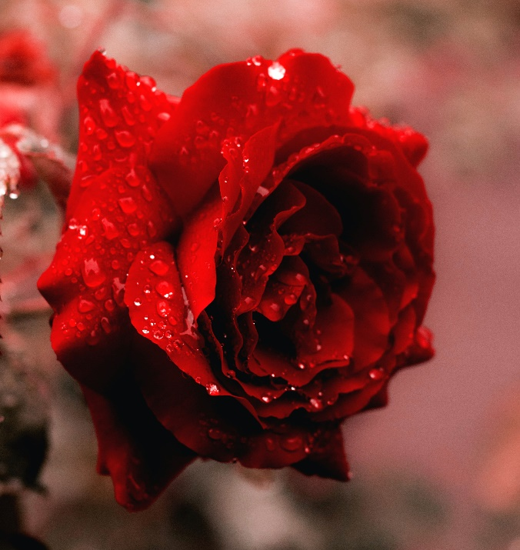
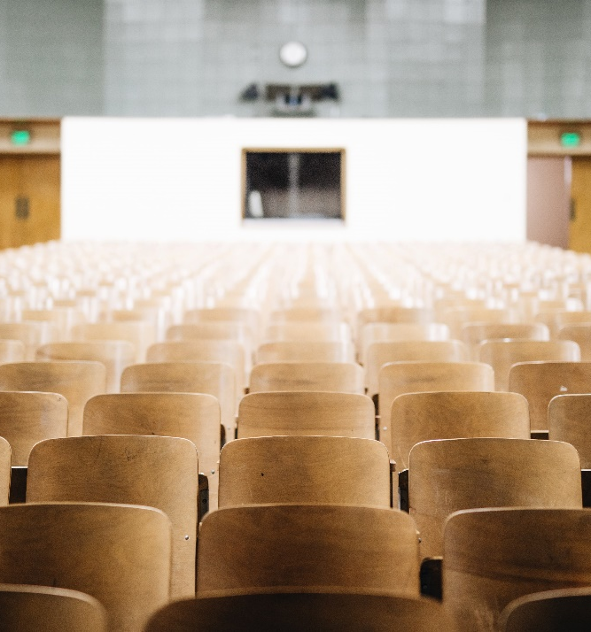
rose
rows
He picked her a beautiful, red .
The of chairs were all set out for the performance.

Slide 24
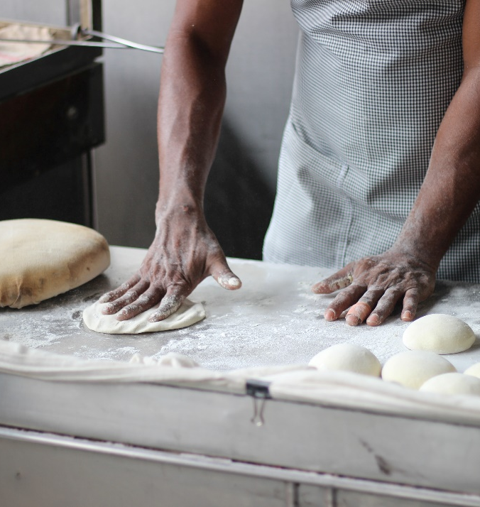
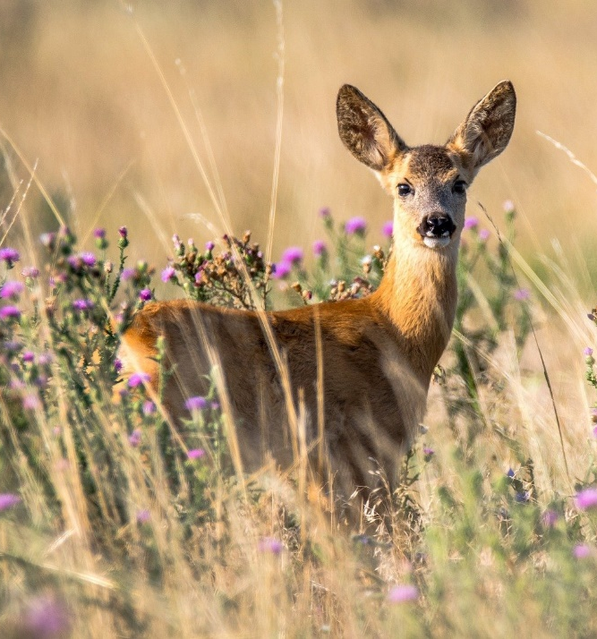
dough
doe
He kneaded the so the bread would rise.
The heard a noise and fled back into the forest.

Slide 25
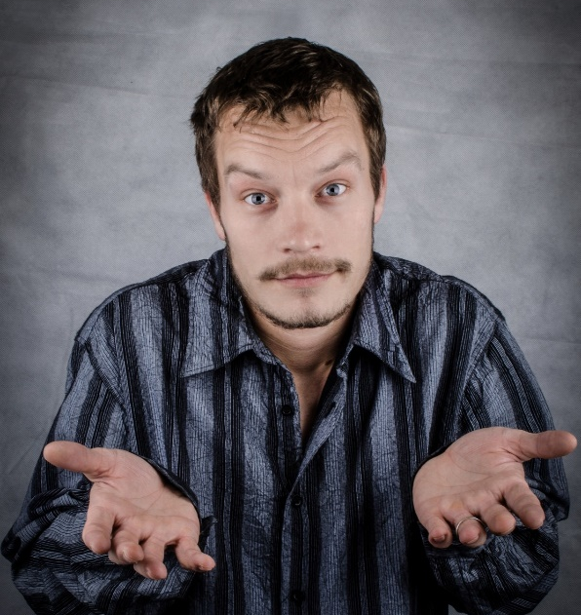
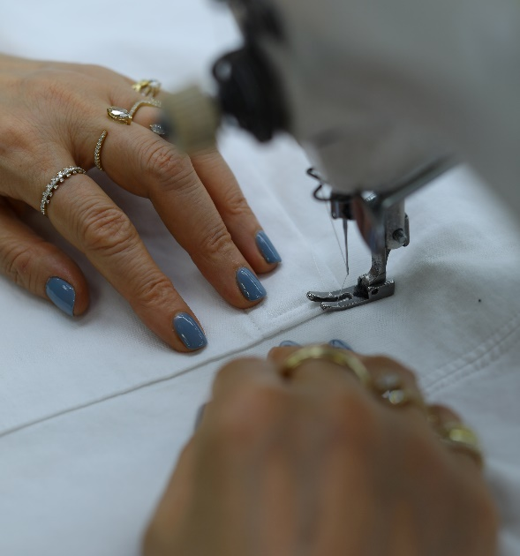

so
sew
sow
“ what?!” He said, clearly not bothered.
My aunty loves to .
The farmers used their tractors to the field.

Slide 26


tows
toes
The car the broken car behind it.
I have ten fingers and ten .

Slide 27


site
sight
You need to wear a hard hat on the building .
She looked around but no one was in .

Slide 28


piece
peace
The missing of the puzzle was found.
Hopefully one day, we will find world .

Slide 29

brake
break
The cyclist gripped his to slow down.
The burglar tried to in to the house.

Slide 30


ate
eight
The girl a juicy apple.
The black ball in a game of pool has the number on it.

