Slide 1


Slide 2

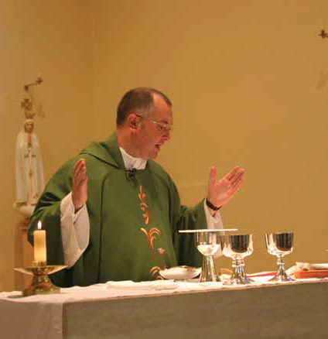
Pray then in this way:
Our Father in heaven, hallowed be your name.
Your kingdom come.
Your will be done, on earth as it is in heaven.
Give us this day our daily bread.
And forgive us our debts, as we also have forgiven our debtors.
And do not bring us to the time of trial, but rescue us from the evil one.
For if you forgive others their trespasses, your heavenly Father will also forgive you; but if you do not forgive others, neither will your Father forgive your trespasses.
Based on Matthew 6: 9-15
(Come and See)

Slide 3


