Slide 1
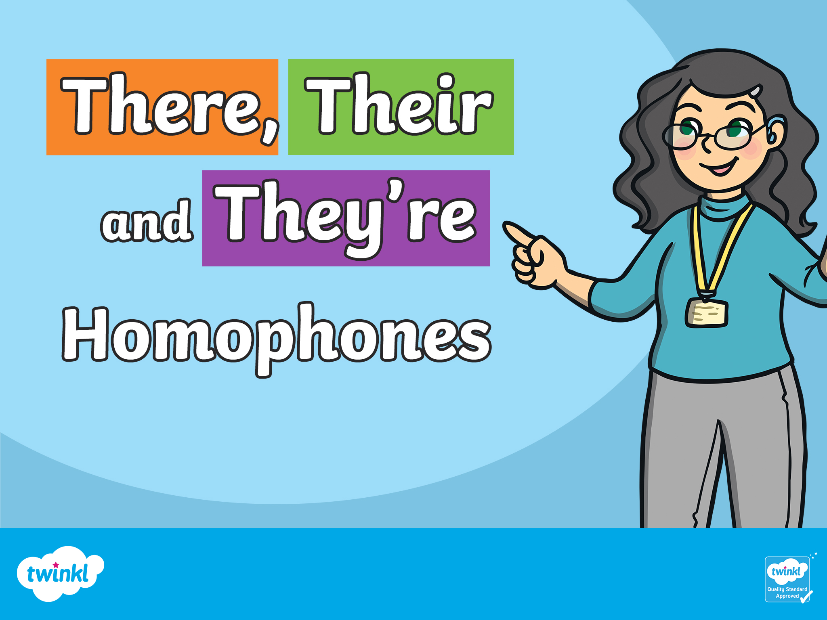

Slide 2
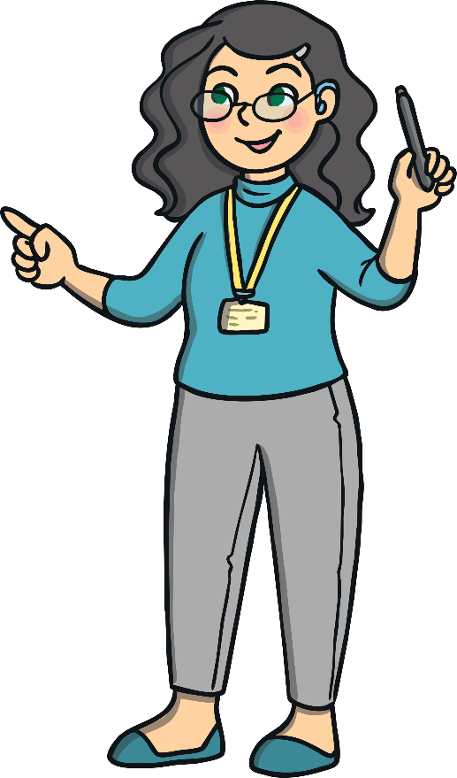
Homophones
These words all sound the same, but they are spelt differently, and have different meanings.
there
their
they’re

Slide 3
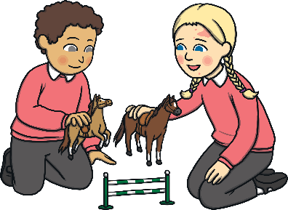
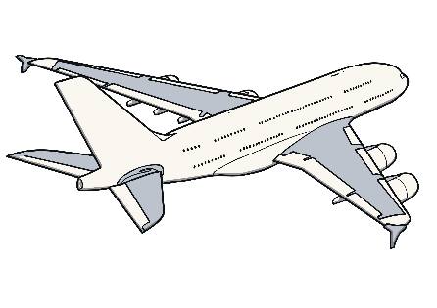
there
‘there’ refers to a place or position.
The children are playing over there.
There is an aeroplane in the sky.

Slide 4
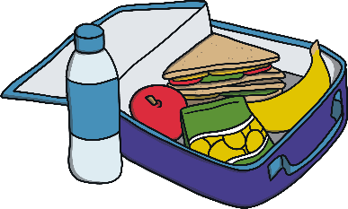
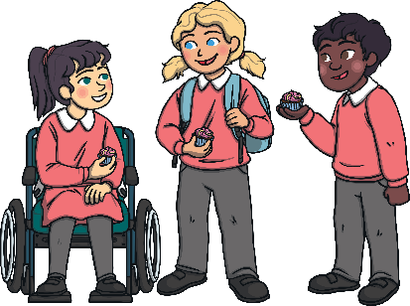
their
‘their’ is a possessive adjective. This means it shows ownership
or belonging.
Their lunch was very tasty.
The children are wearing their school uniform.

Slide 5
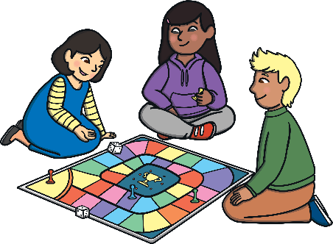
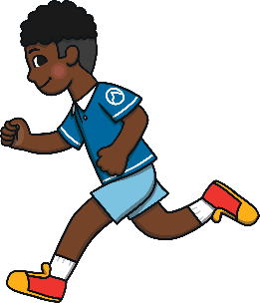
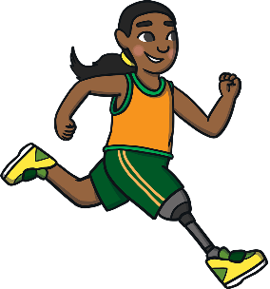
They’re
‘they’re’ is a contraction. This means it is a shorter way of saying
‘they are’.
They’re playing a game together.
They’re running around the track.

Slide 6
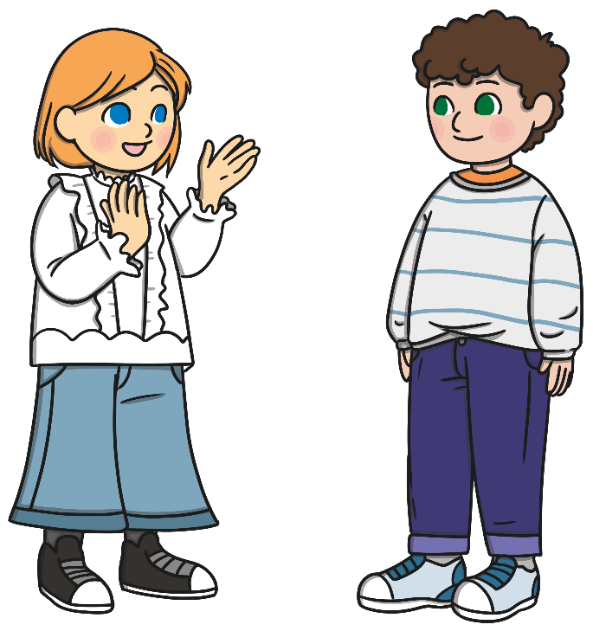
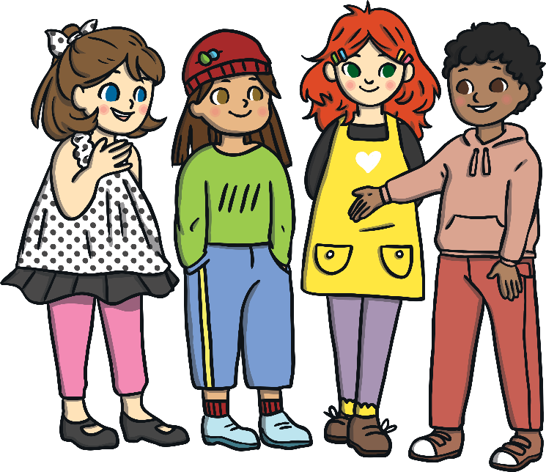
there, their and they’re
They’re all talking to their friends over there.

