Slide 1
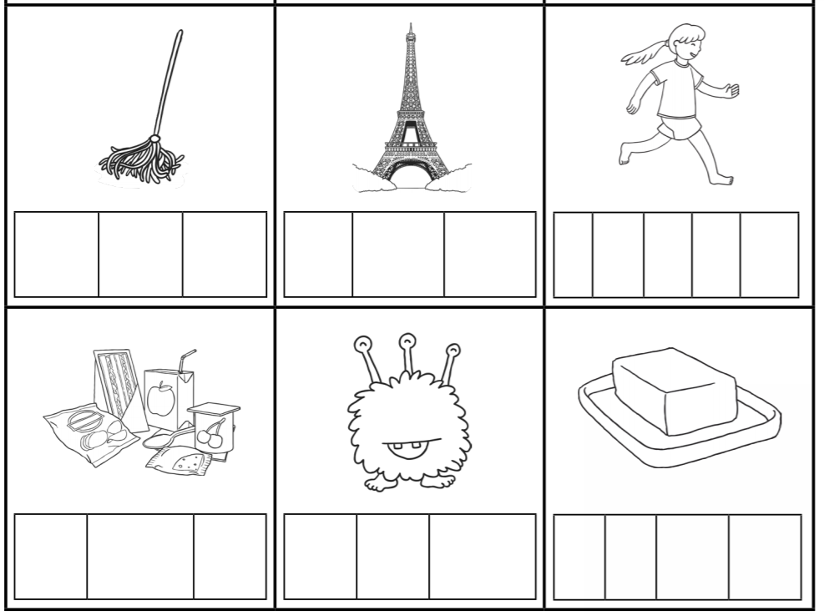
Can I write the words to match the correct pictures?
tower
mop
food
butter
runner
fuzz

