Slide 1
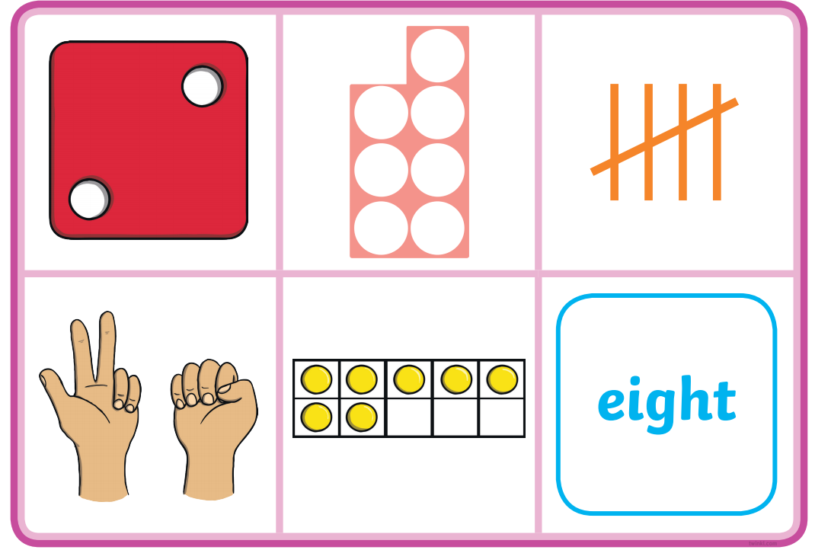
Can I find the matching number to these amounts?
01.03.21

