Slide 2

Did you know…?
Jellyfish can be as small as 0.5cm or grow to be as large
as 2m.

Slide 3
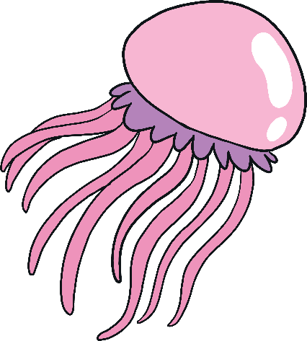
Did you know…?
Jellyfish can be clear or
brightly coloured pink, yellow,
purple or blue.

Slide 4
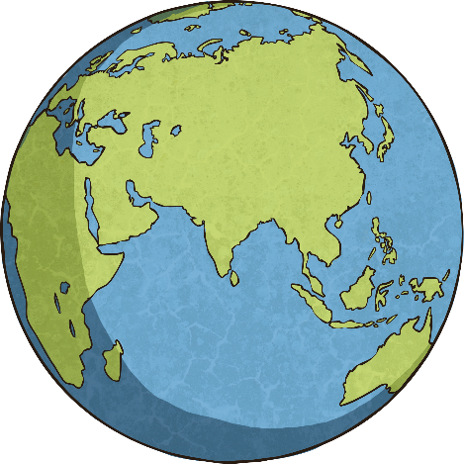
Did you know…?
A jellyfish’s habitat is the sea
and oceans around the world.

Slide 5

Did you know…?
Jellyfish usually live for around
one year.

Slide 6
Did you know…?
The top speed that a jellyfish
can swim is around 5mph.

Slide 7
Did you know…?
Some jellyfish can be transparent (see-through).

Slide 8
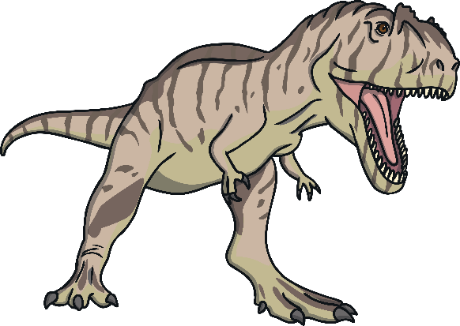
Did you know…?
Jellyfish have been around for
millions of years - they were even around before the dinosaurs lived on earth.

Slide 9

Did you know…?
Jellyfish can make their
own light.

Slide 10
Did you know…?
Jellyfish use their tentacles
to sting.

Slide 11
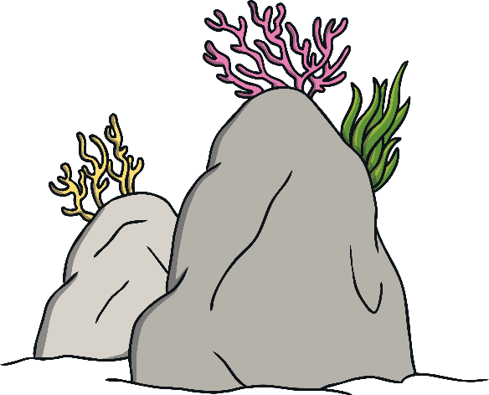
Did you know…?
Some jellyfish live in fresh
waters such as rivers, lakes and
even ponds.

Slide 12

Did you know…?
Jellyfish are not fish.

Slide 13

Did you know…?
Jellyfish don’t have a brain,
heart, eyes or bones.

Slide 14

Did you know…?
A group of jellyfish is called a
bloom, swarm or smack.

Slide 15
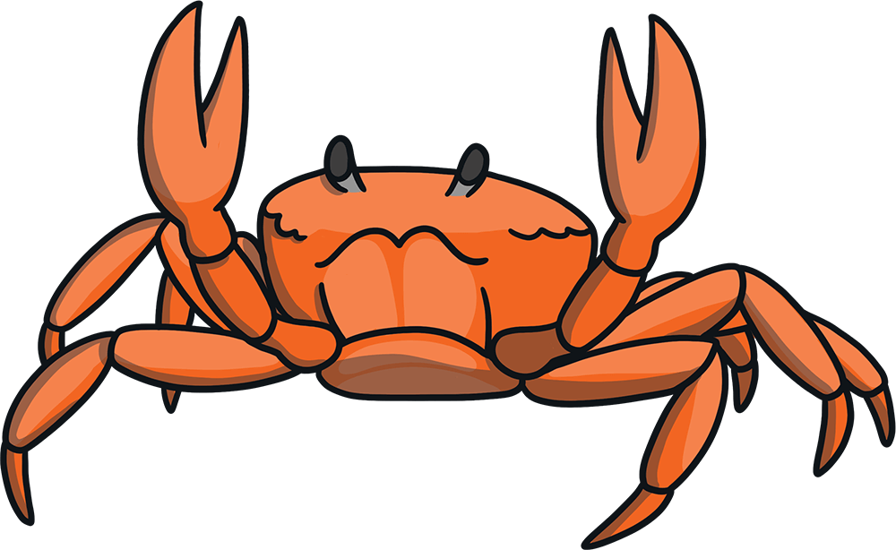
Did you know…?
Jellyfish eat fish, crabs,
small plants, shrimp and even
other jellyfish.

Slide 16
Did you know…?
The mouth of a jellyfish is found
in the middle of its body.

Slide 17
Did you know…?
Jellyfish have a smooth,
bag-like body and tentacles
that have stinging cells.

