Slide 2
What Is BBC Children in Need?
BBC Children in Need is a BBC charity which funds a wide range of projects around the UK that help children. It takes place every November.
Here are just some of the projects that BBC Children in Need support.
Centres who care for children with learning or physical disabilities.
Bereavement services for families who have lost
a child.
Places which support families who cannot be together.
Activity centres where children with difficulties can access sports.
Respite centres for children who have complex needs.

Slide 3
How Did It All Begin?
1927
On Christmas Day, there was a five minute BBC radio broadcast. The response was brilliant and the money raised was split between four main children’s charities.
1955
The first televised appeal was broadcast called Children’s Hour Christmas Appeal.
1978
Broadcaster Terry Wogan made his first presenting appearance on BBC Children in Need.
1980
BBC Children in Need was broadcast as a telethon which meant people could phone up while the programme was on TV and the donations broke the £1 million mark!
1985
Pudsey Bear joined BBC Children in Need.
2014
Other TV presenters, like Tess Daly and Fearne Cotton, joined Terry Wogan on BBC Children in Need Night.

Slide 4
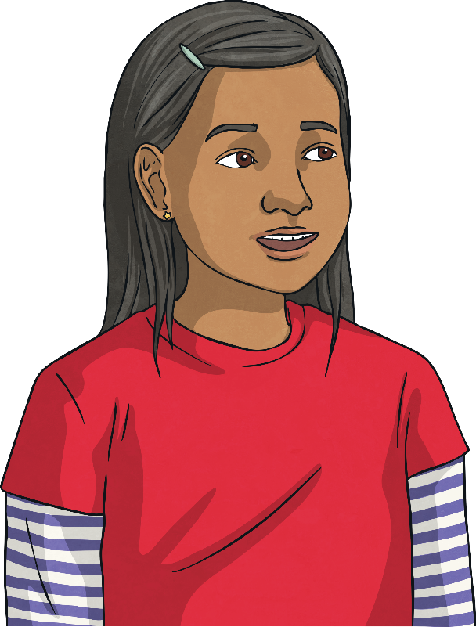
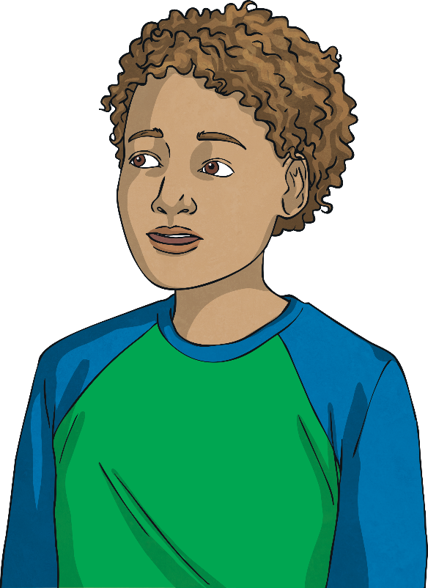
Pudsey Bear
When did Pudsey Bear first appear?
Pudsey Bear became the
mascot of BBC Children
in Need in 1985. He was
a brown, cuddly bear
introduced by Terry Wogan.

Slide 5
Pudsey Bear
Why is he called Pudsey?
Joanna Bell, who designed
the famous bear, was from
Pudsey in West Yorkshire
so that became his name!

Slide 6
Pudsey Bear
What does Pudsey do?
Pudsey has been helping
people raise money to give disadvantaged children
fabulous experiences since he joined BBC Children in Need.

Slide 7
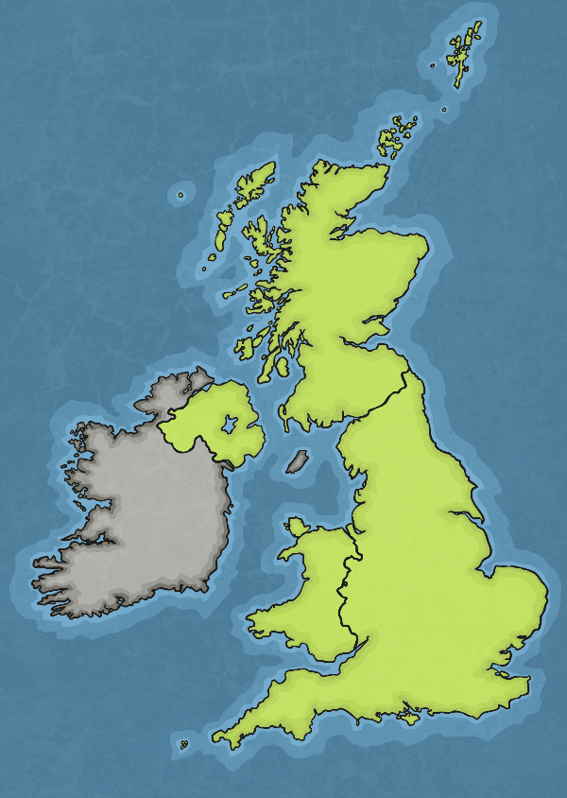
Projects Around the UK
There are hundreds of projects around the UK which are supported by funding from Children in Need. Click on an area of the map and find out about some of the fabulous projects.
The SHINE Health Academy in Sheffield helps children aged between 10–17 who have physical and emotional difficulties due to being overweight. Here, they learn about healthy eating and exercise. It is vital for empowering children to overcome issues with anxiety, low self-esteem and mobility.
The Yard Adventure Centre in Edinburgh helps children with autism and learning disabilities. Through support, children are able to make friends and improve their independence.
Llamau in Cardiff works with children who are at risk of being homeless. These young people are given opportunities to go on work experience, continue with their qualifications and get jobs.
Haven House in Essex is a special place for children with life-limiting illnesses. The centre supports the families as well as the children during the most difficult times.
Action for Children provides music and art sessions for children who are looked after and in care. These experiences help their emotional well-being and improve confidence.
In Shropshire, Hope House is a respite centre for children who have complex needs and require 24-hour care. The centre supports the families when end of life care is needed.
In Londonderry, Foyle Down Syndrome Trust funds development workers who support children with Down syndrome to make friends and have new experiences.

Slide 8

What Happens to the Donations?
BBC Children in Need look at how much has been raised and set
a grant budget.
They read through the applications for money from charities and decide which ones
they will support.
Money is raised and donated by the public.
The money
in the bank earns interest to help run BBC Children in Need again.
BBC Children in Need give out money to the charities over a few months to make sure it is used in the best way possible for the children.

Slide 9
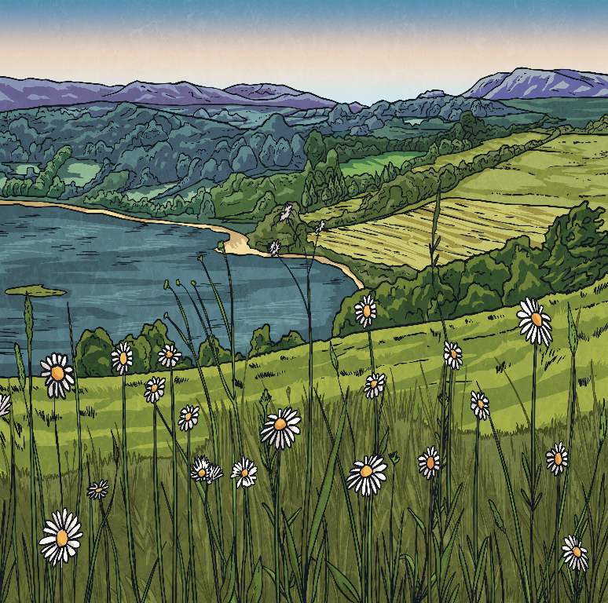
What’s Going On?
There are many big fundraising challenges going on for BBC Children in Need.
This year, people are being asked to get together with their families or small groups of friends to join in the big Countryfile Ramble!
Fundraisers are also being encouraged to take their age and do something good with it. Simply take your age, the combined age of your ramble-mates or the age of something or someone special and turn it into a fundraising or distance target.

Slide 10


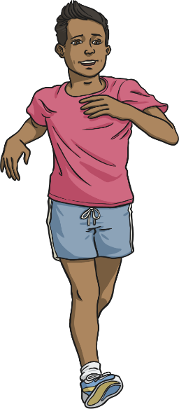
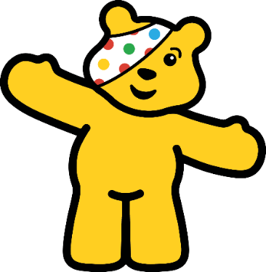
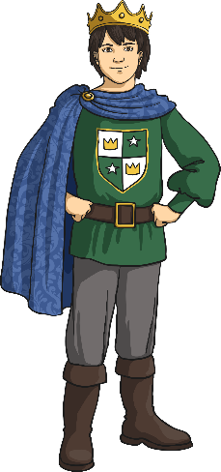

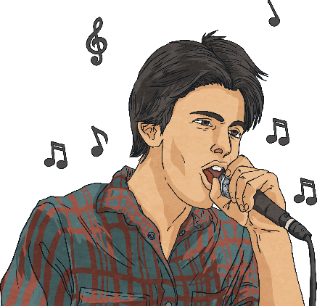
Get Involved!
There are so many ways you can raise money for BBC Children in Need.
Download the Free Fundraising Pack and get involved!
Have a talent show.
Organise a coffee morning.
Have a cake sale.
Dress up for the day.
Do a fun run.
Think of a super sponsored event.
So far, BBC Children in Need has raised over £1 billion in donations and fundraising!
How much more can we raise?

