Slide 2
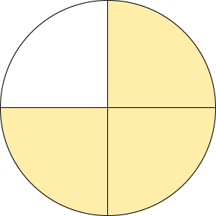
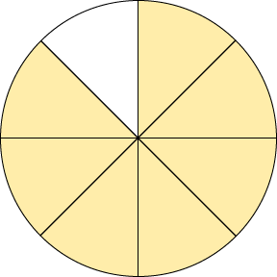
Comparing Fractions
3
7
4
8
Both of these circles have been split into multiples of 4 therefore we can compare them.

Slide 3
Comparing Fractions
3
7
<
4
8

Slide 4
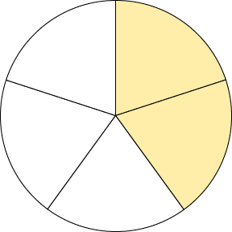
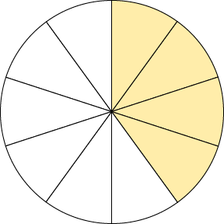
Comparing Fractions
2
4
5
10
Both of these circles have been split into a multiple of 5 therefore we can compare them.

Slide 5
Comparing Fractions
2
4
=
5
10

Slide 6
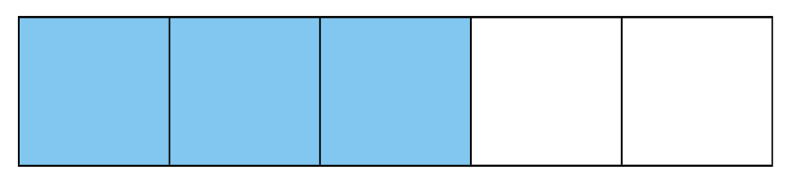
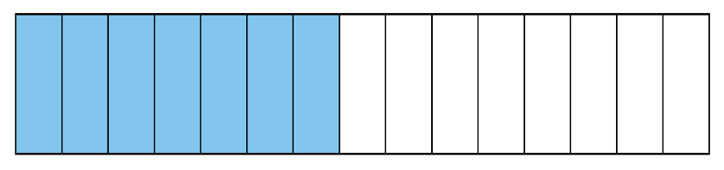
Comparing Fractions
3
7
5
15
5 and 15 are both multiples of 5 therefore we can compare them.

Slide 7
Comparing Fractions
3
7
>
5
15

Slide 8

Comparing Fractions
1
3
4
12
x 3
To compare these two fractions, you must look at what has changed in the denominator, e.g. 4 x 3 = 12
Therefore, if the numerator has changed in the same way, the fractions would be equal, e.g. 1 x 3 = 3
1
3
=
4
12
Remember the Rule: Whatever you do to the denominator, you must do the same to the numerator.

Slide 9
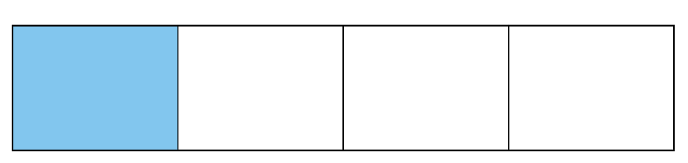

Comparing Fractions
1
3
=
4
12

Slide 10
Comparing Fractions
Can you compare these two fractions by looking at what has changed in the denominator and seeing if it is the same in the numerator?
?
1
6
3
12
Remember the Rule: Whatever you do to the denominator, you must do the same to the numerator.

Slide 11
Comparing Fractions
×4
1
6
3
12
×4
3 × 4 = 12
But 1 x 4 = 4, not 6 so these fractions are not equal.
Which fraction is larger?

Slide 12
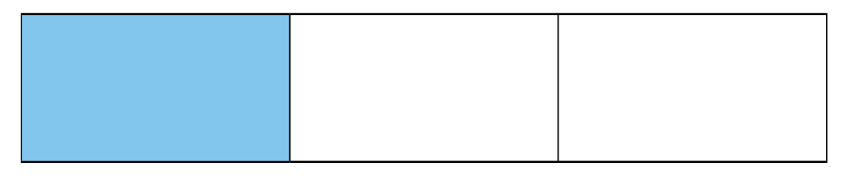

Comparing Fractions
1
6
<
3
12

Slide 13
Comparing Fractions
Can you compare these two fractions by looking at what has changed in the denominator?
?
3
7
7
21
?
Remember the Rule: Whatever you do to the denominator, you must do the same to the numerator.

Slide 14
Comparing Fractions
×3
3
7
7
21
×3
7 × 3 = 21
But 3 x 3 = 9, not 7 so these fractions are not equal.
Which fraction is larger?

Slide 15
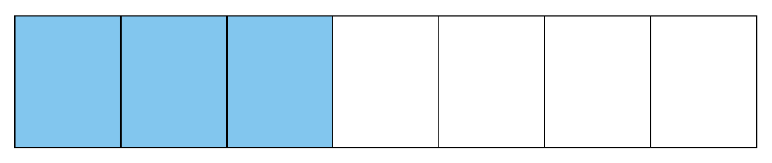

Comparing Fractions
3
7
>
7
21

Slide 16
Comparing Fractions
Have a go at comparing these fractions:
2
<
5
5
10
2
=
4
3
6
4
>
12
5
20
3
=
12
4
16

Slide 17
Ordering Fractions
The denominator in each of these fractions is a multiple of 4 therefore, we can compare and order them.
4
1
3
5
8
4
4
8
First, change all of the fractions so that they have the same denominator.
4
2
6
5
8
8
8
8
Then write them in order from smallest to largest. Remember to write them in their original form.
1
4
5
3
4
8
8
4

Slide 18
Ordering Fractions
Can you order the following fractions from smallest to largest? Start by changing each of the fractions so that the denominator is 20.
2
2
9
3
3
5
10
10
5
10
8
4
18
12
6
20
20
20
20
20
Now put them in order! Remember to write them in their original form!
2
3
2
3
9
10
10
5
5
10

Slide 19
Ordering Fractions
Order these fractions from smallest to largest? Decide on what denominator to change each fraction to.
1
3
3
7
2
2
8
4
8
8
4
3
6
7
2
8
8
8
8
8
Now put them in order! Remember to write them in their original form!
2
3
1
3
7
8
8
2
4
8

