Slide 1
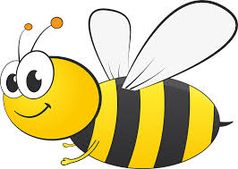
Bees Classroom
Mrs Hickey/Mrs Atkinson
Miss Gosciej

Slide 2
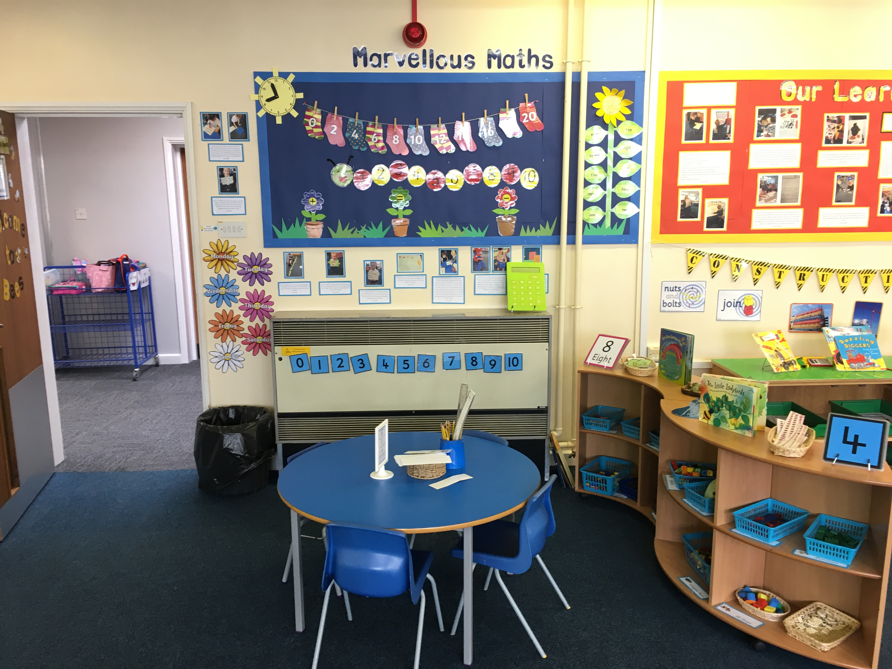
Maths Area
This is our maths area which the children access independently.
It supports number, counting, sorting, measures, shape and ordering.
All our resources meet the Early Years developmental statements for Maths.
We have open ended resources and we will set a challenge each week linked to our current learning.

Slide 3
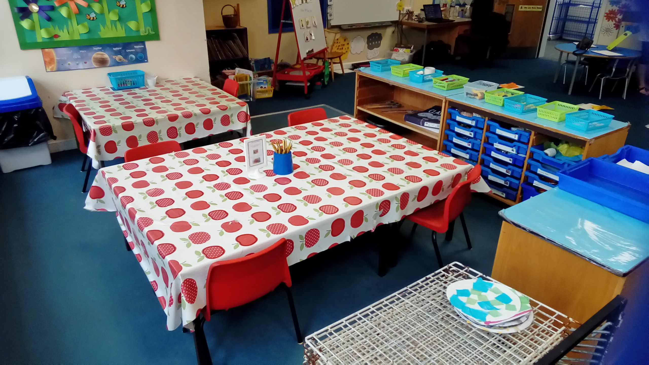
Creative Area
This is our creative area which is used for painting, sticking, drawing, cutting, making, box modelling and play dough.
We fill the baskets with scissors, pens, cellotape, glue, sequins, feathers, paper, card, tissue, pipe cleaners, lollipop sticks and lots more.

Slide 4
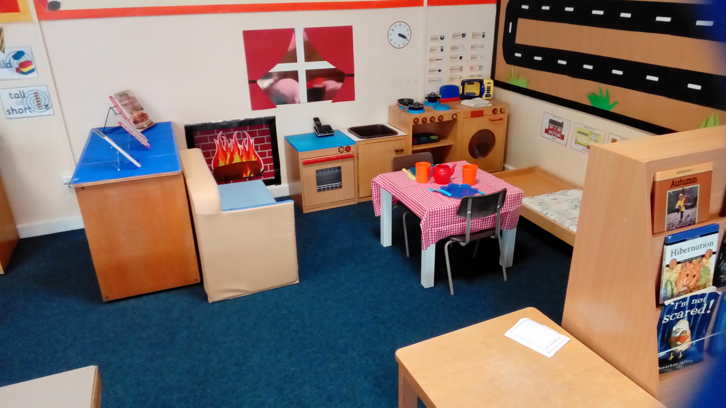
Home Corner
This is our home corner and the children love accessing this area.
We provide lots of real objects to replicate their own home.
We also provide a range of reading and writing opportunities. These include recipe books, shopping lists, notebooks and lots more.

Slide 5
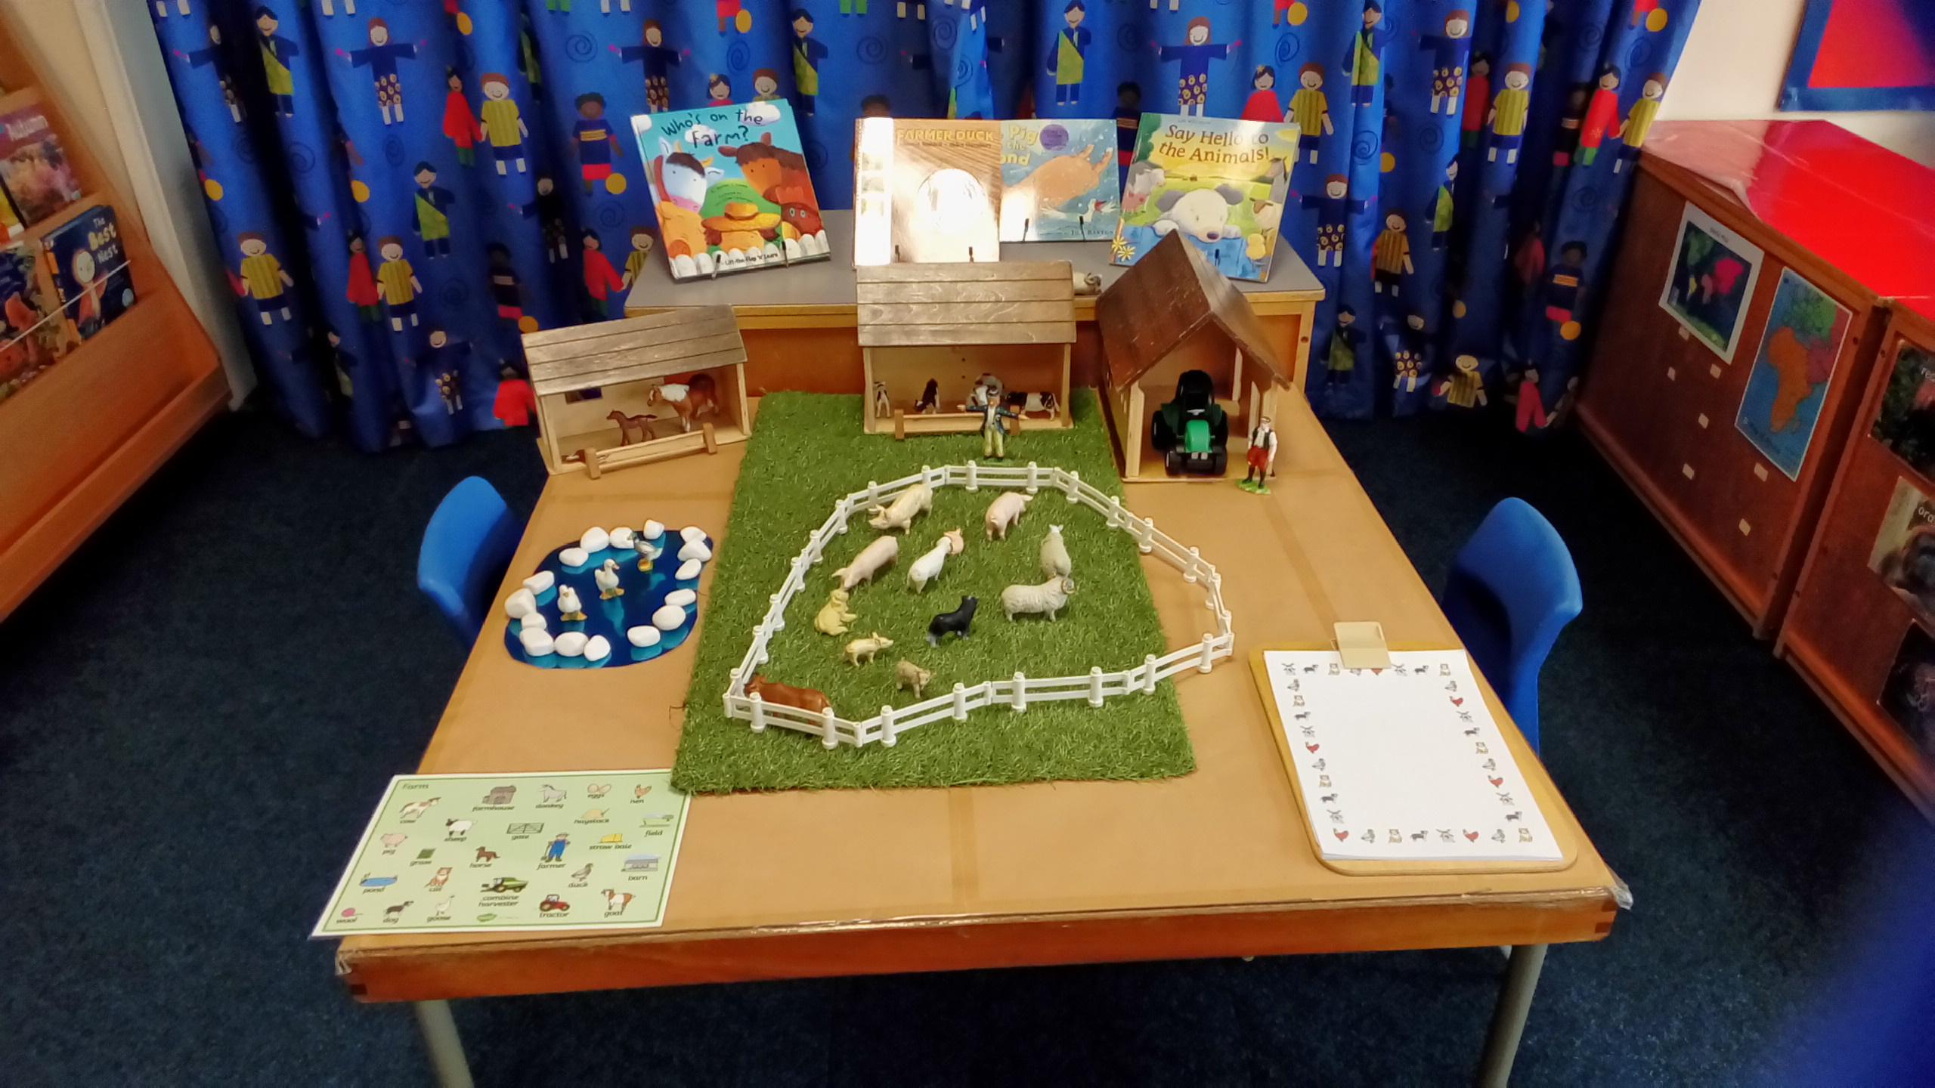
Small World
This is our small world area which changes throughout the year.
We always have a variety of small world figures and natural resources such as wooden blocks so the children can use their imagination to create their own ideas.
This year we have had pirates, woodland animals, knights and castle, dinosaurs, wild animals and farm.

Slide 6
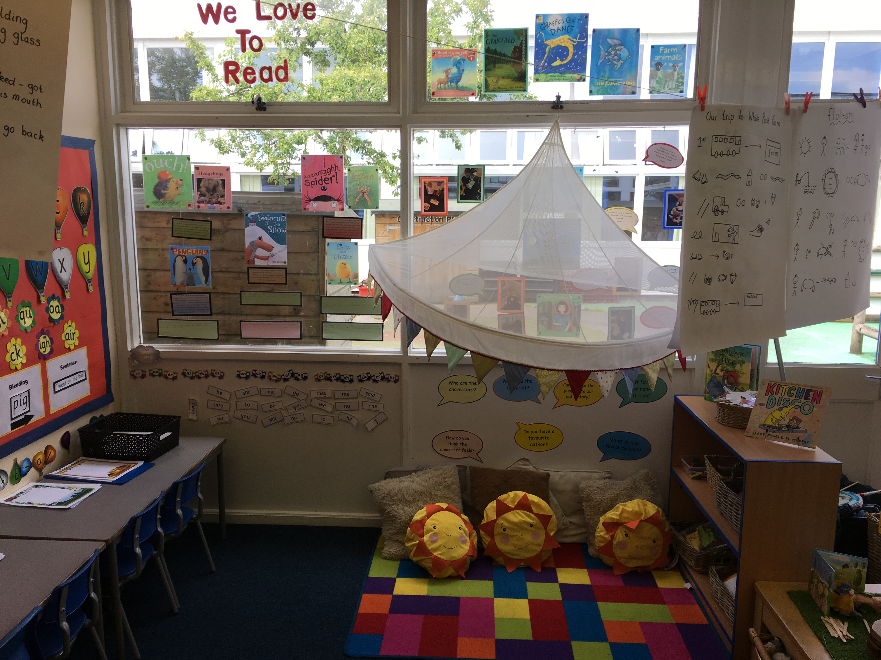
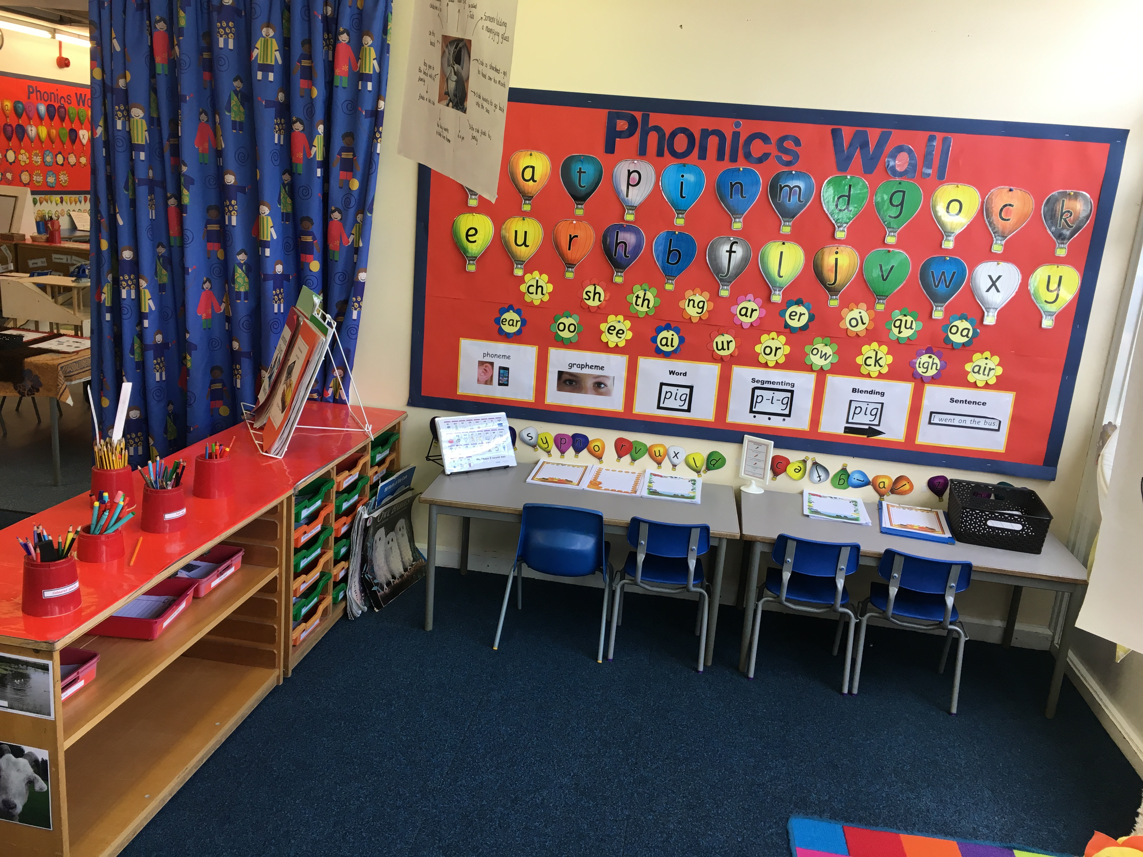
Reading/Writing Area
This is our reading and writing area which the children access independently.
We have a variety of books to read and lots of different writing opportunities linked to our current topic.
Children enjoy sharing books, playing with the puppets and retelling stories.

Slide 7
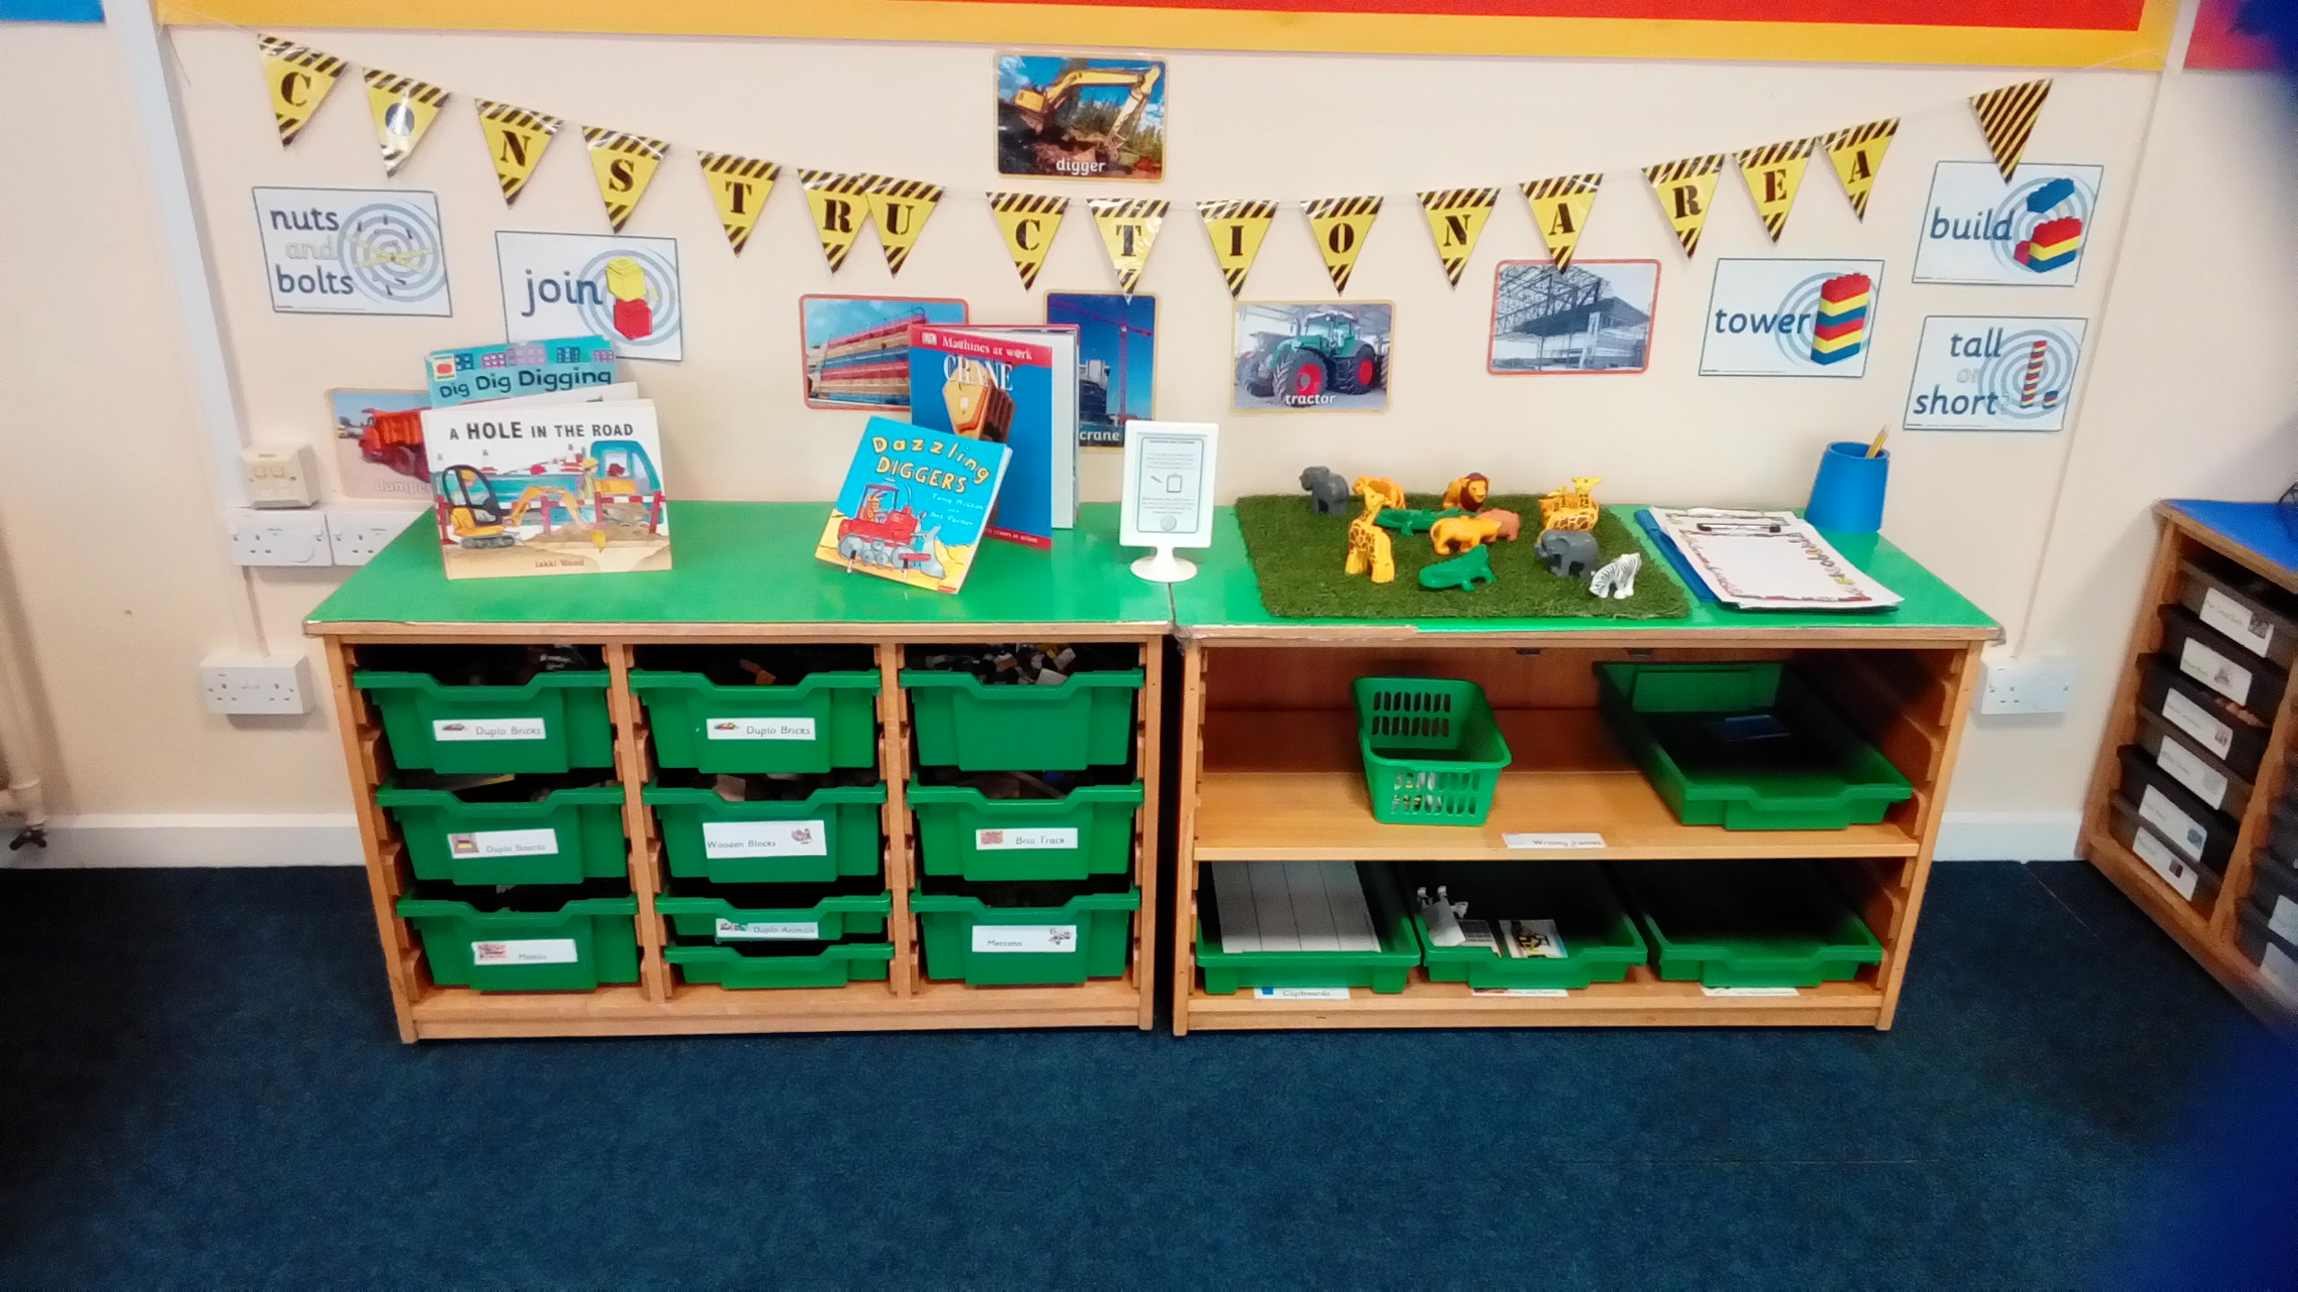
Construction Area
This is our construction area which the children access independently.
We have a variety of resources such as Lego, wooden blocks, train track and Meccano.

Slide 8
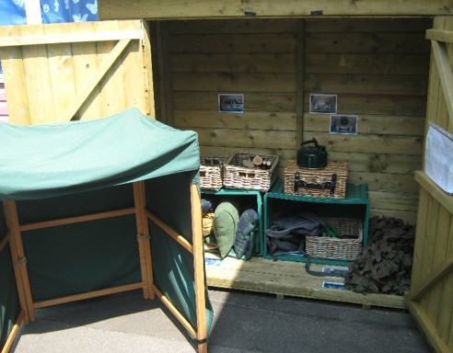
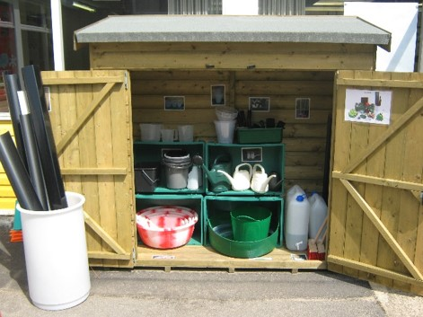
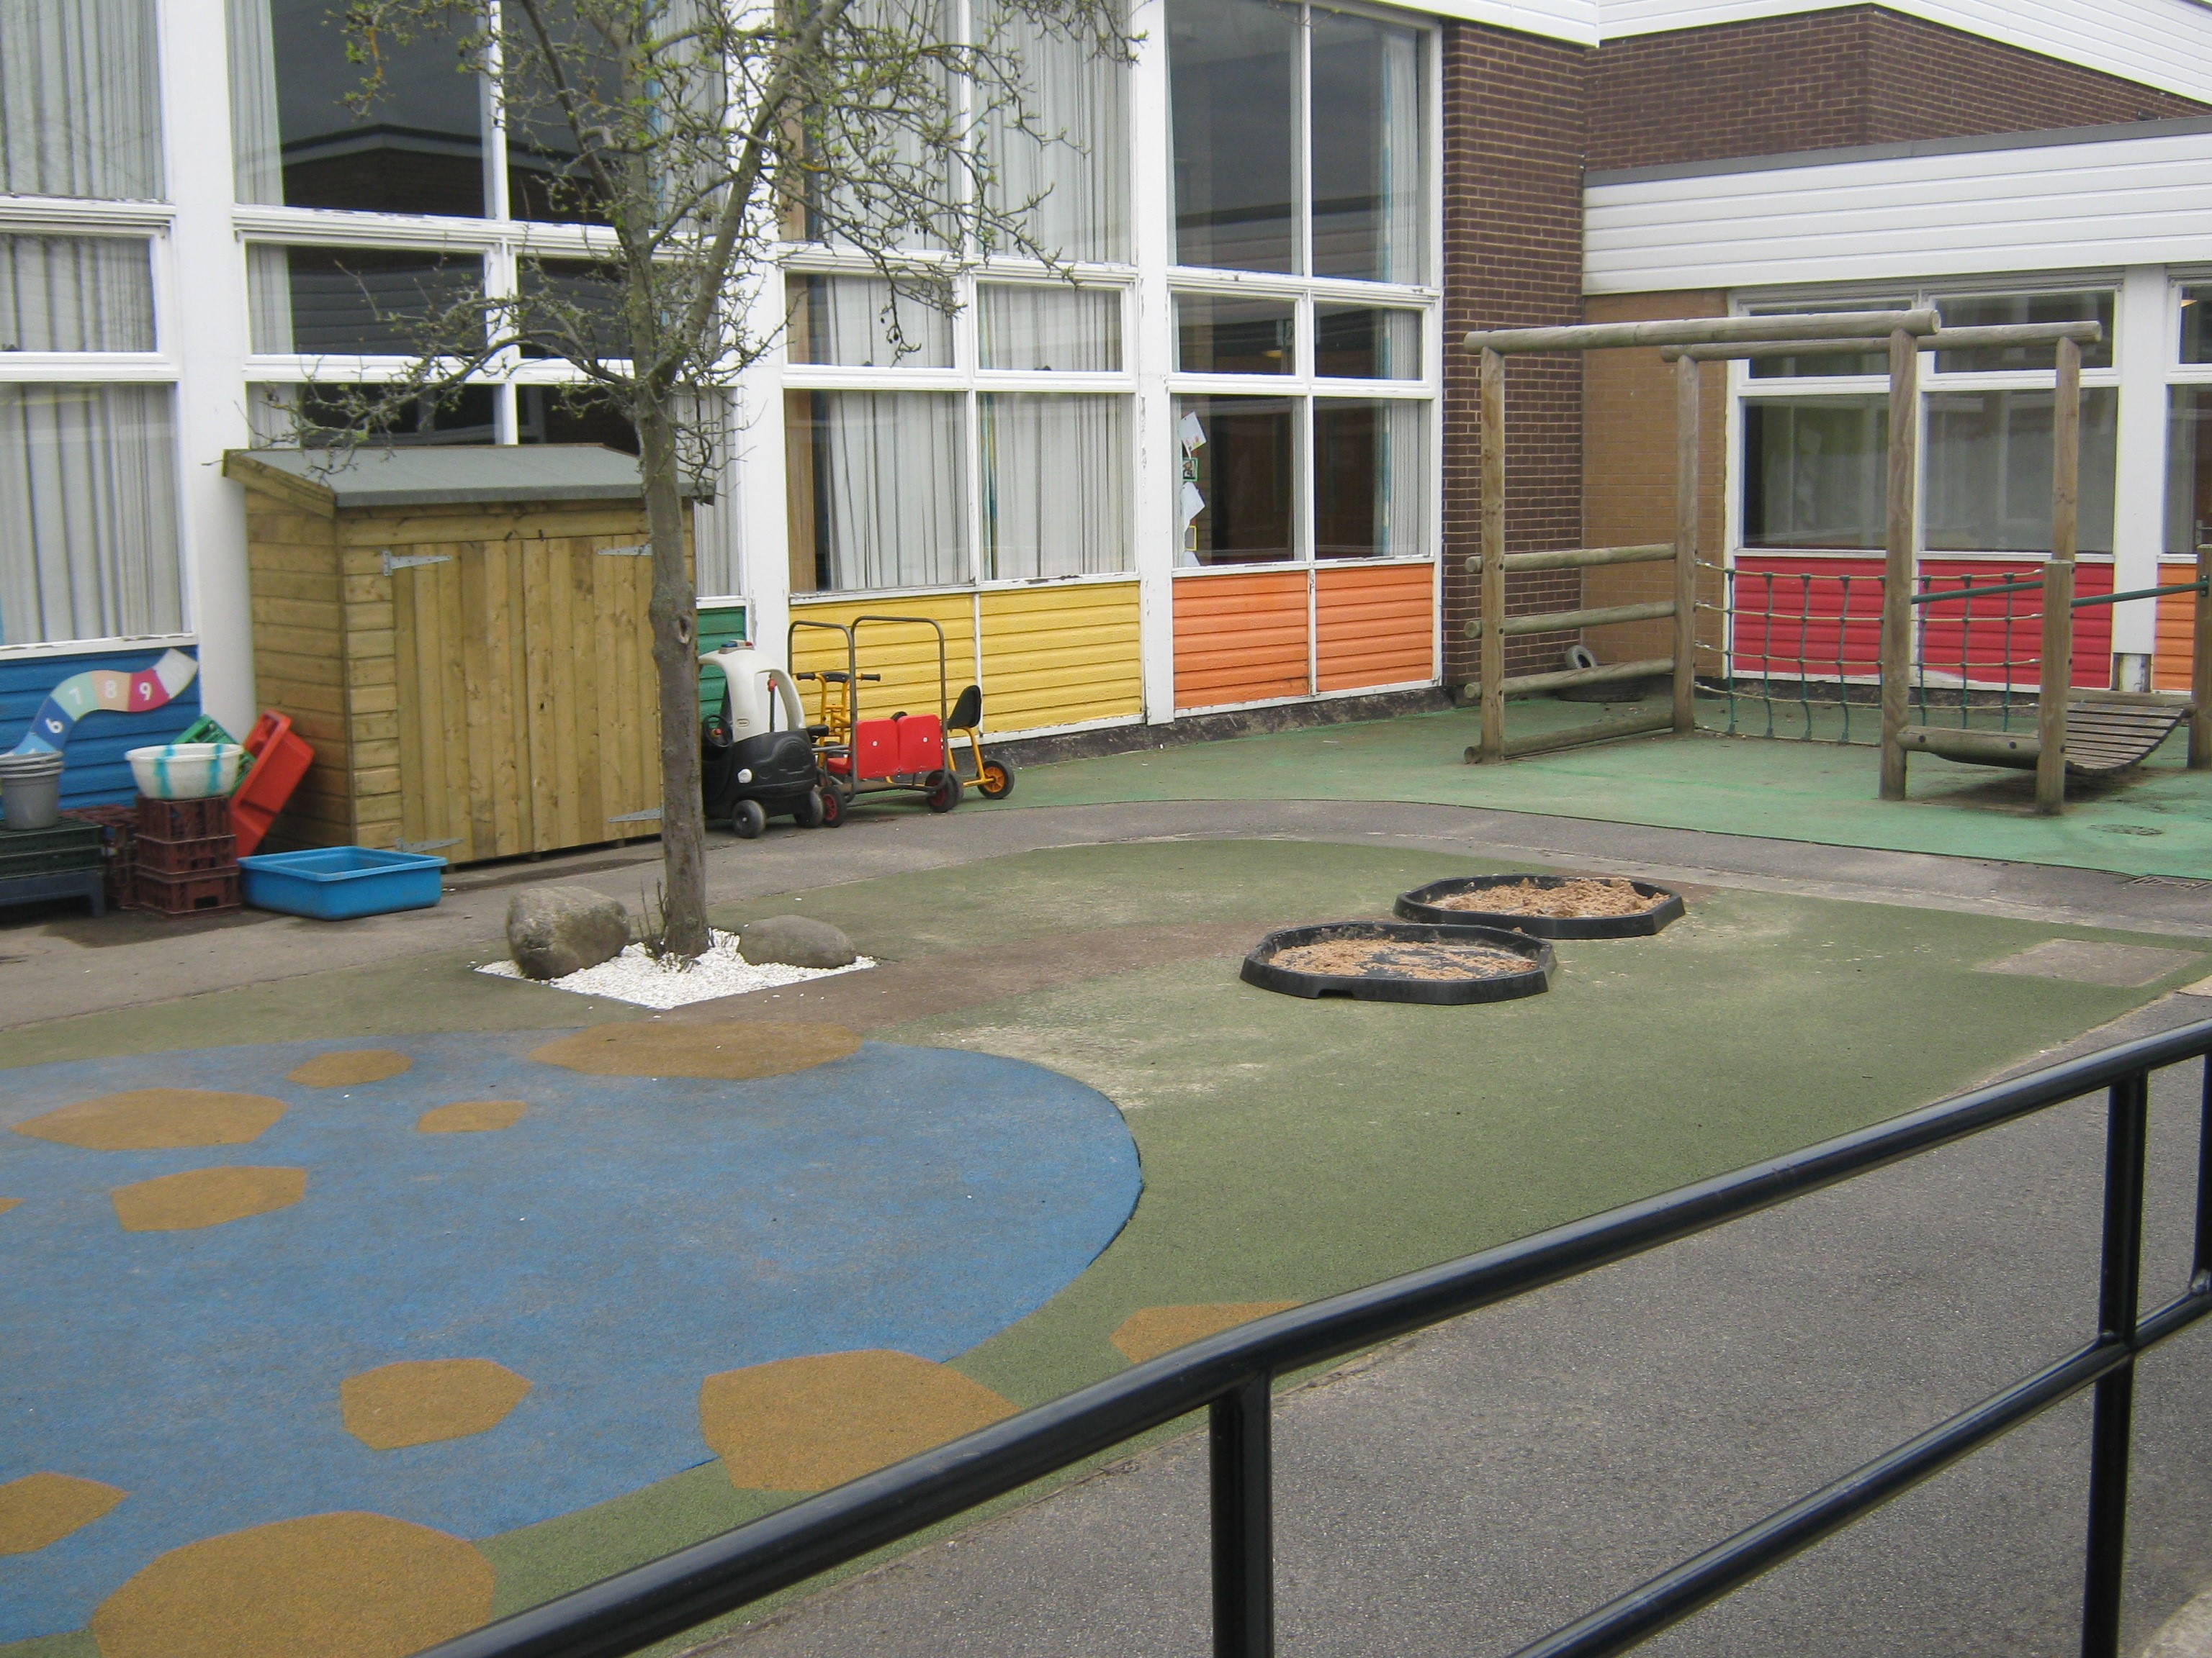
Outdoor Area
This is our outdoor area which has five main areas – den and camping, water, construction, mud kitchen and small world.
The children access the areas independently and we enjoy going out in all weathers!

