Slide 1
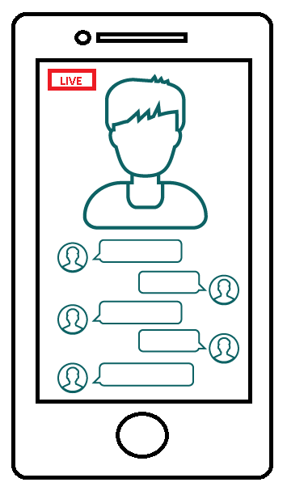
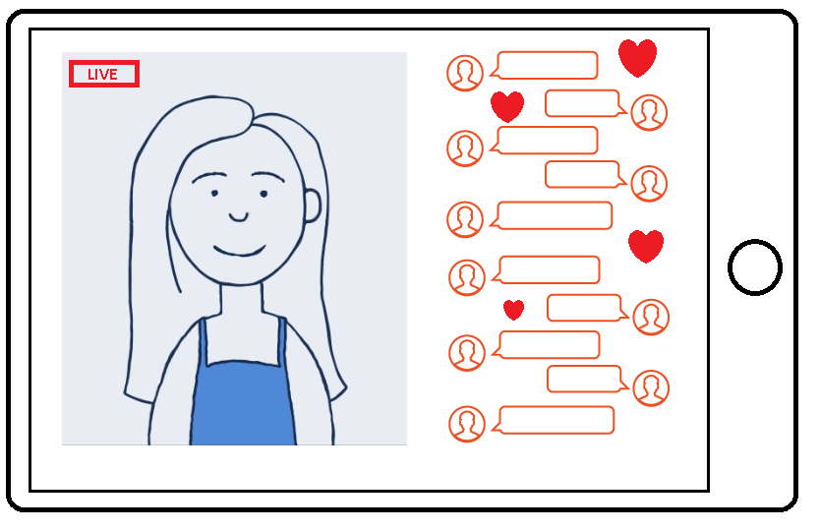
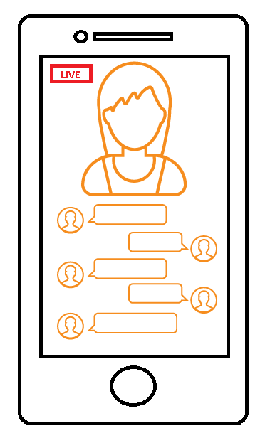


Live Streaming: Information for parents and carers
Notes:
Note to presenter: Please read through the presentation thoroughly before delivery and familiarise yourself with the CEOP Safety Centre and Thinkuknow websites if needed. There are delivery notes and instructions in italics on some slides to aid your delivery. The majority of the slides throughout the presentation are applicable to parents and carers of all age groups, however slides 5-7 are intended for an audience of parents/carers of primary school aged children and slides 8-10 and 12 are for those with secondary school aged children. Please use your professional discretion when deciding which slides are most suitable for your audience. Please hide the slides that are not applicable to your audience, or cover all of them if your audience is mixed.
A full Live Streaming resource pack, including activities for children and young people and information for professionals and parents can be downloaded from www.thinkuknow.co.uk/professionals/resources/live-streaming
Introduce yourself and your role to your audience - This presentation has been developed by the CEOP Education Team.
CEOP is the Child Exploitation and Online Protection command of the National Crime Agency and is committed to tackling the sexual exploitation and abuse of children (CSEA), both online and offline. Within CEOP there are law enforcement officers, social workers, education officers, intelligence officers, child psychologists and many more, all working together to tackle child sexual exploitation and abuse. Working through a multi-disciplinary model enables CEOP to not only pursue offenders and protect those at risk, but also work to prevent young people becoming victims.
Thinkuknow is the education programme from CEOP. In addition to providing professionals with resources to tackle child sexual exploitation and abuse and information for children and young people Thinkuknow creates information and advice parents and carers to help build their confidence and knowledge in protecting their children online. Thinkuknow also offers expert advice to parents and carers supporting children who are victims of sexual abuse and exploitation.
Why are we talking about live streaming?
Live streaming is highly appealing to children and young people and the popularity of live streaming platforms is continuing to rise. In response to this and the risks that live streaming presents to children and young people Thinkuknow have produced information to help parents and carers understand what live streaming is and why it’s so popular, the risks that are associated with live streaming and practical things that can be done to help keep your child/ren safer if they are using live streaming platforms.

Slide 2




What is live streaming?
Visual broadcast live over the internet via any smart phone or tablet with a camera
Live streamed videos are unedited and shared without delay
Unmoderated, unrehearsed & unpredictable
Viewers can send gifts, comment and talk directly with the person live streaming
Notes:
What is live streaming?
Live streaming is a visual broadcast live over the internet. All you need to be able to live stream is an internet enabled device, like a smart phone or tablet, and a platform to broadcast on e.g. within an app.
You can broadcast anything you are doing across the world without delay or edit. With the popularity of live streaming platforms, such a YouNow and Musical.ly (pictured left of middle and far right respectively) continuing to rise, other more conventional social media platforms have branched out into the world of live streaming with YouTube Live (far left image) and Instagram Live (pictured right of middle) to name a few. Other examples include Facebook introducing Facebook Live and Twitter launching Periscope, with the tagline ‘’Explore the world through the eyes of somebody else’.
The inspiration to live stream takes its lead from reality/live TV and YouTube and you can broadcast anything you are doing across the world without delay or edit. And because of this, it is uncensored, unedited and unrehearsed. Viewers can write real-time comments or sending virtual gifts (emojis) or prizes such as online currency.
Live streamed videos have a different life span depending on what platform is used to live stream. E.g. live streamed content stays on Periscope for 24 hours, but on YouTube Live it remains indefinitely until the creator removes it from this platform. This doesn’t delete any saved recordings of this live stream.
(Image credits L-R: YouTube, YouNow, Instagram and Musical.ly)

Slide 3
What does it look like?
Emoji’s/Gifts
Hashtags
#dancing
Live
stream
Live comments
Notes:
This slides helps to explain what a live stream looks like. Each time the presenter clicks, an arrow will appear identifying a feature of the live stream:
Arrow one – live stream – at the click on a button, a person can live stream to a potentially huge audience. All they need is an internet enabled device and a platform. Many of the most popular apps like Instagram and Snapchat have a Live feature now where your device’s camera streams you to your followers and others that have searched for anyone LIVE in a particular area or that matches a certain description.
Arrow two – hashtags - live streams can be categorised and given hashtags that enable users to search for particular content
Arrow three – live comments - Viewers can comment and interact live by posting messages that appear beside the live stream. Often viewers will compliment or even direct the person streaming through comments and the subject will read them out loud and respond to certain comments.
Arrow four – Emoji’s/Gifts - Emoji’s such as hearts and gifts such as coins can be gifted by the audience and these will appear on the screen. These gifts can sometimes be exchanged for real money

Slide 4




Popularity
Live streaming is highly appealing to children and young people as it offers the opportunity for them to be a creator and presenter and be seen by a potentially huge audience.
    Live.me: Over 20,000,000 downloads
    YouNow: 10,000,000 – 50,000,000 downloads
    Live.ly: 5,000,000 – 10,000,000 downloads
    Periscope: 10,000,000 – 50,000,000 downloads
    Musical.ly: 100,000,000 – 500,000,000 downloads
* References: Google Play October 2017. All referenced have an age limit of 13+ years
Notes:
Popularity
Live streaming is highly appealing to children and young people as it offers the opportunity for them to be a creator, a presenter and to be seen by a potentially huge audience, potentially thousands.
We know that for adolescents, self-expression/self-presentation is really important, so sharing something and having hundreds/thousands people show an interest, can feel like the ultimate confidence and ego boost. The immediacy of live streaming combined with the pleasure of affirmation satisfies some of the developmental needs and desires that children and young people experience during adolescence.
The statistics on the slide show how popular live streaming apps are. This is just a snapshot of how many times these apps have been downloaded onto a phone or device from one app store – Google Play. All of the apps referenced have an age limit of 13 years and above. It is worth noting that many apps do not have an age verification function and the age limit is not based on a risk assessment of the app in relation to it’s use by children, but instead to comply with laws regarding the collection and storing of children’s data. The best way to assess if an app is suitable for your child is to research the app and discuss it with your child as well as with other parents to see if it is appropriate for your child to be using, whatever their age.
Some useful sites for information on the most popular apps are:
Thinkuknow social media guides – www.thinkuknow.co.uk/parents/support-tools/How-to-guides
NSPCC Net Aware – www.net-aware.org.uk
The reviews of the app in the providers app store

Slide 5
Risk factors
Developmental stage
Reduced inhibition online
Live streaming is ‘in the moment’
Tactics such as trickery
Affirmation
Power of multiple comments
Fear
Notes:
Slide for parents/carers of primary school aged children. For additional information on the risks of live streaming and responses prior to delivering this slide please read www.thinkuknow.co.uk/parents/articles/live-streaming-responding-to-the-risks
Risk factors
Developmental stage – Children’s brains are still developing and they need lots of support to keep themselves safe. In their offline world they are often taught to do as they are told and follow adult instruction e.g. teachers, parents. Some offenders rely on this acceptance and use young people’s trust in adults to harm them.
Reduced inhibition online – Online children can feel more confident to engage in behaviour that they would not do in ‘real life’. Children have said they find it easier to talk about private things online than face-to-face.
Live streaming is ‘in the moment’ – There can be a tendency for young people to do things in the heat of the moment and act on impulse without thinking of the consequences. This could include sharing personal information when asked to when they usually wouldn’t.
Tactics such as trickery – This can be games introduced by an offender that start off ‘innocent’ and then build up to trick children into taking clothes off.
Affirmation – Lots of positive comments and compliments can make children feel good. Primary aged children tend to want to please others and can be tricked into doing things by the threat of losing their followers (the people watching and commenting on their stream).
Power of multiple comments – Within live streaming apps there can be multiple viewers watching a single live stream. This can make it easier for people to manipulate a child into doing something by increasing the pressure on them through persuasion and comments from multiple sources.
Fear – Offenders sometimes use threats when they are online to try and force children to do things that they do not want to do, which can sometimes makes them feel like they not have any choice but to do what they are being told.

Slide 6
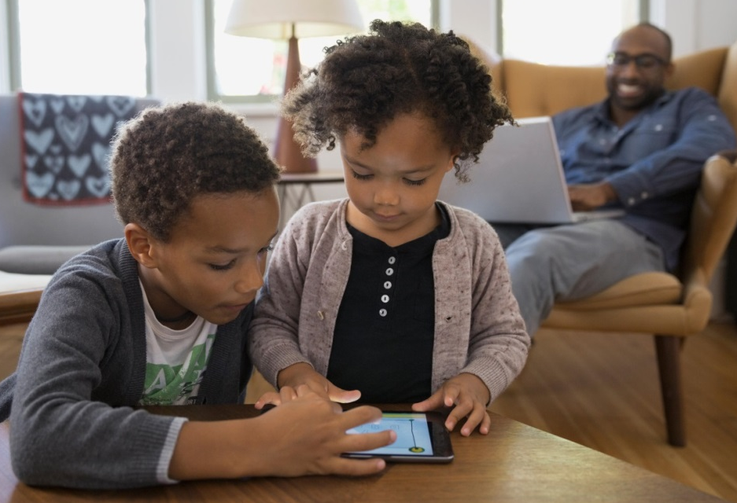
What can you do?
Ongoing conversations with your child about their internet use
Children should only live stream in public rooms
Look out for children moving to private platforms
Build resilience, particularly where children are feeling lonely
Encourage children to identify safe and trusted adults
Make sure children know where to go for support
Notes:
Slide for parents/carers of primary school aged children
What can you do?
There are a lot of practical things you can do to help keep your child safe if they are using an app or website with a live streaming function.
Ongoing conversations with your child about their internet use – Talk to your child about what they are doing online, what they are enjoying, what they are learning and the new things they have discovered. Parental engagement in the positive aspect of being online and not just the risky things will help your child to talk more openly about their internet use, including anything that worries them. Having these discussions little and often is more effective than ‘one big chat’.
Use webcam and devices in public spaces - As young people develop, they often seek more privacy and autonomy in both their online and offline world. However, it’s important to consider whether your child is developmentally ready to be left unsupervised using devices. Young children do not have reasoning skills to keep themselves safe independently, if they are faced with experienced offenders who know how to manipulate and overpower children. Many reports CEOP receive involve children using devices alone in their bedrooms and bathrooms.
Private platforms to chat – Private platforms describe social networks, forums or message services where chat can occur on a private, one to one or small group basis. Here, offenders are able to have private conversations that are likely to be less moderated. Make sure your child knows to keep their conversations in open and public areas.
Build resilience – Loneliness can be an issue for children and offenders can exploit this, especially with primary aged children. Ensure your child or a child that you know are getting the support they need offline. This could include conversations and activities that help build your child’s self-esteem and activities that that are not based on validation from growing fans or views e.g. offline activities like drawing.
Safe and trusted adults - Help your child to identify adults that are there to help them from ones who they do not know. Help them to identify trusted sources on the internet, versus places where they should be more cautious. Reinforce the idea that on the internet adults should not be giving young people instructions or telling them what to do.
Make sure your child knows where to go for support - Children can sometimes feel they are to blame if something goes wrong online. Remind your child that they can always speak to an you or adult they trust if they are worried no matter what may have happened.

Slide 7

Positive vs unhealthy attention
Schedule planned attention
Give personal and positive feedback
Be a positive role model
Encourage choice and consent from an early age
Notes:
Slide for parents/carers of primary school aged children
As we have discussed, some of the main reasons why live streaming is enjoyable for children is the affirmation and attention that it brings and the short term boost to self-esteem. Supporting your child to recognise the difference between positive and unhealthy attention can help them to identify when these behaviours are being displayed online.
Schedule planned attention: One on one time, doing something together that is largely child-directed.
Give personal and positive feedback to child: focus on praising good behaviours more than focussing attention on minor bad behaviours. Specific praise to be emphasised and inclusion of emotions: i.e. ‘You are being such as kind sister sharing the toys with your brother. You are playing with him so gently. I’m sure he feels very happy to be playing with you!’. Practicing this daily can demonstrates to a child what they are specifically doing well so that they know what behaviour to show again.
Be a positive role model: When children see us being critical of ourselves and our appearance or abilities that becomes normative for them to focus on the things they are doing wrong. It can help to notice when we are doing this and try and focus on the positives of our own lives and actions.
Encouraging choice and consent from an early age: Children are socialised to do as they are told, especially when adults ask. Unfortunately adults can exploit this when chatting to children online. Giving a child a choice from an early age develops their autonomy and good decision making skills. For example not forcing a child to hug a relative etc. Give them the option to be polite in another way.

Slide 8
Risk factors
Developmental stage and sexual exploration
Reduced inhibition online
Concept of live streaming
Tactics such as flattery and affirmation
Power of multiple comments
Fear
Notes:
Slide for parents/carers of secondary school aged children. For additional information on the risks of live streaming and responses prior to delivering this slide please read www.thinkuknow.co.uk/parents/articles/live-streaming-responding-to-the-risks
Risk factors
Developmental stage and sexual exploration – During secondary school age, the brain is still developing and this period of development is linked to increase risk-taking. It is also a time when it becomes natural for children to start to explore their sexual feelings, and talking to people online can feel exciting. Unfortunately the adults that they meet online can exploit this natural curiosity and risk-taking by talking about sex and introducing things that might be inappropriate.
Reduced inhibition online – Young people can feel more confident to do things online that they may not necessarily do in real life. They may, for example, feel more confident to explore sex and relationships online than in the real world. Young people can also feel invisible online and may do or say things that they wouldn’t do in real life.
Concept of live streaming – Secondary school children may not categorise live-streamed videos in the same way as an actual photo. Live streams may not be seen as a tangible thing that someone could record and pass on. This could lead to a ‘false sense of security’ where young people may be manipulated into doing something on live streaming that they would not do if it were a photo. Live streaming is ‘in the moment’ and there could be a tendency for young people to do things in the heat of the moment and act on impulse without thinking of the consequences.
Tactics such as flattery and affirmation - Lots of positive comments and compliments can make young people feel good. Live streaming platforms allow users to ‘gift’ emoji’s such as love hearts and coins and young people can be manipulated into doing things through flattery and the promise of gifts.
Power of multiple comments – There may be multiple offenders watching a young person on a single stream. This sense of group approval can make it much easier to manipulate the young person into doing something.
Fear – People can use threats when they are online to try and force young people to do things that they do not want to do, which can sometimes makes them feel like they not have any choice but to do what they are being told.

Slide 9

What can you do?
Ongoing conversations with your child about their internet use
Talk to young people about being asked to move to private platforms
Build resilience particularly where young people are feeling lonely
Encourage young people to identify safe and trusted adults
Make sure young people know where to go to report and for support
Notes:
Slide for parents/carers of secondary school aged children
What can you do?
There are a lot of practical things you can do to help keep your child safe if they are using an app or website with a live streaming function.
Ongoing conversations with your child about their internet use – Talk to your child about what they are doing online, what they are enjoying, what they are learning and the new things they have discovered. Parental engagement in the positive aspect of being online and not just the risky things will help your child to talk more openly about their internet use, including anything that worries them. Having these discussions little and often is more effective than having ‘one big chat’.
Talk to young people about being asked to move to private platforms to chat – Here, offenders are able to have private conversations that are likely to be less moderated. Remind young people to be wary of people they meet online who want to chat to them privately.
Build resilience – Loneliness can be an issue for young people and offenders can exploit this. Ensure your child is getting the support they need offline. This could include conversations and activities that help build your child’s self-esteem and activities that that are not based on validation from online ‘fans’ or views e.g. an offline activity.
If they are looking for support on the internet, speak to them about trusted sources. Use the new article on the Thinkuknow 11-13 site on live streaming to help you to do this (see slide 12)
Safe and trusted adults - Help your child to identify adults that are there to help them versus ones who always want something in return. Reinforce the idea that on the internet, adults should be offering advice and supporting young people to make their own choices, usually via professional and well known organisations, and not be giving them instructions or telling them what to do.
Make sure your child knows where to go to report and for support - Young people can sometimes feel they are to blame if something goes wrong online. Remind your child that they will never be blamed and can always speak to an adult they trust if they are worried, no matter what may have happened. Talk to them about reporting directly within the app or platform they are using and reporting to CEOP (see slide 13)

Slide 10

Conversation topics
Age appropriate news stories/TV storylines
Photos vs live streaming
‘Likes’ and views
Notes:
Slide for parents/carers of secondary school aged children
Starting a conversation with your child about live streaming doesn’t need to be scary or difficult. Here are a few useful ideas for starting the conversation with your child about live streaming
Age appropriate news stories/TV storylines – Use an age appropriate topical news story or TV story line to ask your child what they would do in this situation. This doesn’t have to have a specific focus on sexual abuse, for example the Thinkuknow website for 14+ years has a news article called ’20-year-old crashed car whilst on Facebook Live’ (www.thinkuknow.co.uk/14_plus/News/20-year-old-crashes-car-on-Facebook-Live) which uses the focus of a 20-year-old who crashed his car at high speed whilst live streaming to highlight the wider risks of live streaming.
Photos vs live streaming - Ask your child if they think there are any differences between a photo being shared online and a live stream e.g. do they think that both a photo and a live stream can be saved and kept indefinitely? You can use this conversation to reinforce the message that although live streaming seems ‘in the moment’ and that on many apps a live streamed video disappears after a set amount of time, anyone watching could be recording and saving it, therefore the same care and safety considerations apply to both.
‘Likes’ and views – Ask your child for their opinion on ‘likes’ and views on social media and what it means to them or their friends e.g. how do ‘likes’ and views make them feel, and do they think all of the ‘likes’ they get are all genuine? You can use this to kick start a conversation on thinking critically about why someone they don’t know might be liking their online activity. You can use the Thinkuknow website to support these conversations (discussed in next slide).

Slide 11
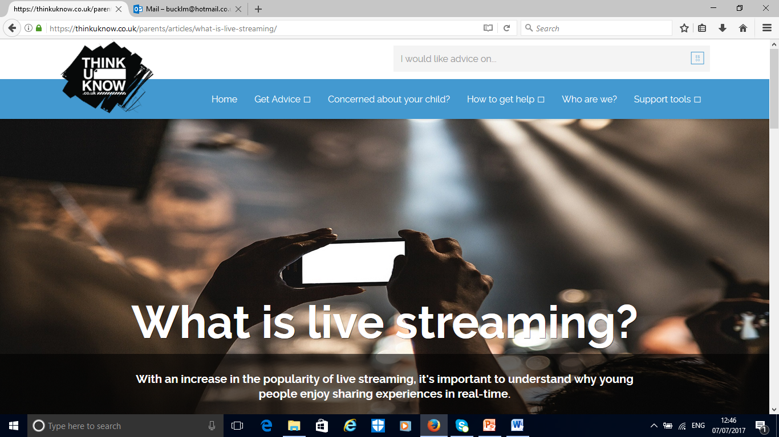
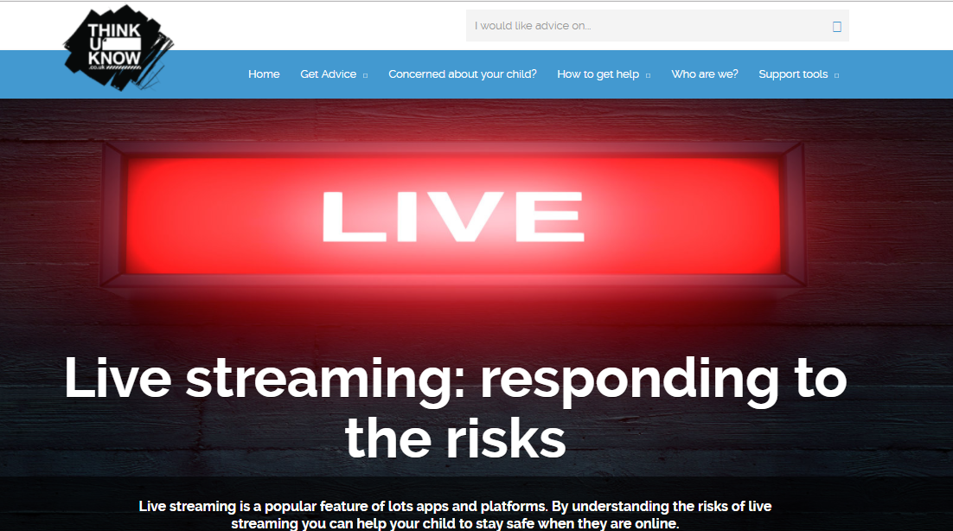
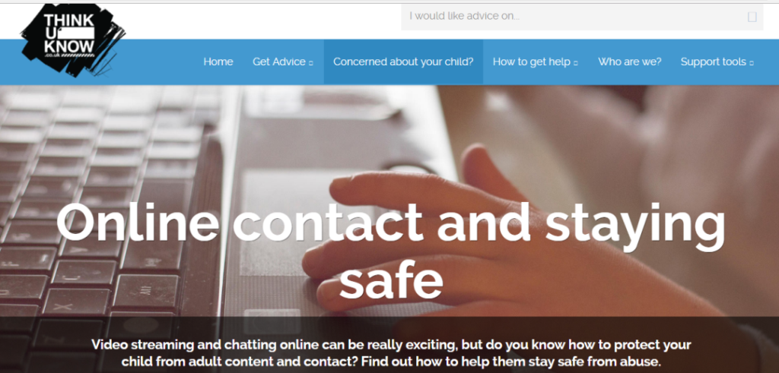
Thinkuknow website for parents/carers
Notes:
L-R: ‘What is live streaming?’, ‘Online contact’ and staying safe and ‘Live streaming: responding to the risks’
Thinkuknow have further practical information and advice on live streaming on their website for parents and carers.
What is live streaming? – This article explores what live streaming is, why it is so important with children and young people and the risks that live streaming can present to young people.
Online contact and staying safe – This article provides advice on protecting your child from adult contact when they are online.
Live streaming: responding to the risks – This article explores what makes live streaming risky for children and young people and provides practical steps parents and carers can take to help keep their child safe if they are using apps or platforms with a live streaming function.
CEOP are continually adding information on live streaming to the Thinkuknow website for parents and carers, as well as on other topics regarding your child’s online safety. To help you keep up to date you can visit the website on www.thinkuknow.co.uk/parents.

Slide 12
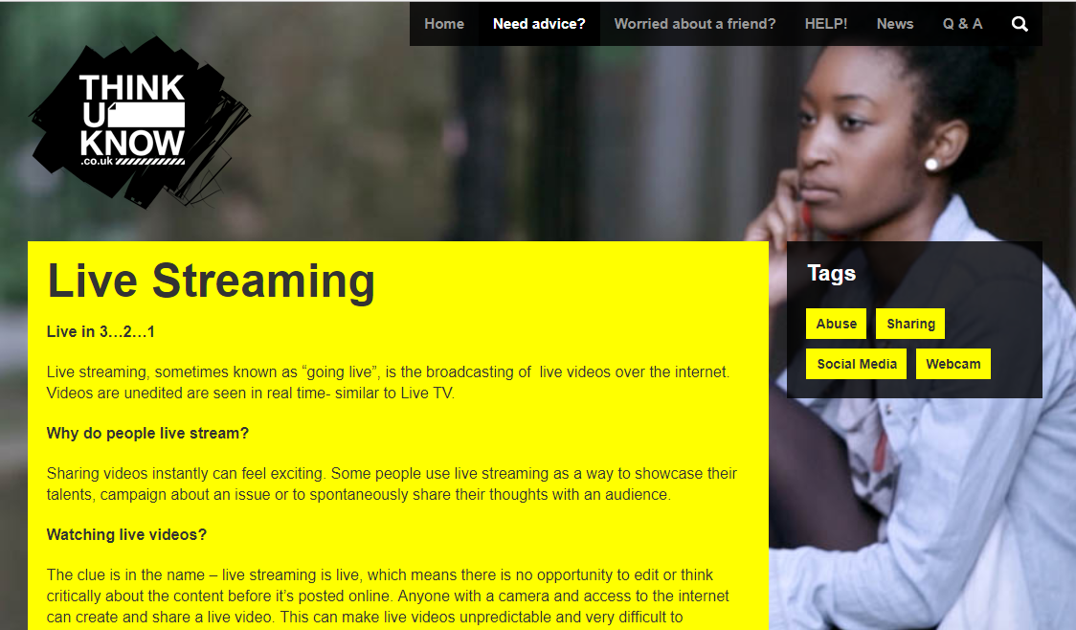

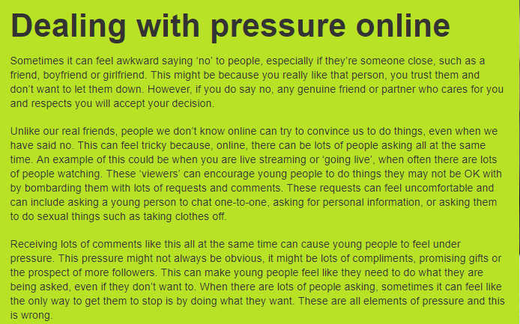
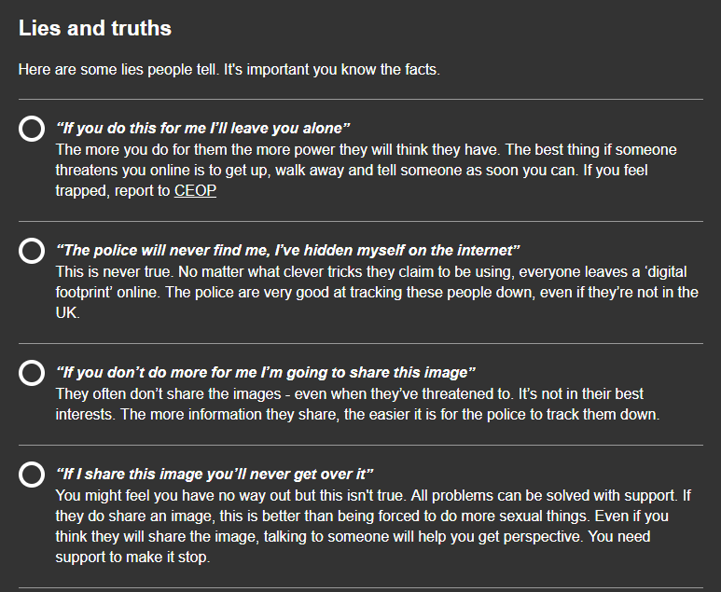

Thinkuknow websites for young people
Notes:
Slide for parents/carers of secondary school aged children.
L- R: ‘Live Streaming’ article on both 11-13 and 14+ website, ‘Cam Sex’ on 14+ website and ‘Dealing with pressure’ on 11-13 and 14+ websites
Thinkuknow websites for young people
The Thinkuknow websites for 11-13 year olds and 14+ hosts information and advice for live streaming safely for these age groups.
Live Streaming - This article covers what live streaming is and the considerations for secondary school aged children to help keep themselves safer if they are thinking of live streaming. (www.thinkuknow.co.uk/14_plus/Need-advice/Live-Streaming or www.thinkuknow.co.uk/11_13/Need-advice/Live-Streaming)
Cam Sex – This article is on the Thinkuknow 14+ website. The article highlights the lies that offenders tell children and young people on webcam or when live streaming in order to get them to d what they want., as well as providing this age group wit way in which they can be safer online if they are using a webcam. (www.thinkuknow.co.uk/14_plus/Need-advice/Webcam-sex)
Dealing with pressure – This article helps young people to identify and respond safely to pressure online. (www.thinkuknow.co.uk/11_13/Need-advice/dealing-with-pressure-online or www.thinkuknow.co.uk/14_plus/Need-advice/dealing-with-pressure-online)

Slide 13
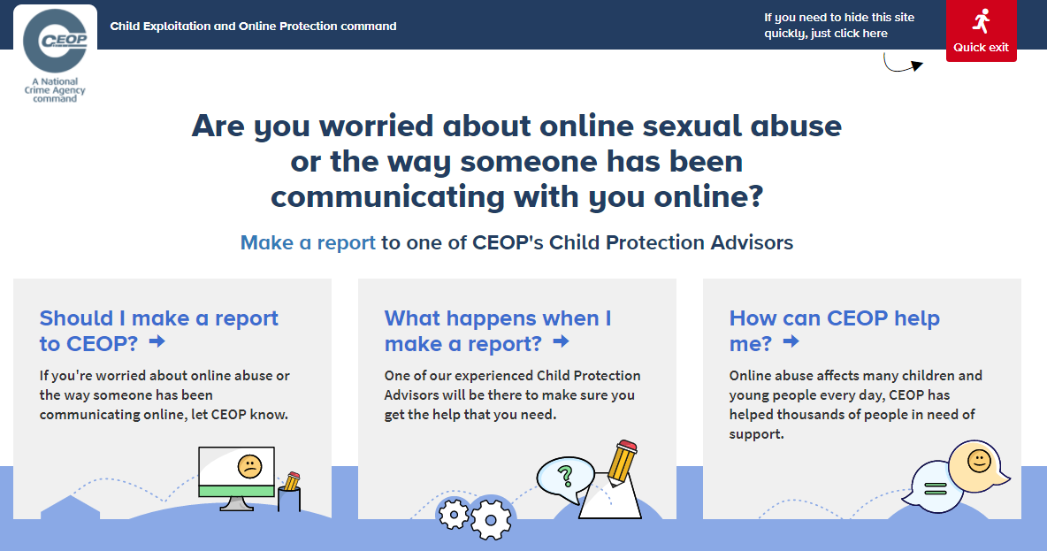
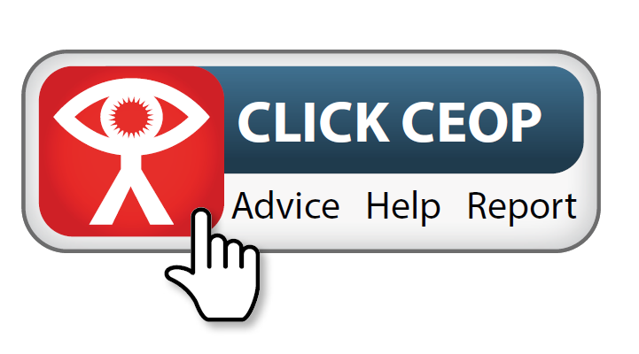
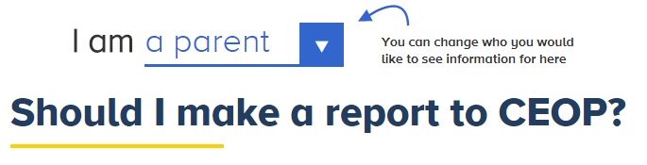
Reporting to CEOP
The CEOP website has information on:
When to report to CEOP
What happens when a report is made to CEOP
How CEOP can help
Notes:
Note to presenter: Before delivering this section, familiarise yourself with CEOP’s website and advice pages by visiting www.ceop.police.uk/safety-centre.
The website has information on:
When to report to CEOP
What happens when a report is made to CEOP
How CEOP can help
The Click CEOP reporting button is an online reporting tool, made specifically for children and young people to report concerns relating to sexual abuse and exploitation directly to CEOP. This can include something that has happened to a child on a live streaming platform. Parents, carers and professionals can also report to CEOP if they are worried about a child or young person in their care.
CEOP takes all reports seriously. The reporting form is designed to be as accessible as possible by children, but it is highly recommend that young children seek the support of an adult they trust to help them make a report.
It is not possible for anyone to report to CEOP anonymously as they need to ensure the child or young person is safe. CEOP advise any urgent reports where a child is in immediate danger should be reported to the local police force where the child is located.
Cyberbullying should not be reported to CEOP and children and young people should be directed to speak to an adult they trust, and/or referred to Childline, if they would like to speak to someone about how they are feeling.

Slide 14



Staying up to date
CEOP social media
CEOP websites
@CEOPUK
ClickCEOP
www.thinkuknow.co.uk
www.thinkuknow.co.uk/parents
www.ceop.police.uk/safety-centre
Notes:
In addition to the information and advice on the Thinkuknow and CEOP websites, you can also keep up to date by following CEOP on Twitter or Facebook.

