Slide 1


Curriculum
Geography – Whole School
Geography

Slide 2
Curriculum
Geography Rationale - Intent
Intent: | At Victoria Road primary school it is our intent for our Geography curriculum to inspire pupils with a curiosity and fascination about the world and its inhabitants that will remain with them for the rest of their lives. Teaching will aim to equip pupils with knowledge about diverse places, people, resources and natural and human environments, together with a deep understanding of the Earth’s key physical and human processes. As pupils progress, their growing knowledge about the world should help them to deepen their understanding of the interaction between physical and human processes, and of the formation and use of landscapes and environments. Through teaching and fieldwork we want our children to gain confidence and practical experiences of geographical knowledge, understanding and skills that explain how the Earth’s features at different scales are shaped, interconnected and change over time.

Slide 3
Curriculum
Geography Rationale
 | The curriculum is led and overseen by the Geography lead. Our Geography lead regularly monitors, evaluates and reviews the work by children thus celebrating the good practice. This allows the curriculum to be evolved and improved further. The teaching, learning and sequencing of our Geography curriculum follows: Will ensure coverage and progression in all skills relating to Geography. In KS1, children will aim to develop knowledge about the world, the United Kingdom and their locality. This will include looking at human and physical features and gaining a hands on experience to these. The children will begin to look at the continents of the world and study a small area of Africa. In KS2, children will aim to extend their knowledge and understanding beyond the local area to include the United Kingdom and Europe, North and South America. This will include locating and identifying key characteristics of a range of the most significant human and physical features in the UK, Europe, North America and South America. Throughout KS2 focus will be on developing their use of geographical knowledge, understanding and skills to enhance their locational and place knowledge. Each geography unit is taught with an overarching key question. The subsequent lessons will build upon each other to allow the children to fully answer the question at the end of the unit. Lessons will develop long term memory by allowing for repetition of learning within the year and year on year. Geographical vocabulary is taught within the unit and reinforced throughout the year. Our Geography curriculum helps to learn and revisit the importance of our world and how it should be treated through a range of Cultural capital activities and experiences including educational visits where appropriate. Through Geography our children will access their local environment to get hands on experience in their learning. Children will become more aware of their local environment as they progress through their geographical education. Children will access resources to acquire learning through atlases, text books, maps, digital technology and photographs to develop their knowledge, skills and understanding.

Slide 4
Curriculum
Geography Rationale - Impact
Impact | Children will achieve age related expectations in Geography at the end of their cohort year. Children will retain knowledge that is pertinent to geography with a real life context. Children will develop skills to pursue their own interests in geography and ask questions relating to their learnt knowledge Children will understand how geography ‘happens’ in their local area and also develop an awareness and understanding of geography not at just a local level but national and global level also. Children will begin to understand their wider world and the implications that we as citizens have on it. Children will work collaboratively to solve problems and explain the processes that they have taken/observed within a real life context.

Slide 5
Curriculum
Geography Rationale EYFS and KS1
EYFS | During early year children develop an understanding of place within their daily life experience. Through role play children and fieldwork the children explore their route to school. The children further develop their understanding of place when they explore other countries through their topics. The countries the children will learn about will be relevant to themselves or children in their class, making it a purposeful link. Early geographical vocabulary is discretely taught and explained and then regularly referred to in direct teaching and continuous provision.
Year 1 | In Year 1 the children focus on their immediate proximity using simple plans and maps and aerial photographs to learn about their local area. They begin to learn and use the four compass points. Through fieldwork they extend their understanding of geographical directional language and knowledge to the local area. They identify both physical features such as the River Weaver, the Neuman Flashes and human features shops, houses, roads and can locate these on simple plans and aerial photographs, interpreting simple symbols or keys. The children will begin to understand how their locality has changed over time during their history study of houses and homes. The children will use maps to compare the changes. The children identify seasonal weather patterns in the UK. Focusing on local weather by carrying out fieldwork to collect weather data on the school grounds. They will use simple equipment to complete their fieldwork enquiry.
Year 2 | In Year 2 basic knowledge of the human and physical features of the locality is visited through fieldwork within local a focus on railways and structures. They build upon features from fieldwork to extend beyond the local area to the wider UK, learning to name, locate and identify the characteristics of the four countries and capital cities of the United Kingdom and its surrounding seas. They will recap over weather from Year 1 and carry out local fieldwork to find out where the best place to locate a bench would be depending on the geography of the school grounds. Through the use of atlases, digital technology and globes, the children then move beyond the United Kingdom and learn to name and locate the world’s seven continents and five oceans and begin to have a basic understanding what characteristics each continent has. They will identify hot and cold areas around the world such as North Pole, South Pole and the equator and the temperatures around the world in-between. They also begin to make use of simple ordinance survey maps. They use simple maps and aerial photographs to recognise landmarks. They construct and use simple keys on maps. The children bring together their knowledge developed so far to consider a contrasting non-European locality, comparing a small area in Northwich with a small town in Kenya. This area links to one of our school charities, Under the Mango tree. They focus on human and physical features, settlement, together with climate. They build on early geographical vocabulary from EYFS.

Slide 6
Curriculum
Geography Rationale LKS2
Year 3 | Through making explicit links with history studied, children revisit key locational knowledge from Key Stage 1 including the world’s seven continents and oceans and the four countries and capitals in the United Kingdom and its surrounding seas. They then extend from this to consider local counties in the UK identifying their key physical and human features using more detailed ordinance survey maps. The children will begin to look at contour lines on OS maps and see how this impacts on where settlements could be built. Through drawing on history knowledge children begin to understand the importance of rivers and mountains when considering where people settle and how this impacts on physical features. This includes an opportunity to look at mountains in greater detail. They also look at the change in land use over time. They further build on geographical vocabulary from Key Stage 1 developing deeper understanding of the differences between villages, towns and cities. Their work on compass directions extends to 8 points of the compass. They also begin to use 4 figure grid references on maps. The children will look at mountains and their formation. They will study the environment around mountainous regions and identify land use. The children will use their knowledge of contour lines and map symbols to identify mountains in the UK using a range of maps and online mapping tools with a focus on Snowdon in Wales. The children will look at mountains and how the environment provides challenges. During the study of early civilisations, the children will build upon their knowledge from Year 2 and locate the equator, northern and southern hemisphere. The children will identify continents located in each hemisphere. Fieldwork builds on simple plans and maps to include graphs to support children in collating information on change over time.
Year 4 | During Year 4 children take a more in depth look at Europe. This links to history work on Greeks, Romans and Invasion. Within Europe the children focus on environmental regions looking at key physical and human features. They locate major cities. They use atlases, maps, globes and digital technology to develop their knowledge. They consolidate mapping skills to read 4 figure grid references. The children then follow an in depth study of one European region, North West Greece including Athens. Building from work in Key Stage 1 the children consider geographical similarities and differences such as climate, settlement, physical and human features. Children will identify key features of a river and through study of River Weaver, River Thames and River Danube understanding the physical features of a river, flooding and its impact. The children will then build form this to understanding the importance of rivers in development of human features, considering settlements and trade, linking from work on settlements in Year 3. During this study they will learn about the water cycle and the distribution of water and sustainability of future water supplies.

Slide 7
Curriculum
Geography Rationale UKS2
Year 5 | When revisiting locational knowledge of the United Kingdom, children will extend their knowledge to counties (making links to history of names of counties and how some have remained the same from Anglo Saxon era). As the children move from Romans to Vikings in history, they will look at changes in land use and understand why land use changes over time. The children will look at both human and physical reasons for changes in landscape. The chn will look at local regions when studying the Anglo Saxons In revisiting world locational knowledge, the children will extend learning to consider climate zones and have an introduction of longitude and latitude. This will be further developed in their science unit. Children will now be taught the significance of the Equator, the Northern and Southern Hemisphere, the Tropics of Cancer and Capricorn, the Arctic and Antarctic Circle. The children will be introduced to how volcanoes and earthquakes are formed. The children will build on their prior settlement knowledge from Year 3 to look at why people live near volcanoes and in earthquake zones. They will look in further detail at a volcanic eruption and an earthquake and examine the human and physical impacts. The children then move on to a focus study on North America understanding geographical similarities and differences between a region in the UK (North West) and a region in North America (Great Lakes). The children will do this through fieldwork, exploring a range of Ordnance Survey and online digital maps and aerial photographs of the UK region and a region of North America. Within this study of North American the children will look at physical and human features and how humans have changed the physical landscape. The children will revisit their learning of settlements, mountains and rivers from Year 3 and 4. They will study fair and unfair distribution of resources, including the distribution of natural resources including energy, food, minerals and water looking at difference between North and Central America. During their history study of the Maya, the children will look at Biomes and vegetation belts and how the Maya adapted to living in the Rainforest Biome.
Year 6 | Children will revisit the locational knowledge of the United Kingdom and the wider world. The children will look at push and pull factors and the role of human and physical geography has on migration. Linking to local history, the children will look at change in local land use/heritage over the last 100 years using interactive NLS maps, fieldwork in local area, land use maps and ordinance survey. Children will be taught to use 6 figure grid references. Children will revisit the significance of the Equator, the Northern and Southern Hemisphere, the Tropics of Cancer and Capricorn, the Arctic and Antarctic Circle. Their locational knowledge, together with their learning in Year 5 about North America, will then lead into a study of South America. Within this study the children will build on prior learning of climate zones, biomes, vegetation belts as well as the human geography of the locality including the distribution of natural resources including energy, food, minerals and water and compare this to their work in previous year on North America. The chn will study trade, what it is, what the UK imports and exports, looking at global trade and fairtrade and its impact. The children will carry out a local fieldwork study to look at the impact of migration in the local area, the chn will choose their own questions to research and own methods of collection, the children will work with the local high school to carry out this fieldwork

Slide 8
Curriculum
Geography Rationale UKS2
Our substantive themes which are taught and built upon throughout curriculum are as follows;
Climate
Migration/diversity
Trade
Settlements
Rivers
The disciplinary concepts, which are integrated within our curriculum and are developed alongside substantive concepts, are;
Interdependence
Space
Scale
Human Features
Cultural Diversity
Physical Features
Environmental Impact

Slide 9
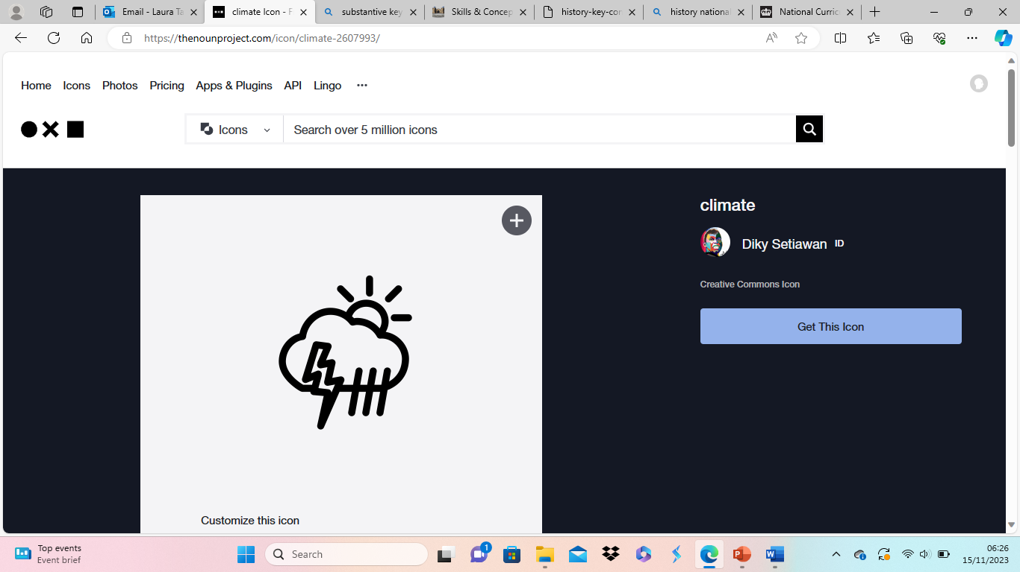
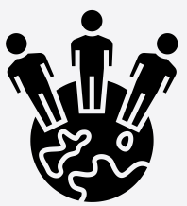

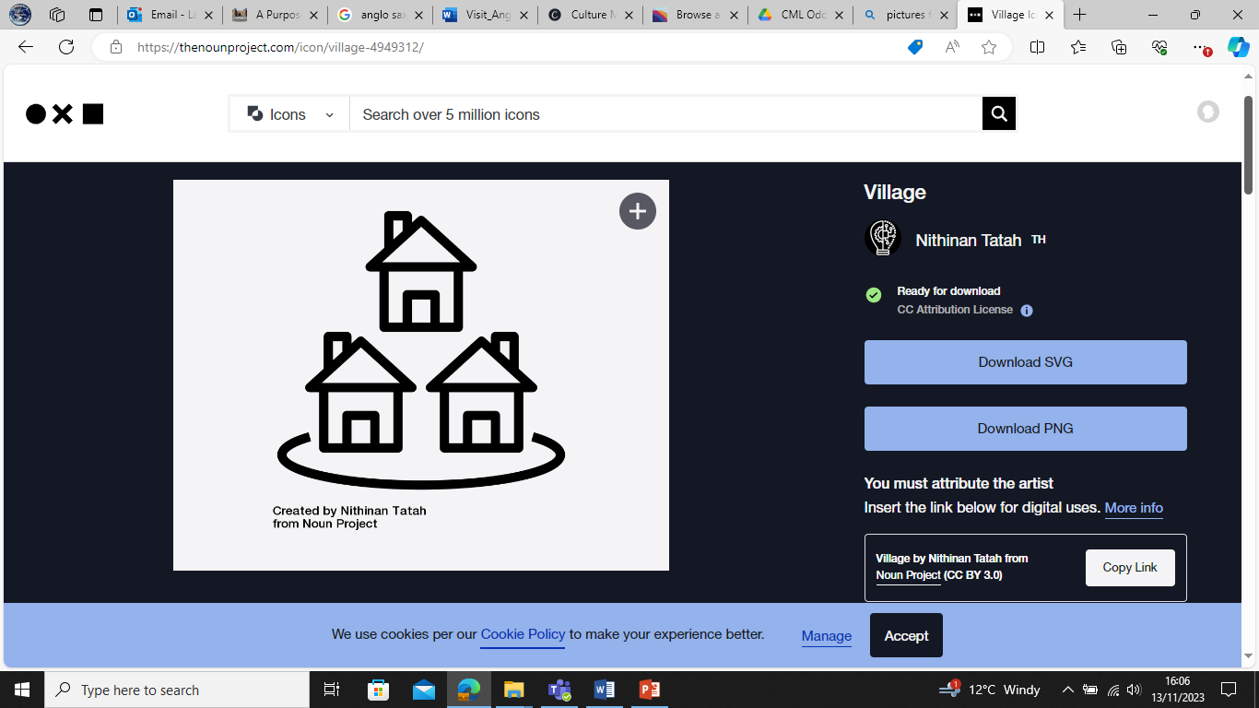
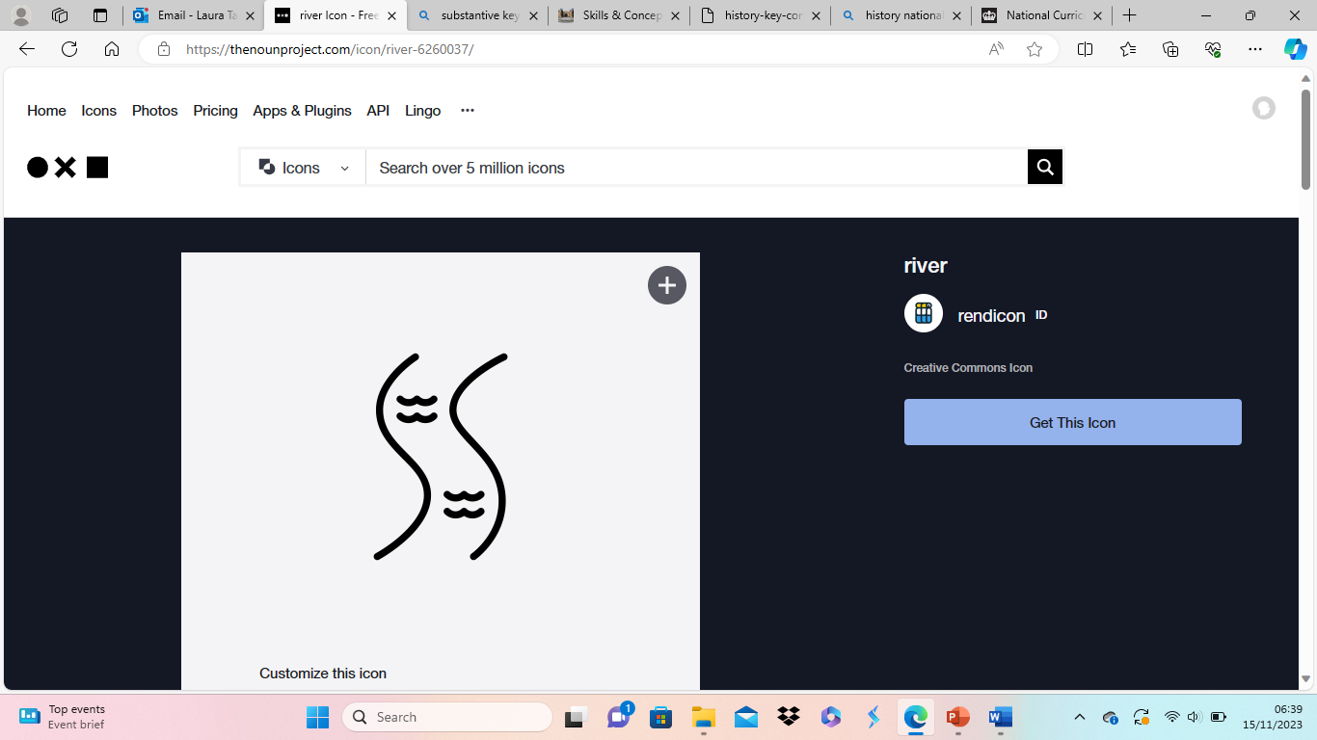
Substantive and Disciplinary concepts
Our substantive themes which are displayed in the classroom
Climate
Migration/diversity
Trade
Settlements
Rivers
Climate
Migration/
diversity
Trade
Settlement
Rivers

Slide 10
Curriculum Map
Whole School 2025-2026
 | Autumn | Spring | Summer
EYFS/ Year 1 | All about me - Settlements Migration/diversity Festivals - Migration/diversity | Off we go - Settlements Migration/diversity Growing - Climate | Animals - Climate Superheros
Year 1/2 | What is in our local area? (geography) Settlements Rivers | How have shops and houses changed? (history) Settlements | Sum 1 Is Northwich famous for anything? (history) Settlements Rivers Is the weather the same all over the world? (geography) Climate
Year 3/4 | How did the Greeks influence us today? (History /geography) Migration/diversity Trade Settlements Climate | What impact did the Roman invasion have on Britain? (history) | Are Rivers important to the people of Northwich? (Geography) Trade Settlements Rivers
Year 4/5 | Were the Saxons and Vikings the same, both invaders? (history) Settlements Climate | Is there more to North America than Disneyland? (Geography) Trade Climate Rivers | Who achieved most, the Maya or the Vikings? (History/Geography) Climate Settlements Rivers
Year 6 | What makes people come to Britain? (history and geography) Migration/diversity Trade Settlements Climate Rivers | Would you like to live in Brazil? (Geography) Is distribution the same around the world? (Geography) Migration/diversity Trade Settlements Climate Rivers | Sum 1 - How has Northwich changed over time – family study (history) Sum 2 - Is there evidence of connections to other places in Northwich? (hist/geography) Migration/diversity Trade Settlements

Slide 11
Curriculum Map
Medium term overview – EYFS
All about me | Festivals a2 | Sp1 – off we go | Growing | Animals | Superheros
Journey to school – know where their school is and what they pass on the way to school | How does a letter get to my home – write their basic address, that they live in Northwich which is a town in England | Transport walk – river/canal Draw map of journey in local area or imaginary maps Chinese new year – locating where China is and how they celebrate. How would we get there? | Seasons and basic what’s the weather today Locate other countries they know and discuss the weather in that country | School environment – where is the best place for habitats – map of field and locate where. Local environments for animals – farm animals live on farms and fields, foxes may live in forests. | Sustainability Protecting our environment Visit local park

Slide 12
Curriculum Map
Medium term overview – Year 1/2
Enquiry Question | What is in our local area? | How have houses and shops changed since 1950? (history unit) | Sum 1 Did Northwich have any famous people, places or events? (6 weeks) Sum 2 - Is the weather the same all over the UK? (geography)
 | Locate where in the world do we live - UK and Northwich 4 countries of the UK Locate our school on a map Use NSEW Find places in Northwich Locate human and physical features in the area Plan a route Find features on a range of maps and photos Create own maps and add symbols and pictures | Use maps to locate key shops in local area Name and locate shops on the map and identify these on local walk Draw own sketch map and locate shops on the map using compass points Use maps to see how settlements have changed over time | Identify key weather of the UK and how it varies. Identify the 4 countries of the UK Look at weather symbols and how to read a weather map How are we effected by extreme weather in Northwich? Fieldwork – local weather study for local area data collection

Slide 13
Curriculum Map
Medium term overview – Year 3/4
Enquiry Question | How did the Greeks influence us today? (History /geography) | What impact did the Roman invasion have on Britain? (history) | Are Rivers important to the people of Northwich? (Geography)
 | Name and locate continents and oceans Locate Ancient Greece and locate Greece today – how has it changed? Use compass points to locate other countries in Europe Identify key physical features of Greece and the impact this would have had on the people living there Use maps, atlases and globes Where is Northwest (year 3) Look at OS maps – (year 3) Contour lines – what do they show? | Name and locate continents and oceans Locate 4 countries of the UK, capital cities and surrounding seas Identify countries in Europe Identify the physical and human features why the Romans came to Britain | Name and locate continents and oceans Locate 4 countries of the UK, capital cities and surrounding seas Discuss how water effects our lives Look at a river and features of a river environment Discuss where does water come from – is the NW the wettest place in the UK? Identify key environmental regions of Europe and how latitude effects this Locate key rivers in the UK and why they are important Locate Rivers in Europe – name countries and capital cities Look at River Rhine and its importance to Europe – compare to River Thames and/ Or River Weaver and River Danube Use maps, atlases and globes

Slide 14
Curriculum Map
Medium term overview – Year 4/5
Enquiry Question | How did the Greeks influence us today? (History /geography) | What impact did the Roman invasion have on Britain? (history) | Are Rivers important to the people of Northwich? (Geography)
 | Name and locate continents and oceans Locate Ancient Greece and locate Greece today – how has it changed? Use compass points to locate other countries in Europe Identify key physical features of Greece and the impact this would have had on the people living there Use maps, atlases and globes Where is Northwest (year 3) Look at OS maps – (year 3) Contour lines – what do they show? | Name and locate continents and oceans Locate 4 countries of the UK, capital cities and surrounding seas Identify countries in Europe Identify the physical and human features why the Romans came to Britain | Name and locate continents and oceans Locate 4 countries of the UK, capital cities and surrounding seas Discuss how water effects our lives Look at a river and features of a river environment Discuss where does water come from – is the NW the wettest place in the UK? Identify key environmental regions of Europe and how latitude effects this Locate key rivers in the UK and why they are important Locate Rivers in Europe – name countries and capital cities Look at River Rhine and its importance to Europe – compare to River Thames and/ Or River Weaver and River Danube Use maps, atlases and globes

Slide 15
Curriculum Map
Medium term overview – Year 6
Enquiry Question | Why is Britain so diverse? (History and geography) | Would you live in South America? (geography) | Why do we trade? (Geography and history)
 | Migration, what is it and why did people come to Britain Push and pull factors for people coming to Britain Explore if the Romans, Saxons and Vikings pulled or pushed to Britain How has migration impacted the people e.g. food we eat, racism, discrimination | Locate South America/Brazil on digit mapping and create a route from Northwich Identify the human and physical features of Brazil Bridge back to climates/biomes from year 5 and identify climate zone/biomes for South America how does this differ to North America and UK – look deeper in to the climate of Brazil Discuss urbanisation and the push/pull factors Human features of Brazil and the difference between rich and poor Using ICT to identify what life is like in Brazil | Look at what Trade is and the scale at which it can be carried out. Explore the developments that have come with trade. Explore food trade and how in the UK we won’t have a lot of foods without trade (bridge back to A) Identify key stages of trade and the importance of each stage Identify the patterns of glabal trade and how and where UK exports to Fairtrade, what is it and who does it affect? Highest value exports linking with human and physical features of places

Slide 16
Curriculum Map
Medium term overview – Year 6 cont…
Enquiry Question | What is the Heritage of Northwich? (History) | What evidence is there in Northwich of connections to other places?
 | Locate places on a range of maps and plan routes to walk in the local area | Use 6 figure gird references to locate key settlements in and around Northwich Use symbols and keys on maps to identify key features Think abut why people may have been pulled/pushed to Northwich Speciality shops/restaurants discuss why they are here, who uses them, have they always been here? Carry out survey for those people using the shops/restaurants Present findings

Slide 17
Curriculum Map
End points – EYFS
 | Locational Knowledge | Place knowledge | Human and Physical Geography | Skills and fieldwork
EYFS | To know how they are part of their own locality, which is part of a bigger world Know we live in England. Know our school is in Northwich. Know their journey to school Know there are other places continents/ countries in the world and name some of them. (depending on chns family links) | Describe their immediate environment using knowledge from observation and discussion, River, road, tree, field, playground, shop, house. To know about 1 similarity and1 difference between myself and others, and among families, communities, cultures and traditions. | To know and talk about places they have visited or been to on holiday including beach, farm (trip) To know some key aspects of hot and cold countries and the wildlife there. | Draw maps of real or imaginary places
KS1 sustainability week | KS1 sustainability week | To understand the effect my behaviour can have on the environment

Slide 18
Curriculum Map
End points – Year 1/2
 | Locational Knowledge | Place knowledge | Human and Physical Geography | Skills and fieldwork
Year 1 | Children can name and locate two rivers of Northwich (A) Children can locate where they live on a map of the UK (A) | Children understand and can name some of the difference between physical and human features within the local area (A) | Know the difference between city, town and village and recognise Northwich as a town, Chester as a City and some our surrounding villages (A) To identify key human features of Northwich including shops, factory and houses and physical features including field, tree (Sp) | Children can draw and label a simple sketch map of Northwich adding a simple key (Sp) Chn can identify seasonal and daily weather patterns of the UK (Su) Children can identify and use the 4 points on a compass (A) Chn can collect data for fieldwork enquiry using simple weather equipment
Field work week | Chn can use maps, photos to carry out field work within the school locality (A) Chn use observational skills to study the geography of their school and its grounds (A)
KS1 sustainability week | Chn can say how we can protect and improve our school for the future. (Su) Chn can identify ways to reduce waste and save energy within school (Su)

Slide 19
Curriculum Map
End points – Year 3/4
 | Locational Knowledge | Place knowledge | Human and Physical Geography | Skills and fieldwork
Year 4 | Know the names and location of at least 8 European countries and their capital cities using maps Greece, France, Spain, Italy, ( 4 others based on chns links) (A/Su) Chn can name and locate 2 significant rivers in the UK (River Weaver and Thames) and significant rivers in the world including, Nile, Amazon, Yangtze, Danube and Rhine (Su) | Chn can identify key human and physical characteristics of Greece including key European landmarks (A) | Chn can identify and label features of a river and its environment (Su) Chn can identify trade and reasons/examples why countries trade and understand the term fair trade and its implications on the lives of many people(Sp) Know why ports are important for world trade Chn can compare 2 similarities and differences between living in the UK and contrasting locality in Greece (A) Explain the features of the water cycle (Su) Chn begin to know that the distribution of water is not equal across the world (Su) Chn can identify the natural resources of the UK *taught within history curriculum chn can identify how settlements have changed in the UK since stone age *taught within history curriculum (Sp) | Use google maps to follow journey of a river (Su)
LKS2 Fieldwork week | Chn can identify on maps features in the local environment Chn can use fieldwork skills to collect data
LKS2 Sustainability week | Chn can understand the term fair trade and its implications on the lives of so many people Chn know the main physical and human differences between developed and third world countries

Slide 20
Curriculum Map
End points – Year 4/5
 | Locational Knowledge | Place knowledge | Human and Physical Geography | Skills and fieldwork
Year 4 | Know the names and location of at least 8 European countries and their capital cities using maps Greece, France, Spain, Italy, ( 4 others based on chns links) (A/Su) Chn can name and locate 2 significant rivers in the UK (River Weaver and Thames) and significant rivers in the world including, Nile, Amazon, Yangtze, Danube and Rhine (Su) | Chn can identify key human and physical characteristics of Greece including key European landmarks (A) | Chn can identify and label features of a river and its environment (Su) Chn can identify trade and reasons/examples why countries trade and understand the term fair trade and its implications on the lives of many people(Sp) Know why ports are important for world trade Chn can compare 2 similarities and differences between living in the UK and contrasting locality in Greece (A) Explain the features of the water cycle (Su) Chn begin to know that the distribution of water is not equal across the world (Su) Chn can identify the natural resources of the UK *taught within history curriculum chn can identify how settlements have changed in the UK since stone age *taught within history curriculum (Sp) | Use google maps to follow journey of a river (Su)
LKS2 Fieldwork week | Chn can identify on maps features in the local environment Chn can use fieldwork skills to collect data
LKS2 Sustainability week | Chn can understand the term fair trade and its implications on the lives of so many people Chn know the main physical and human differences between developed and third world countries

Slide 21
Curriculum Map
End points – Year 6
 | Locational Knowledge | Place knowledge | Human and Physical Geography | Skills and fieldwork
Year 6 | Chn can name some countries of South America, their capitals and environmental region (Sp) Chn can relate location to trade links (Sp) | Contrast the main features found in two different biomes, rainforest and desert Appreciate that climate and physical features has an important part to play when considering how people live (Sp) | Chn can name 2 push and 2 pull factors (A/Sp) Chn can understand that the distribution of energy, minerals, water and food has an impact on migration (Sp) Chn can begin to understand Fairtrade | Chn can draw, annotate, create key on a sketch map of the local area. Including their route of their local heritage walk using scale (Su) Using graphs to record temperature and rainfall (Sp) Know what is meant by latitude and longitude (Sp) Pupils can collect, analyse and communicate with a range of data gathered through experiences of fieldwork (Su)
UKS2 Fieldwork week | Chn can plan a route within the local area Chn can use appropriate language when giving directions Chn can use sketch maps and plans to describe features in the local area (A) Chn can recognise the positive and negative impacts of plastic (A)
UKS2 Sustainability week | Chn have an understanding of climate change and it’s potential impact on our lives (Su)

Slide 22
Curriculum Map
Progression of skills – Key concepts
Progression of Key Knowledge Concepts | Interdependence | Space Scale | Human Features Cultural Diversity | Physical Features Environmental Impact
 | Developing a sense of place runs through all the key concepts above.
EYFS | Children discover the similarities and differences between their own lives and the lives of people in different countries | Children discover they live in a town. | Children discover the human features around them | Children discover the physical features around them
Year 1 | Children discover the similarities and differences between Kenya, Africa and their own lives in the UK | Children discover their town is part of England and England is part of the United Kingdom. | Children discover the human features and culture of their local area and Africa | Children discover the physical features of their local area and Africa
Year 2 | Children discover the similarities and differences between countries of the UK | Children discover the four countries of The UK and the UK is part of Europe, one of the continents that make up the world. | Children discover the human features and culture of countries of The UK and hot and cold places around the world | Children discover the physical features of the countries of The UK and hot and cold places around the world. They are introduced to the concept of weather.
Year 3 | Children discover the similarities and differences between regions in the UK. They also explore Mount Everest region in minor detail. | Children discover counties in The UK and Europe in more detail. | Children discover the human features and culture of counties of the UK and mountainous regions. They are introduced to the concepts of settlements and land use. | Children discover the physical features of counties of the UK and mountainous regions. They are introduced to the concept of mountains and their environmental impact.
Year 4 | Children discover the similarities and differences between an area in Greece and their own lives in the UK. | Children discover Europe in more detail. | Children discover the human features and culture of Greece. They consider the differences in lives between people who live near rivers and those who don’t. They are introduced to the concept of trade. | . Children discover the physical features of Greece. They are introduced to the concept of rivers and flooding, and their environmental impact.
Year 5 | Children discover the similarities and differences between North America and their own lives in UK. They also explore South East England in small detail. | Children discover North America in more detail. | Children discover the human features and culture of the USA. They consider the differences in lives between people who live in a rainforest and their own lives. | Children discover the physical features of the USA. They are introduced to the concept of vegetation belts, biomes, and rainforests, volcanoes and earthquakes and their environmental impact
Year 6 | Children discover the similarities and differences between South America and their lives in the United Kingdom. The children look at how Northwich has links to other countries. | Children discover South America in more detail. Children discover UK and its relationship with other countries. | Children discover the human features and culture of Brazil and other areas of South America. They are look further in to trade links, settlements and land use. The look at the distribution of natural resources and its positive and negative impact on humans | Children discover the physical features of South America. They look at the distribution of natural resources and its impact on the environment.

Slide 23
Curriculum Map
Progression of skills – Fieldwork skills
Progression of Fieldwork Skills | Reception | Year 1 | Year 2 | Year 3 | Year 4 | Year 5 | Year 6
 | Fieldwork is undertaken at the start of each year in KS1, LKS2, UKS2. Fieldwork is then carried out throughout the year with some year groups having support from the local high school
Posing and Planning | Ask who, what, where, when and why questions to find out more | Suggest simple geographical questions before taking part in teacher-led enquiries | Suggest simple geographical questions before deciding on a whole-class enquiry, planned by the teacher | Suggest geographical questions before deciding on a whole-class enquiry, that they help to plan | Suggest geographical questions before deciding on a whole-class enquiry, that they plan individually | Suggest geographical questions before deciding on an enquiry as a group, planned with guidance from the teacher | Suggest geographical questions before deciding on an enquiry individually or in a group, planned independently
Collecting Data | Data is collected by speaking to an adult and through self-discovery play | Data is collected as a whole class using a method chosen by the teacher | Data is collected in groups using a method chosen by the teacher | Data is collected individually using a method chosen by the teacher | Data is collected using a method chosen by the children with guidance from the teacher | Data is collected using a range of methods chosen by the children | Data is collected with increasing accuracy using a range of methods chosen by the children
Reflecting and Evaluating | Discuss their answers with their friends and family | Discuss their fieldwork findings as a class | Discuss their fieldwork findings in groups | Begin to formally present their findings with a question they would like to find out next time | Formally present their findings with some consideration to what they would do differently next time | Formally present their findings with some consideration to what they could do next time and a whole-class discussion on whether the evidence and method of collection was reliable | Formally present their findings with consideration to what they could do next time and whether their evidence and method of collection was reliable

Slide 24
Curriculum Map
Progression of skills – Map Skills
Progression of Skills | EYFS | Year 1 | Year 2 | Year 3 | Year 4 | Year 5 | Year 6
Positional Language | Use simple directional language (forwards, backwards, move towards) to move around a space | Use directional language (up, down, left, right, forwards, backwards) to navigate around a map begin to use four compass points | Use a mix of directional language and the four points of a compass to navigate around a map | Use the four points of a compass to navigate around a map confidently and begin to use four – figure grid references | Use the eight points of a compass and fur figure grid references to navigate around a map | Use the eight points of a compass to navigate around a map and four-figure grid references to navigate around a map | Use the eight points of a compass to navigate around a map and use six-figure grid references to navigate around a map
Drawing Maps | Begin to draw places they know and maps from stories | Draw places they know are close to one another to form a basic map of school and local area | Draw a map of a real place with some drawn features, using aerial photographs for support | Draw or make a map of a real location that includes a range of human and physical features | Draw a map based on a fieldwork sketch with symbols and a key | Draw a map with positioning of key features located accurately in relation to one another and use OS Symbols | Draw a map that begins to show appropriate distance between places or features based on a given scale
Representation on Maps | Begin to recognise represented features on a map | Use own symbols on a basic map | Use agreed symbols and begin to understand the need for a key | Use standard symbols and a key | Begin to recognise basic symbols on an OS map | Use most OS symbols on a map | Use atlas symbols
Using Maps | Pick out information from a simple map | Use a simple picture map to move around the school | Follow a short route on a small-scale map | Follow a longer route on a small-scale map with increasing accuracy | Follow a route on a large-scale map | Select a type of map for a specific purpose and follow a route | Select an appropriate map at an appropriate scale and follow a route.

Slide 25
Curriculum Map
Progression of skills – Vocabulary KS1
Key Geography Vocabulary: Always revisit the year group’s before key vocabulary |  |  |  | Other useful words for this age group | Challenge for this age group
 | Human features | Physical features | Geographical map skills and fieldwork
EYFS | Building , Town, farm , road, park, Path, people, | Beach, sea , river , desertl countryside, forest / wood, weather, seasons | Map , local, place, globe | Village , city, shop , land , house , water, Pond
Year 1 | Town, factory, farm, house, shop, country | beach, forest, hill, sea, ocean, river, season weather | Africa, Europe, England, Scotland, Wales, Northern Ireland United Kingdom, Compass, Compass points: East North South West, plan | Environment , recycle, Equator, Direction, key, Country, Continent, globe, atlas, Address, Right/ left, contrasting non-European , culture | Scale , route planner, grid, places, resources natural Physical and human features
Year 2 | human features, City, Capital city, town, village, port, harbour, Canal | physical features, cliff, mountain, coast, soil, valley, vegetation, weather | Europe, Asia, North and South America, Antarctica, Africa Australia, Belfast, Cardiff, Edinburgh, London, North/ Irish Seas, English Channel, Arctic/Southern/Pacific/Atlantic/Indian Ocean, Fieldwork, aerial photograph, map key symbols | Patterns, characteristics, surrounding seas, Culture, hot/cold | Human resources natural resources, human and physical environments, diverse vegetation, urban rural challenge

Slide 26
Curriculum Map
Progression of skills – Vocabulary KS2
Key Geography Vocabulary: Always revisit the year group’s before key vocabulary |  |  |  | Other useful words for this age group | Challenge for this age group
 | Human features | Physical features | Geographical map skills and fieldwork
Year 3 | Region, Europe, Country, County | Landscape, Hills and mountains , N.B. including the UK names, Rural, Climate, Alps, Tundra, Mountainous , Land use patterns | Observe , measure, record, Compass points: NW NE SE SW, map, Scale, 2 figure grid reference, Sketch map | Land use , Mountains, food chain, Differences/similarities City/country/continent, Atlas/map/globe, Great Britain Change/ effect, processes Formation, Change over time | Topographical, Services, Geology, Minerals and rock types , Ordnance survey map Contour
Year 4 | Economy, Trade, Energy, Fair trade | Erosion, deposition, water cycle, coast, Tributary confluence, meander, source, mouth environmental regions | Ordnance Survey map, Scale | Compare/ contrast, river features, Interaction between physical and human processes Interconnected, globally significant , 4 figure grid references | Estuary, terrestrial ox bow lake, equator, delta, bay, British Isles
Year 5 | Trade, Deforestation, Derelict, Fair trade | climate zones, Principal states, volcanoes earthquakes | Global warming, Latitude, Longitude, North/ South hemisphere, Greenwich Meridian | Geographical influences / significance, Climate change, Ordnance Survey, Geographical Information Systems | Relief, Digital mapping, Tropics of Capricorn and Cancer hemisphere
Year 6 | Economy, Sustainable , Urban Push/pull factors | Biomes/ Vegetation belts Energy, Minerals, Rural Volcanoes, earthquakes | Arctic and Antarctic Circle Distribution of natural resources | spatial variation Human influences / significance/ 6 figure grid references

