Slide 1
Year Ahead Meeting
Thursday 10th September
Miss Watson (class 5)
Mrs Falconer (class 6)

Slide 2
General Information.
Reading books and records brought to school EVERY DAY.
Always bring a coat!
Names in uniform.
No earrings or jewellery.
All medication to be taken in school requires the completion of medication form – speak to office staff.
Water (can be flavoured)
Healthy snack for first playtime.

Slide 3
Events
Nativity Performance Autumn 2
*The Lowry in the Spring term
*Martin Mere in the Summer term
History Alive Workshop

Slide 4
Weekly routine
Morning
Sounds-Write phonic lesson
English
Maths
Guided Reading/ Comprehension lesson
Assembly (Monday, Wednesday, Friday)
Afternoon
Every day –Handwriting practice – lead out to practice cursive
Monday – PSHE and Geography
Tuesday – Indoor PE and R.E
Wednesday - Science
Thursday – Outdoor PE and Art
Friday – Computing and Music

Slide 5


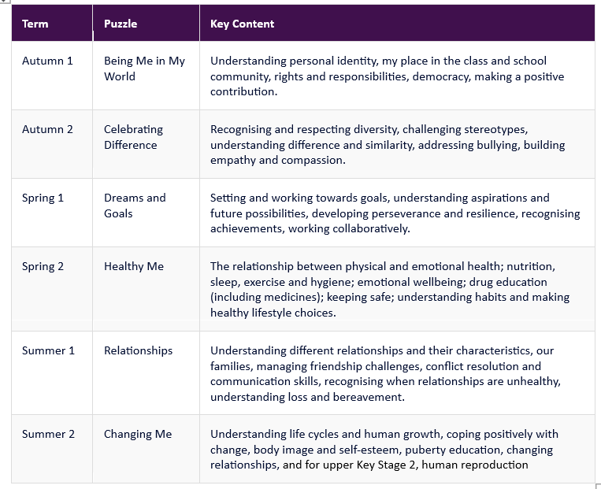
PSHE Curriculum at Lowton West
Our PSHE curriculum is organised into six themed units (‘Puzzles’), each taught in every year from Reception to year 6 group for approximately half a term.

Slide 6
PSHE Curriculum at Lowton West
At Lowton West, PSHE is an important part of our curriculum and supports the whole child to develop the knowledge, skills and confidence they need to thrive.
Through progressive, age-appropriate learning, children will develop:
Emotional wellbeing – understanding and managing feelings, developing resilience and knowing when to seek support.
Healthy relationships – building positive relationships, showing respect and understanding boundaries.
Health and safety – learning how to keep themselves safe and make healthy, informed choices.
Citizenship – understanding rights and responsibilities and how they can make a positive contribution to their school, community and wider world.
Preparation for the future – developing independence, confidence and the skills needed for adolescence, adulthood and beyond.
PSHE is not just taught through weekly lessons. It is embedded throughout school life through our values, relationships, assemblies, enrichment opportunities and everyday experiences.
We work in partnership with parents and carers to support children to become confident, respectful, responsible and healthy individuals.
Further information and support for parents can be found on our School Website in our Parent Knowledge Organisers for Topic: https://www.lowtonwest.wigan.sch.uk/page/pshe-including-rse-and-he/59669
You can also contact : Miss Green – PSHE Subject Leader.

Slide 7
Handwriting
Continuing to develop cursive writing.
Children will practise the lead out initially in year 2 using the Letter-Join programme.

Slide 8
Guided Reading
All children take part in daily reading fluency and comprehension lessons.
We focus on the following skills:
*Blending sounds to read new words, including using alternative sounds for letters ( such as ay, ai, a-e).
*Decoding and reading multisyllable words -words with two or more syllables.
*Reading and writing common exception words (often tricky words that do not follow a standard spelling rule)
*Fluency and re-reading – reading books aloud to build speed , accuracy and expression.
*Retrieval- finding direct answers from the text.
*Inference- answer “why” questions about a character’s actions or feelings.
*Predicting-Guess what might happen next based on the clues already provided
*Sequencing and summarising-ordering events and explain the main points of what they have just read.
*Discussing books- talk about words and phrases

Slide 9
English
Grammar, punctuation and spelling – skills for writing
(commas, apostrophes, noun phrases, conjunctions, verbs, adjectives, nouns, spelling patterns)
Study of different genres – fiction and non- fiction
(Instructions, retell of a story, character descriptions, poetry)
Example texts
(W.A.G.O.L.L)
Shared writing
(collaboration in pairs, groups or whole class)
Independent writing
(Last stage of the process – Show us what you’ve learned!)

Slide 10
Reading
Library books – chosen by child, to be shared with a grown up or sibling.
Library books can be changed on a Class 5 Wednesday and Class 6Thursday only.
Book Banded reading books and dandelion reading books – increase in difficulty as the child develops greater reading ability.
Reading books will be changed every Friday.
Please ensure your child’s reading book and reading record are in their bag everyday so they may further practice reading in school.
(please let staff know via message in reading record if your child has struggled with text)
1:1 reading – with Teacher, Teaching Assistant or volunteers.

Slide 11
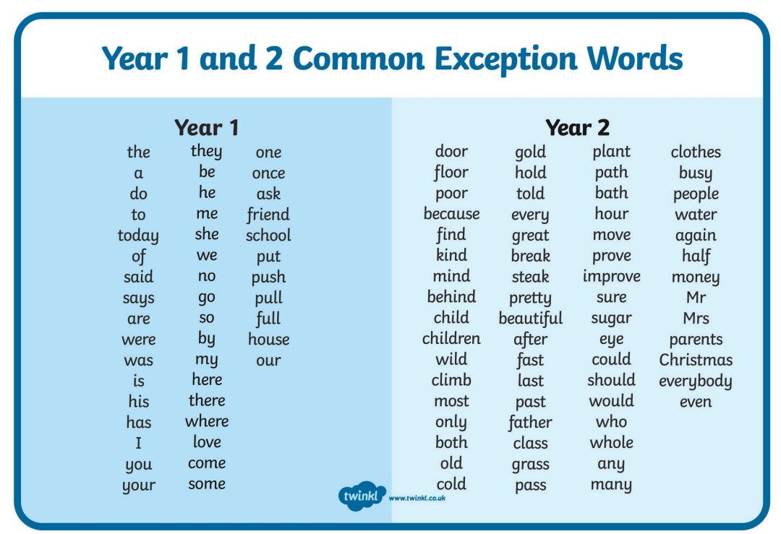

Slide 12
Maths
White Rose Scheme of work.
TT Rockstars – Multiplication and Division
2s, 5s, 10s and 3s are a focus but children can progress further as their speed and accuracy increases
 | AUTUMN | SPRING | SUMMER
YEAR 2 | WEEKS 1 – 4 PLACE VALUE (WITHIN 100) WEEKS 5 – 9 ADDITION AND SUBTRACTION WEEKS 10 AND 11 MONEY WEEK 12 CONSOLIDATION (BASED ON ASSESSMENTS) | WEEKS 1 – 4 MULTIPLICATION AND DIVISION WEEKS 5 – 8 FRACTIONS WEEKS 9 – 10 TIME WEEKS 11 – 12 SHAPE | WEEKS 1 – 3 MASS, CAPACITY AND TEMPERATURE WEEKS 4 – 5 LENGTH AND HEIGHT WEEKS 6 – 7 POSITION AND DIRECTION WEEKS 8 – 9 STATISTICS WEEKS 10 – 12 CONSOLIDATION (BASED ON ASSESSMENTS)

Slide 13
Homework
Minimum of 3 reads per week.
New homework will be available of Ed Shed every Friday.
This will include:
English homework- Grammar and punctuation to begin and then reading comprehension homework in the Spring term onwards.
Spelling Shed- weekly spellings, tested in school every Friday
Maths homework.
(all homework will reflect a skill that has been taught in class during the week)
TT Rockstars
All the log in details for these educational sites are in the back of your child’s reading record.

Slide 14
Autumn Term A Topics
Geography – Oceans and Continents.
Art – Portraits
Science – Animals including Humans (Growth)
R.E – Christianity (God)
P.S.H.E – Being Me in My World
Outdoor PE - Basketball
Indoor PE - Dance
Autumn Term B Topics
History – The Life of Christopher Columbus
Design Technology – Design and Make a Healthy Wrap.
R.E – Christianity (Jesus)
P.S.H.E – Celebrating Differences
Outdoor PE – Tag Rugby
Indoor PE - Gymnastics

Slide 15
Spring Term A Topics
Geography – Our Local Area
Art – A study of the Artist and Art of L.S. Lowry
Science – Animals including Humans
R.E - Hinduism
P.S.H.E – Dreams and Goals
Outdoor PE - Hockey
Indoor PE – Target Games
Spring Term B Topics
History – Local History and Alfred Wilkinson
Design Technology – Make a Mechanical Monster
R.E – Islam
P.S.H.E – Healthy Me
Outdoor PE – Tri-golf
Indoor PE - Gymnastics

Slide 16
Summer Term A Topics
History – Seaside Holidays in the past
Art – Seascapes
Science – Plants and growth
R.E – Christianity (Church)
P.S.H.E – Relationships
Outdoor PE - Athletics
Indoor PE - Dance
Summer Term B Topics
Geography – Compare and Contrast 2 different localities.
Design Technology – Make a Hand Puppet
R.E – Judaism
P.S.H.E – Changing Me
Outdoor PE – Cricket
Indoor PE – Sports Day Practice

Slide 17
Safeguarding
At Lowton West, safeguarding is everyone's responsibility. Our highest priority is ensuring that every child feels safe, happy, and supported so they can thrive both academically and personally.
We teach children how to stay safe in school, at home, and online, while also encouraging them to speak to a trusted adult if they are worried about anything. Our staff receive regular safeguarding training and work closely with families and external agencies when needed to support children's wellbeing.
As parents and carers, you play a vital role. By working together, sharing concerns, and maintaining open communication, we can create the safest possible environment for every child.
If you ever have a concern about your child's safety or wellbeing, please contact us, by telephone or email, our safeguarding email address is confidential and will only be viewed by the designated safeguarding officers in school.
No concern is ever too small to share.
Pastoral Safeguarding Manager Mrs A Higgens Email: safeguarding@lowtonwest.wigan.sch.uk
"Safeguarding is not just about protecting children from harm; it is about helping them feel secure, valued, and able to achieve their full potential."

Slide 18
School Lunches
Free School Meals
From September 2026, all children in households receiving Universal Credit may be eligible for Free School Meals, regardless of household income? This change could save families around £500 per child each year and helps ensure children are well-fed and ready to learn.
Even if your child is already receiving Universal Infant Free School Meals in Reception, Year 1 or Year 2, we encourage you to register if you receive a qualifying benefit. This can unlock additional funding that helps us provide extra support and opportunities for pupils.
Check your eligibility and apply here: https://www.gov.uk/apply-free-school-meals
If you think you may be eligible, please take a few minutes to apply. If you would like any support with the application process, please speak to the school office.
We are always happy to help.

Slide 19
Attendance Matters
At our school, we are committed to ensuring every child has the best possible opportunity to succeed. One of the most important factors in achieving this is regular attendance.
Attendance below 90% is classed as persistent absence by the Department for Education.
Nationally, 18.1% of pupils were persistently absent in Autumn 2025/26.
Children attend school for only 190 days a year.
Every lesson matters. Excellent attendance helps children achieve academically, build confidence, develop friendships and establish positive lifelong habits.
We understand that children will occasionally be absent due to genuine illness or exceptional circumstances.
Please let the school know if your child is too unwell to attend school before registration, each day that they are absent. This can be done via school spider or email- absences@admin.lowtonwest.wigan.sch.uk
However, we ask all families to prioritise school attendance wherever possible and not to take holidays during term time. Holidays in term time will not be authorised unless they are in exceptional circumstances and could result in an Education Penalty Notice. More information about this can be found on the school website.
Together, we can give every child the best chance to succeed.

Slide 20
Punctuality Matters
To help children start the day calmly and settle into their learning, our school gates are open from 8:40am to 8:55am.
Electronic registers are taken at 8:55am.
The gates are closed promptly at 8.55am for the accurate recording of the school register.
Children arriving after 8:55am should come to the school office accompanied by a parent/carer so we can ensure our attendance records are accurate and that every child is safely accounted for.

Slide 21
Power point is available to view on School Website – class information.
Thankyou.

