Slide 1
Year Ahead Meeting
Thursday 11th September
Mrs Trickett (class 5)
Mrs Falconer (class 6)

Slide 2
General Information.
Reading books and records brought to school EVERY DAY.
Always bring a coat!
Names in uniform.
No earrings or jewellery.
All medication to be taken in school requires the completion of medication form – speak to office staff.
Water not juice (please)
Healthy snack for first playtime.

Slide 3
Events
Nativity Performance
2 Trips (awaiting confirmation)
Visit from Canal and Waterways Trust
History Alive
Visit from Rev Trev
Visit to the Church

Slide 4
Weekly routine
Morning
Handwriting
Guided Reading
English
Maths
Assembly (Monday, Wednesday, Friday)
Afternoon
Monday – Computing and Music
Tuesday - Outdoor PE, R.E and PSHE
Wednesday - Indoor PE and Art
Thursday - Science
Friday - Geography

Slide 5
Handwriting
Continuing to develop cursive writing.
Children will practise joining letters together.

Slide 6
Guided Reading
Daily Carousel of Activities:
Reading to teacher
Reading to teaching assistant
Listening station
Spelling shed
Class library

Slide 7
English
Grammar, punctuation and spelling – skills for writing
(commas, apostrophes, noun phrases, conjunctions, spelling patterns)
Study of different genres – fiction and non- fiction
(Instructions, retell of a story, character descriptions, poetry)
Example texts
(W.A.G.O.L.L)
Shared writing
(collaboration in pairs, groups or whole class)
Independent writing
(Last stage of the process – Show us what you’ve learned!)

Slide 8
Reading
Library books – chosen by child, to be shared with a grown up or sibling.
Library books can be changed on Wednesday only.
Book Banded reading books – increase in difficulty as the child develops greater reading ability.
Reading books can be changed as soon as the book is finished … or if your child is not enjoying their choice of book.
(please let staff know via message in reading record if your child has struggled with text)
1:1 reading – with Teaching Assistant or parent volunteers.

Slide 9
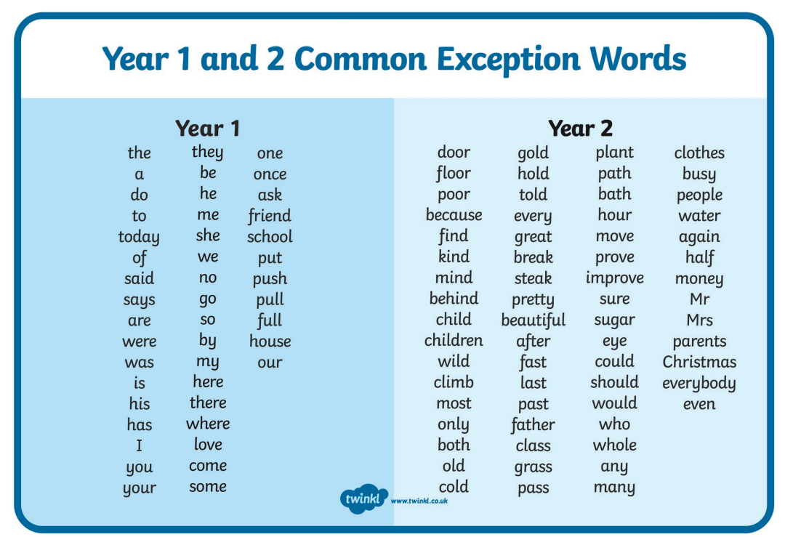

Slide 10
Maths
White Rose Scheme of work.
TT Rockstars – Multiplication and Division
2s, 5s, 10s and 3s are a focus but children can progress further as their speed and accuracy increases
 | AUTUMN | SPRING | SUMMER
YEAR 2 | WEEKS 1 – 4 PLACE VALUE (WITHIN 100) WEEKS 5 – 9 ADDITION AND SUBTRACTION WEEKS 10 AND 11 MONEY WEEK 12 CONSOLIDATION (BASED ON ASSESSMENTS) | WEEKS 1 – 4 MULTIPLICATION AND DIVISION WEEKS 5 – 8 FRACTIONS WEEKS 9 – 10 TIME WEEKS 11 – 12 SHAPE | WEEKS 1 – 3 MASS, CAPACITY AND TEMPERATURE WEEKS 4 – 5 LENGTH AND HEIGHT WEEKS 6 – 7 POSITION AND DIRECTION WEEKS 8 – 9 STATISTICS WEEKS 10 – 12 CONSOLIDATION (BASED ON ASSESSMENTS)

Slide 11
Homework
Minimum of 3 reads per week.
1 Page of English (comprehension)
1 Page of Maths (mental arithmetic)
Spelling Shed
TT Rockstars
Sometimes, additional subject specific homework:
Make a list of things from around your house to use in your ‘Marvellous Medicine’

Slide 12
Autumn Term A Topics
Geography – Oceans and Continents.
Art – Portraits
Science – Animals including Humans (Growth)
R.E – Christianity (God)
P.S.H.E – Being Me in My World
Outdoor PE - Basketball
Indoor PE - Dance
Autumn Term B Topics
History – The Life of Christopher Columbus
Design Technology – Design and Make a Healthy Wrap.
R.E – Christianity (Jesus)
P.S.H.E – Celebrating Differences
Outdoor PE – Tag Rugby
Indoor PE - Gymnastics

Slide 13
Spring Term A Topics
Geography – Our Local Area
Art – A study of the Artist and Art of L.S. Lowry
Science – Animals including Humans
R.E - Hinduism
P.S.H.E – Dreams and Goals
Outdoor PE - Hockey
Indoor PE – Target Games
Spring Term B Topics
History – Local History and Alfred Wilkinson
Design Technology – Make a Mechanical Monster
R.E – Islam
P.S.H.E – Healthy Me
Outdoor PE – Tri-golf
Indoor PE - Gymnastics

Slide 14
Summer Term A Topics
History – Seaside Holidays in the past
Art – Seascapes
Science – Animals including Humans (Growth)
R.E – Christianity (Church)
P.S.H.E – Relationships
Outdoor PE - Athletics
Indoor PE - Dance
Summer Term B Topics
Geography – Compare and Contrast 2 different localities.
Design Technology – Make a Hand Puppet
R.E – Judaism
P.S.H.E – Changing Me
Outdoor PE – Cricket
Indoor PE – Sports Day Practice

Slide 15
Power point is available to view on School Website – class information.

