Slide 1
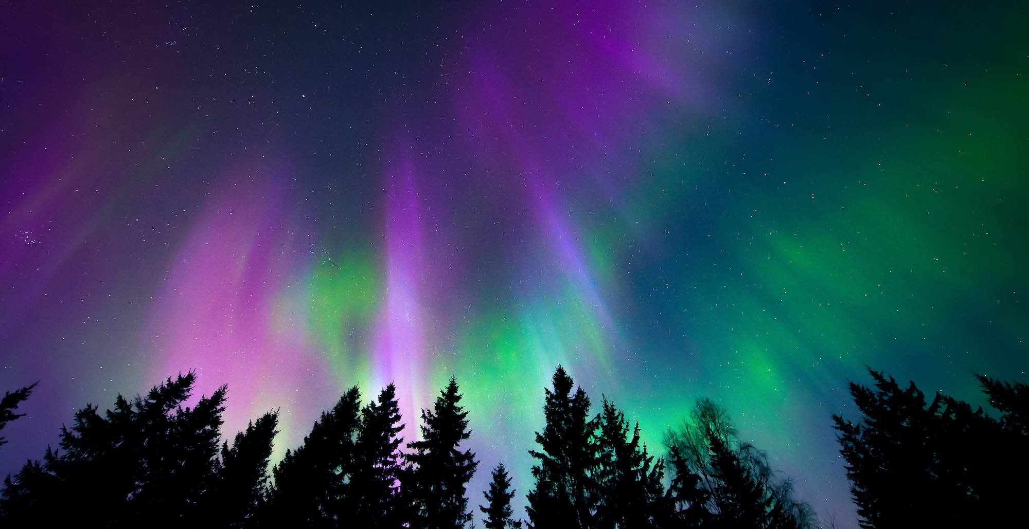
Swaying joyfully in delight like a fire burning bright
Northern Lights Northern Lights
Glistening LED painted stars of every colour
Northern Lights Northern Lights
Pulsing rapidly like a heartbeat in the sky
Northern Lights Northern Lights
Relaxed and calm, astonished by the sight
Oh Northern Lights Northern Lights
Just look how bright you are!

