Slide 1
Year Ahead meeting 2026-2027
Year 5/6B

Slide 2
General information
PE on Monday and Friday (Swimming for Y5 October – December)
Homework to be sent out on Monday.
Homework to be checked on Monday.
Homework will include each week: 1 x Maths book task, TT Rockstars task, Spellings, 3 x signed reading sessions completed at home, 1 x 30 minute Reading Plus session. We also ask for your child to complete 3 x independent research activities throughout the half term.
Contact the teacher on email: year5@horwichparish.net
Any immediate messages please contact the school office.

Slide 3
School Planners
Planners to be signed x 3 weekly and books read recorded in the planner.
Spellings to be completed 3 times a week in the planner at home.
Common words spelling test completed at the end of each half term.
Common words to be learnt at home. Words are listed in the planner. At the end of the half term, the words spelt incorrectly will be highlighted to help you see which spellings are not embedded.

Slide 4
Expectations in writing
Writing objectives are introduced and reinforced across different types of writing tasks and subjects.
Grammar terms constantly being reinforced.
Daily handwriting in books.
Regular practice of spellings in the week.
Each day we address misconceptions at the start of the lesson.
Exemplification of writing for the end of year expectation for the ‘expected standard’ can be found on the school website- teaching and learning tab- writing tab’.
Information will be sent to you on school spider to support your understanding.

Slide 5
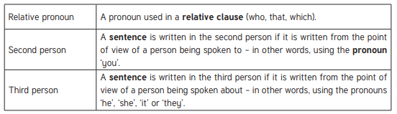
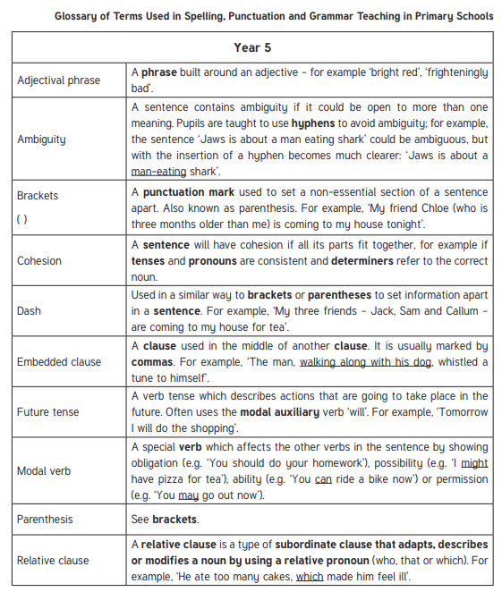

Slide 6
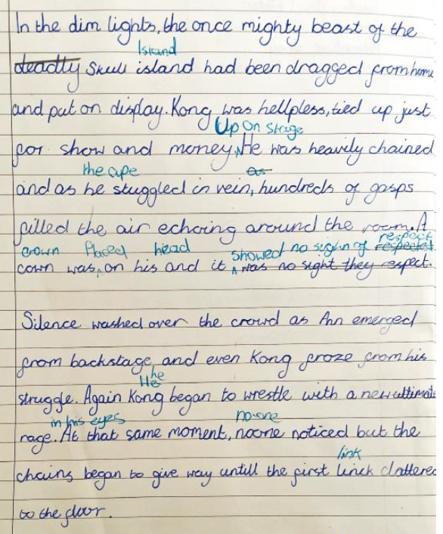
Exemplification of a piece of writing

Slide 7
Expectations in reading
Develop fluency.
Read a range of different types of books.
Take note of punctuation when reading aloud.
Understand the meaning of new vocabulary in books.
Retrieve information of texts to answer questions.
Draw inferences from reading a text.
Make predictions based on what has been read.

Slide 8
Expectations in maths
Maths objectives are covered each term and applied across different subjects where relevant.
Daily ‘Basic skills’ session to reinforce key skills and the fast recall of each skill.
Children work towards: bronze, silver, gold award in times tables and maths facts.
A huge focus on fluency in number.
Further information can be found on the school website: teaching and learning tab- mathematics tab .

Slide 9
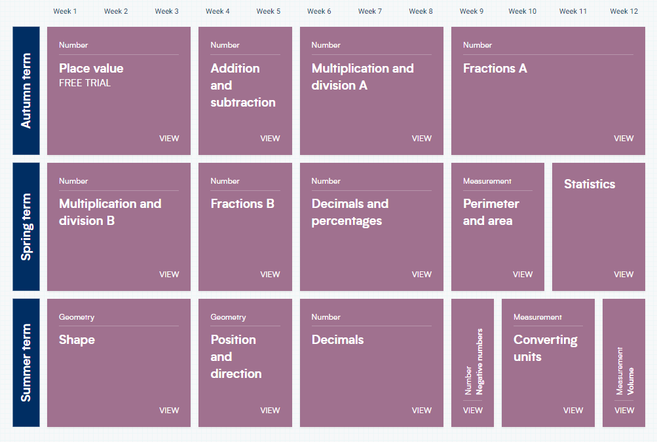

Slide 10
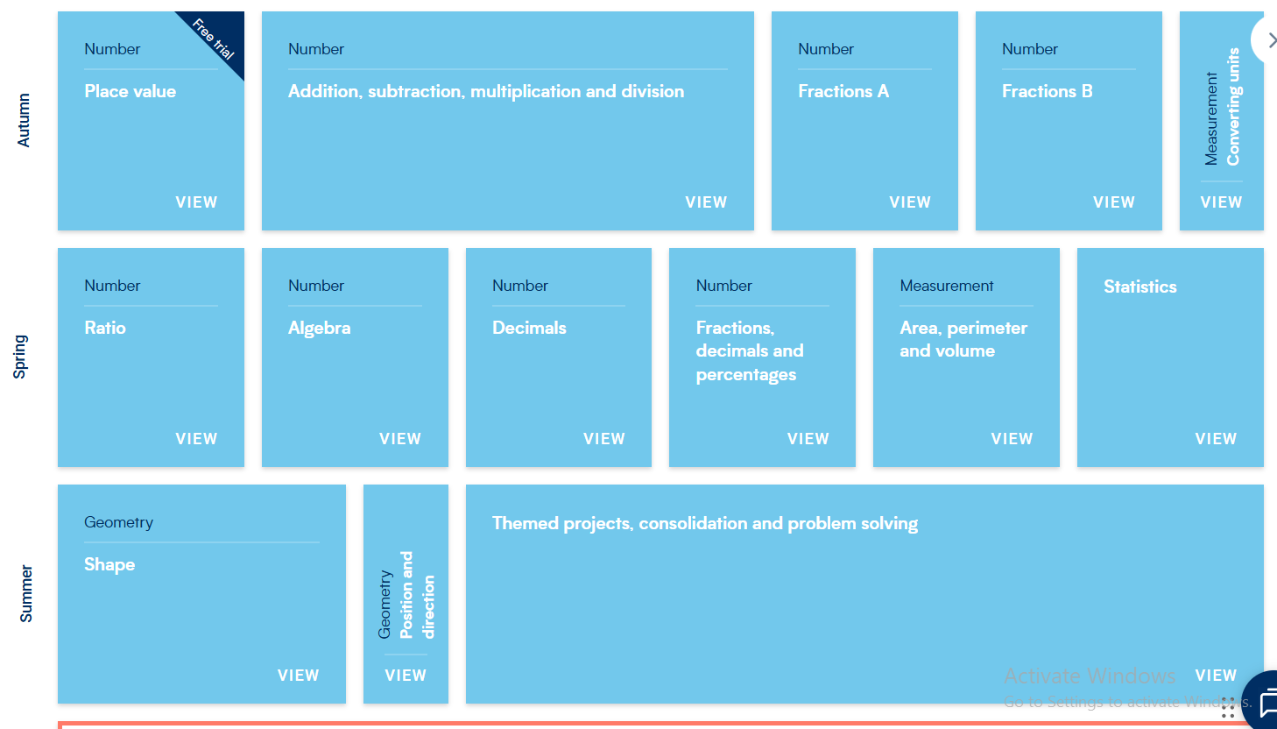

Slide 11
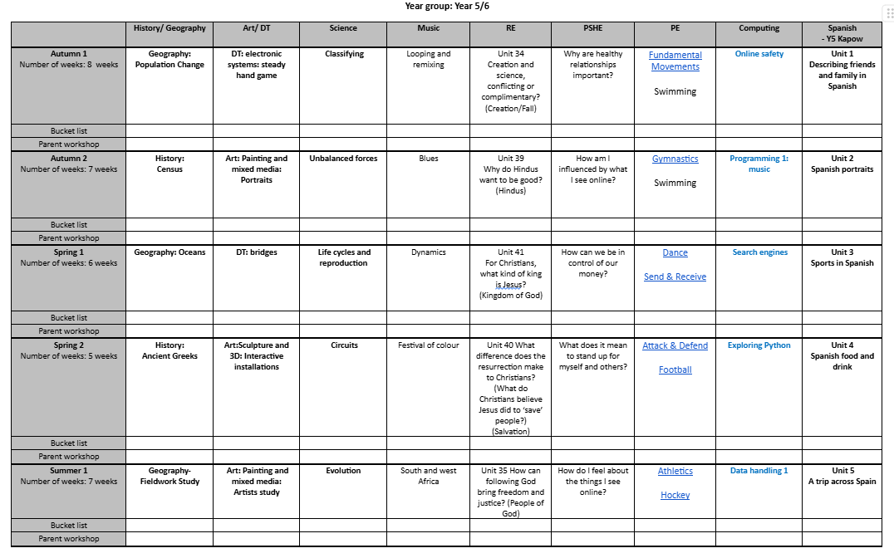

Slide 12
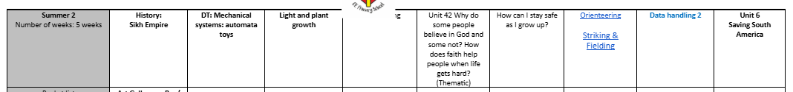

Slide 13
Home and school working together
Learn the common words with your child each half term.
Learn times tables facts and related division facts.
Read 3 times a week with your child.
Complete Reading Plus x 1 weekly.
Support the ‘Independent Research Log’ activities to support half term focus.
Develop handwriting/ pencil control skills.
Keep talking to us.

Slide 14
Thankyou

