Slide 1
Welcome to 2B!
Miss O’Boyle and Mrs Lindsay

Slide 2
GENERAL INFORMATION
PE for 2B is on Tuesday and Wednesday.
Homework/ Reading books to be sent out on Monday.
Homework will include each week: Reading daily with a signature 3x a week, spellings 3x a week, Numbots, complete comprehension.
Please ensure the reading book is brought into school every day.
Contact the teacher on email: year2 @horwichparish.net
Any immediate messages please contact the school office.

Slide 3
Planners
Reading to be completed at home and planners signed x 3 weekly.
Children will complete spelling practice in their planners- if your child has completed these on a separate piece of paper, I will staple/stick these into their planner.

Slide 4
Expectations in Reading
Develop fluency.
Read a range of different types of books.
Take note of punctuation when reading aloud.
Understand the meaning of new vocabulary in books.
Retrieve information from texts to answer questions.
Draw inferences from reading a text.
Make predictions based on what has been read.
Expectations

Slide 5
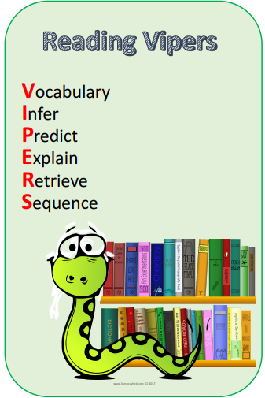

Slide 6
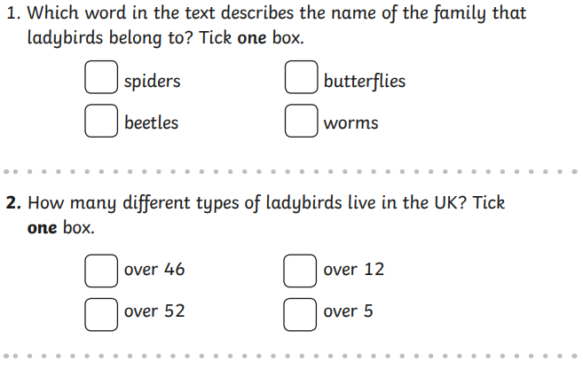
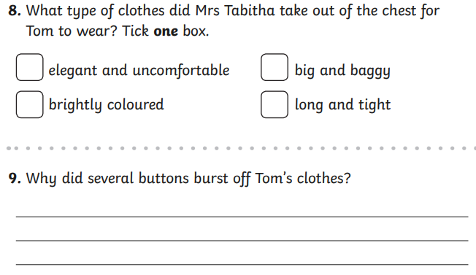
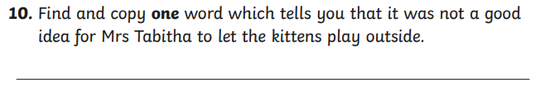
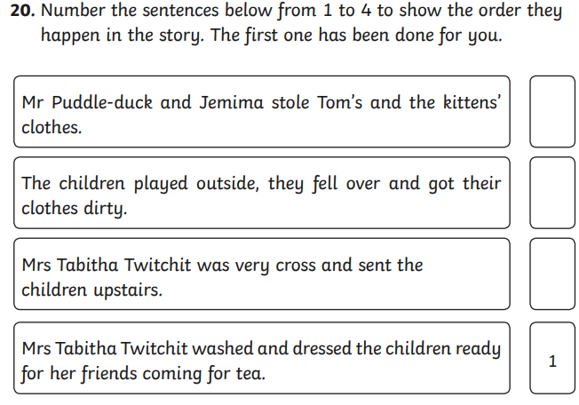
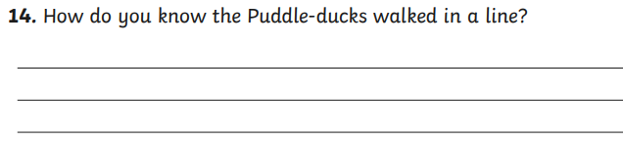
Example questions:

Slide 7
Writing
Writing objectives are introduced and reinforced across different types of writing tasks and subjects.
Grammar terms constantly being reinforced.
Daily handwriting and retrieval in books.
Regular spelling activities throughout each week.
Each day, we address misconceptions at the start of the lesson.
Exemplification of writing for the end of year expectation for the ‘expected standard’ can be found on the school website.

Slide 8
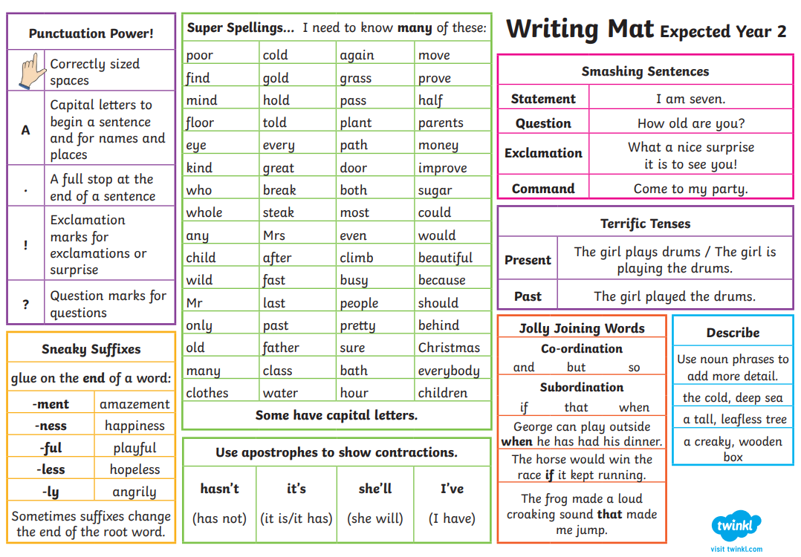

Slide 9
Maths:
Maths objectives are covered daily and applied across different subjects where relevant.
Daily ‘Mastering number’ session to reinforce key skills and the fast recall of each skill.
Children work towards: bronze, silver, gold award in number bonds and times tables. Please use Numbots/ TTRockstars at home to support these.
A huge focus on fluency in number.
Times Tables: 2, 3, 5, 10s
We follow White Rose Maths curriculum which also provides home learning videos if your child would like to practice at home.

Slide 10
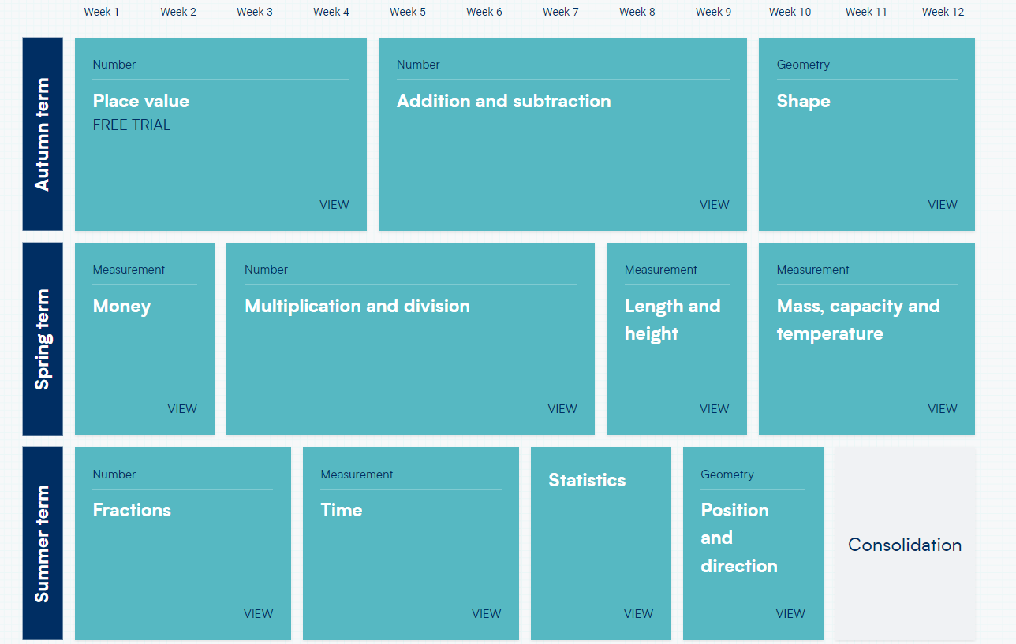
Year 2:

Slide 11
Home and School Working together
Learn number bonds and begin times tables facts.
Read 3 times a week with your child.
Spelling practice 3 times a week.
Develop handwriting/ pencil control skills.
Keep talking to us.

Slide 12
Thank you!

