Slide 1

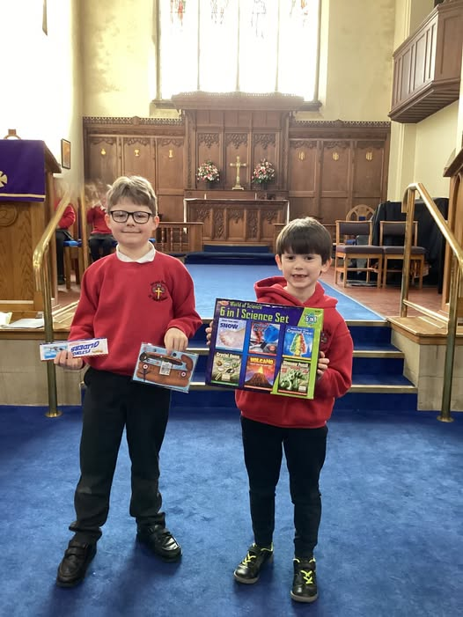
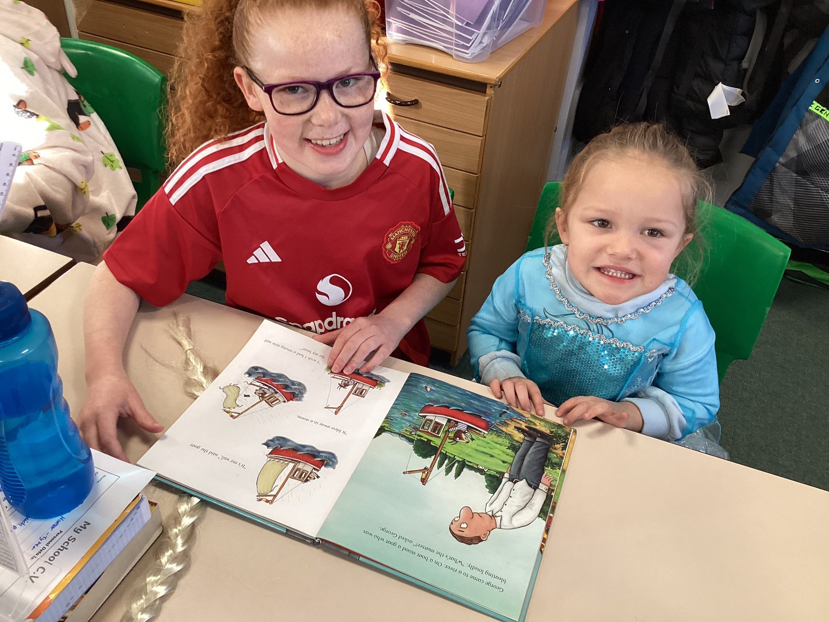
Welcome to
Horwich Parish CE
Primary School
2025-26
Tuesday 3rd June, 6pm
Notes:
1

Slide 2

Our Mission Statement
God with us,
Lighting the way to Love and Respect
Notes:
2

Slide 3

Our Vision
Our vision is to be a school where everyone can achieve and
“let their light shine” both individually and collectively as a community.
Learning to love each other as Jesus has loved us, respecting each other and growing into the people God has called us to be.

Slide 4
Introducing our staff
Debbie Mills, Headteacher
Steph Gregory, Deputy Headteacher and SENCo
Members of the governing body
Members of the EYFS Team

Slide 5
Meet the Governors
Susan Baines- Chair of Governors

Slide 6

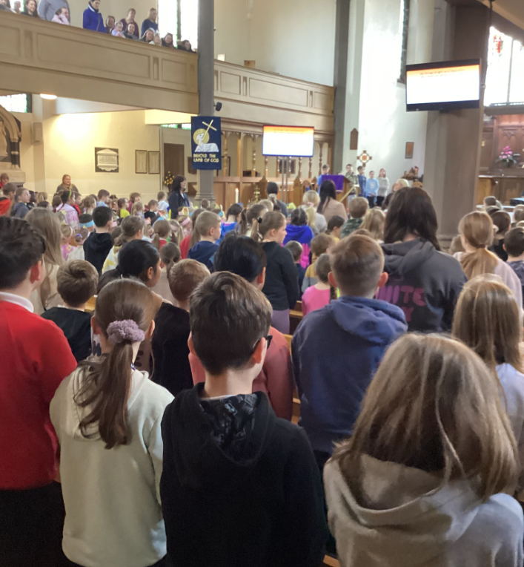
Meet our Clergy
Reverend Nicola

Slide 7
Meet the Office staff
Miss Nolan and Mrs Cooke
Mrs Green - Business Manager

Slide 8
A big step
A new environment
New friends to make
A large school
All ages of pupils
May be a longer day
Notes:
8

Slide 9
Getting to know you…
We have arranged a series of activities to help us to get to know your children and to support them to become familiar with us and the school environment.

Slide 10

Visits to us in school
Three ‘Stay and Play’ session are available for each child (accompanied by a parent) to explore the reception class environment. Thursday 12th June
Tuesday 17th June
Thursday 26th June
All from 4.00 – 4.45pm
Teddy Bears picnic, Slaters Field (good weather), in school (bad weather)
14th July at 2.30pm

Slide 11
Pre-school settings
We will arrange to visit/contact pre-school settings during the first week of July, in order to become familiar with your child’s development and dispositions.

Slide 12


Home visits
Week beginning 7th July
(please sign up for your preferred day at the end of the meeting)
These visits will give the children another opportunity to meet their teacher and teaching assistant and will allow parents to share information about their child.
Notes:
12

Slide 13
Starting school
What can parents do to help?
(Taken from Bolton LA document)
The best start a child can have is when you support them to:
• Be independent - such as being able to put on their coat, or go to the toilet
• Manage emotions - they are ok to leave you and are used to playing with groups of other children
• Communicate, listen and learn - being able to talk to their teachers and friends, join a group for story time and explore new things
• Be healthy and well - brushing teeth every day,
getting out and about

Slide 14
Workshops for parents
Reading, Phonics and Maths
In order to inform parents of our methods of teaching the basic skills, a short workshop will take place around 45 minutes before the end of the school day.
This will take place on Tuesday 9th September at 2.30pm.

Slide 15
Behaviour Expectations

Slide 16
Classes
The children will be organised into two registration classes once we have spoken to parents and staff at their pre-school settings. You will be informed of their class by letter in July.
Children will register in their classes but the Early years department works as one unit with lots of opportunities to work together.
Notes:
16

Slide 17
Starting Dates and Times
Event | Date | Time
Induction week |  | Adam Class | Eve Class
Children in School (am/pm) | Tuesday 2nd September | Morning 9:00am-11:30am | Afternoon 1:15pm 3:00pm
Children in School(am/pm) | Wednesday 3rd September | Afternoon 1:15 pm-3:00 pm | Morning 9:00am 11:30am
Children in School (half day) | Thursday 4th September | All children in and lunch provided 9:00am – 1:30pm
Children in School (Full day) | Friday 5th September | All children in 9:00am-3:00pm
 | Monday 8th September onwards | All children in for usual school hours - 8.40am- 3.15pm
Notes:
17

Slide 18
Attendance
We strive for excellent attendance for all of our pupils.
Gates open at 8.40 and close at 8.50.If you arrive at school later than 8.50, you will need to report to the office and sign in on the electronic inventory.
Appointments for routine medical appointments should be made outside of school hours. If appointments need to be taken within school hours, please request a form from the school office.
Unfortunately any holidays taken during
term time will be classed as unauthorised.

Slide 19
Housekeeping

Slide 20
Sickness
Please ring in every day that your child is off school so that the office staff can update the register.

Slide 21
School Meals
All children in Reception and Key Stage One classes are entitled to a free school meal.
Please give the school office 2 weeks notice if you would like your child to change to packed lunches.
Notes:
21

Slide 22
Medication
We can only administer medication that is prescribed by a doctor 4 times a day. Medicines required 3 times a day should be given outside of school e.g. before school, after school, after bedtime
In these circumstances, please report to the office for a form.

Slide 23
School Uniform
Our school uniform policy can be found in the pack.

Slide 24
Pupil Premium Funding
If you are entitled to any of the benefits below, we may be able to claim additional funding to further support your child.
Income support
Income-based job seekers’ allowance
Income-related employment and support allowance
Support under part IV of the Immigration and Asylum Act 1999
The guaranteed element of the state pension credit
Child tax credit, provided you are not also entitled to working tax credit and have an annual gross income of 16,190 or less
Universal credit
Notes:
24

Slide 25
Information from you…
Before children can officially be admitted to school, there are some essential pieces of information we need.
Mrs Green will explain all of the paperwork that needs to be completed and returned.

Slide 26

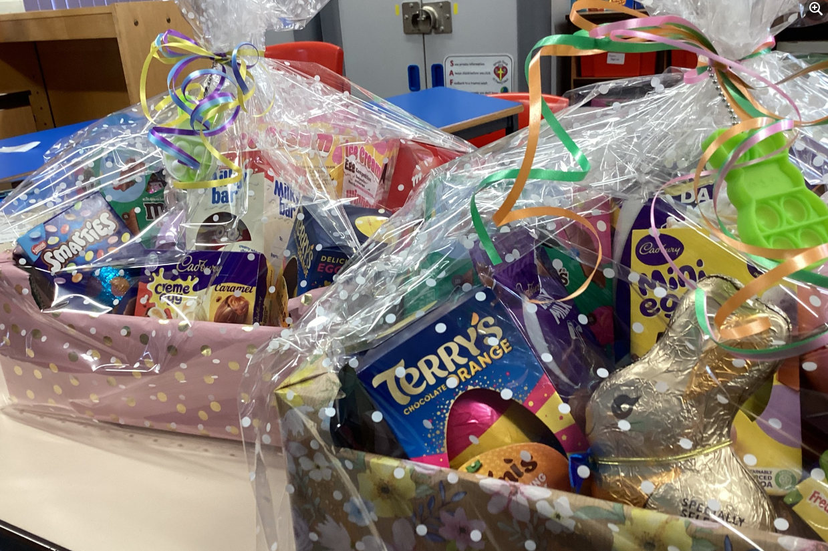
Working together
Horwich Parish PTA supports school funds by providing a range of enjoyable opportunities for children and their families.
You are warmly welcomed to
take part.
Notes:
26

Slide 27
After School Care
HPCE Wrap Around Care:
The Lighthouse Club

Slide 28
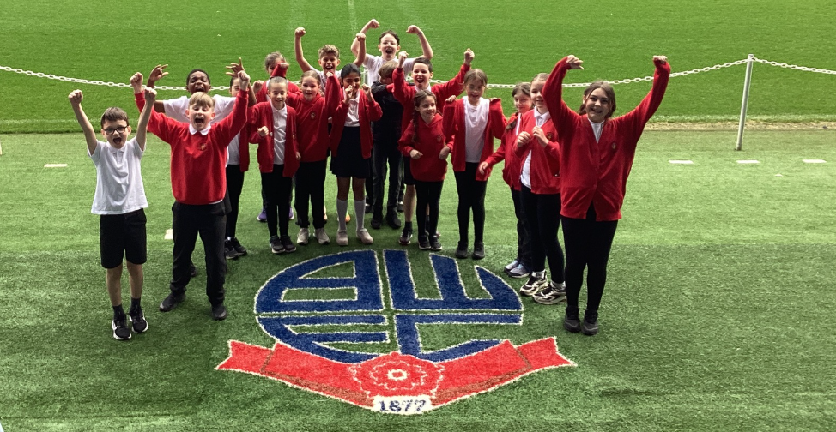
Many Thanks for attending this meeting
Before you go:
Please see a member of staff to sign up for a home visit, share documentation or to ask any questions.
We look forward to working with you and your child.

