Slide 1

YEAR AHEAD MEETING 2025-2026
Class 3B

Slide 2
General Information
PE on Mondays and Wednesdays
Homework to be sent out on Monday and checked the following
Monday
Homework will include each week: x3 reads, x3 spelling practice,
TT rockstars, Reading Plus
Contact the teacher on email: year3@horwichparish.net
Any immediate messages please contact the school office.

Slide 3
What will we be learning?
Topic overview
Why do people live near volcanoes?
Would you prefer to live in the Stone age, Bronze age or Iron age?
Who lives in Antarctica?
Why did the Romans invade and settle in Britain?
Are all settlements the same?
What was important to the Ancient Egyptians?

Slide 4
Spellings Planners
Planners to be signed x 3 weekly and books/pages read
recorded in the planner.
Spellings to be completed 3 times a week in the planner at home
but not tested in school.
Times tables test every Monday and recorded in the planner.
Common words spelling test completed at the end of each half term.
Common words to be learnt at home. Words are listed in the planner. At the end of the half term, the words spelt incorrectly will be highlighted to help you see which spellings are not embedded.

Slide 5
Expectations in Writing
Writing objectives are introduced and reinforced across different types of writing tasks and subjects.
Grammar terms are constantly being reinforced.
Daily handwriting in books.
Regular practice of spellings in the week.
Each day we address misconceptions at the start of the lesson.
Information will be sent to you on school spider to support your understanding.

Slide 6
Grammatical Terms
word family
conjunction
adverb
preposition
direct speech
inverted commas
prefix
consonant
consonant letter
vowel letter
clause
subordinate clause
subordinating conjunction
co-ordinating conjunction

Slide 7
Expectations in Reading
Develop fluency.
Read a range of different types of books.
Take note of punctuation when reading aloud.
Understand the meaning of new vocabulary in books.
Retrieve information from texts to answer questions.
Draw inferences from reading a text.
Make predictions based on what has been read.

Slide 8
EXPECTATIONS IN MATHS
Maths objectives are covered each term and applied across different subjects where relevant.
Daily Mastering Number and ‘Basic skills’ sessions to reinforce key skills and the fast recall of each skill.
Children work towards: bronze, silver, gold award in number bonds and times tables.
A huge focus on fluency in number this year in all classes.
Further information can be found on the school website: teaching and learning tab- mathematics tab .

Slide 9
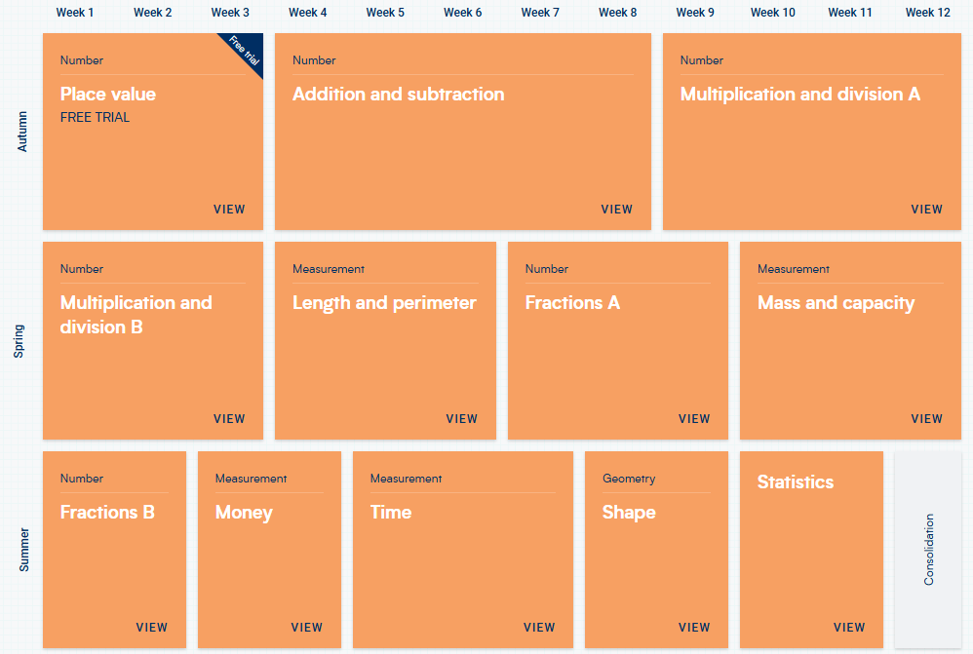
Maths Year 3 Overview
Add WRM overview for each year group

Slide 10
Home and school working together
Learn the common words with your child each half term.
Learn number bonds and times tables facts.
Read 3 times a week with your child.
Support the ‘Independent Research Log’ activities to support half term focus (optional)
Develop handwriting/ pencil control skills.
Keep talking to us.

Slide 11
Parental support
Emails
Weekly drop- in with Mrs Mc Knight
Half termly drop- in with SENCO
Open classrooms
Invites to church events
Events calendar shared with parents
School spider

Slide 12
THANK YOU

Slide 13
Additional year groups
Year 6- talk about councils and applying for them
Reception- baseline testing
Year 1- phonics screen
Year 4- multiplication
Year 6- SATS

