Slide 1

Parent Partnership
at Tarporley CE Primary School

Slide 2
Working Together
Thank you for coming
We are here today to develop a:
  Better understanding of our shared responsibility for our children
  Better understanding of the positive impact of high levels of attendance
  Better understanding of the impact of homework on homelife
  Better understanding of the impact of growing up with modern day technology
  Better understand of the impact of behaviour in school and at home
  Better understanding of the ways we can communicate

Slide 3
Our Shared Responsibility
Thank you for coming.
The Early Years - The importance of the first five years
Supporting the transition from pre-school to primary
Focus on helping our children to grow and become more independent
Enable our children to create meaningful connections to their wider world and to foster a love of learning.
Prioritise the Prime areas to ensure strong foundations in development and learning.

Slide 4
Characteristics of Effective Learning
They focus on how children learn rather than the learning outcome.
Playing and Exploring
Finding out and exploring
Using what they know in play
Willing to have a go
Active learning
Being involved and concentrating
Keep on trying
Enjoying and achieving what they set out to do.
Creating and Thinking Critically
Having their own ideas
Using what they know to learn new things
Choosing ways to do things.

Slide 5
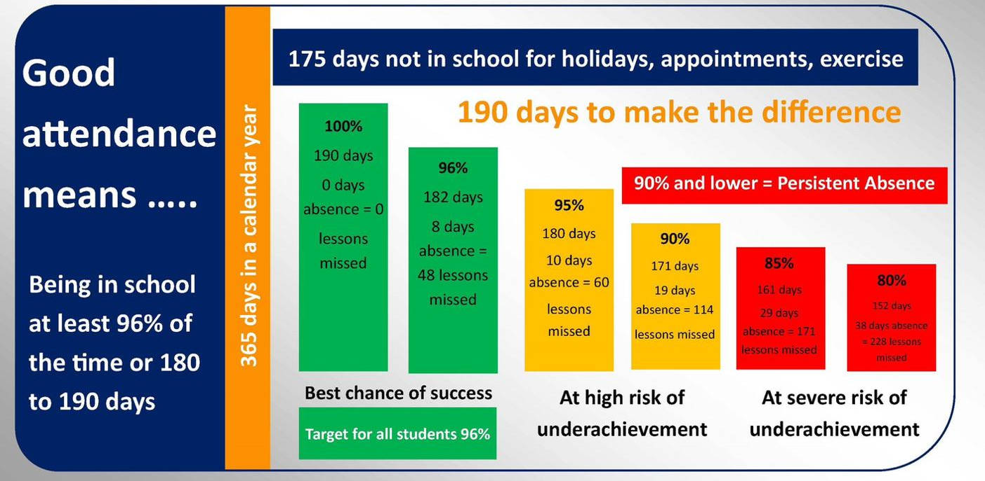
Attendance
Notes:
Discuss how missing one lesson does impact on learning and that our curriculum is planned as a series of lessons that build on prior knowledge and skills.

Slide 6
Homework
Expected daily activities
Reading with an adult using the Little Wandle reading book x4 week. When a child reads, there needs to be a comment recorded in their reading record.
Being read to at home by an adult. We encourage parents to read to their child every day to model good quality reading.
Optional Homework
A ‘Burger Menu’ of optional homework activities linked to the learning focus that term. This is sent out via email and can be found on the class webpage
Classroom Secrets
Username and password can be found on the inside cover of your child’s reading record. These may be linked to phonics or mathematics and will be sent throughout the term.

Slide 7
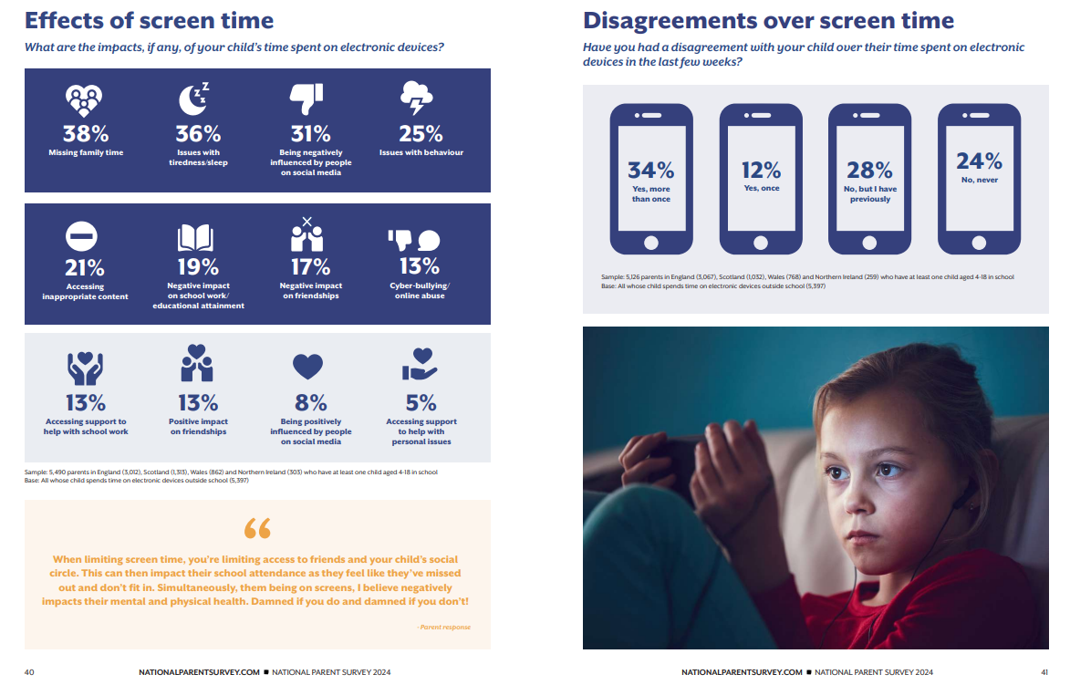
Screen Time
Notes:
Discuss at appropriate level – signpost to the NSPCC e-safety – workshop coming with KF & KG in the New Year

Slide 8
Behaviour & Respect
National Picture
Some trends in children's behavior in primary school include:
Swearing: 97.47% of schools reported being sworn at
Verbal threats: 80.61% of schools reported being verbally threatened
Shoving: 40.34% of schools reported being shoved or barged
Damage to property: 38.50% of schools reported damage to other property
Theft: 35.46% of schools reported theft
We have seen a real change here at Tarporley CE and experience an increase in line with the national picture.
Five golden rules – focusing on ‘respect everyone and everything’.
‘Big feelings’ – Connect, Acknowledge, Limit, Move. Reflect and reset.
Notes:
Phases to personalise their approach to behaviour management and how vital parent support is.

Slide 9
What you can do in EYFS
Talk, talk and more talk! – Explaining, discussing, questioning, stories, rhymes.
Encouraging the correct pencil grip
Sharing and enjoying books at home. Pop down to the local library to access free picture books.
Mystery Reader
Developing greater independence - tidying up, managing their own things, giving them responsibility
Establishing a good routine
The Outdoor classroom – developing gross motor skills
Join the PTA!

Slide 10
Improving Communication Between Home and School
We’ve noticed that communication between school and parents can sometimes be a challenge. While some families prefer emails and texts, others do not, which means that important messages can occasionally be missed.
We want to hear from you! How can we communicate more effectively to ensure everyone stays informed and connected?
Is the blog helpful?

Slide 11


Slide 12
Dates for the Spring Term!
Tuesday 11th/Wednesday 12th February – Parents Evening
Thursday 6th March – World Book Day
Monday 31st March – Class Trip to Crown Bank Quarry Nature Reserve
Wednesday 2nd April – Reception Class Assembly (9am)

