Slide 1
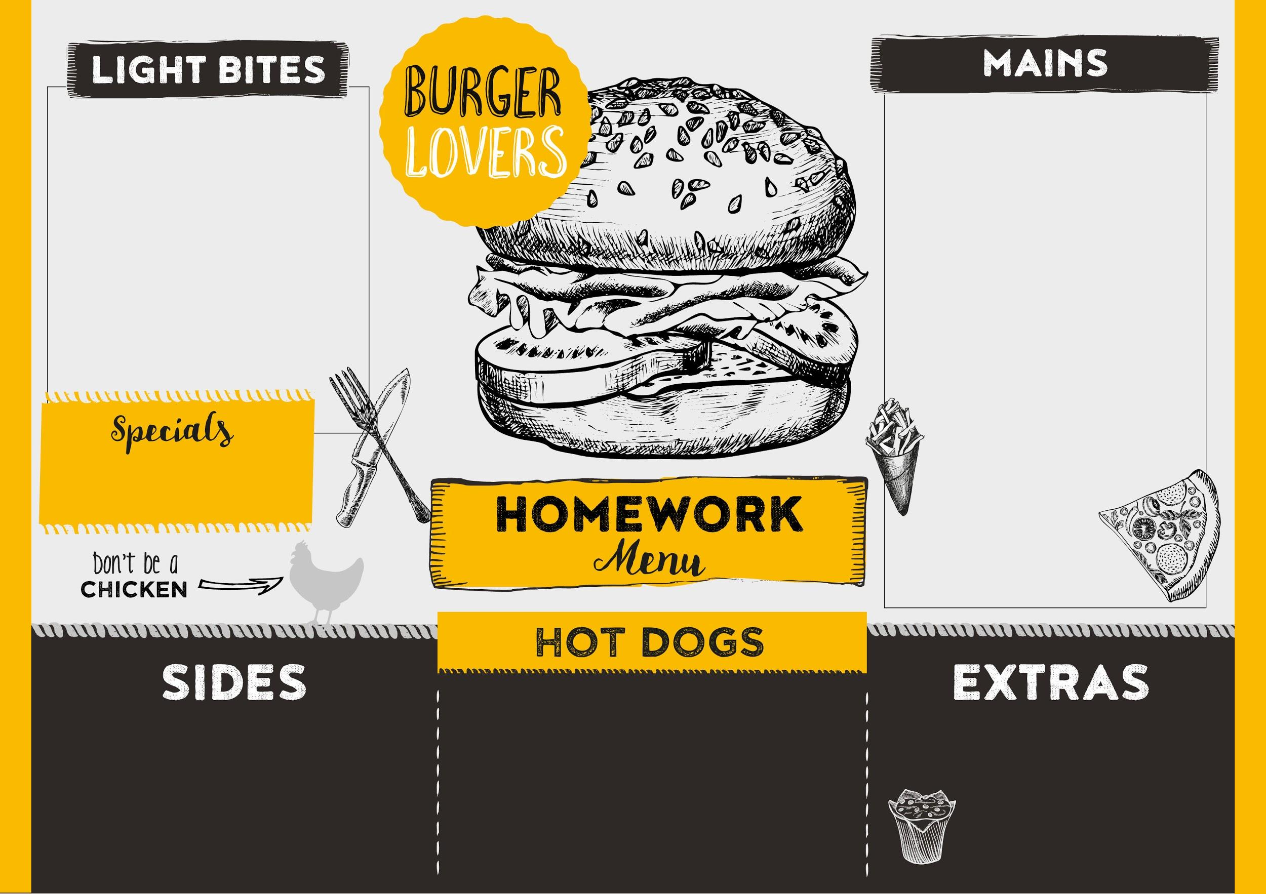
Mains: Things you can do each week to support your child’s learning at home!
Desserts (optional): A list of shared reading texts which are recommended for children in Reception….enjoy!
Light Bites (optional): 8 house points Sides and Extras (optional): 10 house points Special(optional): 15 house points
Option 1: Learn to count forwards and backwards (to 20 but higher if you can!) Challenge yourself to start at numbers other than 1!
Option 2: Make a Lego tower or model using two colours and ten bricks. How many of each colour did you use?
Main 1:
Read your home reading books daily with an adult.
Main 2:
Practice recognising and writing the sounds in your reading record.
Main 3:
Read your class Friday Blog and choose one of the extra tasks.
Paint a picture of your favourite spring flower and bring it to Show and Tell
The Twits (Roald Dahl)
Yucky Worms (Vivian French)
The Storm Whale (Benji Davies)
What the Ladybird Heard (Julia Donaldson)
Great Women Who Changed the World (Kate Pankhurst)
Stories For Boys Who Dare to be Different (Ben Brooks)
Shrove Tuesday- Make pancakes with your family and write the recipe.
Easter – Decorate hard boiled eggs- can you make a repeating pattern?
Make fat balls for the birds and feed them this winter- what birds can you see in your garden?

