Slide 1
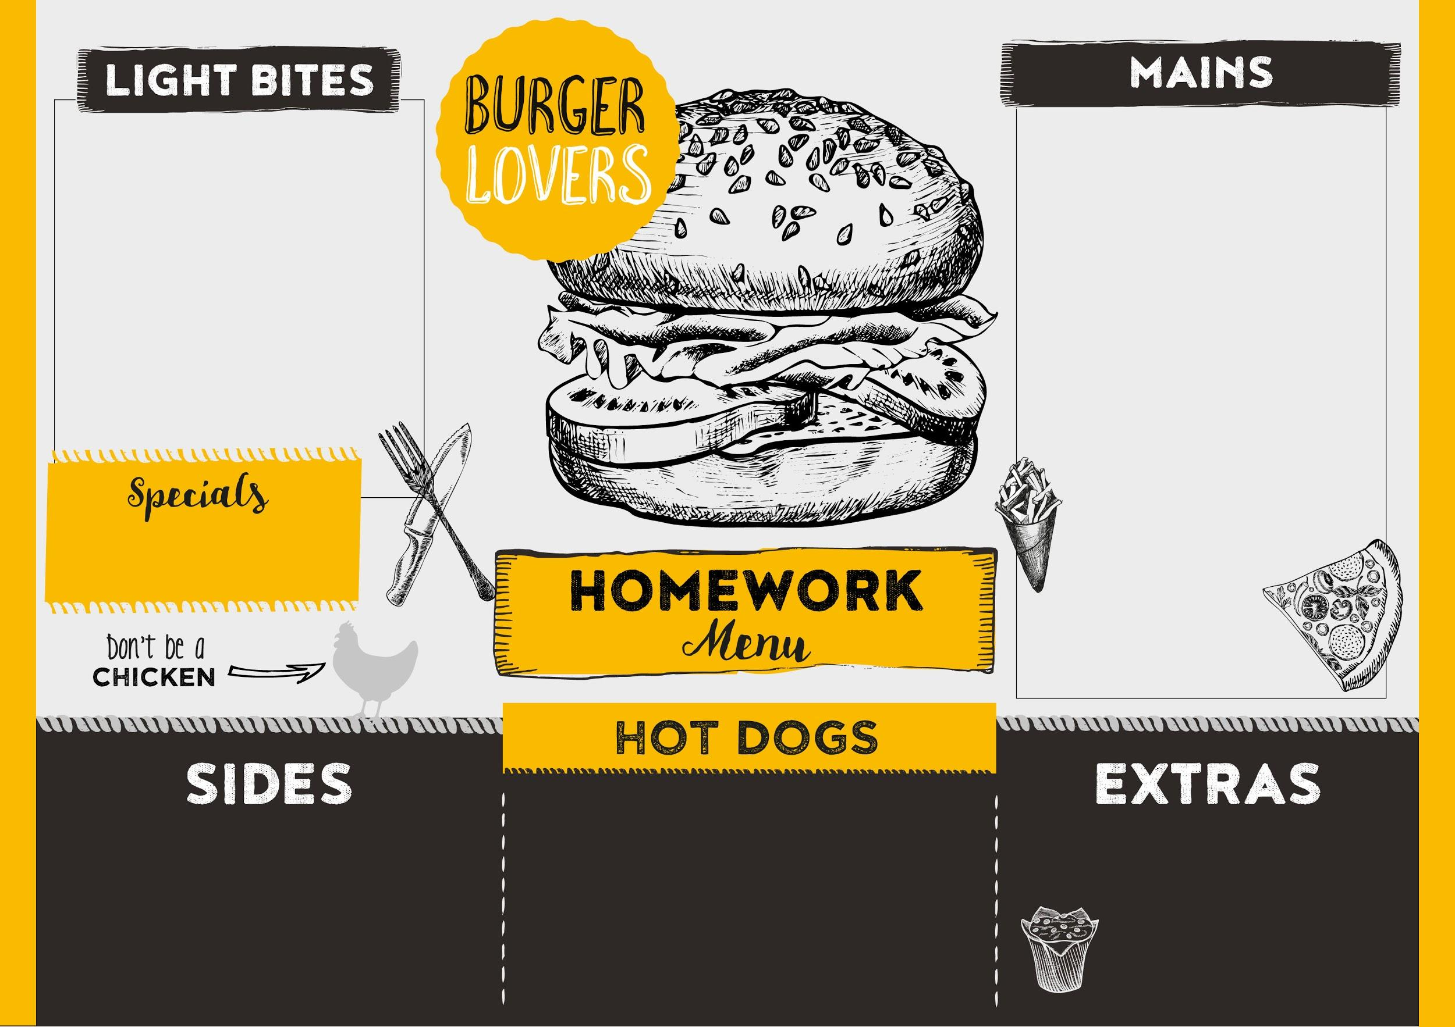
Mains: Things you can do each week to support your child’s learning at home!
Desserts (optional): A list of shared reading texts which are recommended for children in Reception….enjoy!
Light Bites (optional): 8 house points Sides and Extras (optional): 10 house points Special(optional): 15 house points
Option 1: Choose your favourite fairy tale and rewrite it in your own words. You could make your own book!
Option 2: Learn your number bonds to 10 by heart (e.g. 5+5, 6+4, 7+3, 8+2, 9+1, 10+0)
Main 1:
Read your home reading books daily with an adult.
Main 2:
Practice recognising and writing the sounds in your reading record.
Main 3:
Read your class Friday Blog and choose one of the extra tasks.
Make a papier-mâché volcano that works! You can put your video or photos on Tapestry to show.
The Mega Magic Teacher Swap (Rochelle Humes)
How Big is a Million? (Anna Milbourne)
Billy and the Beast (Nadia Shireen)
Dogger (Shirley Hughes)
The Bear amd the Piano (David Litchfield)
Under the Same Sky (Britta Teekentrup)
Grandad’s Island (Benji Davies)
The Paris 2024 Olympic Games is just around the corner! Find out about one of the countries taking part. Hold your own multicultural week and try different foods from around the world.
Use junk modelling to make a musical instrument. It can be something you hit, shake or pluck! What 3D shapes have you used?

