Slide 1
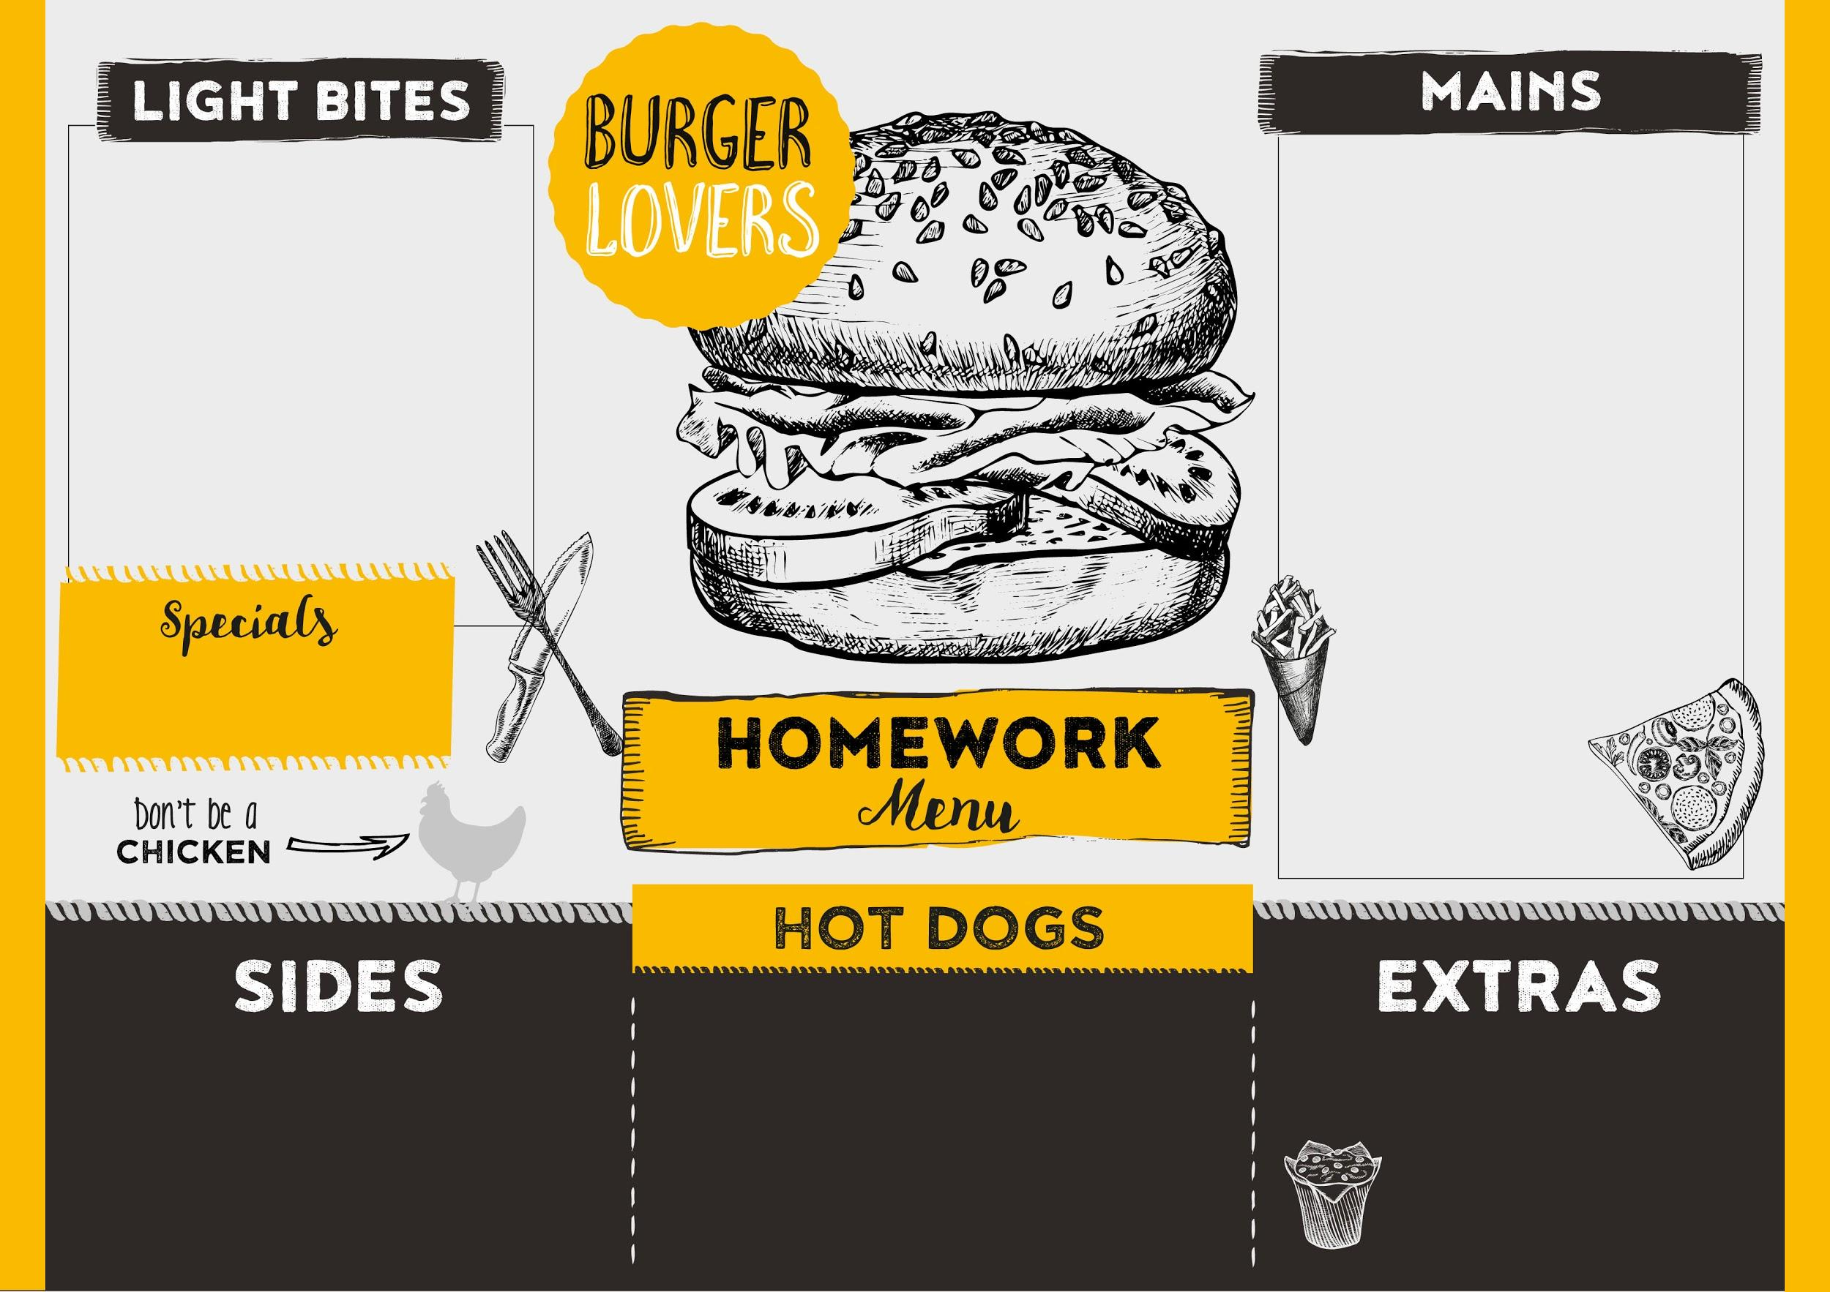
Mains: Things you can do each week to support your child’s learning at home!
Desserts (optional): A list of shared reading texts which are recommended for children in Reception….enjoy!
Light Bites (optional): 8 house points Sides and Extras (optional): 10 house points Special(optional): 15 house points
Option 1: Hide numbers around the room (can be written on bits of paper). Can you find, name and order them?
Option 2: Learn write your name using Kinetic Letters formation. First name then surname!
Main 1:
Read your home reading books daily with an adult.
Main 2:
Practice recognising and writing the sounds in your reading record.
Main 3:
Read your class Friday Blog and choose one of the extra tasks.
Practice a song or nursery rhyme at home and share it with the class in Show and Tell.
Bonfire Night- Make a model rocket using recyclable materials.
Christmas – Draw a picture of a snowman using 2D shapes. Label your picture.
Peace at Last (Jill Murphy)
Elmer (David McKee)
I Want My Potty! (Tony Ross)
Room on the Broom (Julia Donaldson)
Once Upon an Alphabet (Oliver Jeffers)
Winnie the Witch (Valerie Thomas)
The Jolly Christmas Postman (Allan Ahlberg)
Bake at home with your parents. Can you make a gingerbread man, some bread or even pumpkin soup?

