Slide 1
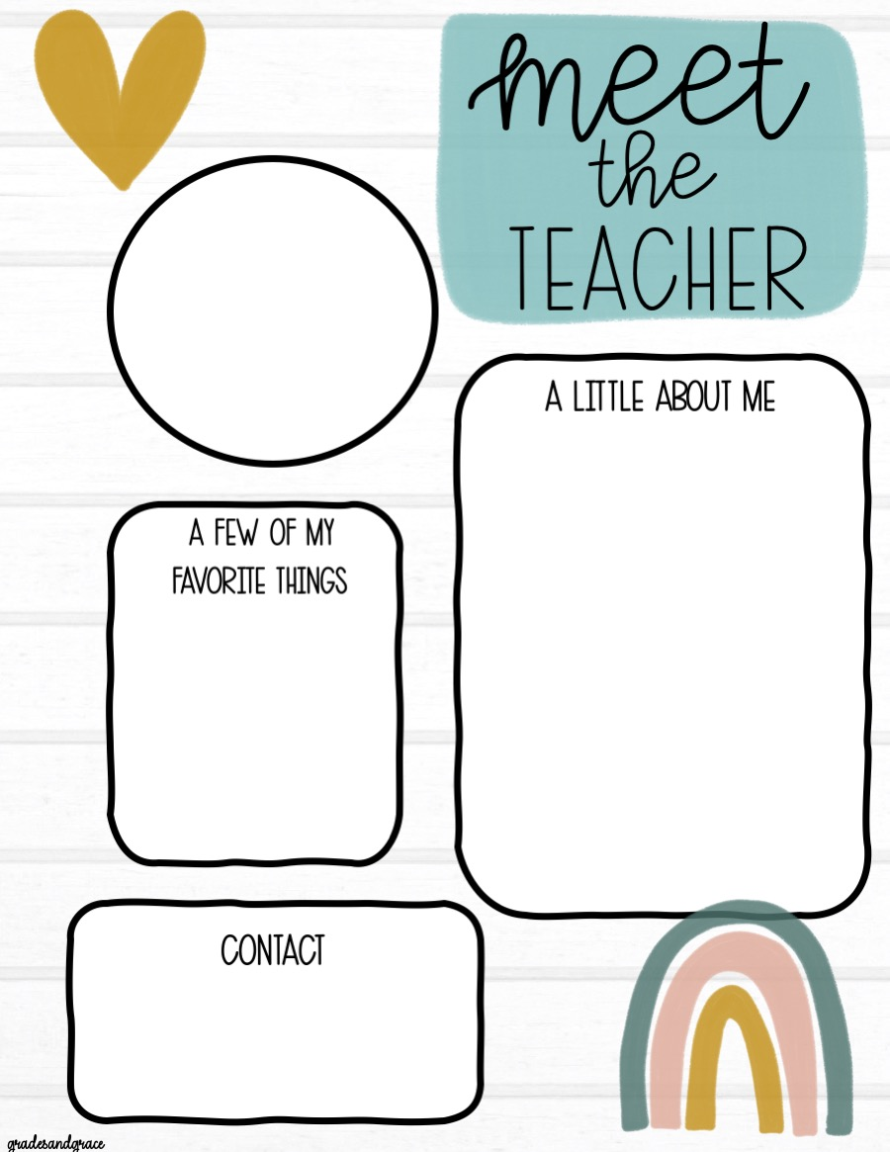
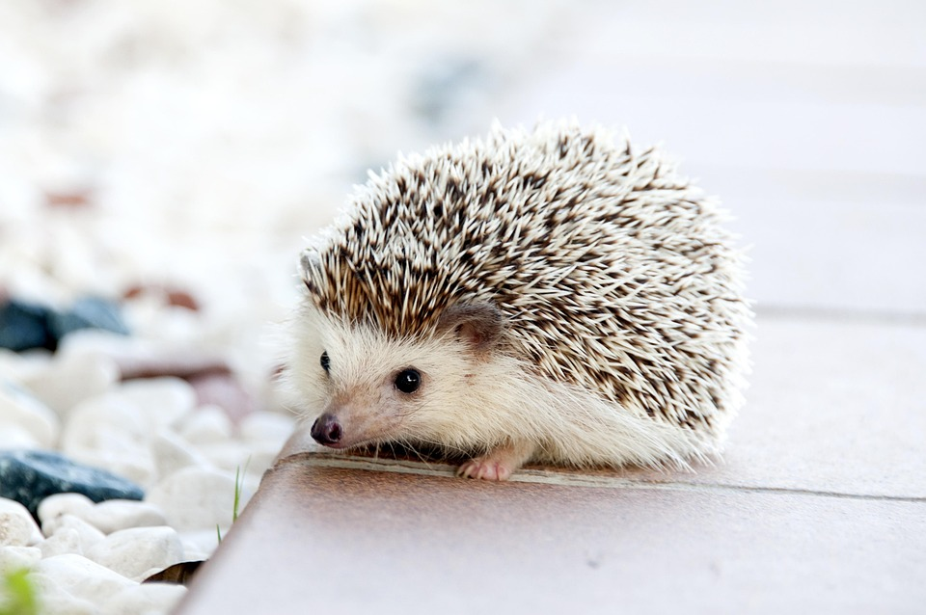
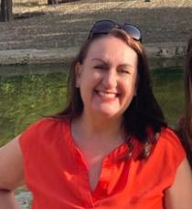

You will be in HEDGEHOG class!
Hello! My name is Mrs Harrison. 4 years ago, I moved back to Cheshire after 20 years’ teaching in Bournemouth. I miss the beach but love being so close to family.
Mrs Harrison
I love teaching reading. So phonics and story time are special. I love our books that we study!
Me on holiday in Seville last year. Can you tell my favorite colour is red!
I like baking. My specialities are squidgy brownies and Victoria sponge cakes.
admin@tarporleyce.cheshire.sch.uk

