Slide 1




Slide 2
Structure of the school day.
The importance of attendance in school
  The Government regard 95% as the minimum satisfactory attendance for a primary school pupil.
  95% attendance is the equivalent of 2 weeks off school.
  A 2 week absence each year in primary school means a total of 14 weeks teaching time missed – this could have real impact on your child’s basic numeracy and literacy skills.
  90% attendance is like having a day off every two weeks or 4 whole weeks off school
  80% attendance is the same as having a day off every week.
  Most children should routinely have attendance rates of 97% or more. This is the equivalent of 6 days absence a year. 100% is achieved by many pupils every year in both primary and secondary schools.
Holidays in term time – These will not be approved by Mrs Forrester and fines may be issued for unauthorised holidays taken.
Playground
School starts
Register open until
Collective worship
Session 1 English
Breaktime
Session 2 Maths
Spelling
Lunch
Session 3
Daily Mile
End of day ​
8.35
8.45
9.00
Daily
9.20 to 10.30
10.30 - 10.45
10.45 - 11.50
11.50 - 12.15​
12.15 - 1.15
1.15 - 3.15
Daily
3.20

Slide 3


Benefits of Emotional Wellbeing
The charity, Young Minds, states that, “emotional wellbeing is a clear indicator of academic achievement, success and satisfaction in later life” and “wellbeing provision in schools can also lead to reductions in poor classroom behaviour and bullying.”
The Emotional Management Programme (EMP) for Children
is delivered to all pupils from reception class to Year 6.
It teaches children through a range of fun and effective exercises, how to:
• Think positively
• Trust their own instincts
• Embrace new ideas and situations
• Relax
• Make choices
• Find the good in every situation
• Talk about and manage emotions
• Choose their response
• Practise appreciation
• Be emotionally resilient
More information at
School website: Parents/
Emotional Management Programme

Slide 4

English
Inspiration from books
A range of fiction and non-fiction genres, including poetry
Planning, drafting and composition
SPaG – integral to English lessons
Spelling- keep up and catch up
- 5 daily spelling sessions
- Y3/4 spelling list

Slide 5

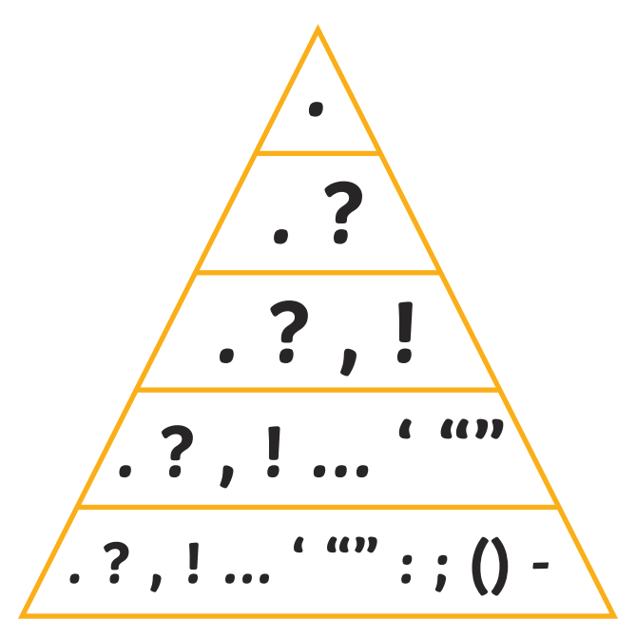
English – writing expectations
Planning, drafting and editing skills.
Increasingly sophisticated vocabulary.
Accurate spelling - rules and exceptions.
Increasing range of accurate punctuation. COMMA
Increasingly complex sentence structure.
Neat kinetic handwriting, moving to cursive when ready.

Slide 6

English - reading
Guided reading
School banded reading book
Reading for pleasure
Reading spine

Slide 7

Maths
Streaming
Fluency
Times tables – up to 12 x 12 Statutory testing for Year 4 in June
Mental maths
Fluency of methods
Fractions (and decimals Y4)
Mastery
Application
Multi-step problems - reasoning

Slide 8

Science
Living things, classification and their habitats
Electricity
Sound
Animals including humans, digestion, teeth and food chains
States of matter

Slide 9

History Geography
Ancient Maya
Roman Britain
Anglo Saxons
Rainforests
Volcanoes
Settlements

Slide 10
Class trips/events
Charging
We have an extensive school policy which all staff follow when arranging a visit. You will be asked for a voluntary contribution to cover the costs. If this cost is not met the visit will have to be cancelled. If you are having any financial difficulty paying for a trip then please speak to our bursar, Mrs Jane Taylor, or Mrs Forrester
Permissions
Via Compass
Residential must be confirmed and deposit paid by 25th September.
Maya workshop – 24th September
Y4 Lantern Parade – Last week of November
Christmas Panto – December 16th
^{Spring trip TBC}
Residential PGL Boreatton Park in Shropshire
Year 3: 19th – 21st April
Year 4: 21st – 23rd April

Slide 11
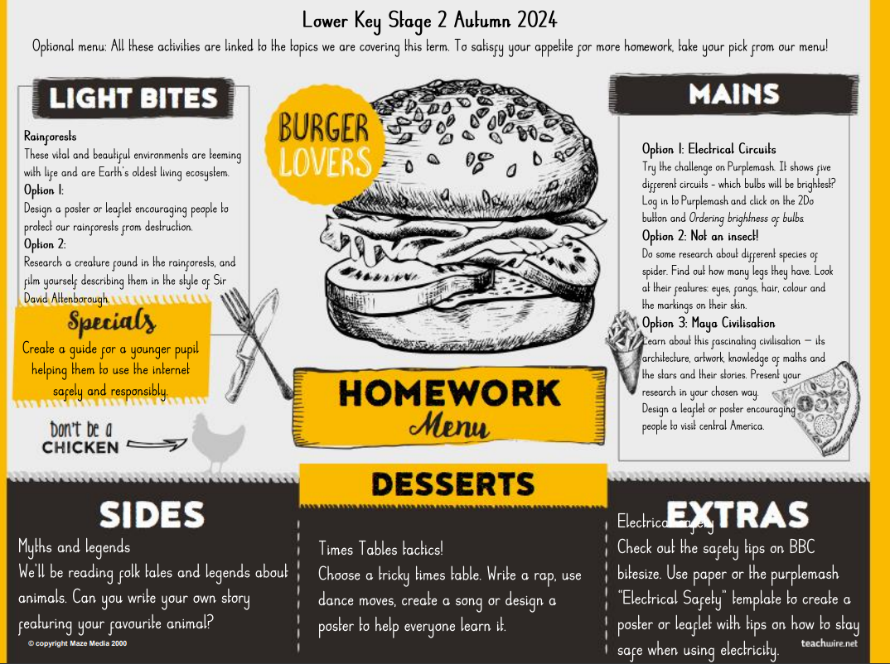
Homework
Expected Homework
Reading
Maths - Magma
Optional homework

Slide 12
Reminders
A small bag please
Named water bottles
Uniform – policy on line and pre-loved uniform in the school entrance
Long hair to be tied back please. Stud earrings only.
PE kits – labelled - red school logo PE shirt, black shorts and pumps/trainers. Dark coloured tracksuit/similar for cold days. Football kit should not be worn.
Lunches – Payment is made online via ParentPay during the ordering process.
Some pupils will be eligible for Pupil Premium (free school meals) which provides additional support to parents going through financial difficulties. Please speak to the office for more information.
Absence reporting
Reading records
Healthy school – snack ordering online and healthy snacks from home or fruit from school
No smart watches
Going home with a friend

Slide 13
Communication
Compass
Class pages
Admin text and email
Change of circumstances/contact
Catching up/discussions
Parents’ evening – October 20th and 21st face-to-face
Behaviour and rewards
Red stickers, golden book, house-points and class coins

Slide 14


Slide 15
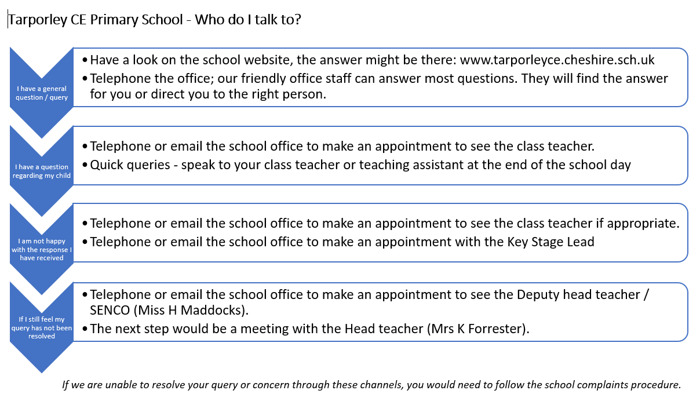
Safeguarding concerns – speak to your class teacher or to the Designated Safeguarding Leads:
Mrs Forrester, Miss Maddocks, Mrs Massey

Slide 16

Partnership

