Slide 1


Year 2 - Otters
Teacher: Mrs Massey
TA: Mrs Dillon (Monday and Tuesday)

Slide 2
Welcome
Thank you for joining us!
For anyone not able to attend this evening, this PPT will be shared on our class page

Slide 3
Today’s agenda
Our week
Attendance
Food and Lunchtimes
How you can support us
Curriculum
Mental Health and Wellbeing
Trips and Residentials
Homework including reading
Who do I talk to?
Any questions

Slide 4
General info & Reminders
Book bags only, please – we have limited space
Water bottles needed everyday
Please label EVERYTHING with their name!
Class pages/ website/ Compass
Change of circumstances/contact
Catching up/discussions
Parents’ evening – one virtual, one face-to-face
Going home with a friend? Please let us know!

Slide 5
Our Week
Mrs Massey is in class Monday to Friday while Mrs Dillon or Mrs Line will cover time out of class
PE will be on Tuesday and Thursday (children should come to school in their outdoor PE kits)
Uniform should be worn all other days and children should be smartly dressed
Reading records and water bottles to be brought into school daily

Slide 6
Attendance and Punctuality
The school day begins promptly at 8:45 with our first lesson beginning straight away
The Government regards 95% as the minimum satisfactory attendance for pupils in primary school
95% is the equivalent of two weeks absence. Two weeks every year is 14 weeks of teaching time missed which will have an impact on their progress and attainment
90% attendance is equivalent to having 1 day off every 2 weeks or 4 whole weeks
80% attendance is equivalent to having a day off every week
Most children should routinely have attendance rates of 97% or more which is 6 days absence in a year. Pupils often have 100% attendance during their primary years
Holidays during term time will not be approved by Mrs Forrester
Being 5 minutes late every day is the equivalent of missing 3 days of learning
Report all absences on COMPASS

Slide 7
Food and Lunchtimes
Children order dinners using the online system - Compass
No sweets, fizzy drinks or glass bottles
We will provide free fruit for breaktimes
NO NUTS, PLEASE – we have members of the school with serious allergies
Some pupils will be eligible for Pupil Premium (free school meals and additional funding) which provides a range of additional support to parents. Please call CWAC on 0300 123 7039 to see if your child is eligible

Slide 8
How you can support us
Please, please read to and hear your child read as often as you are able – the impact it has on their fluency, vocabulary, communication skills, empathy, knowledge of the world and their writing skills is HUGE!
Volunteer to join us on trips
Little Wandle books returned on a Wednesday, Reading for Pleasure books on a Monday
Show and Tell….. TUESDAY

Slide 9
Our curriculum
Reading In Year 1, the focus is on learning phonics and developing basic reading fluency. In Year 2, children are expected to read more fluently, understand a wider range of vocabulary and answer questions about what they have read using evidence from the text. Writing Year 1 children learn to write simple sentences using basic punctuation and phonics knowledge. In Year 2, pupils write longer pieces for different purposes, use a wider range of punctuation, improve spelling accuracy and begin to edit their own work. Mathematics Year 1 focuses on developing number sense, counting and basic addition and subtraction. In Year 2, children build on these foundations by working with larger numbers, learning multiplication and division facts, solving more complex problems and applying their mathematical knowledge in different contexts. Science and the Wider Curriculum Year 1 introduces children to scientific enquiry and basic concepts about animals, plants and materials. In Year 2, pupils investigate ideas in greater depth, ask more scientific questions and record their findings in a variety of ways. Learning across history, geography, computing and the arts also becomes more detailed and independent. Independence and Responsibility One of the biggest differences in Year 2 is the expectation that children take greater responsibility for their learning. They are encouraged to work independently, explain their thinking, persevere with challenges and develop good learning habits in preparation for Key Stage 2.

Slide 10
Dates for your diary
Harvest- 8th October 2026 2:30pm AT SCHOOL
Nantwich Museum- Thursday 19th November
Nativity- Wednesday 9th December 6pm at St Helens
Manchester Airport- Tuesday 9th February 2027
Class Assembly- 29th April 9am
School Sleepover – July TBC

Slide 11

Our Reading spine
We encourage pupils to read, and be read to, as often as possible.
Reading spine – a list of these age-appropriate books can be found on our school website. These are books we’d like every child to have read, or had read to them, before July. We’ve provided the sorts of questions we ask in school to support

Slide 12
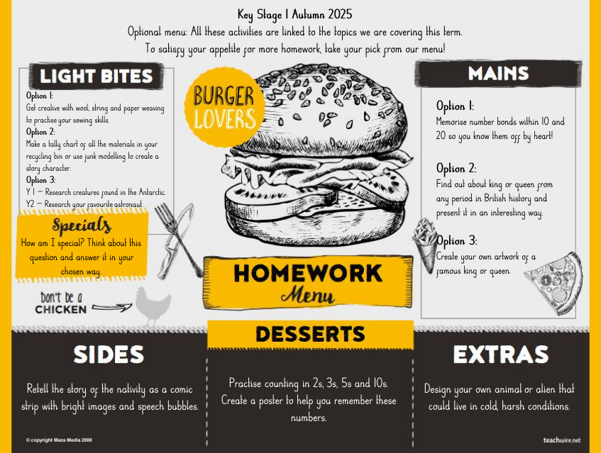
Homework
Reading
Optional menu of activities

Slide 13
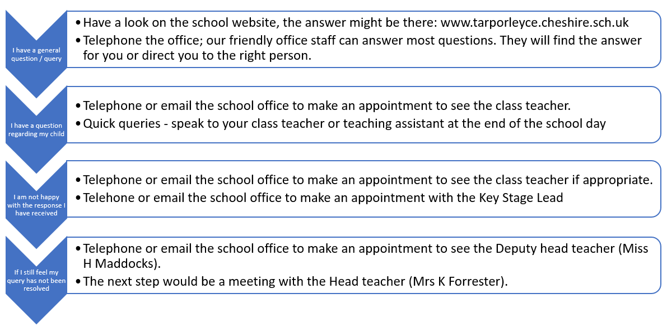
Who do I talk to?

Slide 14
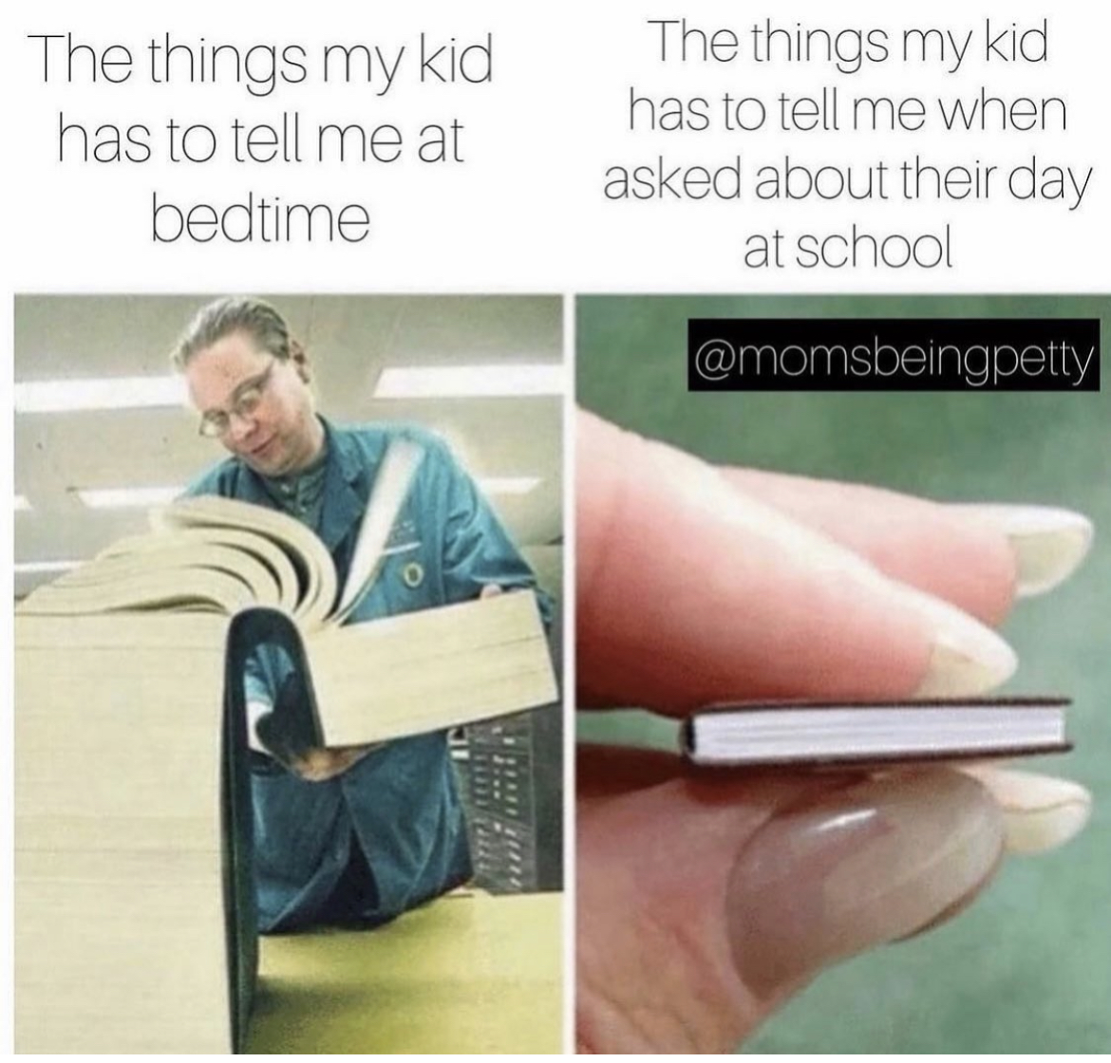

Slide 15
Thank you!
We’re looking forward to working with you to achieve the best for your children.
Please get in touch either by phone or via email (admin@tarporleyce.cheshire.sch.uk) if we can help with anything.
We will share this presentation and anything else we discuss via Compass and our webpages.

Slide 16
Any questions?

