Slide 1

Notes for teachers
The aim of the parent launch is to make parents aware how important their role is in their child’s reading and that the school wants to work in partnership with them.
As an opening question, perhaps you could ask parents to think about what they want their child to achieve this year. Asking this simple question can do so much to show parents that their input is crucial to their child’s success.
Teachers will need to update:
Slide 6 – Add the date you will launch the reading log
Slide 9– Add any additional school incentives you will use to encourage and reward pupils for reading
Slide 10 – Remove/edit if you’re not using our teacher feedback functionality
Slide 13 – Add your own reading challenge to the slide (we have listed some ideas in the notes section)
Further support:
You can read top tips for launching the digital reading log here.
To request the link to demo the activities or if you have any questions about how best to launch and use our programmes you can contact us at schools@learningwithparents.com

Slide 2

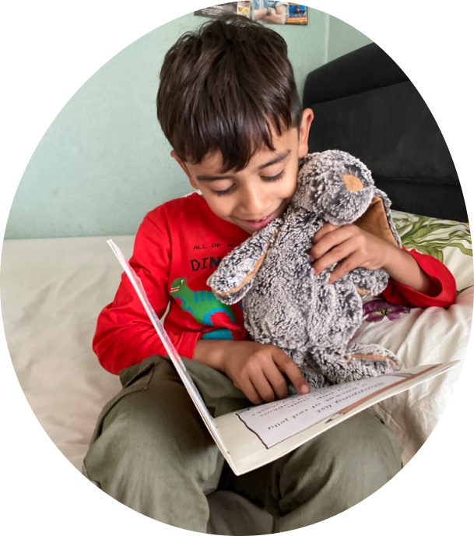

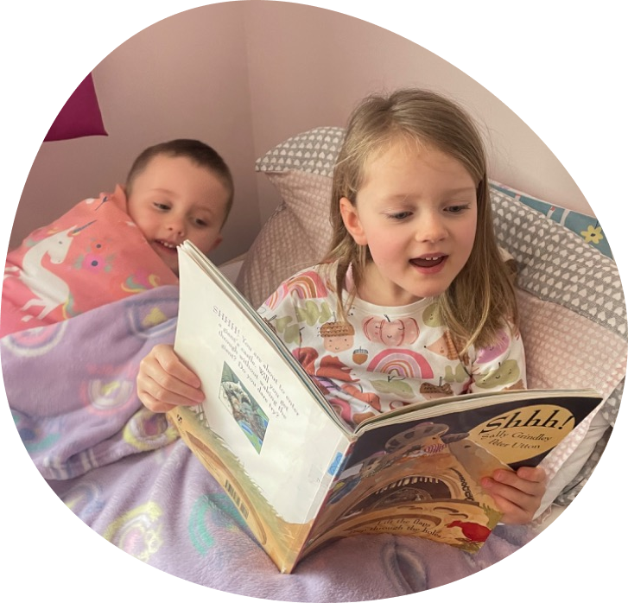
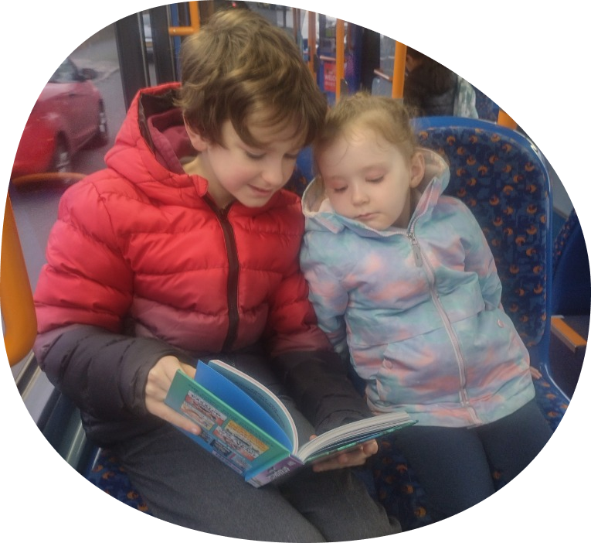
Learning with Parents Digital Reading Log

Slide 3
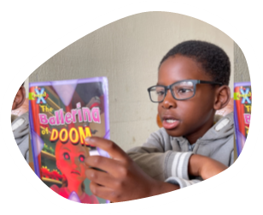
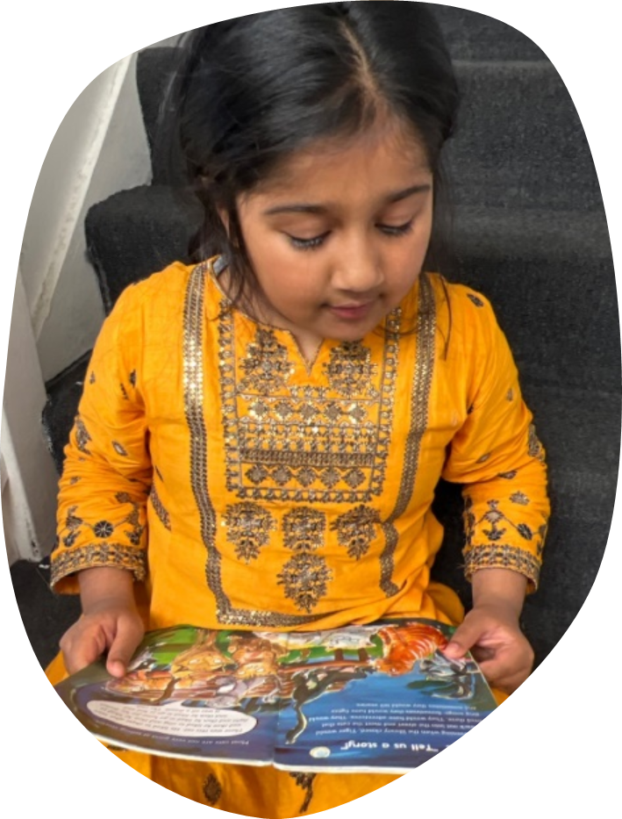
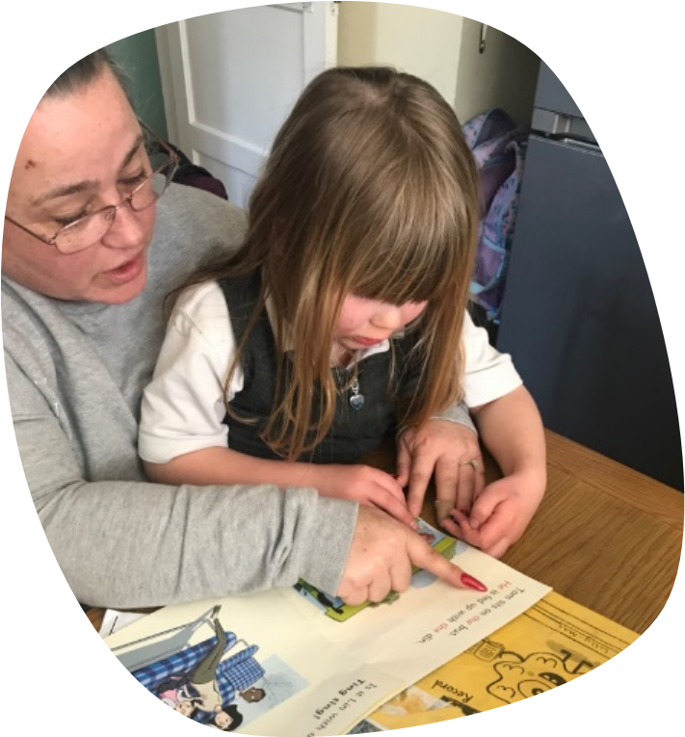
What do you want your child to achieve with their reading this year?
Notes:
Notes for teachers:
Highlight to parents how important their role is and that you want to work in partnership with them to make reading easier and more fun
Perhaps you could ask them to think about what they want their child to achieve this year?
Here highlight why you have decided to start using the digital reading log-
Easier for parents to use compared to paper logs
No risk of reading logs being lost, everything is stored digitally
It’s fun – can leave photos and record audio clips of their child reading
Reading can be recorded anywhere – on the bus, out and about!
All reading can be recorded – road signs, own books etc

Slide 4

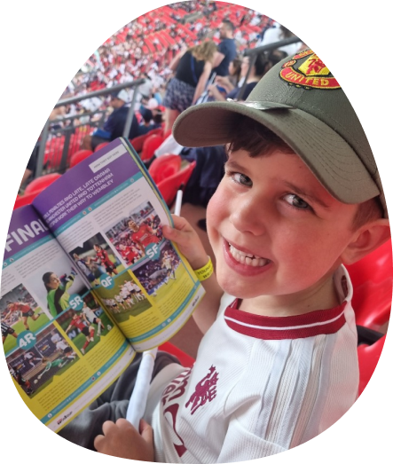
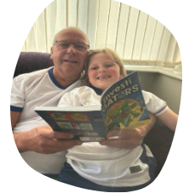
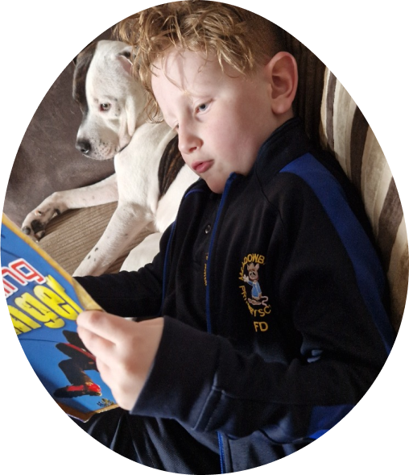
Why your support is important
We want to encourage a love of reading and want to see you reading all sorts of things, not just your school book
Reading for 5 minutes, 3 times a week means your child will have read for an extra hour a month!
By making reading aloud a regular part of your family’s routine, you’re not just helping your children with their learning – you’re
building memories
finding out more about each other
instilling a love of reading that will last a lifetime!
Notes:
Teacher notes: We know you have your child’s best interests at heart and are probably aware of the points on this slide already. However, we also know that it can be tricky to read regularly at home for lots of reasons. That’s why we are using the digital reading log, to make it easy and as fun as possible for you and your child
Parents supporting reading is crucial for a child's development, it helps develop language skills, cognitive growth, and a lifelong love of learning
Reading aloud, engaging with books, and creating a reading-rich environment at home positively impacts a child's academic success, emotional well-being, and overall future
By making reading aloud a regular part of your family’s routine, you’re not just helping your children with their learning – you’re building memories, finding out more about each other, and instilling a love of reading that will last a lifetime!

Slide 5

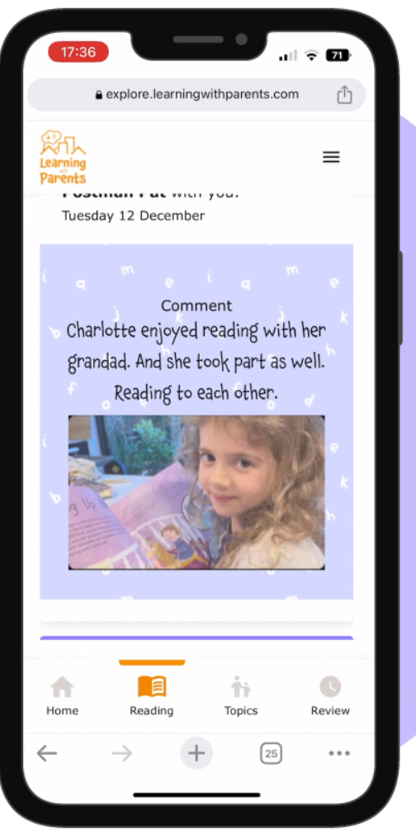
Why Learning with Parents?
Click here to watch our parent demo video!
No password or login to remember
Accessible – record reading anytime, anywhere by using your phone
Interactive and fun! Record audio clips, take photos, leave messages
“You can track progress and receive feedback from teachers”
“I can listen and learn how my child reads fluently through the days and if they have improved.”
“It’s always at hand, even on the go”
Feedback from parent survey 2025
Notes:
Notes for teachers:
Introduce the digital reading log. Explain you will now walk through the steps parents need to take to get set up on the platform and to start recording reading

Slide 6
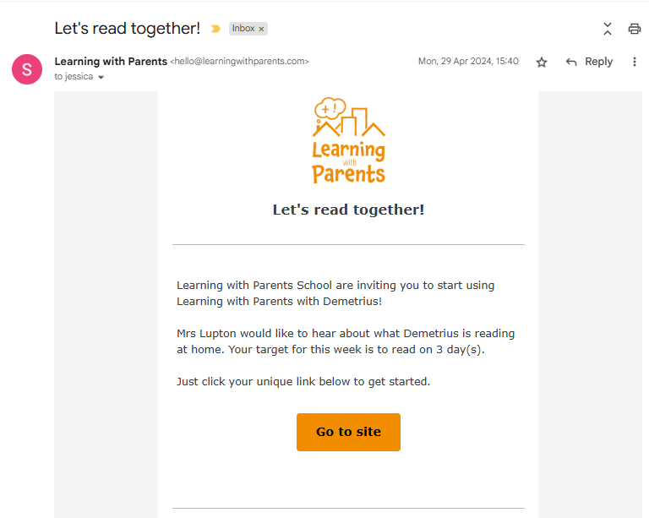

Step 1
You will receive an email from us <add date you will launch>
The email will be called ‘Let’s read together!’ and sent from hello@learningwithparents.com Check your junk box and add the email address to your contacts
Click on the link to go straight to your child’s reading log
Notes:
Teacher notes:
Add the date your reading week will start so parents know when to expect their email
There is no need to set up an account with a username and password. The secure magic link will take you straight to your child’s reading log home page.”
Add if you are doing a live launch at this session to look out for the email, check spam

Slide 7

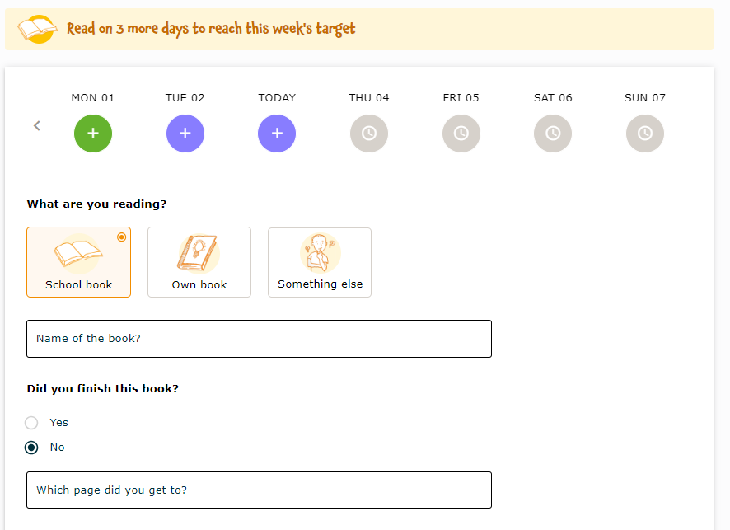
Step 2
Click on the day you would like to log reading for
Complete the information about the book
You must add the name of the book, but the rest is optional
Notes:
Teacher notes:
You can log reading for any day in the past week, just not in advance
You must fill in the book title, but the rest is optional

Slide 8

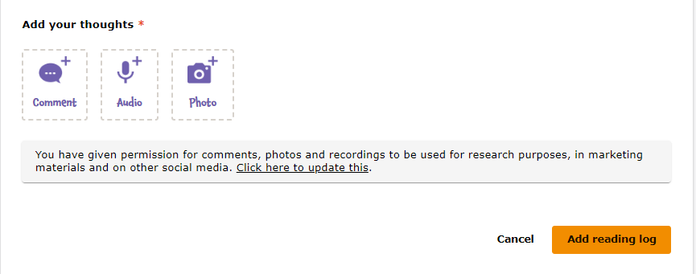
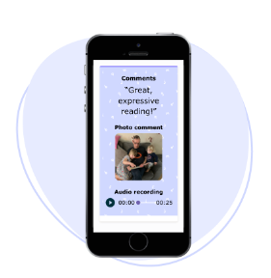
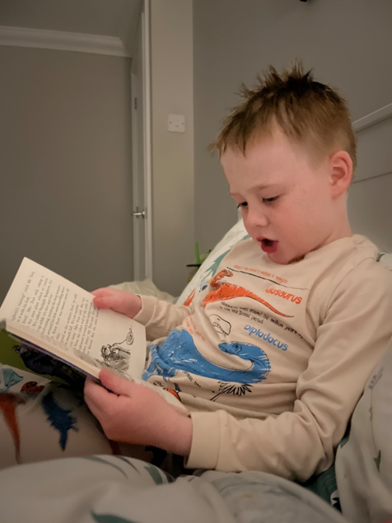

Step 3
Select how you would like to log the reading -
leave a comment
upload a photo
record audio
Click ‘Add reading log’ to submit
Notes:
Teacher notes:
EDIT: Mention here if you are making these methods of logging reading optional. E.g. Parents can log reading just by filling in the book title or, they must also select one of these methods
We love seeing your comments, photos and listening to the audio clips, they come through to us on an activity feed and the pupils love to see themselves when we share this on the whiteboard

Slide 9


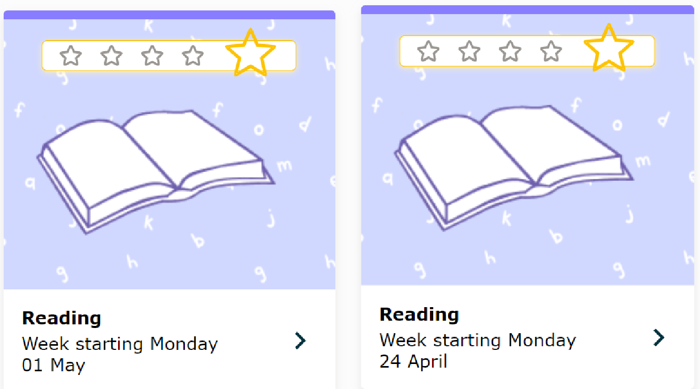
Earn stars
Notes:
Teacher notes:
Every time you and your child record reading your child will get a silver star. If you reach the weekly target set by the teacher your child will get a gold star!
Mention any school incentives you are also doing
Note for teacher: the number of stars shown to parents will depend on what their reading target is. Ei: the above image would be for a child whose reading target is 5 times a week.

Slide 10

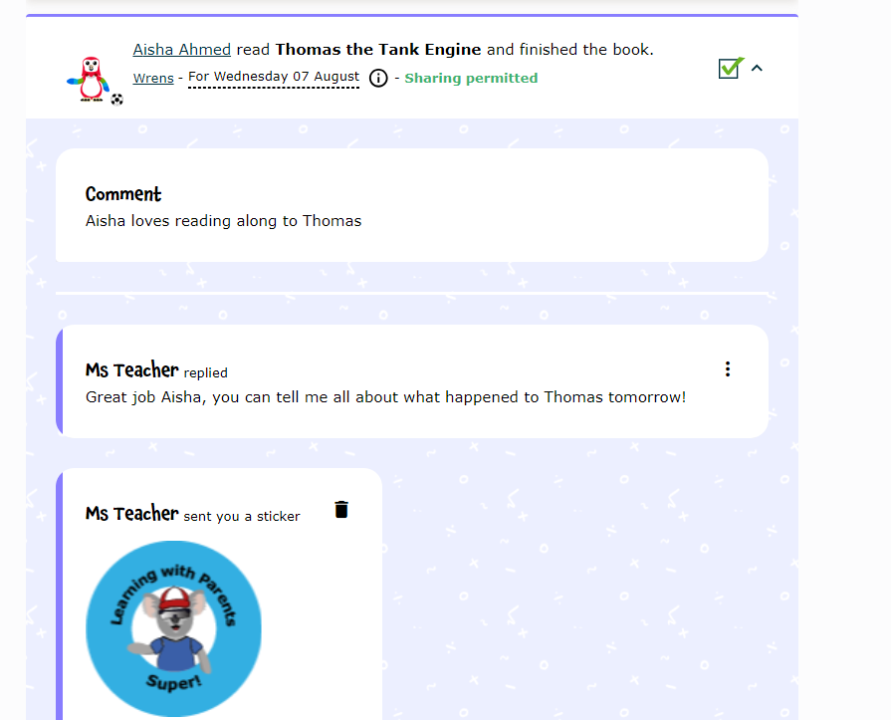
Easily see feedback from teachers and any stickers given to your child
Notes:
Teacher notes:
“We can leave comments and respond to your feedback. We can’t wait to give out our stickers for great reading! You’ll receive a notification whenever any teacher comment is left”

Slide 11
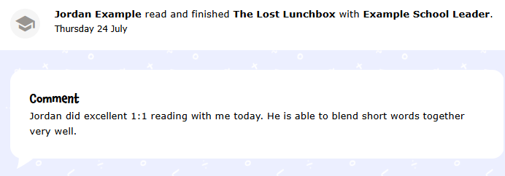
See the reading your child is doing in school too
See when your child has read 1:1 with a teacher or as part of a group
Teachers can also use the audio function so you can hear your child read in school

Slide 12

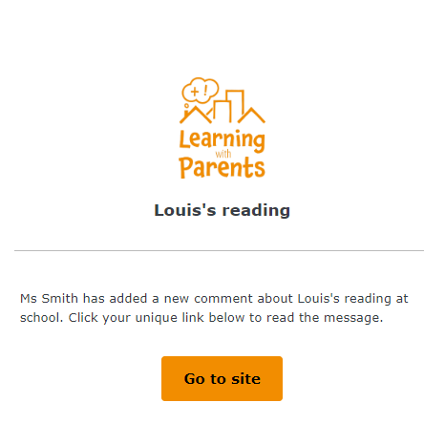
Helpful reminders
1
2
3
4
5
Welcome to Learning with Parents!
You will receive an email with a magic link which will take you directly to the platform.
Your reading week has started!
You will receive an email asking you to read at home and leave feedback for the class teacher.
You can also see your child’s reading target.
This email is sent at the start of every reading week.
Reading reminder 1
If no reading has been logged within 2 days, you will receive a reminder.
Reading reminder 2
If the reading target hasn’t been met, then you will receive another reminder after 5 days.
Reading log entry from school
You will receive an email when a teacher leaves a reading log entry.
After 2 days
After 5 days
After teacher comment
Notes:
Teacher notes:
“You will receive emails from LwP with reminders to complete your weekly reading. This slide outlines how the reminders work and when you can expect to receive them”

Slide 13


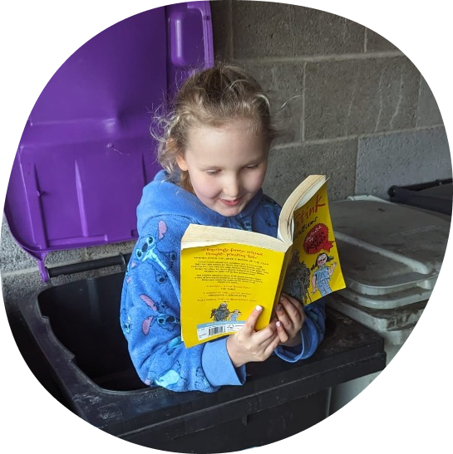
Reading challenge!
Add details of your reading challenge here
Notes:
Teacher notes:
At this stage you may want to launch a reading challenge to help motivate families to use the log such as ‘read to your sibling, pet or cuddly toy, read 3 new words when you are ‘out and about’ or read a new book and share a new fact!
The main thing to consider when setting a reading challenge is to make sure it is inclusive and something all families & children can enjoy.

Slide 14

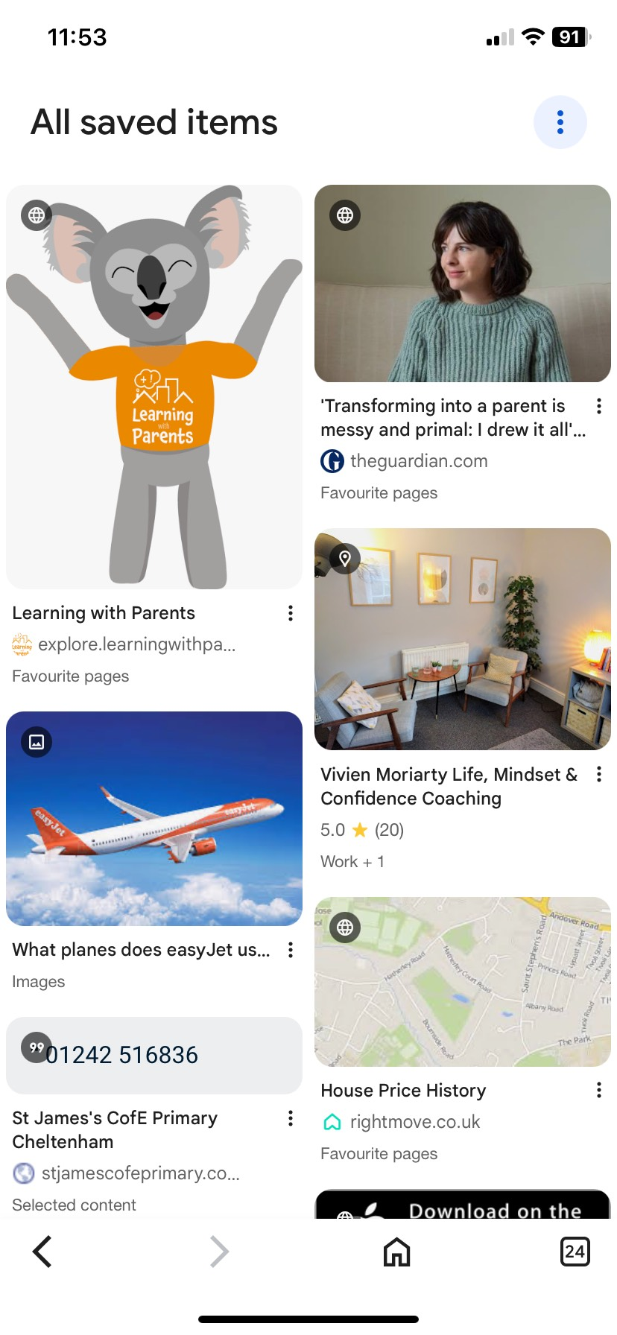
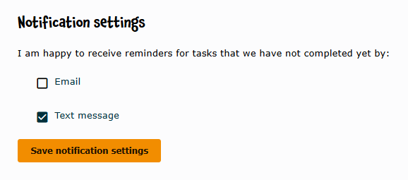
Parent Top Tips!
Add the Learning with Parents emails to your favourite contacts so you can find them easily
Bookmark the Learning with Parents webpage to your browser
If you’d rather receive text messages with your magic link, then change your preference in your account settings

Slide 15

Any questions?
Notes:
Teacher notes:
*Have a print-out of our FAQs to help you if needed

Slide 16

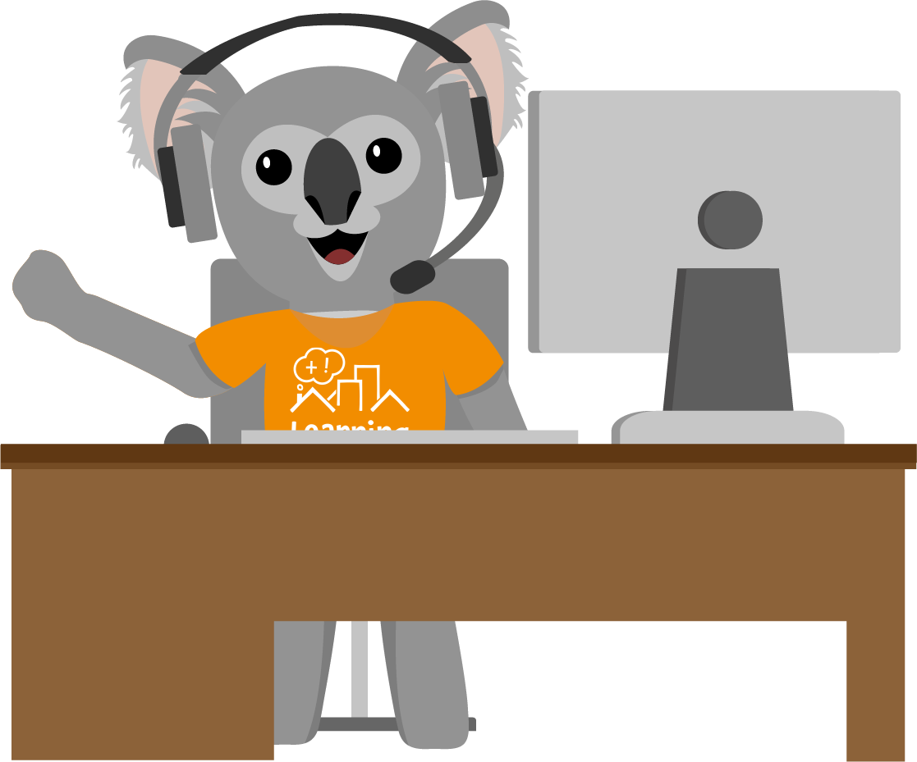
Support
We have different ways to support you:
FAQs on the website
Instant chat on the website to the Learning with Parents team
Or email Learning with Parents and they will get back to you within 3 working days
hello@learningwithparents.com

