Slide 1




Slide 2
Structure of the school day.
The importance of attendance in school
  The Government regard 95% as the minimum satisfactory attendance for a primary school pupil.
  95% attendance is the equivalent of 2 weeks off school.
  A 2 week absence each year in primary school means a total of 14 weeks teaching time missed – this could have real impact on your child’s basic numeracy and literacy skills.
  90% attendance is like having a day off every two weeks or 4 whole weeks off school
  80% attendance is the same as having a day off every week.
  Most children should routinely have attendance rates of 97% or more. This is the equivalent of 6 days absence a year. 100% is achieved by many pupils every year in both primary and secondary schools.
Holidays in term time – These will not be approved by Mrs Forrester and fines may be issued for unauthorised holidays taken.

Slide 3


Benefits of Emotional Wellbeing
The charity, Young Minds, states that, “emotional wellbeing is a clear indicator of academic achievement, success and satisfaction in later life” and “wellbeing provision in schools can also lead to reductions in poor classroom behaviour and bullying.”
The Emotional Management Programme (EMP) for Children
is delivered to all pupils from reception class to Year 6.
It teaches children through a range of fun and effective exercises, how to:
• Think positively
• Trust their own instincts
• Embrace new ideas and situations
• Relax
• Make choices
• Find the good in every situation
• Talk about and manage emotions
• Choose their response
• Practise appreciation
• Be emotionally resilient
More information at
School website: Parents/
Emotional Management Programme

Slide 4

English
Inspiration from books
A range of fiction and non-fiction genres, including poetry
Planning, drafting and composition
SPaG – integral to English lessons
Spelling- keep up and catch up
- 5 daily spelling sessions
- Y3/4 spelling list

Slide 5

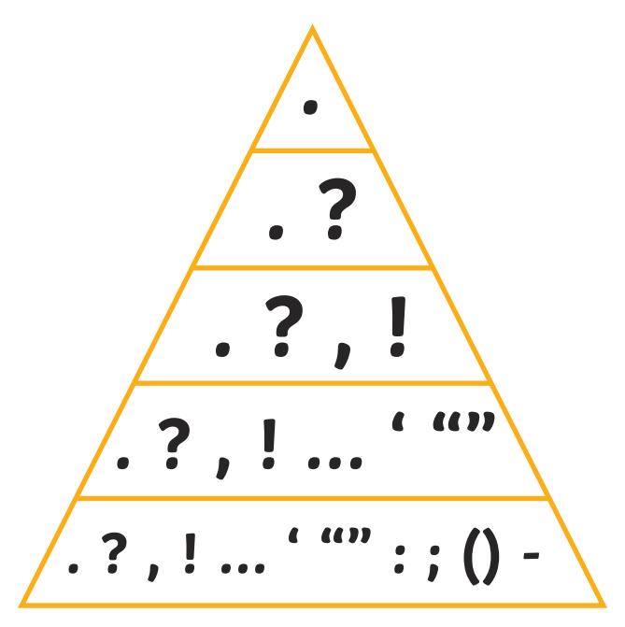
English – writing expectations
Planning, drafting and editing skills.
Increasingly sophisticated vocabulary.
Accurate spelling - rules and exceptions.
Increasing range of accurate punctuation. COMMA
Increasingly complex sentence structure.
Neat kinetic handwriting, moving to cursive when ready.

Slide 6

English - reading
Guided reading
School banded reading book
Reading for pleasure
Reading spine

Slide 7

Maths
Streaming
Fluency
Times tables – up to 12 x 12 Statutory testing for Year 4 in June
Mental maths
Fluency of methods
Fractions (and decimals Y4)
Mastery
Application
Multi-step problems - reasoning

Slide 8

Science
Forces and magnets
Light
Rocks and soil
Plants – parts of a plant – requirements for life
Animals Including Humans – food, skeleton, muscles

Slide 9

History Geography
How have children’s lives changed?
Stone Age, Bronze Age and Iron Age
Ancient Egypt

Slide 10
Class trips/events
Charging
We have an extensive school policy which all staff follow when arranging a visit. You will be asked for a voluntary contribution to cover the costs. If this cost is not met the visit will have to be cancelled. If you are having any financial difficulty paying for a trip then please speak to our bursar, Mrs Jane Taylor, or Mrs Forrester
Y4 Lantern Parade - November
Christmas Panto – December 11th
Spring residential - 11-13 February
Condover Hall, Shropshire
All year 3 and 4 together
Spring/summer trip – date tbc
Anderton Boat Lift

Slide 11
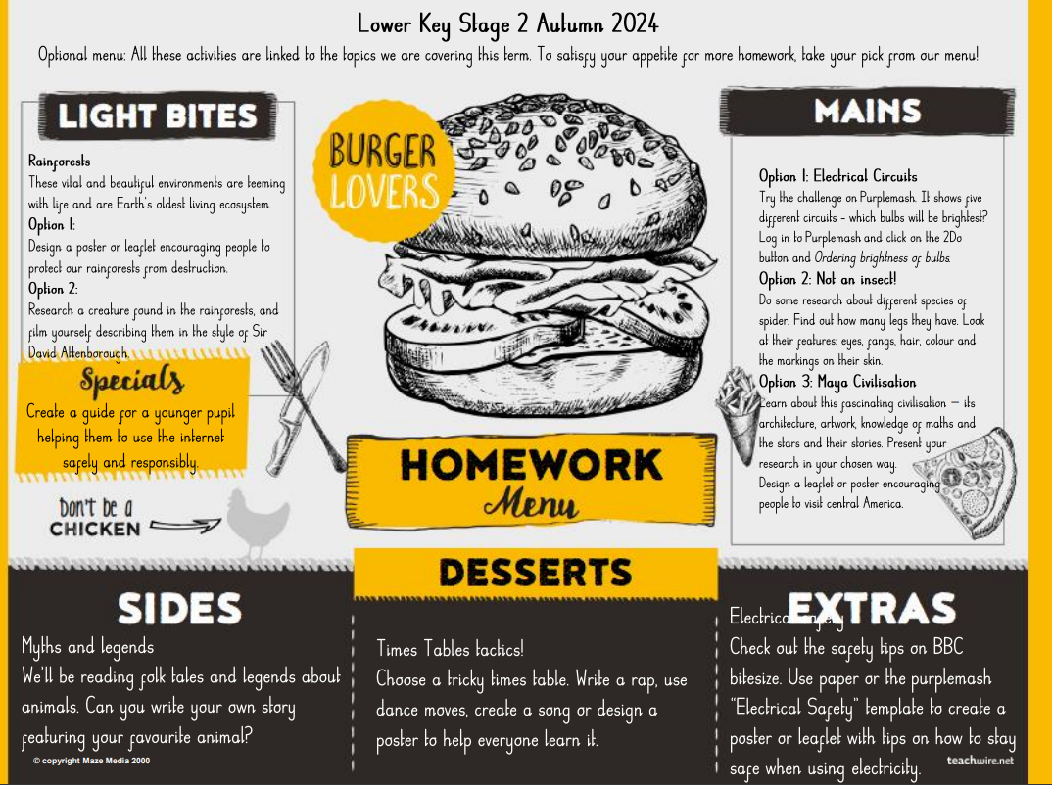
Homework
Expected Homework
Reading
Maths
Optional homework

Slide 12
Reminders
A small bag please
Named water bottles
Uniform – pre-loved uniform in the school entrance
PE kits – labelled - red school logo PE shirt, black shorts and pumps/trainers. Dark coloured tracksuit/similar for cold days. Football kit should not be worn.
Lunches – Payment is made online via ParentPay during the ordering process.
Some pupils will be eligible for Pupil Premium (free school meals) which provides a range of
additional support to parents going through financial difficulties. Please speak to the office
for more information.
Reading records
Healthy school – snacks
Going home with a friend

Slide 13
Communication
Twitter (X) /web
Class pages
Admin text and email
Change of circumstances/contact
Catching up/discussions
Parents’ evening – October 21st and 22nd face-to-face
Behaviour and rewards
Red stickers, golden book, house-points and class coins

Slide 14


Slide 15
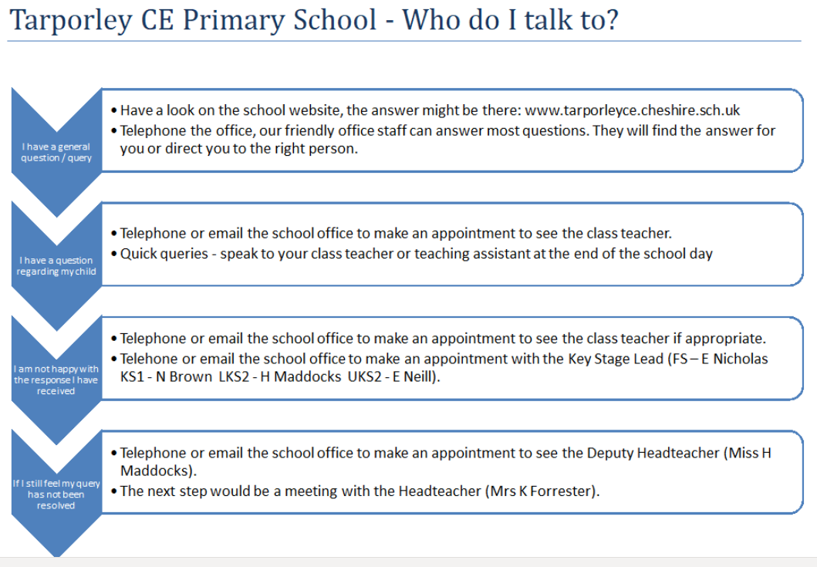

Slide 16

Partnership

