Slide 1
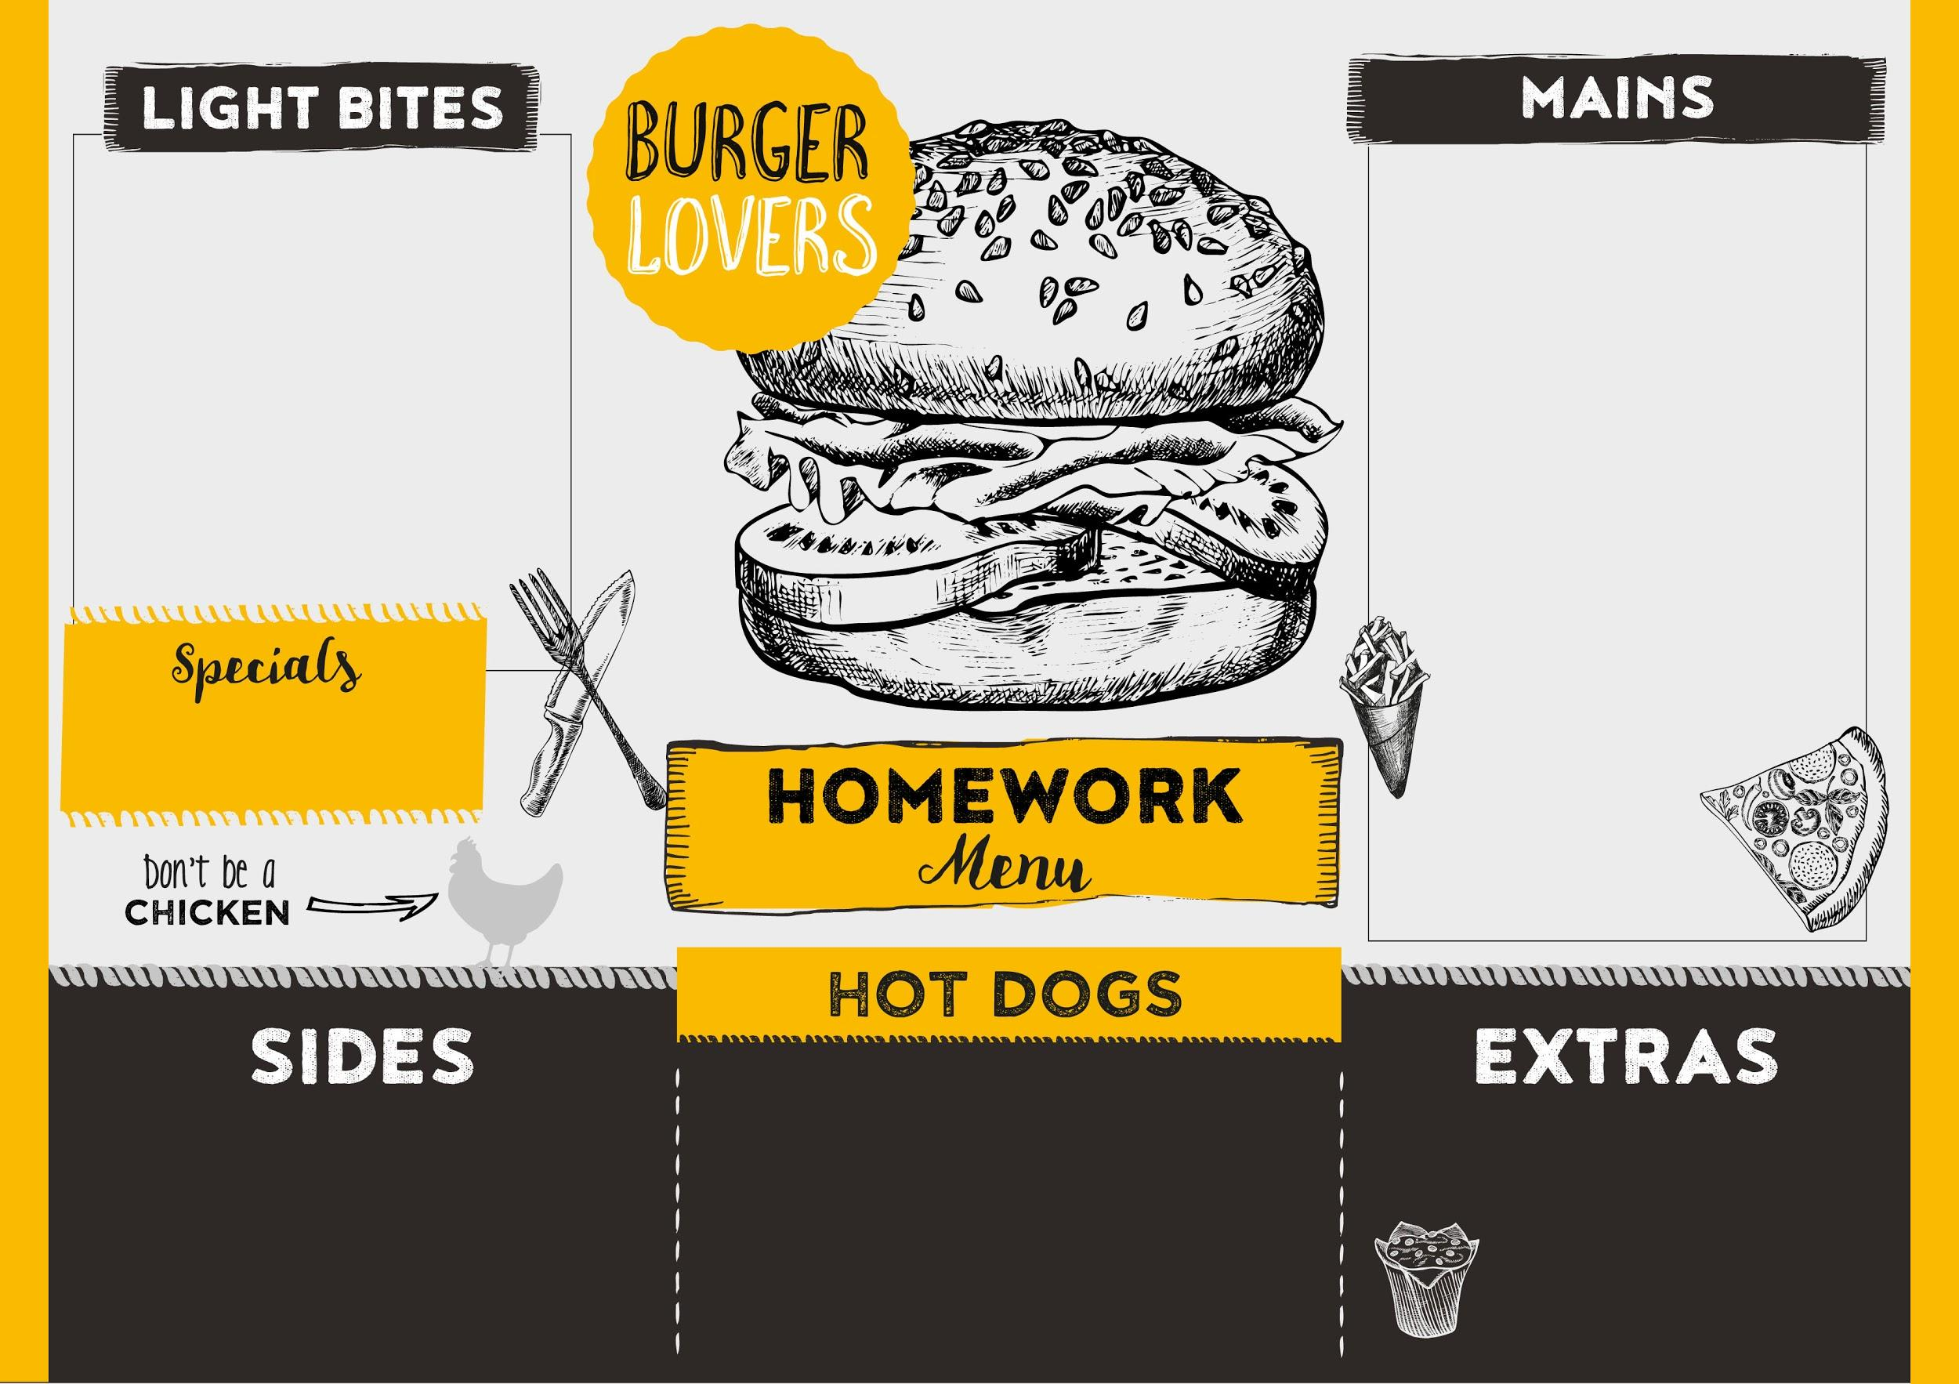

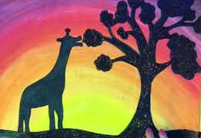
Lower Key Stage 2 AUTUMN 2025
Optional menu: All these activities are linked to the topics we are covering this term. To satisfy your appetite for more homework, take your pick from our menu!
Ocean wonders!
Choose an interesting creature from the deep and create your own fact file for
the class to learn all about it. You could include Fun Facts, diagrams, information on what it eats, where in the world it is found and what it looks like.
Art and reading
Create a storyboard or comic strip of a book that you have enjoyed. Use different mediums for artistic effect.
Maths
Set yourself a target of coins to earn on TTRockstars and see how fast you can collect them!
Judaism - think about places that are special to you and make a model of one.
- Create a Sukkah in your garden.
Recommend a read! Create an eye-catching poster about your favourite book. Include a picture (a character or the book cover) and key information or adjectives to describe your book “thrilling”, “intriguing”, “hilarious” to encourage your friends to read it too.
Science and art – light
Create a silhouette picture. Paint a sunset background like this one and use black pen or paint to add silhouetted people, animals or trees/hills/buildings.
Computer-aided design CAD
Use Purplemash to create your own vehicle design. Go to 2Designandmake. You can select a vehicle, make changes to its shape and colour/design before you print and build it.

