Slide 1


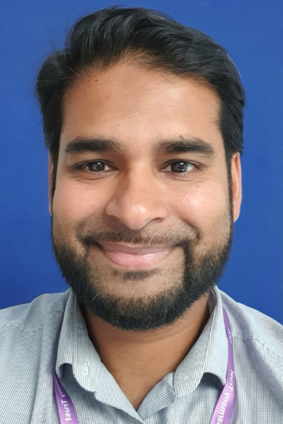
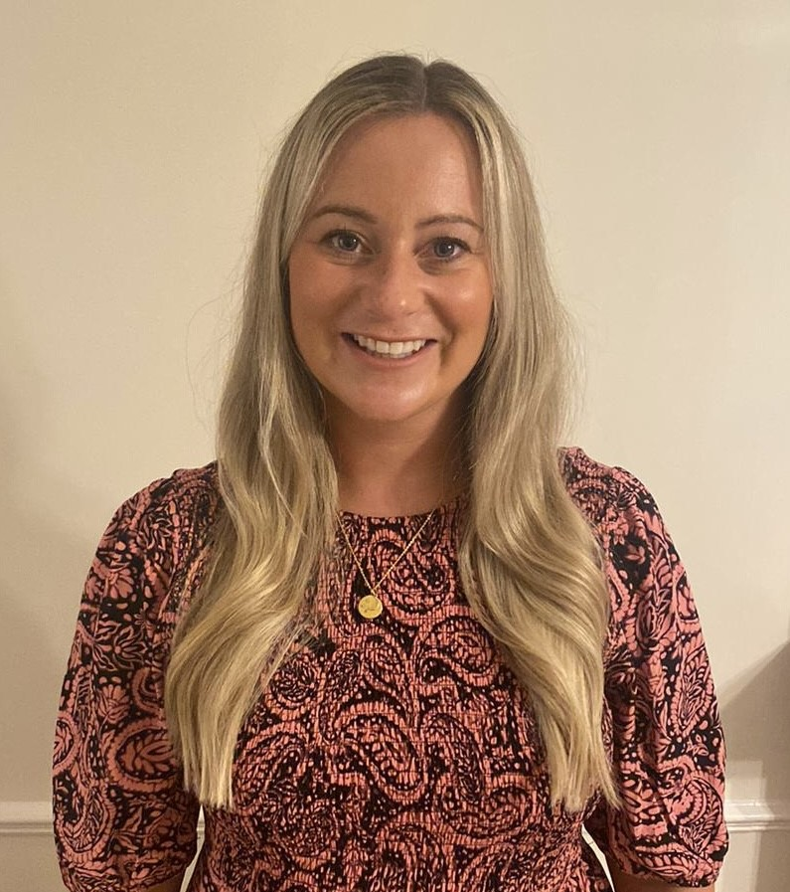
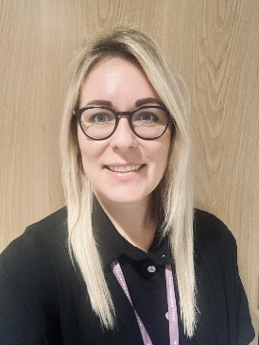
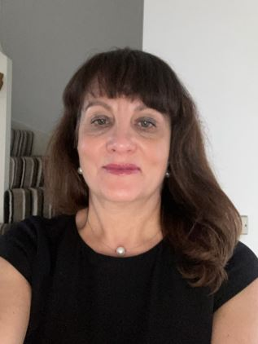
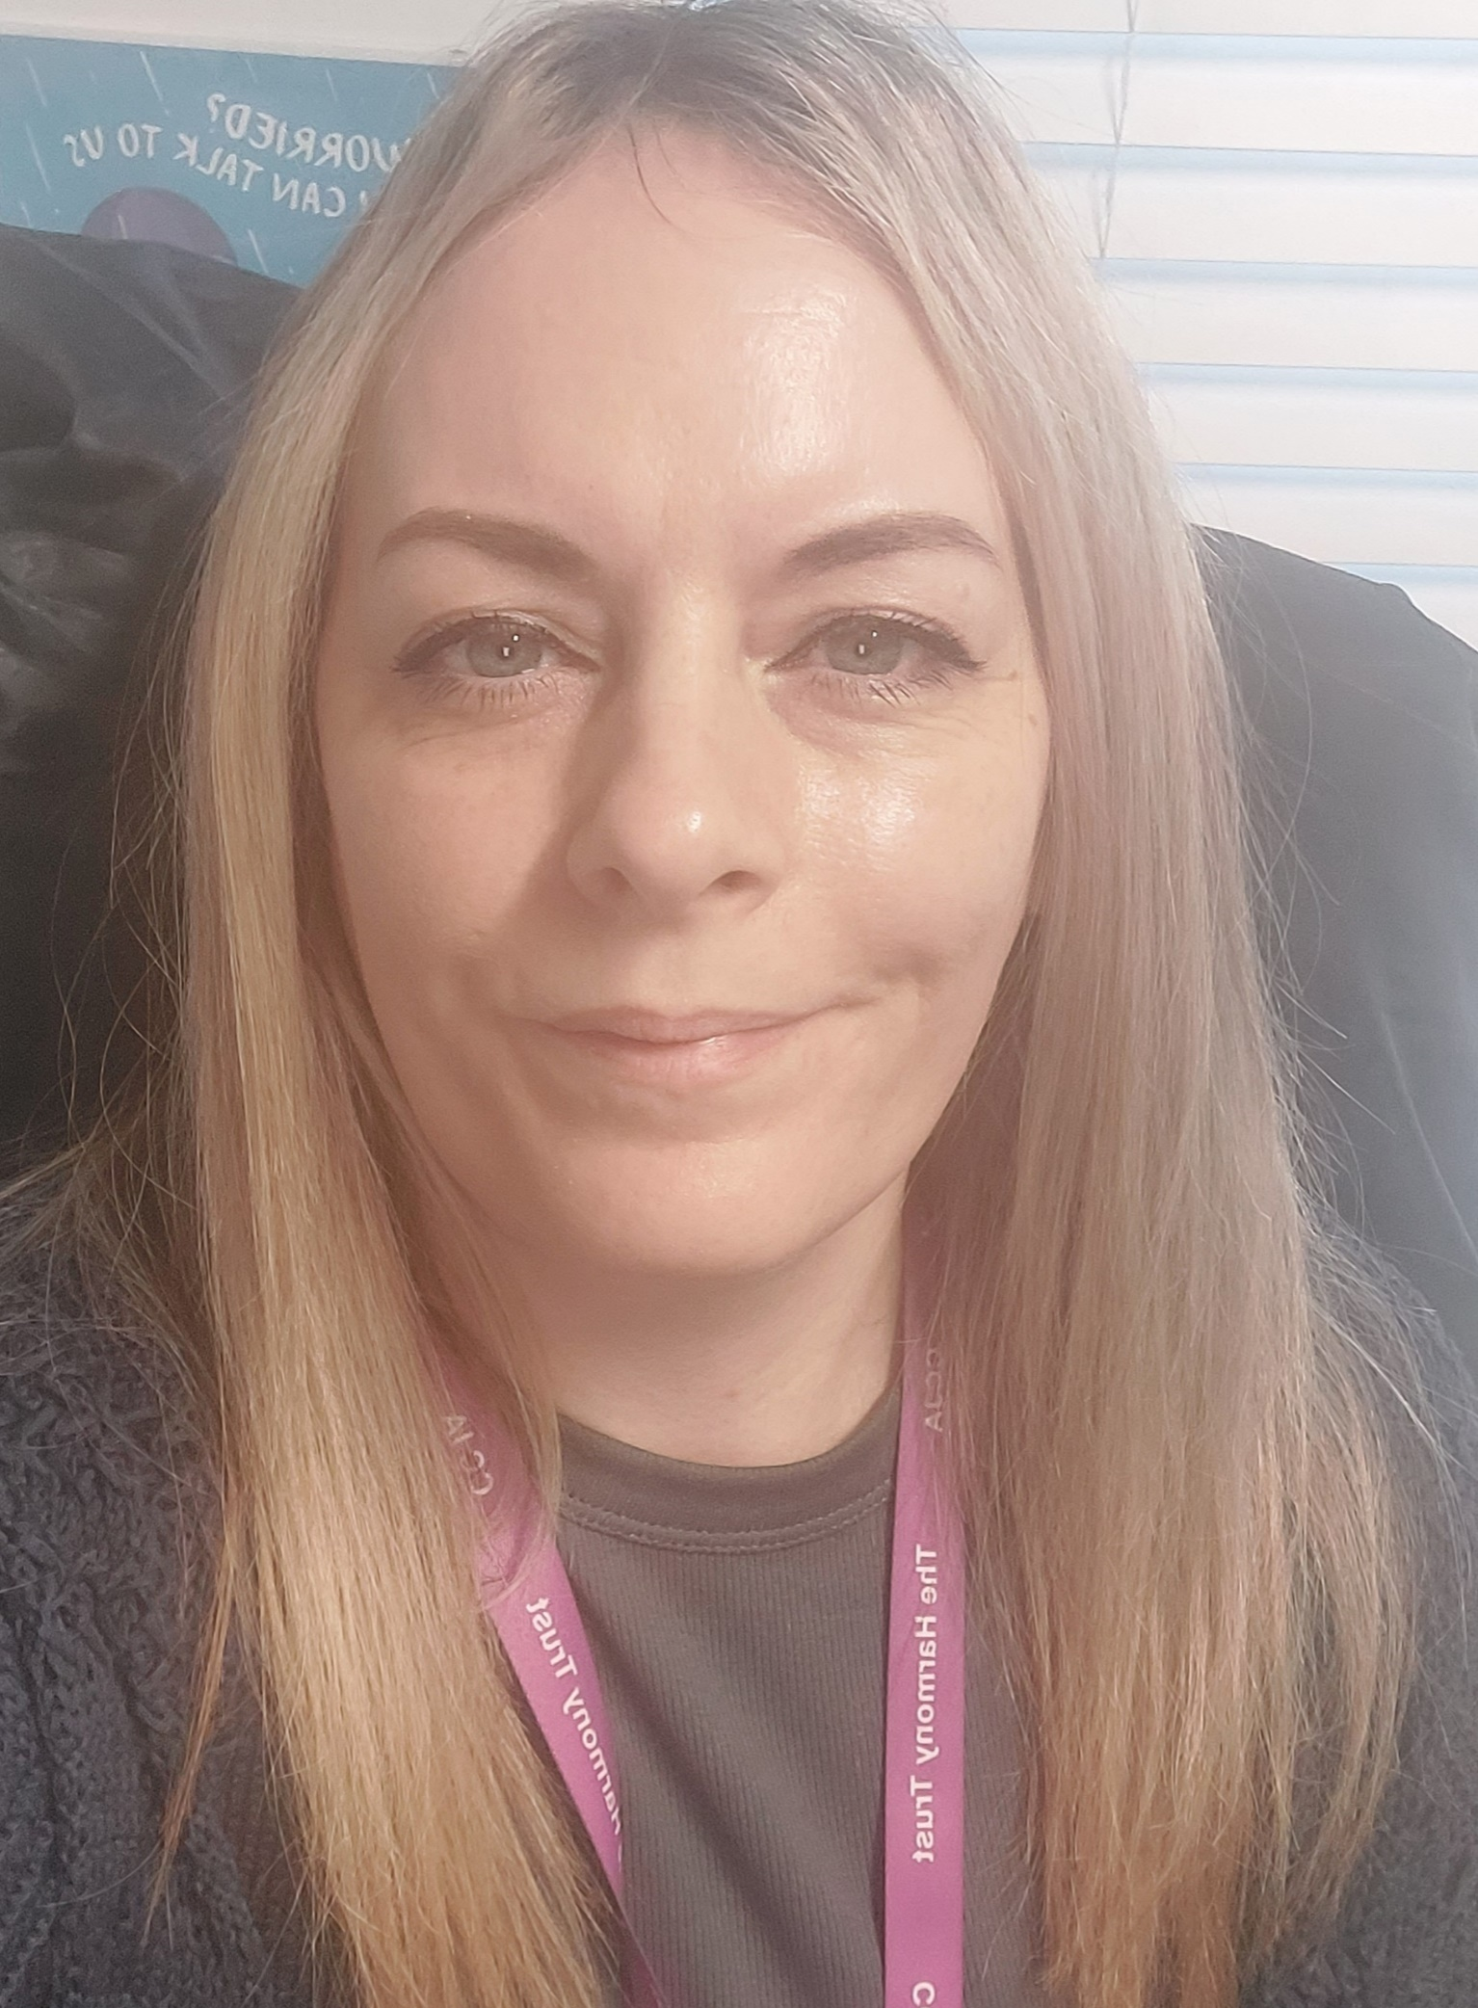




Hackwood Primary Academy Safeguarding Team
We pledge to recognise the rights of everyone and ensure that all our children are ‘Respectful, Persevere and Take pride in everything they do’.
Should you have any concerns about safeguarding or child protection, you can talk to any member of staff or contact one of the Safeguarding Team by calling the school on 01332 985466 or email: safeguarding@hackwood.theharmonytrust.org
If you believe that a child is at immediate risk of harm and in need of protection, then you should call the Police on 999.
Forid Miah
Designated Safeguarding Lead
Principal
Alex Yeomans
Deputy Designated
Safeguarding Lead
Assistant Principal/Year 6 Teacher
Kate Morley
Deputy Designated
Safeguarding Lead
Deputy Principal
Nicky Trickey
Deputy Designated
Safeguarding Lead
EYFS Lead/Reception Teacher
Anna Smith
Deputy Designated
Safeguarding Lead
Safeguarding, Attendance &
Family Support Officer

