Slide 1









Nursery INSPIRE curriculum newsletter – Autumn 1
Through our topic ‘Nursery Rhymes’, we will explore a range of familiar and traditional nursery rhymes, songs and stories. Nursery rhymes provide lots of opportunities for children to develop their language, confidence, imagination and creativity, while also supporting learning across all seven areas of the EYFS.
We will sing, move, act out and explore rhymes through play, encouraging children to join in with repeated words and actions, learn new vocabulary and develop their confidence when speaking and performing.
We will also explore Stanley’s Stick, using the story to encourage children to use their imaginations, creativity and language. We will think about what a simple stick could become, create our own ideas and stories, and use these ideas in our play and creative activities.
Most importantly, we will have lots of fun singing, talking, moving, imagining and playing together as we develop our confidence and curiosity as learners.
Children will learn the Squirrels motto;
Kind hands,
Kind feet,
Kind voices.
We will have fun joining in with a wide range of nursery rhymes and songs, we will also enjoy many stories bringing them to life with play and take part in activities and games that extend our learning. Music and movement will be key in supporting our communication and language.
We will also learn about ourselves and get to know one another.
INSPIRE - Investigate Nurture Skills Practical Imaginative Reflect Enjoy

Slide 2



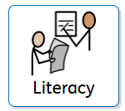


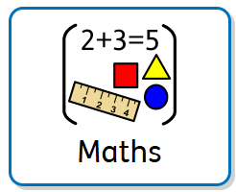
Nursery curriculum newsletter – Autumn 1
Whilst we settle into the new environment, we will work on developing our communication and language skills. We will model showing children how to communicate their wants and needs, we will learn key phrases such as, yes please and no thank you, can I play too, stop it I don’t like it, I need some help. We will have whole group and small group circle speech and language activities to help us gain confidence in this area.
Our focus this half-term is to settle the children into school life and to help them to feel happy, safe, and secure. Our main priority is that the children are happy and enjoy coming into school and have fun. We will work hard so that all the children develop a sense of belonging and feel that they are valued members of the class.
Throughout the day, we will be developing our fine motor and gross motor skills. We will have dough discos (making shapes with playdough to music) and funky finger discos to get our finger muscles strong. Over the half term we will be spending lots of time in the outdoor learning area – becoming confident climbers, movers, and cyclists. We will be working hard to develop our spatial awareness and negotiation of space.
We will be sharing a range of different stories together; we will read traditional tales such as The Gingerbread man and modern stories such as Room On The Broom. Children can also look at books independently as and when they choose to in the reading area. We will bring our books to life with matching activities and games.
We will use photos of our own families and homes to build a small world area. We will look at the Hackwood community and where we live and ask who lives in my house? We will talk about and celebrate our differences. We will talk about the places we visit such as Tesco's, the Post Office, the local library and the park.
The children will have lots of opportunities to create and construct their very own masterpieces. The ‘Creative Area’ will be available for them to choose the resources they need; whether that be feathers, pom-poms, lollypop sticks or string. The children will be encouraged to find the materials and tools they need to create fantastic artwork which I am sure they will all love sharing with you.
We will introduce numbers in fun ways such as counting steps, claps and items. Children will begin to recognise numbers 1-5 written and will count to 10 each day with support.
INSPIRE - Investigate Nurture Skills Practical Imaginative Reflect Enjoy

Slide 3

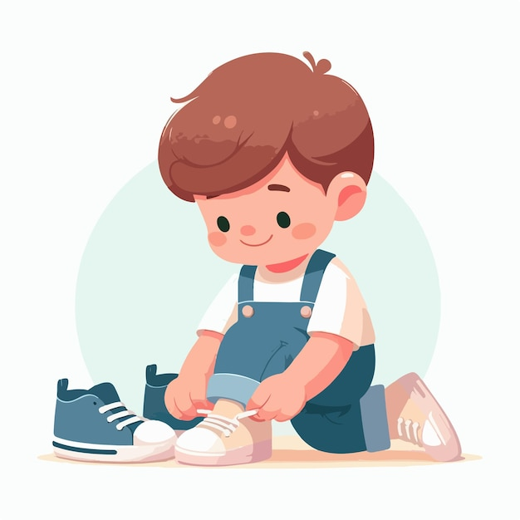
Nursery curriculum newsletter – Autumn 1
This term, we will fulfil the Harmony Pledge; Be safe, happy and healthy by trying new snacks a range of fruit and vegetables and participating in movement activities. Be Respectful by following the class rules, looking after our resources, being kind, polite and use good manners.
Be safe, happy and healthy
Be a fundraiser
Be a performer
Be an eco-warrior
Be respectful
Be a volunteer
Be democratic
Be an adventurer
Be an expert learner
Be workwise
Our learning happens indoors and outdoors, children are encouraged to spend time outside throughout the day. This does mean that their independence in getting items of clothing on is something we focus on helping them with.
At home you can help your child by giving them time to practice putting on their shoes and coat.
INSPIRE - Investigate Nurture Skills Practical Imaginative Reflect Enjoy

