Slide 1

Reading workshop

Slide 2
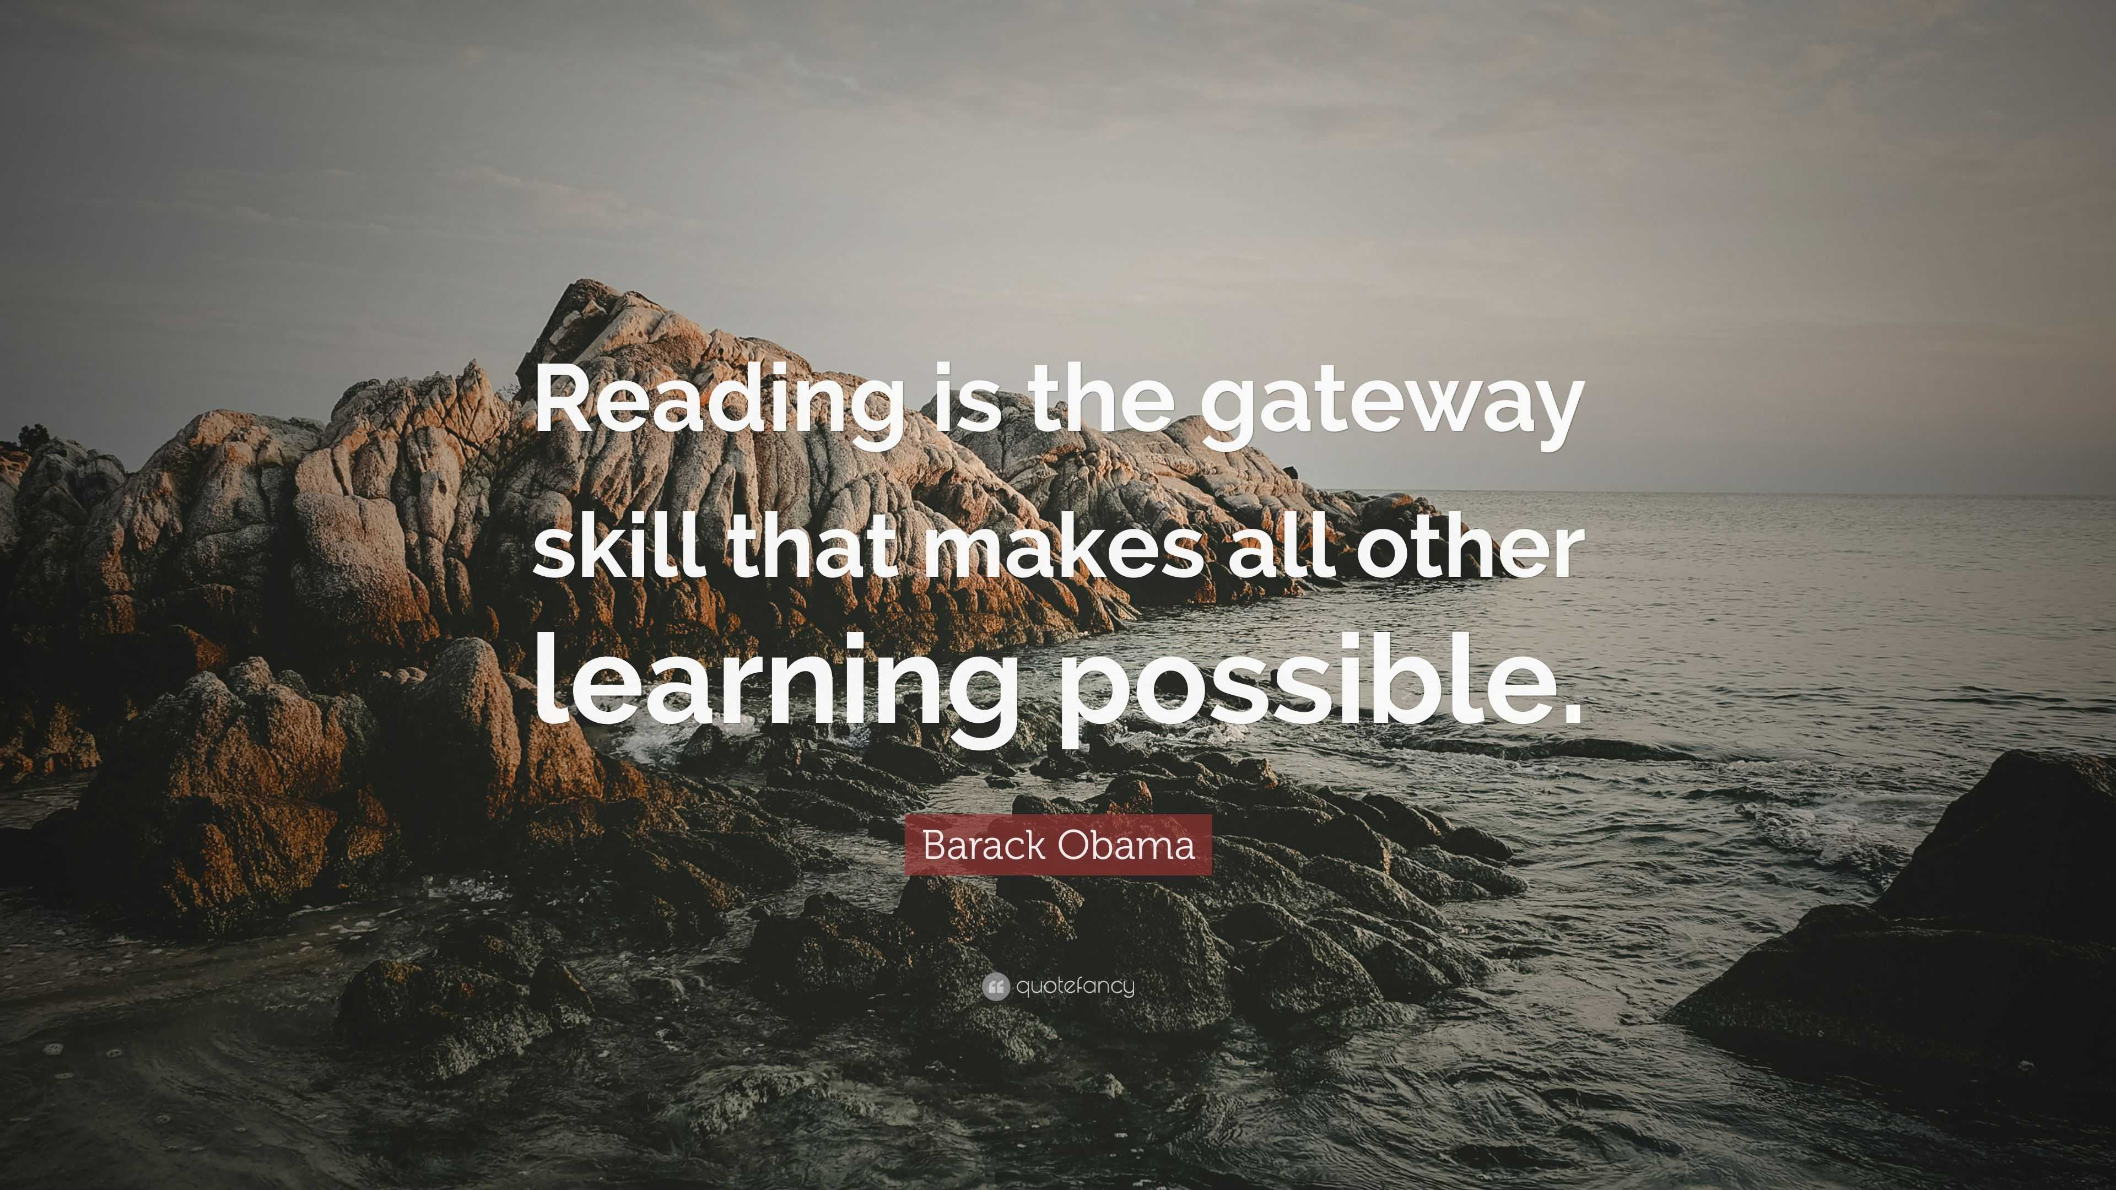

Slide 3


Slide 4
The impact of parents reading with their children quoted the following figures in a news release about their findings: Here’s how many words kids would have heard by the time they were 5 years old: Never read to, 4,662 words; 1–2 times per week, 63,570 words; 3–5 times per week, 169,520 words; daily, 296,660 words; and five books a day, 1,483,300 words.

Slide 5
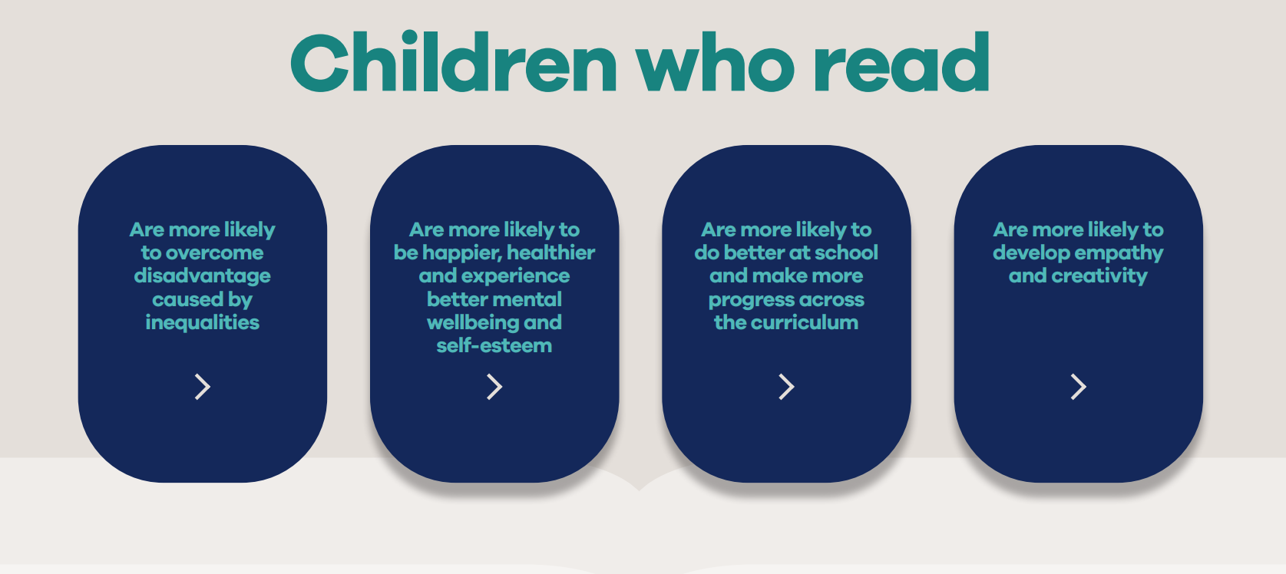

Slide 6
Session aims
What and why is reading for pleasure important?
How does a child develop a pleasure for reading?
What is reading comprehension?
How is reading comprehension developed and how can we develop it?
Providing resources and support for Reading at home ☺

Slide 7
What is reading for pleasure?
‘Reading that we do of our own free will anticipating the satisfaction that we will get from the act of reading.’
For children, reading for pleasure can be reading themselves or being read to by someone.
Reading to a child every day is just as important as a child reading to a grown up.
By reading and sharing books with young children, children develop a love for reading.

Slide 8
Why should we develop children’s pleasure for reading?
It helps children to
- enjoy and understand stories
- see how stories start and finish
- see the structure of stories
- see how a plot unravels and is resolved.
- learn new vocabulary
- learn sentence structure
- learn punctuation
- learn spellings and grammar
- to develop listening and attention skills
- to develop speaking and language skills
- to relax, feel calm and happy
- to be entertained
- to escape to a different world
- to be curious
– to ask and answer questions
- feel different emotions
- to find out information
- to write in different styles (stories, information texts, recounts) to share stories with others
- to relate to personal experiences
- to understand the world we live in, different cultures, beliefs.

Slide 9
How do we develop a pleasure for Reading?
-Daily story times
- Special days, world book day, vocabulary day, book fair
- Diverse and inviting book corners
- School library
- Books linked to all areas of the curriculum –
Reading spine

Slide 10
What is reading comprehension?
Reading comprehension is the ability to read text, process it and understand its meaning. It relies on two interconnected abilities: word reading (decoding-phonics) and language comprehension (being able to understand the meaning or words and sentences.
Good comprehension is vital if reading is to have a purpose, if a reader is to engage with and learn from a text and ultimately, if a reader is to enjoy what they are reading

Slide 11
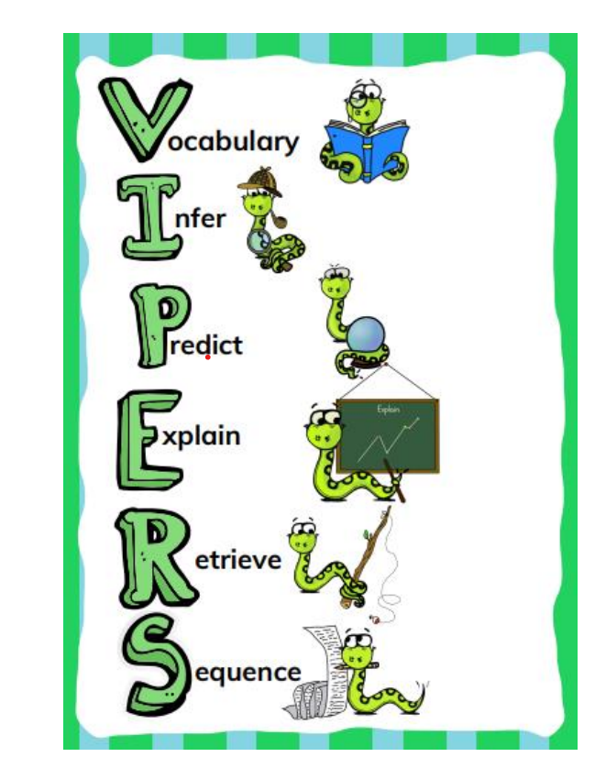

Slide 12
To help Reading at home
Genres- Introduce your children to different genres of books so they can figure out what they enjoy reading. Comics, fiction, real-life stories, thrillers, horror, or drama – give an age-appropriate sample of each genre to your child and let them figure out what they love most. Reading different kinds of books helps kids enjoy the reading process. Once your child has developed a habit of reading, you can even introduce some academic or skill-based material, such as how-to guides for a craft/hobby, computer coding or web design basics. Assist them with selections and help make reading a fun activity for your children.
Story Charades- Another way to make reading fun is by playing story charades as a family. Story charades is like regular charades, but you only have to guess books. Games like these will encourage your children to read and play so they can also act, guess, and become involved in a fun activity. You can encourage them by giving different roles to play. You can even get costumes so they can role play while playing games after reading books.
Dedicated Reading Space- If you have enough space at home, try to make a reading corner for your kids. Focus on the ambiance and make it cozy for them, so they enjoy the whole mood. Children love to have fun with make-believe things, so try out a tent or a fort made of pillows and sheets with cute lights. The feeling of having a fun space for reading or writing will motivate them to have their reading time every day, and eventually they might start seeking out the space and reading more often.

Slide 13
Lead by example- Teach your children how to love books and keep them safe from an early age. Make a dedicated space like a bookshelf or special book box where you can keep all the books safe. If you show that you love books in front of your kids, they will learn to value them and keep them safe as well.
Let Them Read What They Want- Taking your children to the library or bookstore is another fun family activity that can deepen their love for reading. Let them decide which book they want to read. This activity can be very motivating for children when they know they get to choose their next book. If a child is reading what you want them to read, most likely they will lose interest quickly; however, a book of their own choice will keep them motivated to read it.
Curiosity- Children love to find out what happens next. If you make them curious about story time, they will likely be interested in reading what happens next. Curiosity is the one thing that makes it difficult for anyone to leave books!
Read aloud- Reading aloud with your child can add a bit more excitement to any book. Make the story more fun by using different voices for each character and an expressive voice for dramatic parts. You can also take turns reading aloud together, choosing a character you will each provide a voice for.

Slide 14
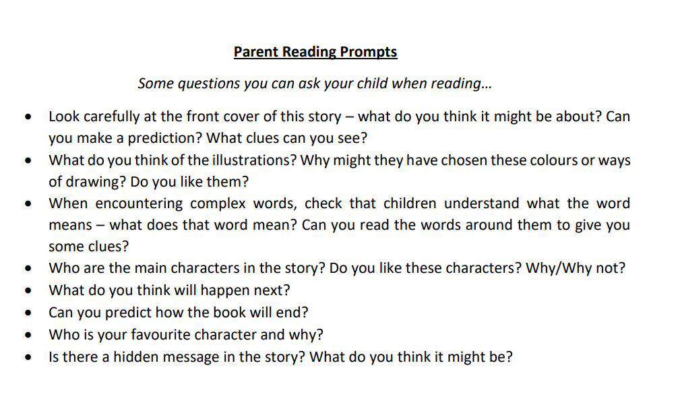

Slide 15
Free eBook library | Oxford Owl from Oxford University Press

