Slide 1
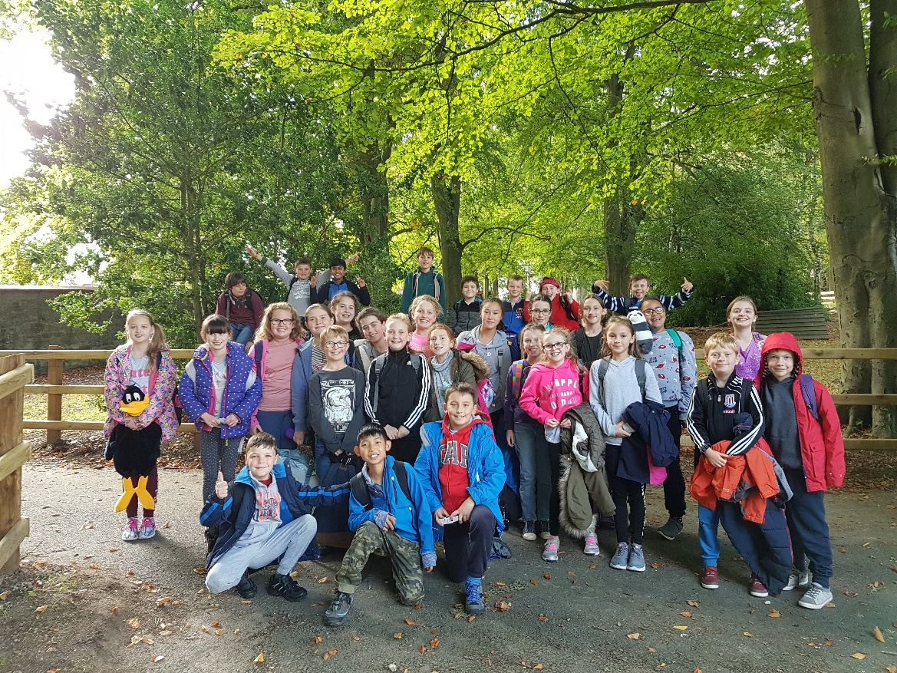
Manor Adventure
14th - 16th October 2026
An adventure - team building ,developing individual skills and self-confidence

Slide 2
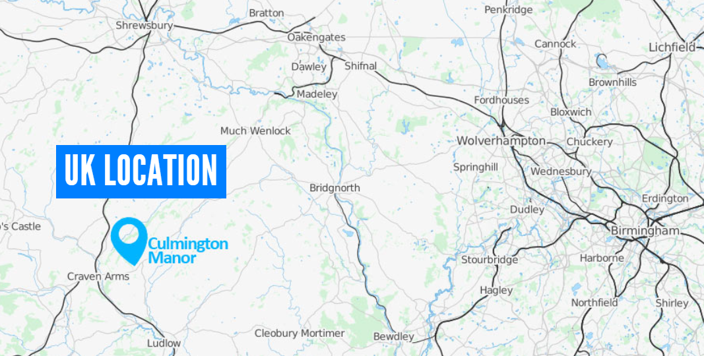

Slide 3
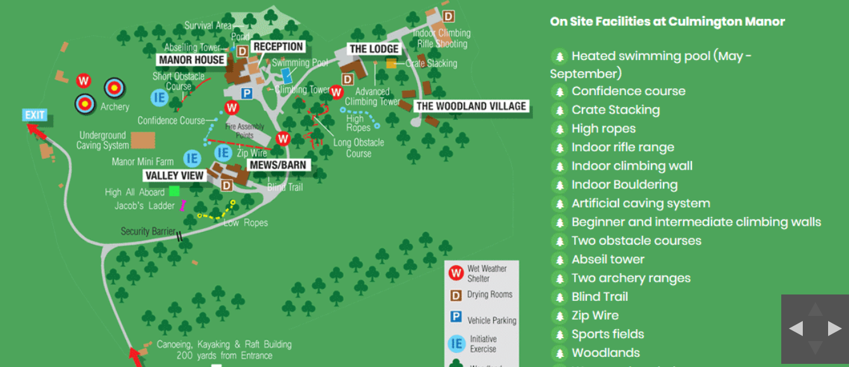
Culmington Manor

Slide 4


Slide 5


Slide 6


Slide 7


Slide 8
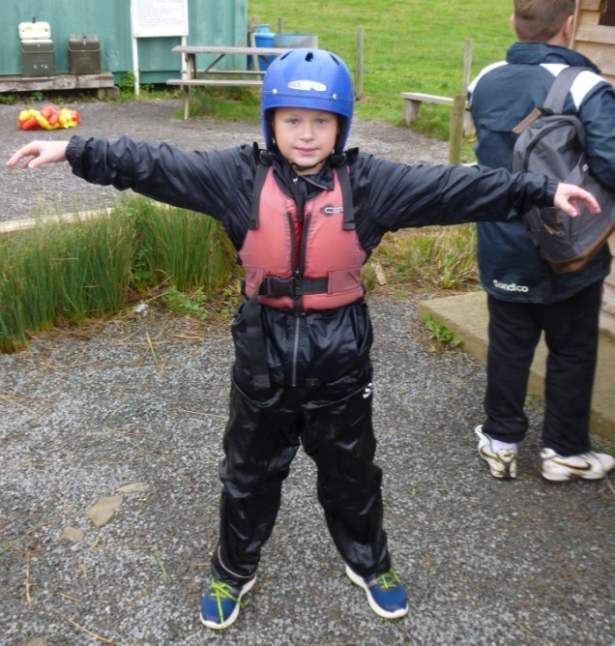
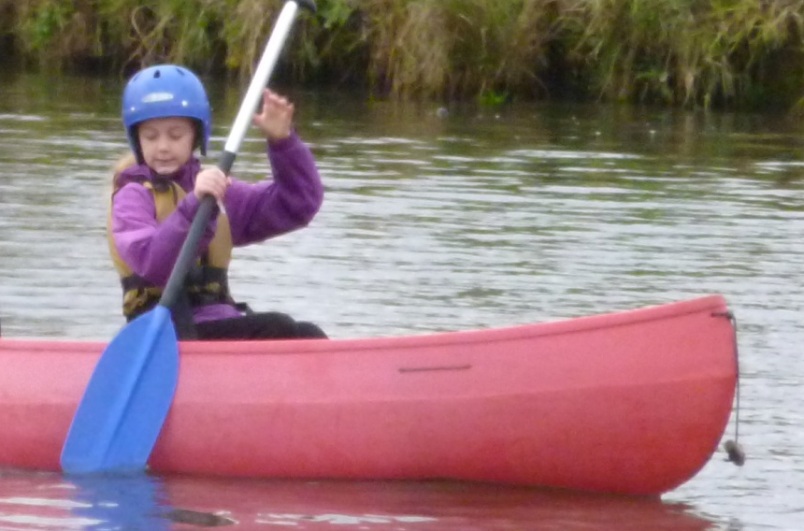
The Activities
Kayaking and Canoeing

Slide 9
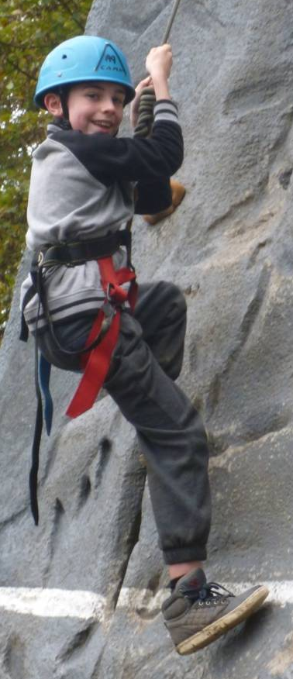
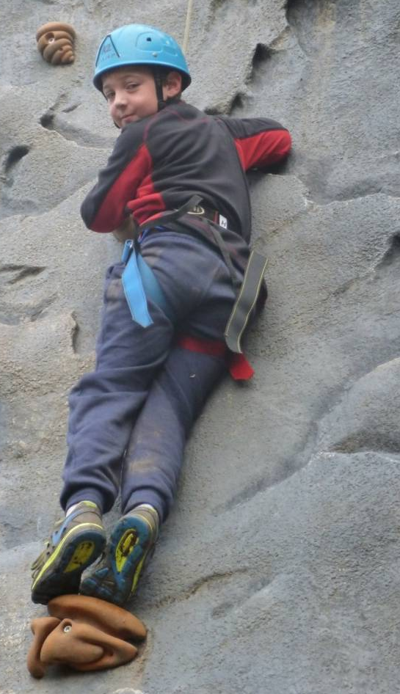
Climbing wall

Slide 10
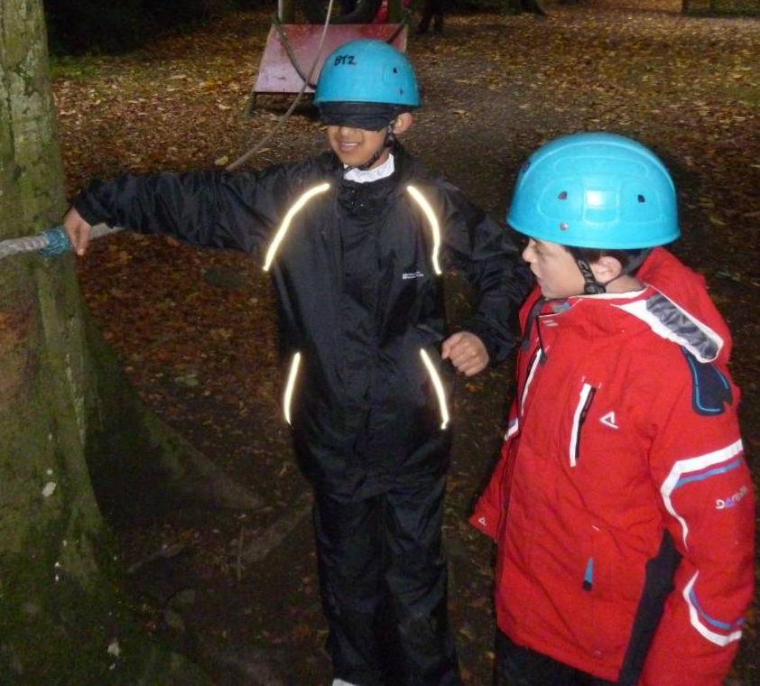
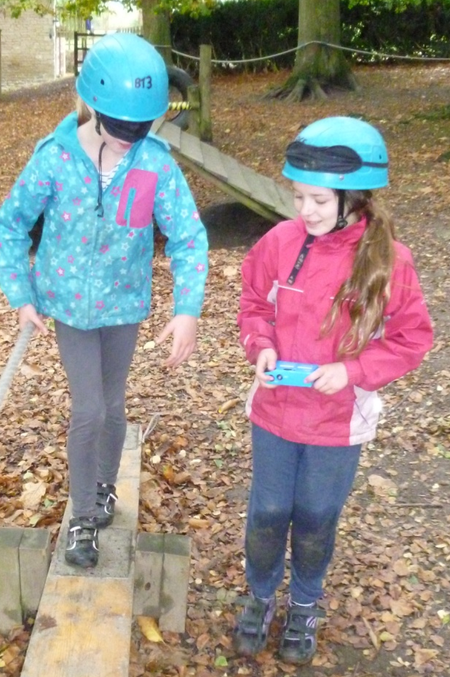
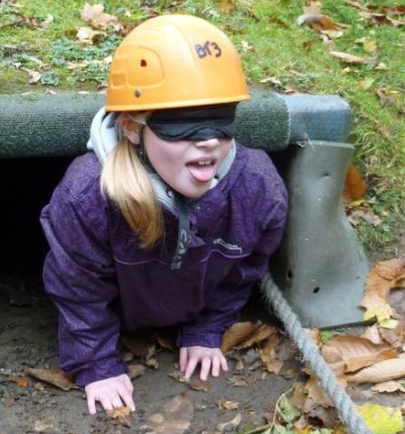
Blind Trail

Slide 11
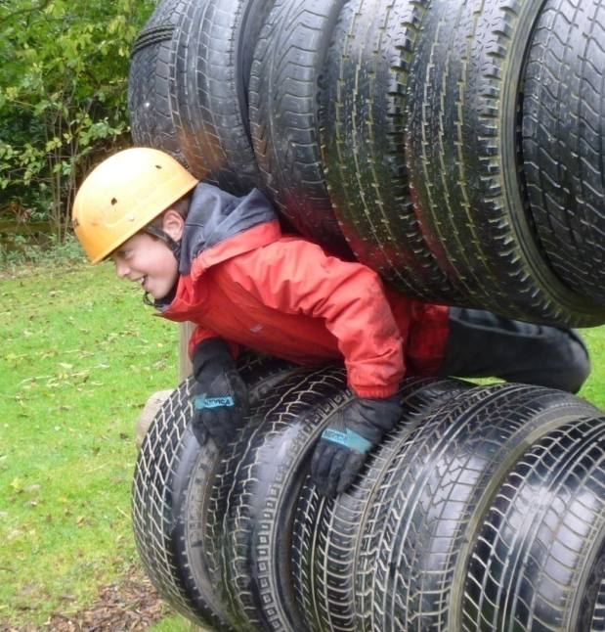
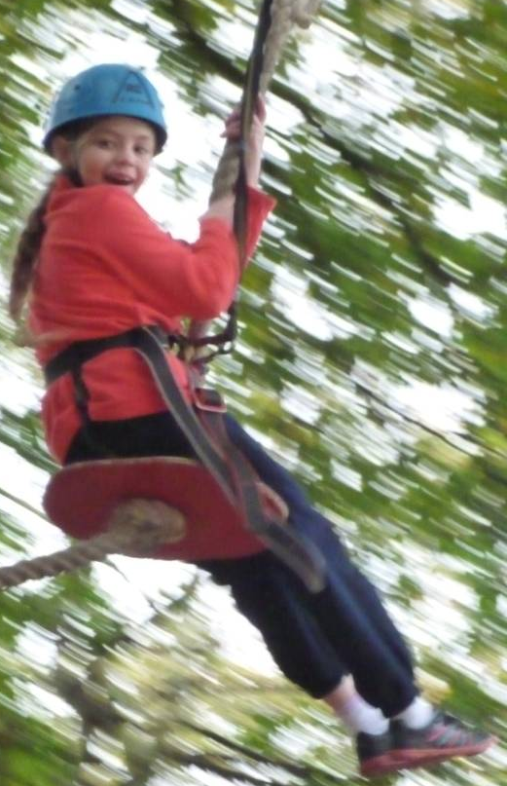
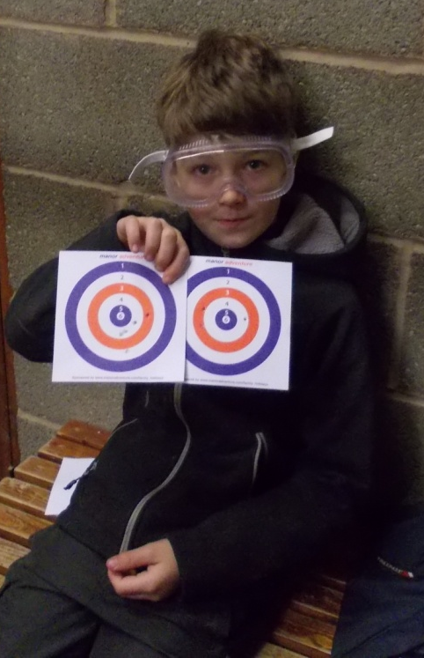
Zip-Wire
Obstacle Course
Rifle Shooting

Slide 12
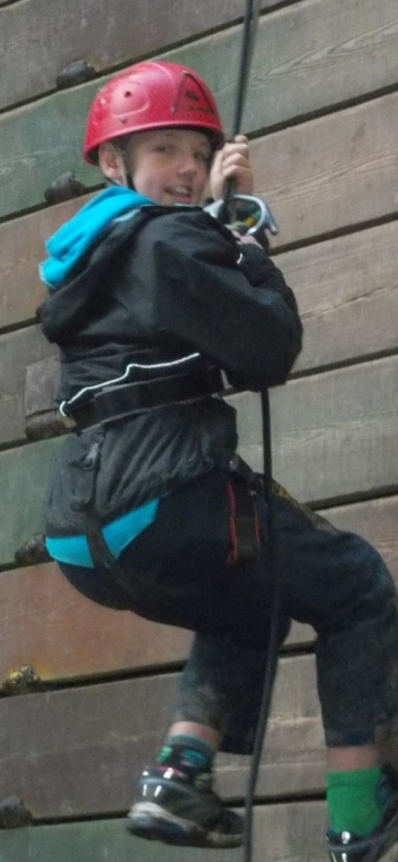
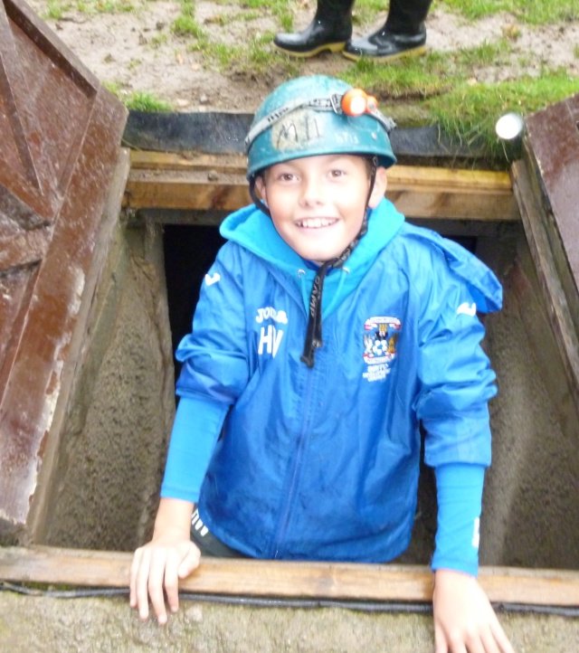
Abseiling
Under Ground Maze

Slide 13
Timetable
7:30 - Rise and Shine
8:00 - Breakfast (time on a rota)
9:10 – 10:30 Activity Session 1
10:30 – 10:45 Break Time
10:45 – 12:15 Activity Session 2
12:15 – 14:00 Lunch (time on a rota)
14:00 – 15:30 Activity Session 3
15:30 – 15:45 Break Time
15:45 – 17:15 Activity Session 4
17:15 – 19:00 Evening Meal (time on a rota)
19:00 – 20:30 Activity Session 5

Slide 14
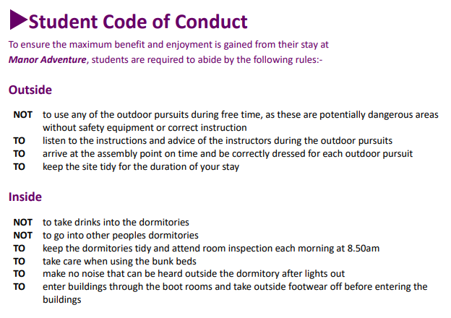

Slide 15
Accommodation
Boys’ dormitories and girls’ dormitories
Bunk beds
Cases used as cupboard
Teachers have rooms nearby
Dining room (serving lots of food!)
Outside areas during free time

Slide 16
Bed bugs
First and foremost, I want to emphasise that the safety and well-being of the children and students attending the centres are our top priorities. We have taken all necessary precautions to ensure that our facilities are clean and free from any potential risks, including bed bugs. Our dedicated staff members have been diligently maintaining a high standard of cleanliness and hygiene throughout our centres.
However, as a proactive measure, we kindly request that you ensure all children and students attending the centres have thoroughly laundered their sleeping bags before the trip. While we take every precaution to keep our centres clean, it is important to remember that many sleeping bags are kept in storage, and a thorough hot wash above 60 degrees can help eliminate any potential allergens or irritants including Bed Bugs

Slide 17
What to bring
Pack a case that will slide under a bed:
Sleeping bag + pillow and pillow case
Drink bottle
Torch
Rucksack
Toiletries (no aerosols please)
Old clothes (long and short sleeved T-shirts/jumpers, jogging bottoms, underwear, leggings, socks)
Old trainers (no wellies)
Waterproof clothing – jacket and trousers
Bag for dirty clothes
Bath towels (x2)
Hat and gloves
Pyjamas/slippers
1 snack
Quiet activities – playing cards, books, colouring etc.
Please name as many items as possible.

Slide 18
Medication
Please bring any medication in a clear plastic bag on Wednesday 14th October and hand it to Miss Cole.
Please ensure it is clearly labelled with your child’s name and the dosage required.
Please label inhalers with your child’s name.
Please inform us of any new medical information.

Slide 19
Valuables
Do send your child with a disposable camera. No phones please.
Don't bring mobile phones.
Don't bring electronic games.
There is no need for you child to bring any money.

Slide 20
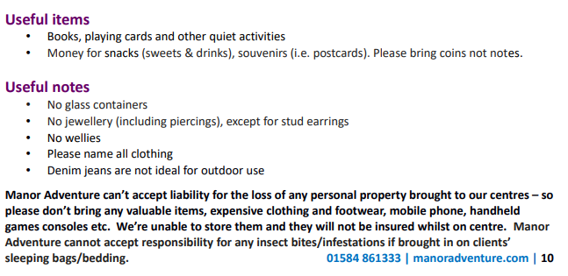

Slide 21
Arriving and Departing
Wednesday 14th October – arrive at school at normal time, in non-uniform with a packed lunch. Leave school and arrive at Manor at 14.30pm.
On arrival, we will ring school and the office staff will email parents.
Fri 16th October – leave Manor at 13:30. Arrive back at school by 15:30 – hopefully!

Slide 22
More Information
More information about Manor Adventure (Culmington Manor) can be found on their website: www.manoradventure.com
Culmington Manor, Craven Arms, Shropshire, SY7 9BY
Tel: 01584 861333

Slide 23
Any questions?

