Slide 1


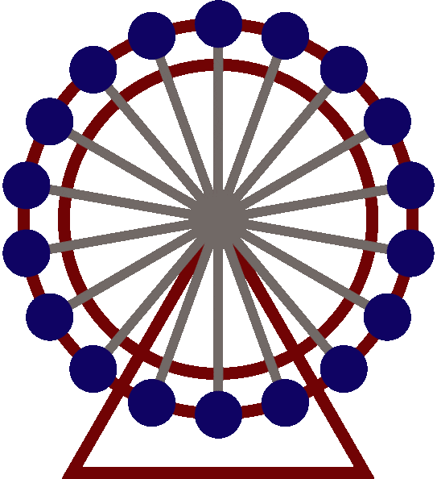








LONDON
Parent Guide
for our Year 2 Trip!
Presented by: Mrs Jayne Lavelle
Date: 27 April 2026

Slide 2
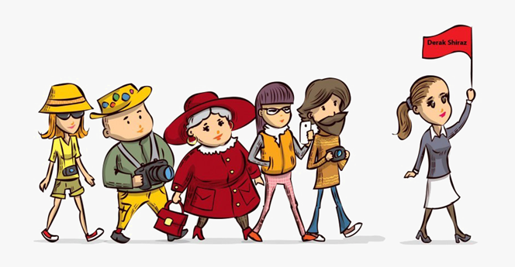

Confirmed Adult Details
Trip lead: Mrs Lavelle
Assistant Lead: Mrs Horlor
First Aider: Miss Cole
Parent Volunteers:
Miss Humphries
Mr Allsopp
Mrs Unitt
Miss Athwal
Mrs Somerville
Mr Wright

Slide 3

Details of Travel
Meet at School on Thursday 25th June, at 07:50 to walk to Warwick Parkway.
Travel by train to London
Children will need a packed lunch, two small snacks and plenty of water for the day.
Arrive in London at 09:45.
We will contact school informing them of our safe arrival & also post to social media.
Return to Warwick Parkway at approx. 6:10pm for collection.

Slide 4
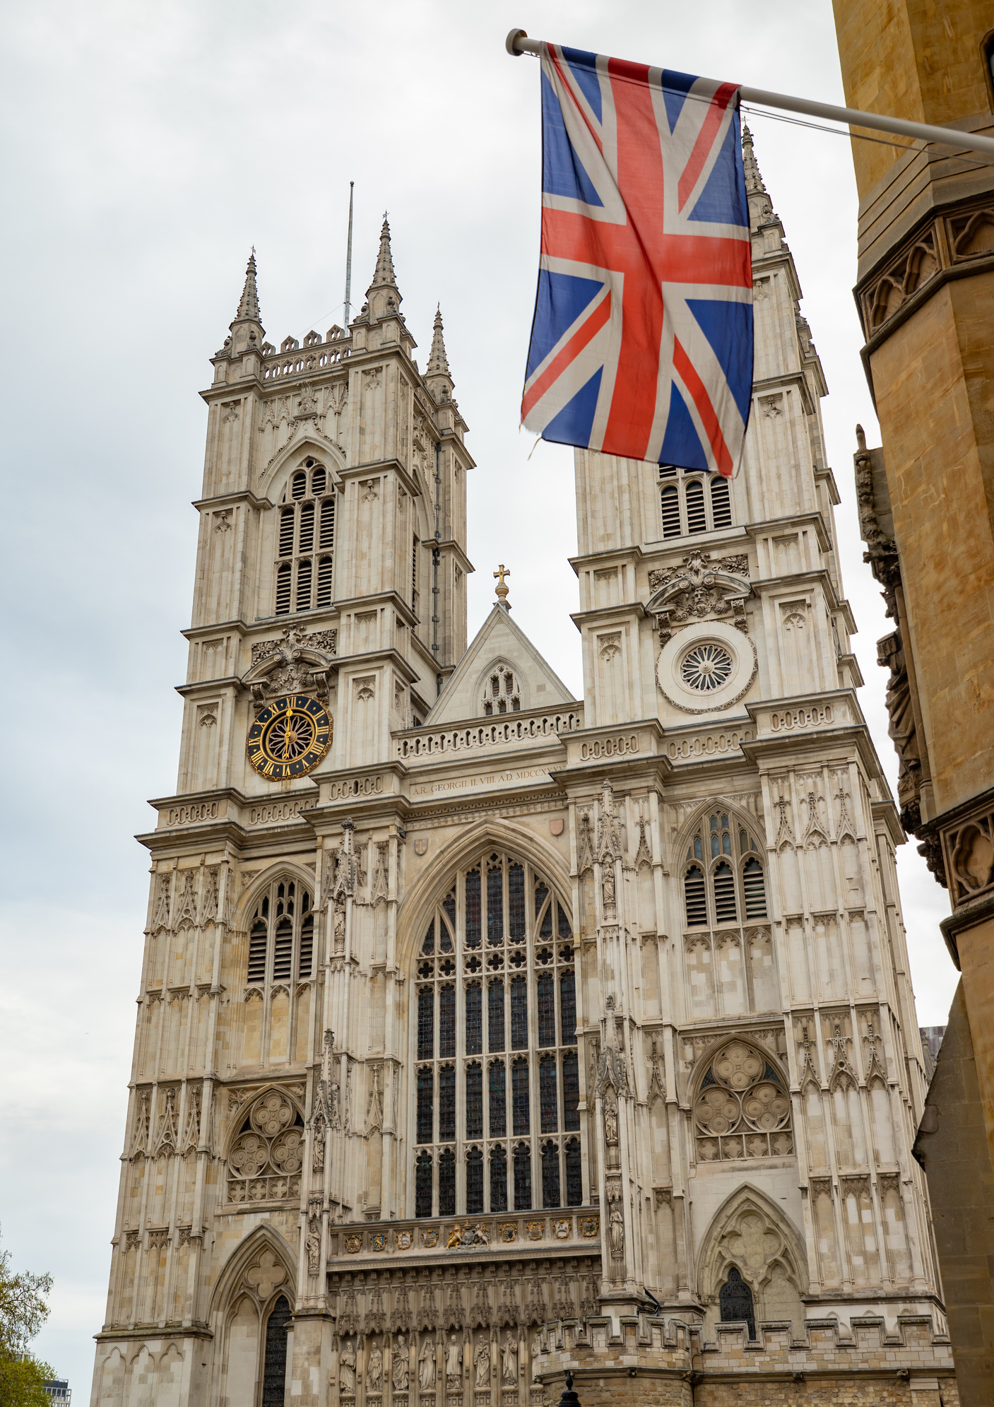

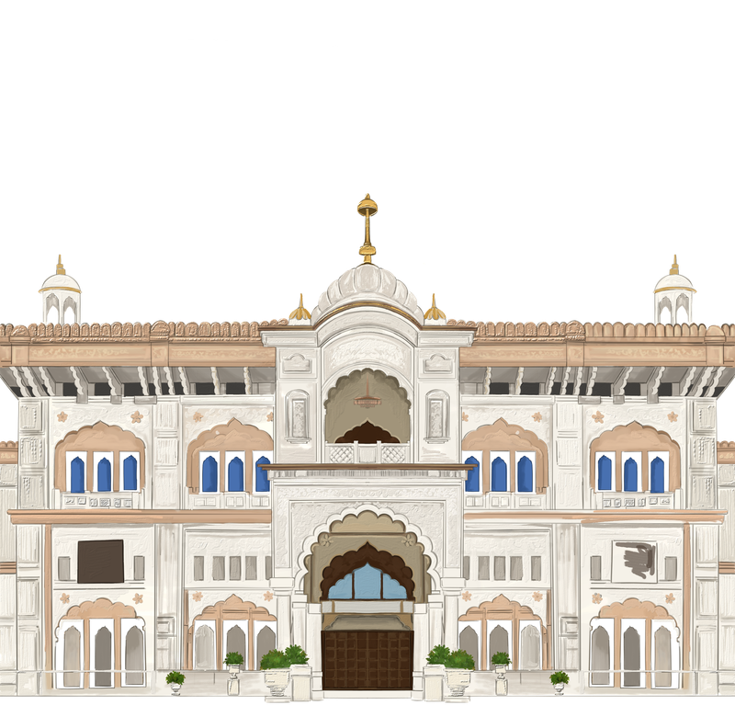
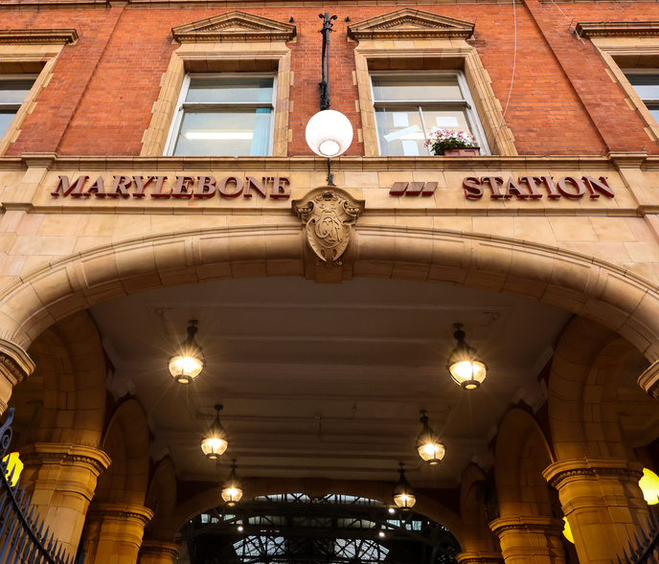
Itinerary
Depart Warwick Parkway: 08:11
Arrive at London Marylebone Station: 09:45
Toilet break
Bakerloo Line from Marylebone to Baker Street (1 stop - 1 minute)
Walk to Jubilee Line
Jubilee Line to Green Park (2 stops 16 minutes)
Walk to Buckingham Palace through the park (10 minutes)
Tour at 10:30 and lunch 12:30?
Walk along Birdcage Walk to Westminster Abbey (10 minutes)
Tour at 14:00 - 15:30
Walk to Westminster Tube station (2 minutes)
Jubilee Line to Baker Street (3 stops, 20 minutes)
Bakerloo Line to Marylebone (1 stop, 1 minute) with a short walk to terminal
Toilet break
Train to Warwick Parkway at 16:37
Arrive back at Warwick Parkway for collection 18:08

Slide 5
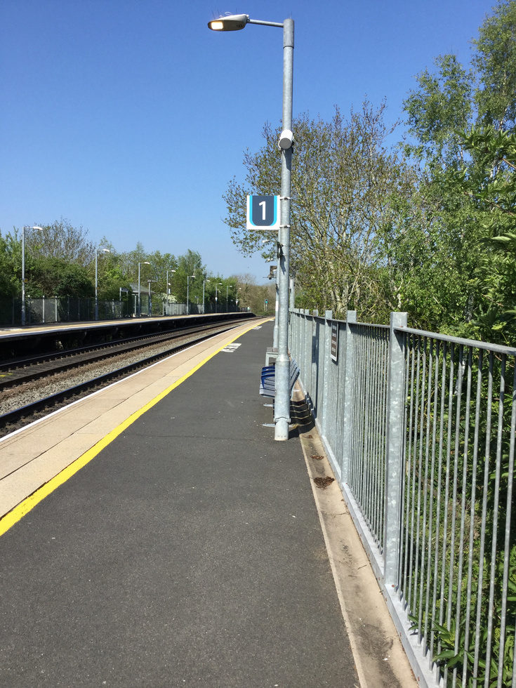
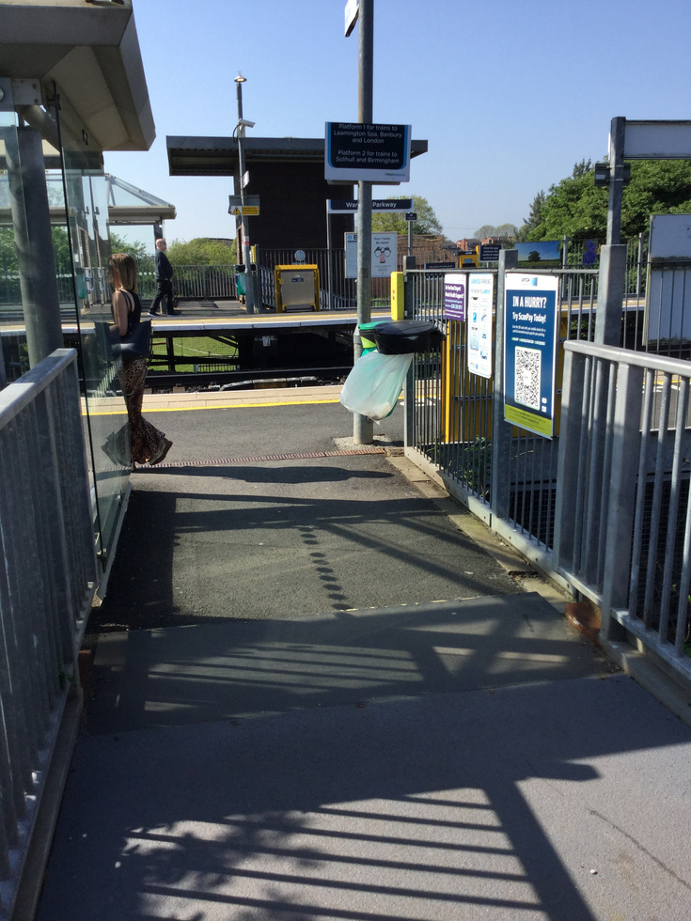
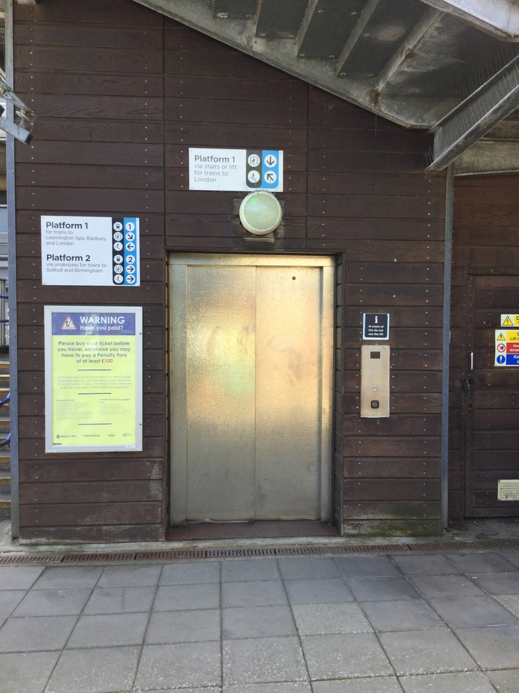
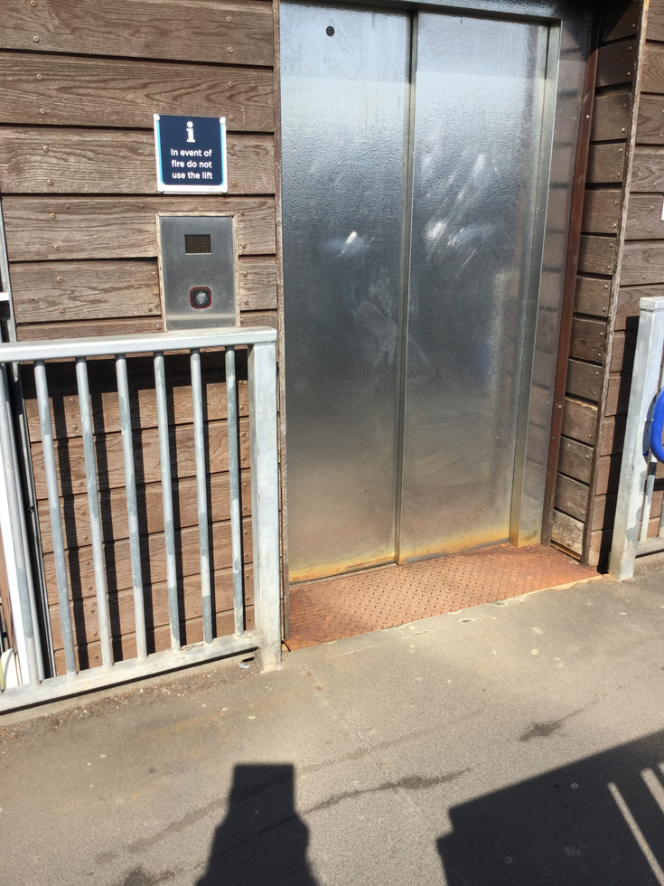
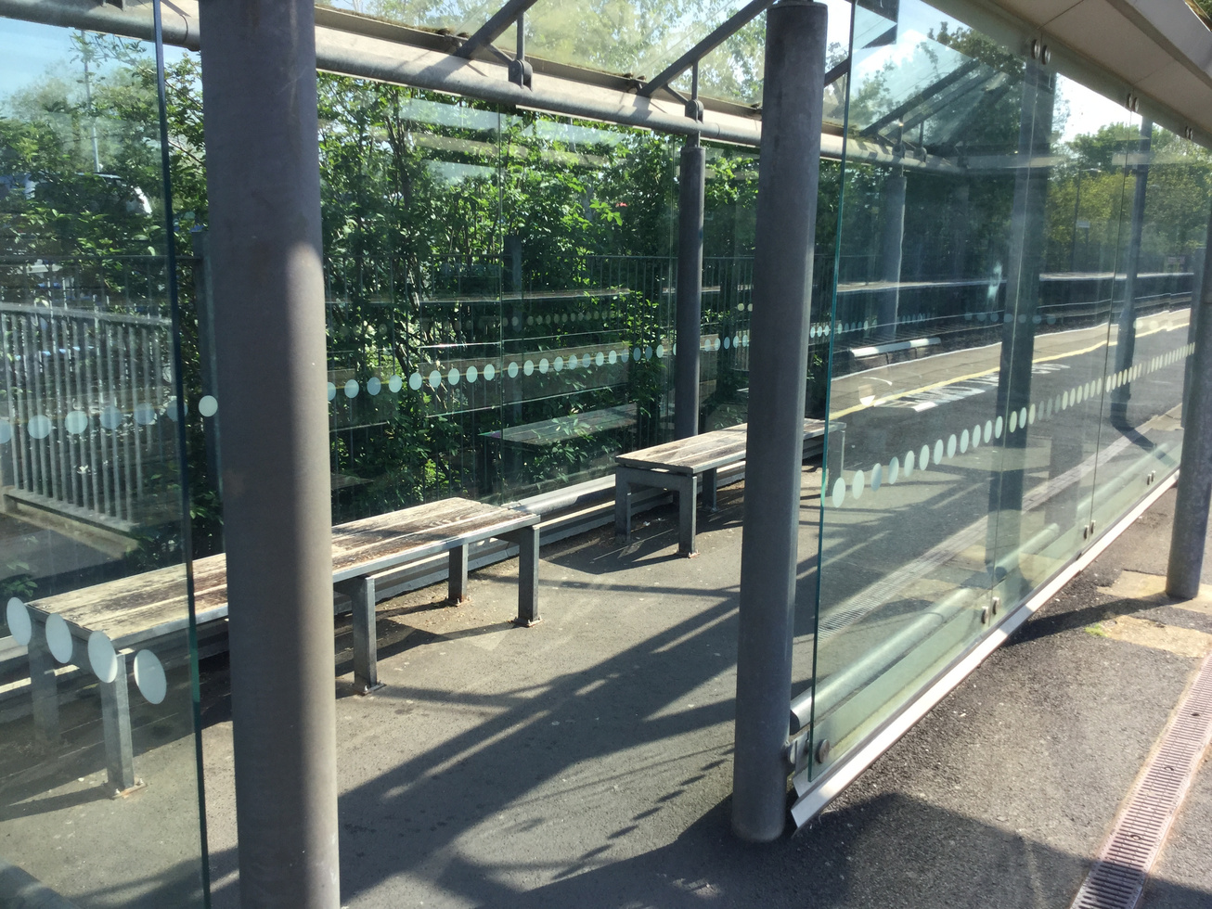
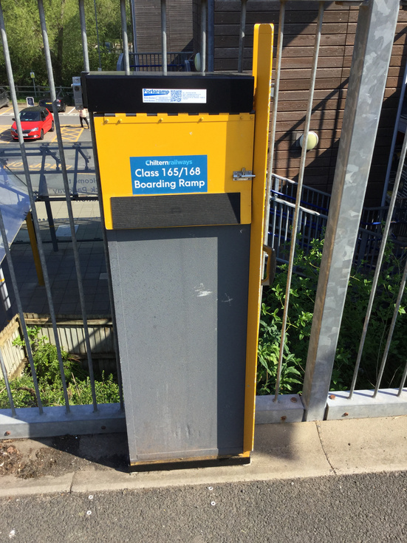
Photos of the route:
Warwick Parkway

Slide 6
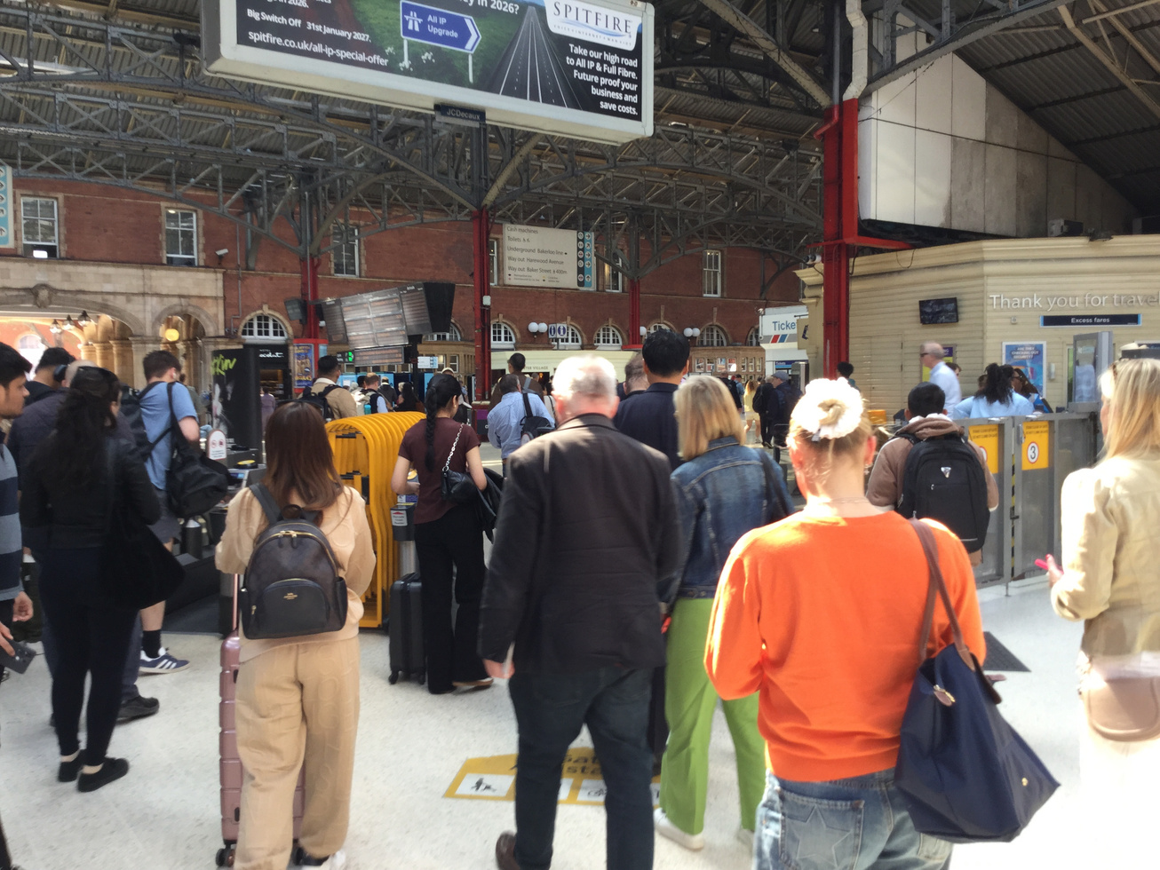
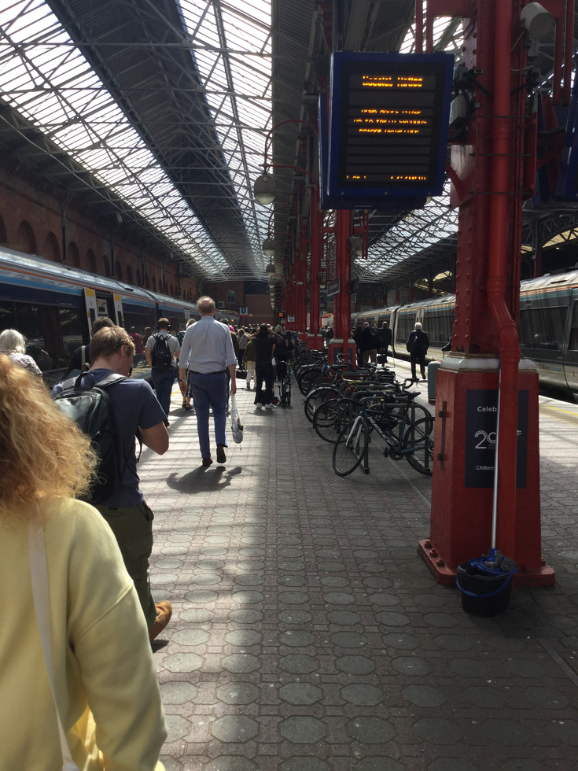
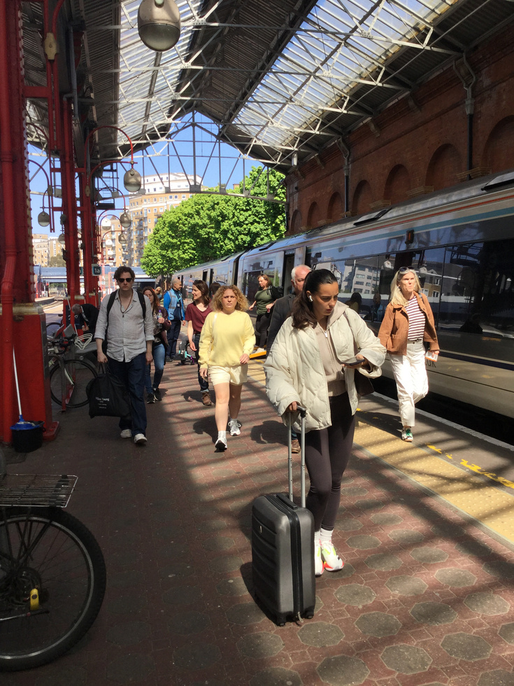
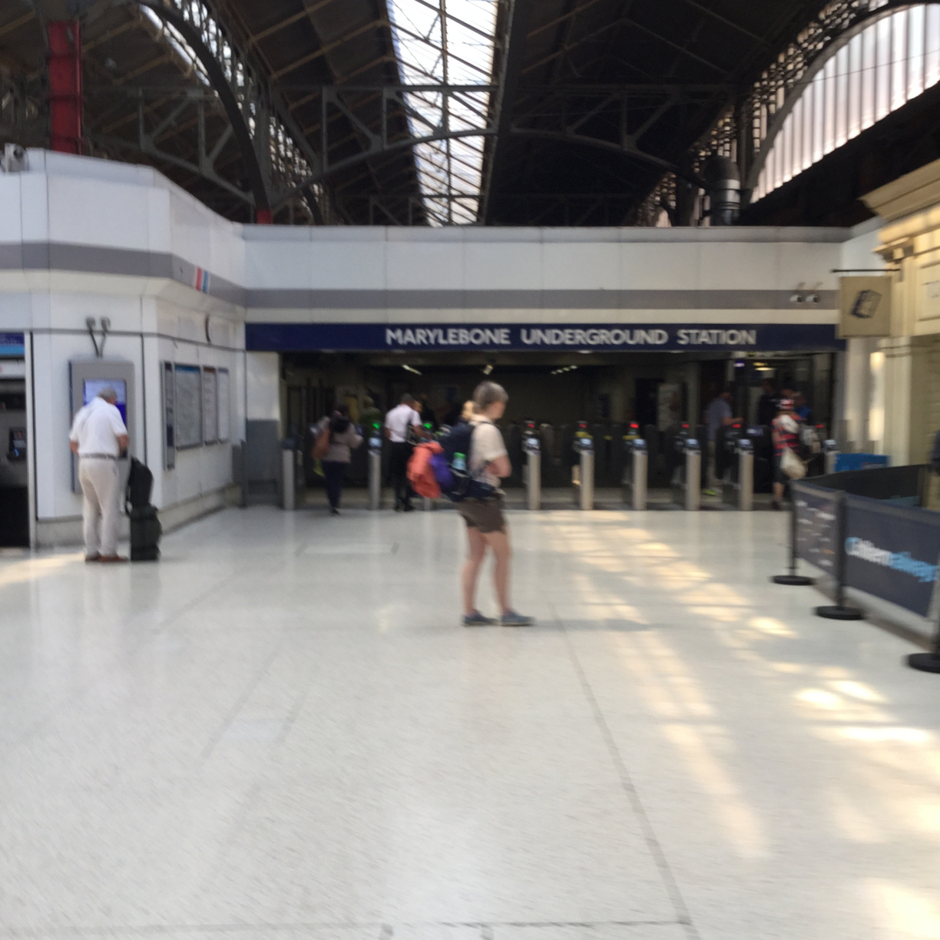
Photos of the route:
London Marylebone

Slide 7
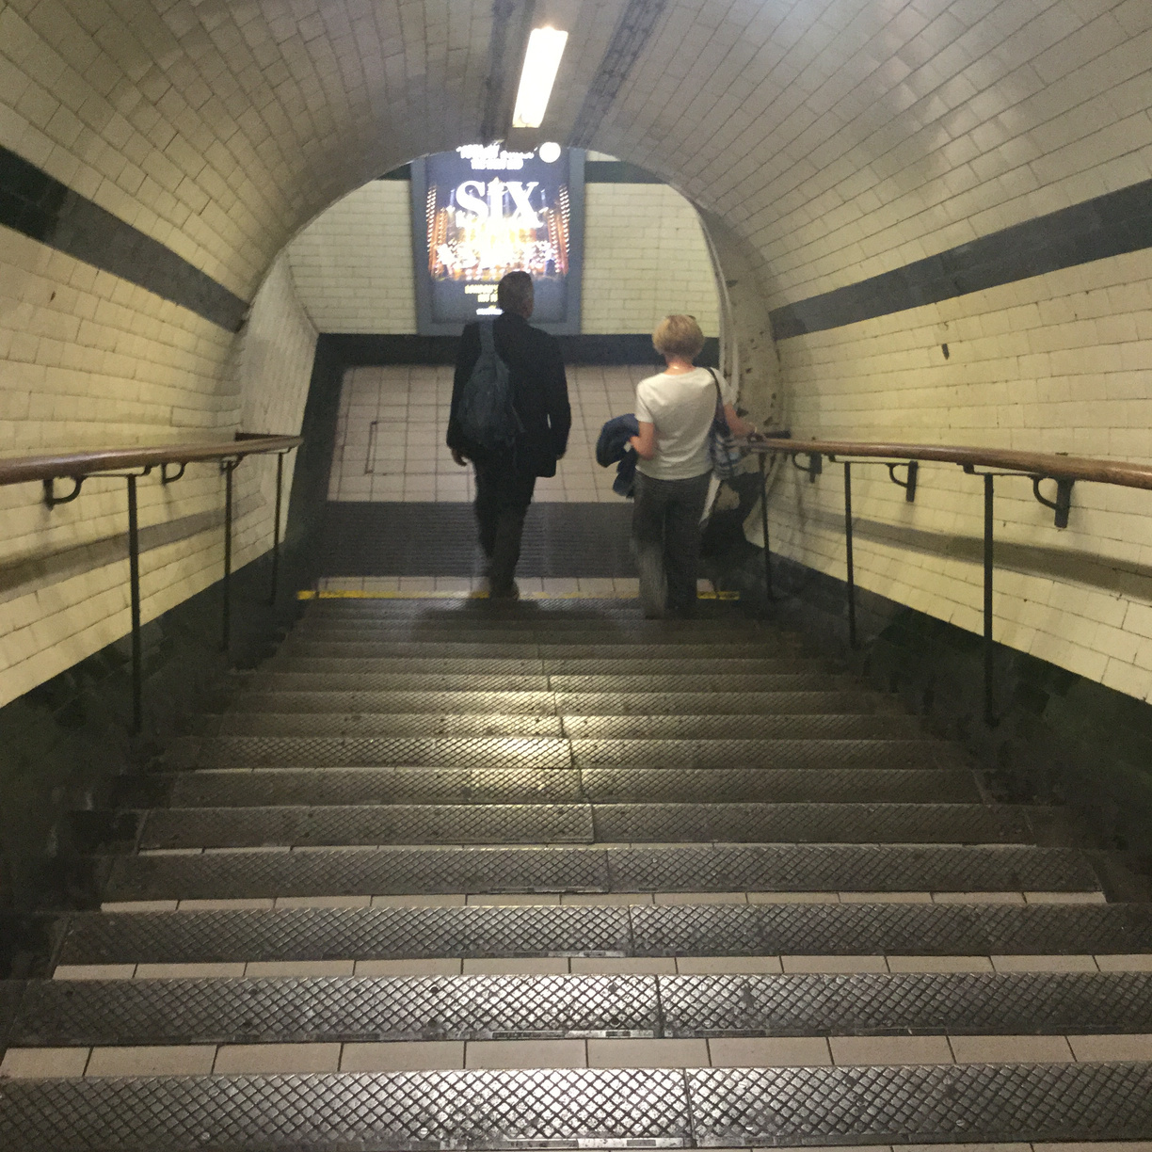
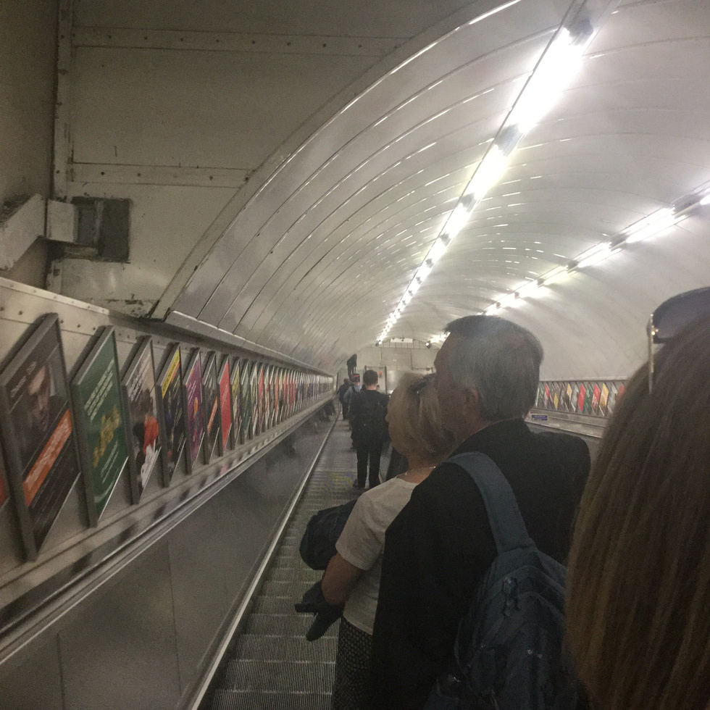
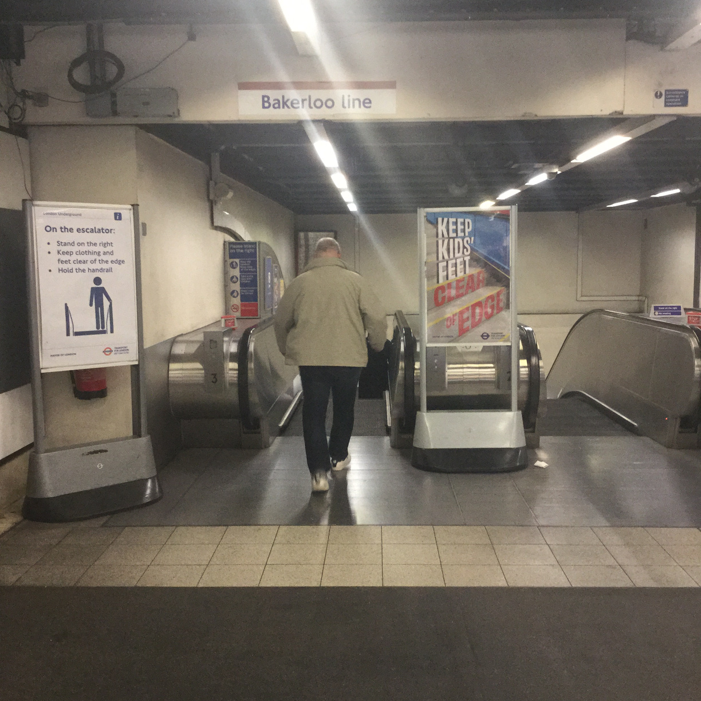
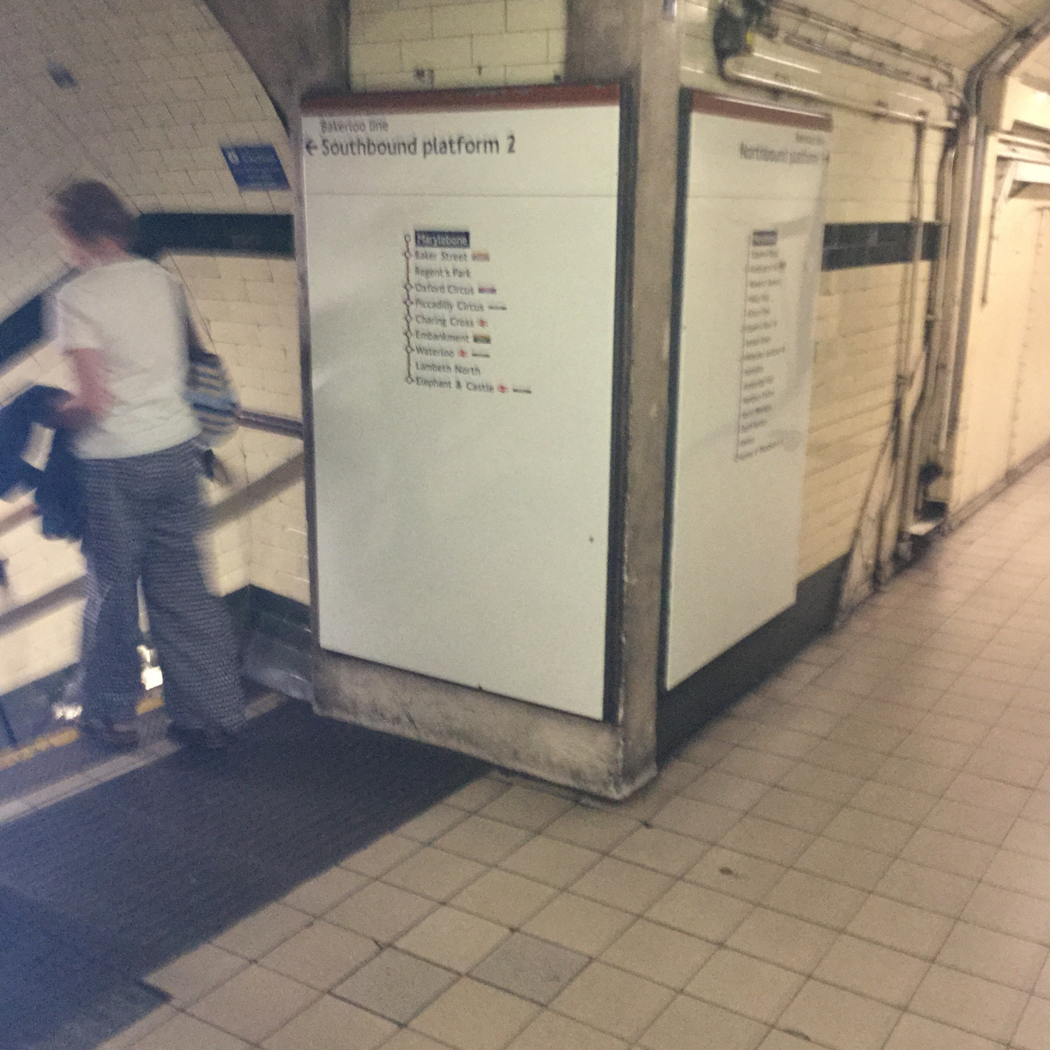
Photos of the route:
Bakerloo Line

Slide 8
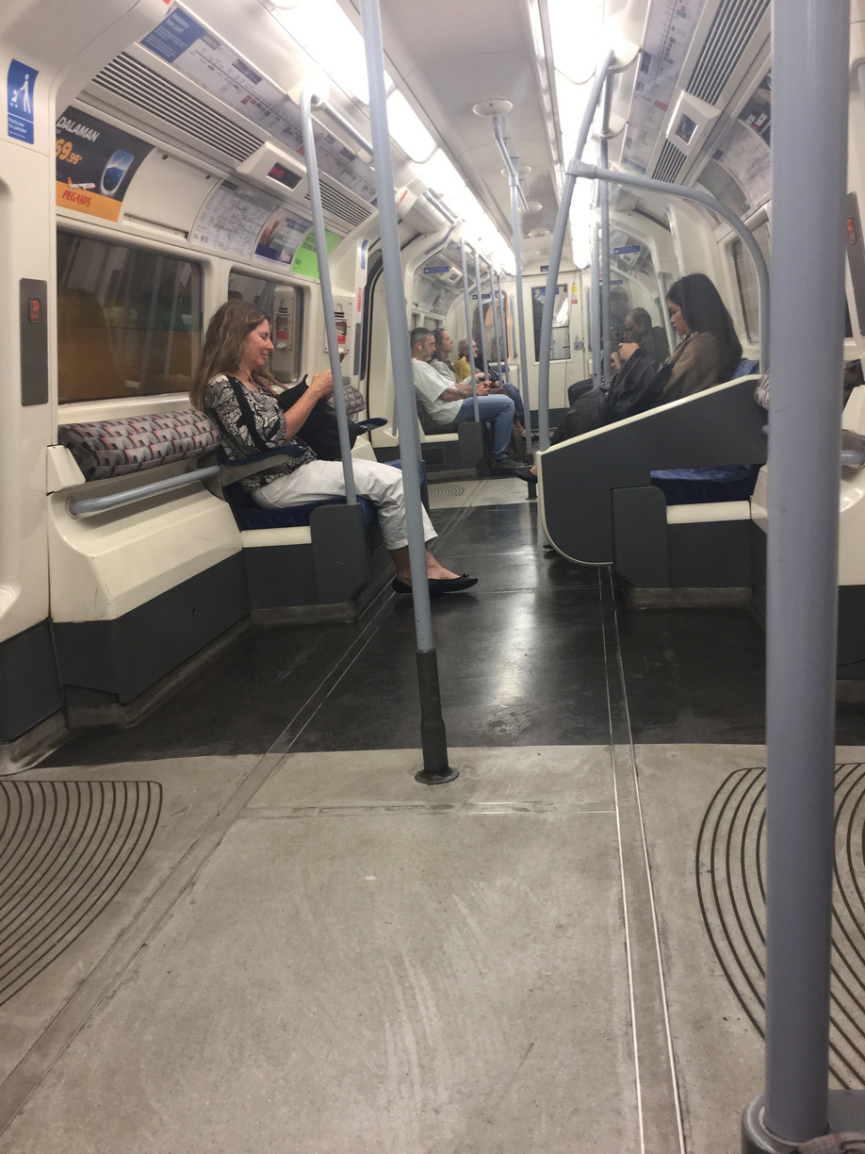
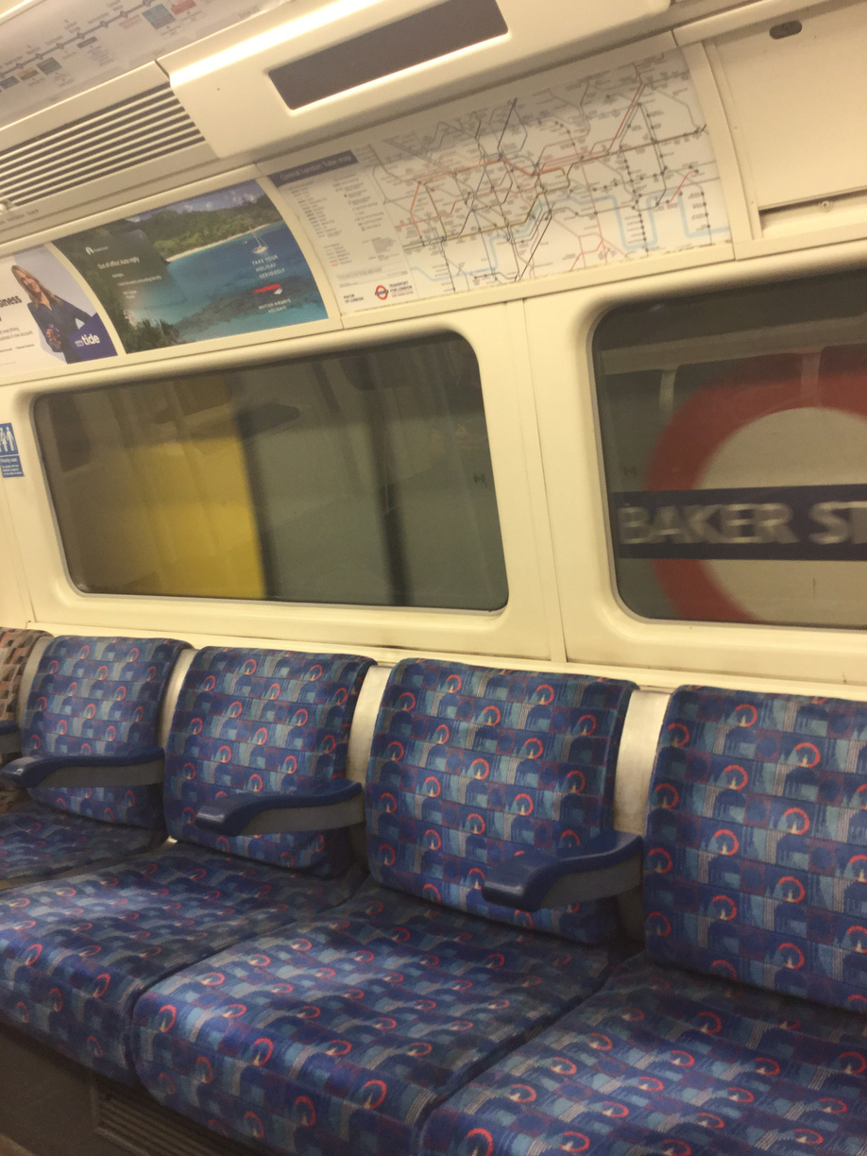
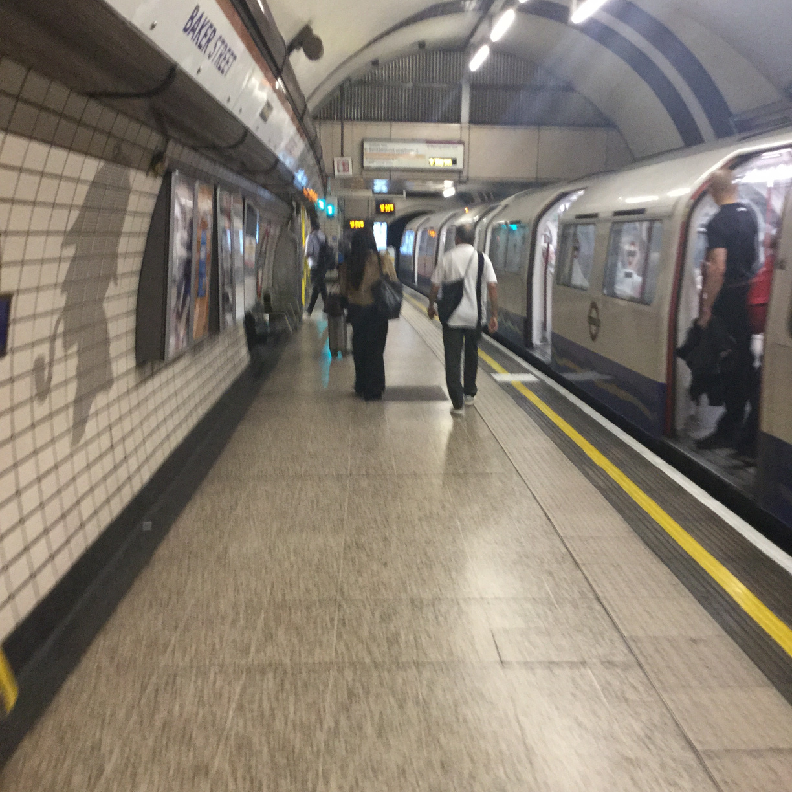
Photos of the route:
Jubilee Line

Slide 9
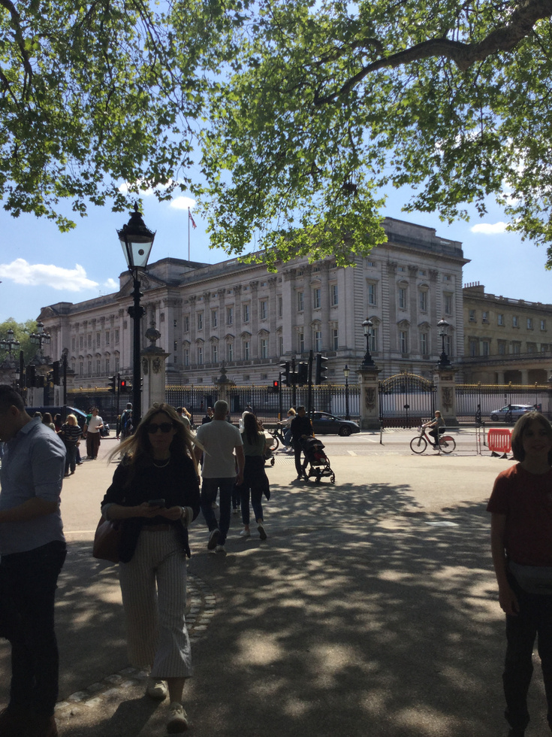
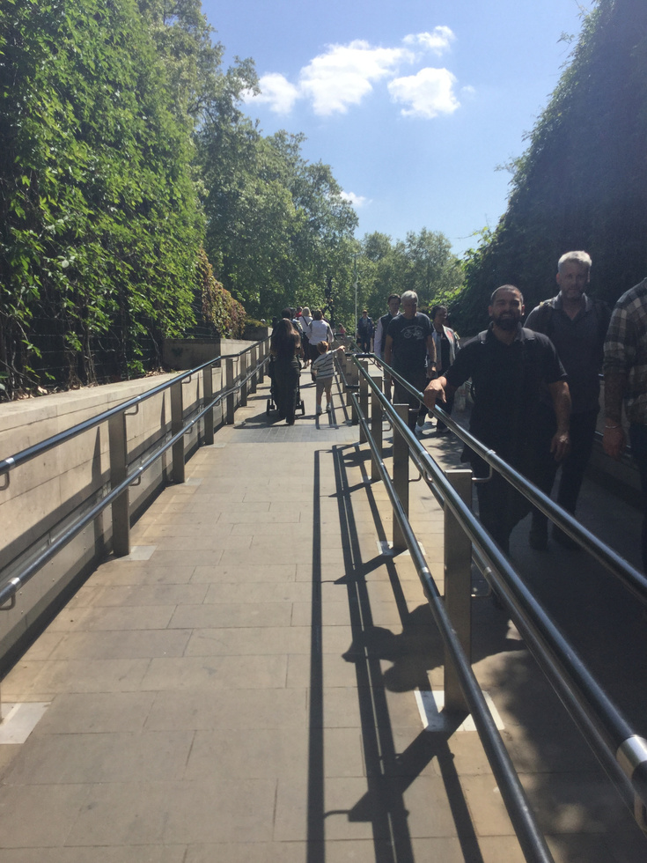
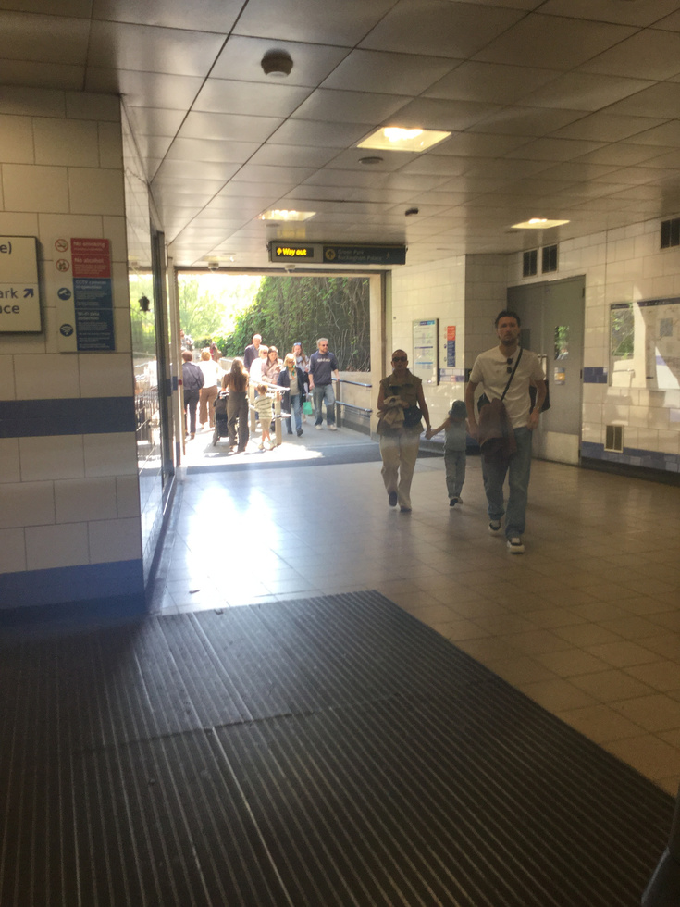
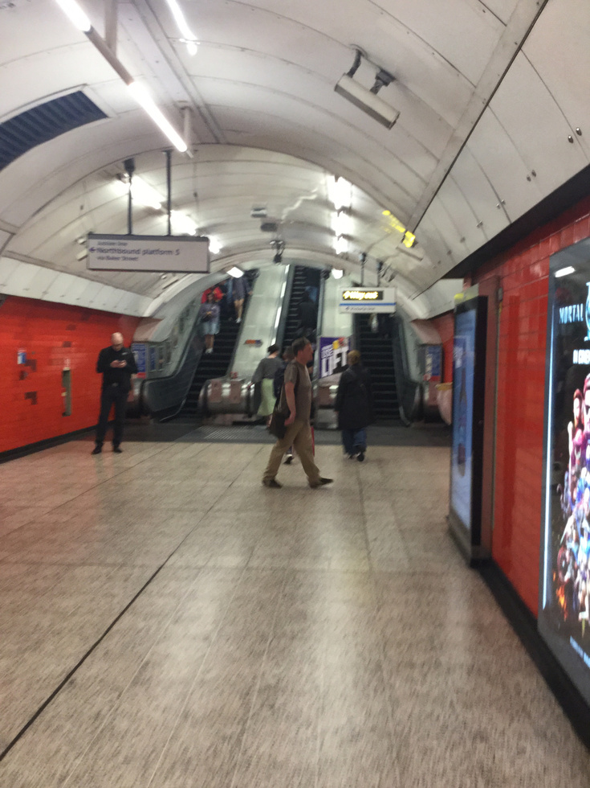
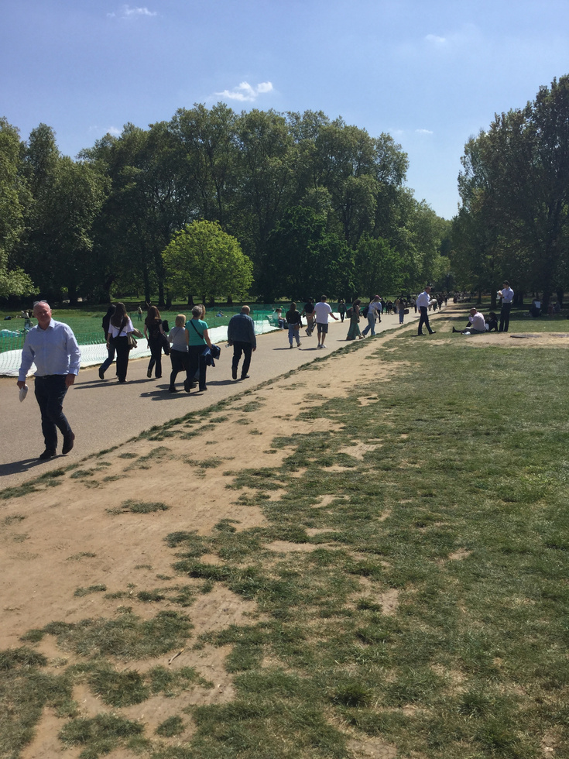
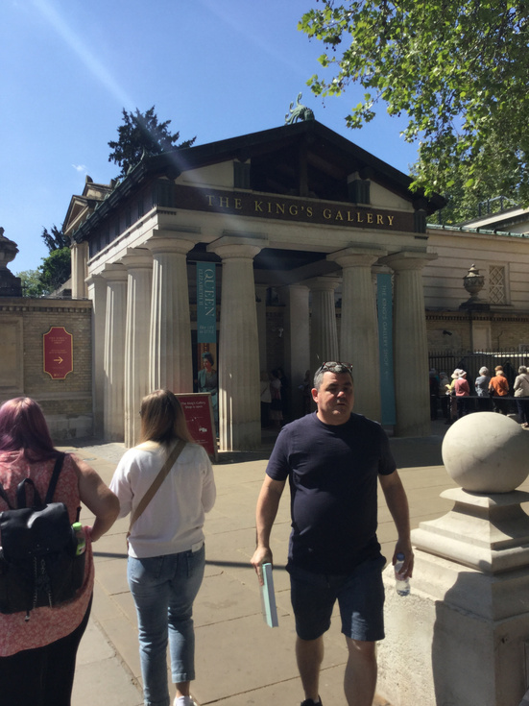
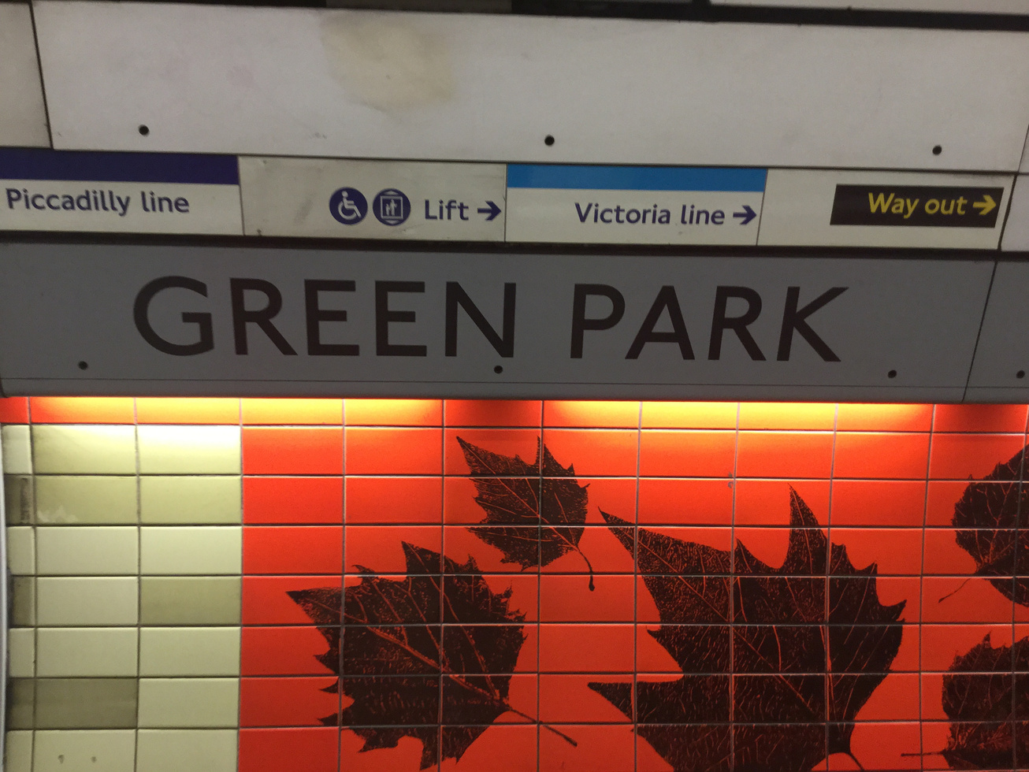
Photos of the route:
Walk to Buckingham Palace

Slide 10
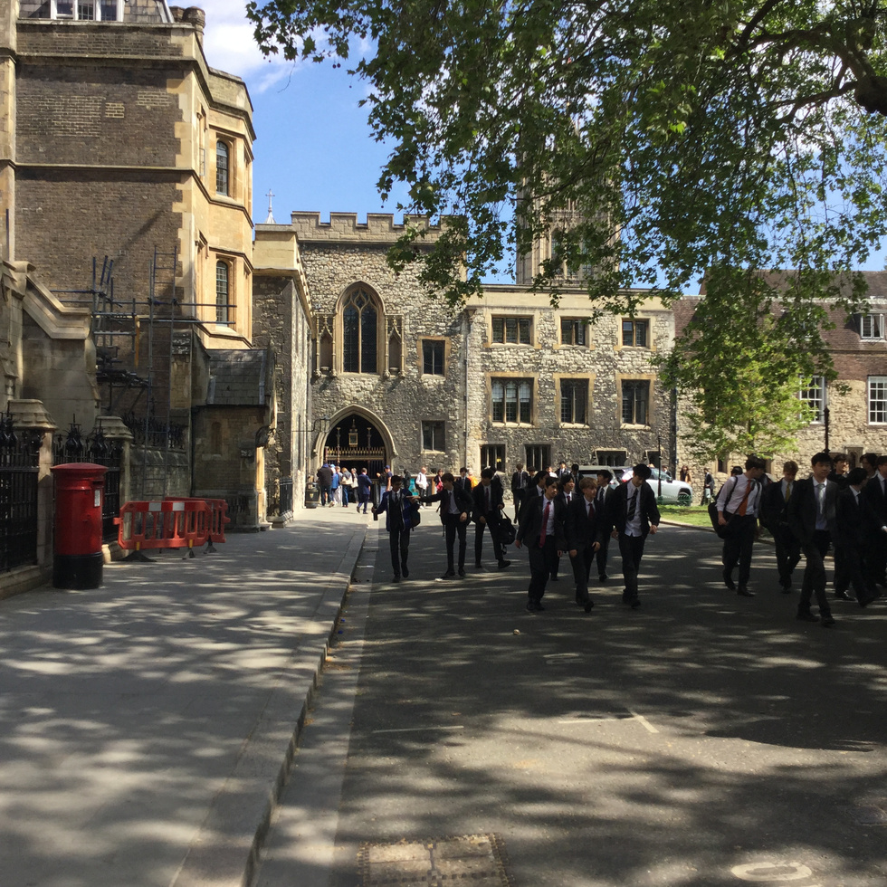
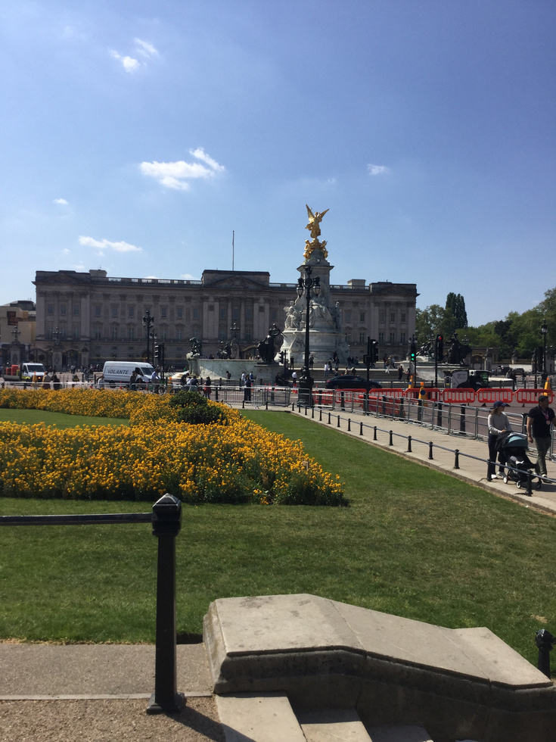
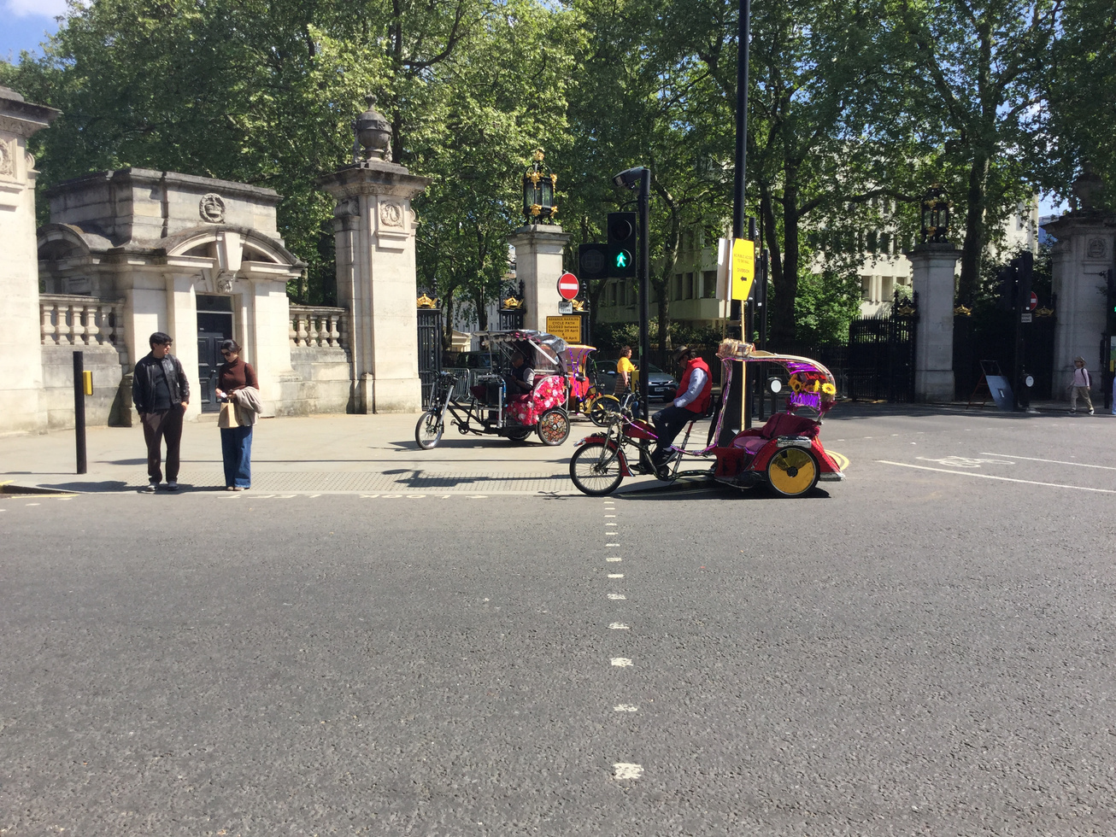
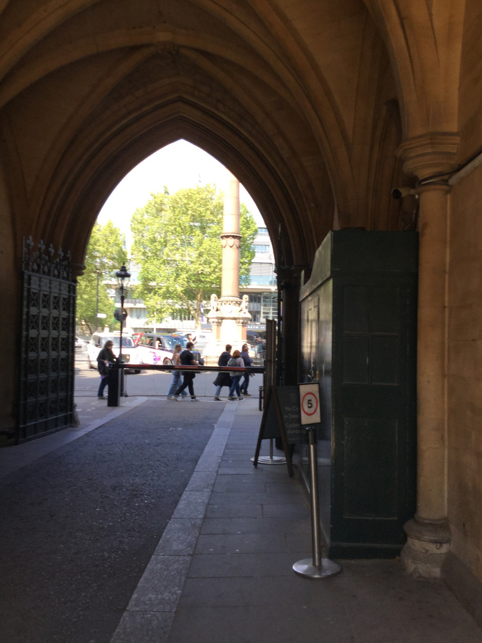
Photos of the route:
Walk to Westminster Abbey

Slide 11
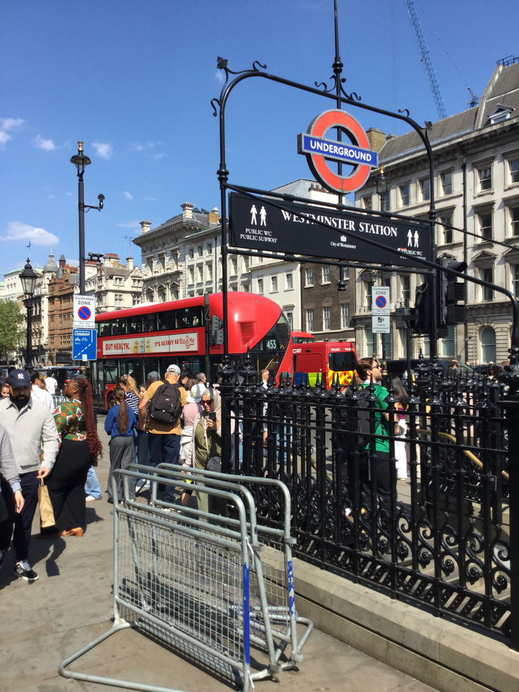
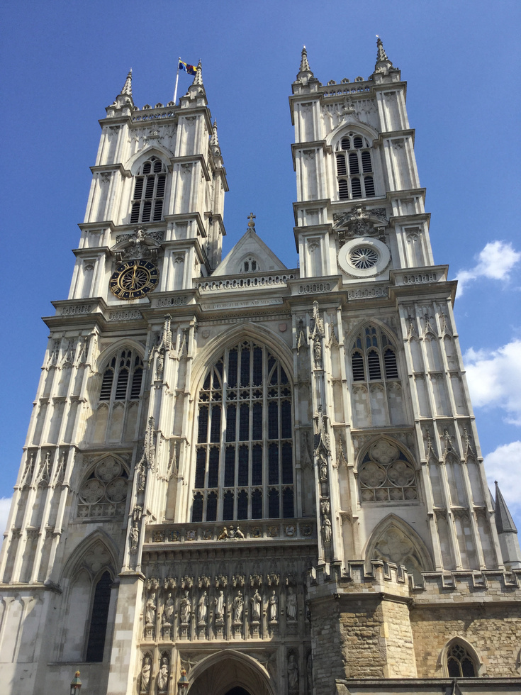
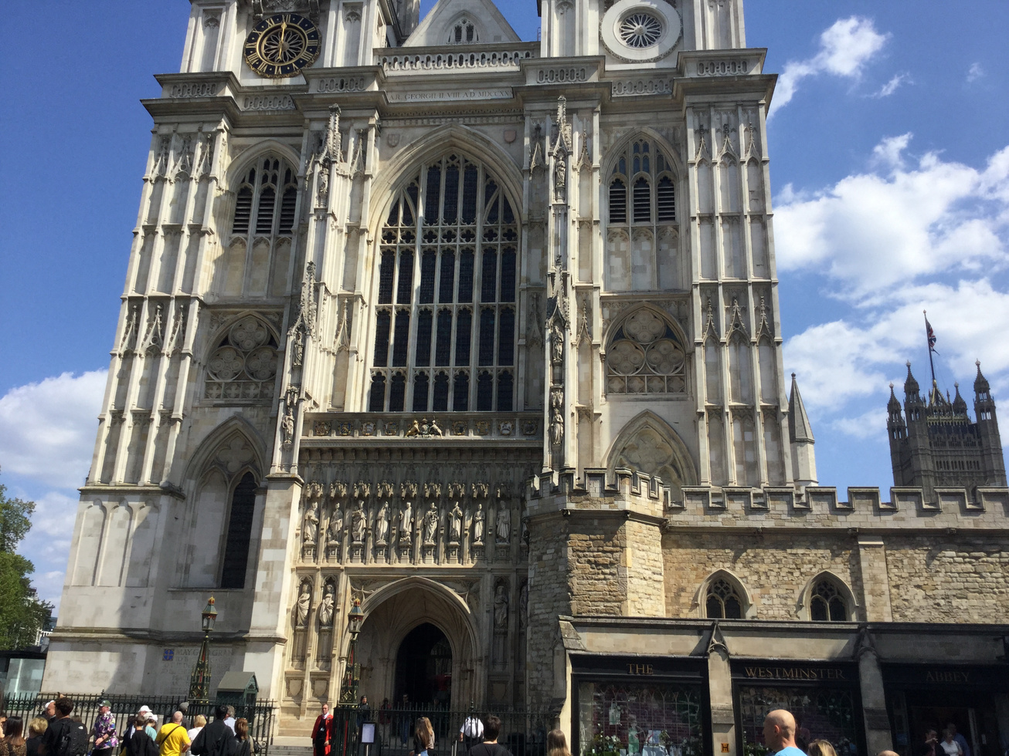
Photos of the route:
Westminster Abbey

Slide 12
