Slide 1

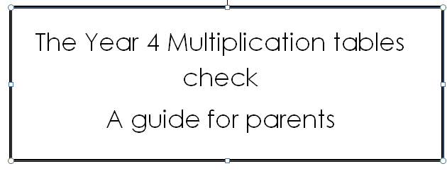
Thursday 5th February 2026

Slide 2
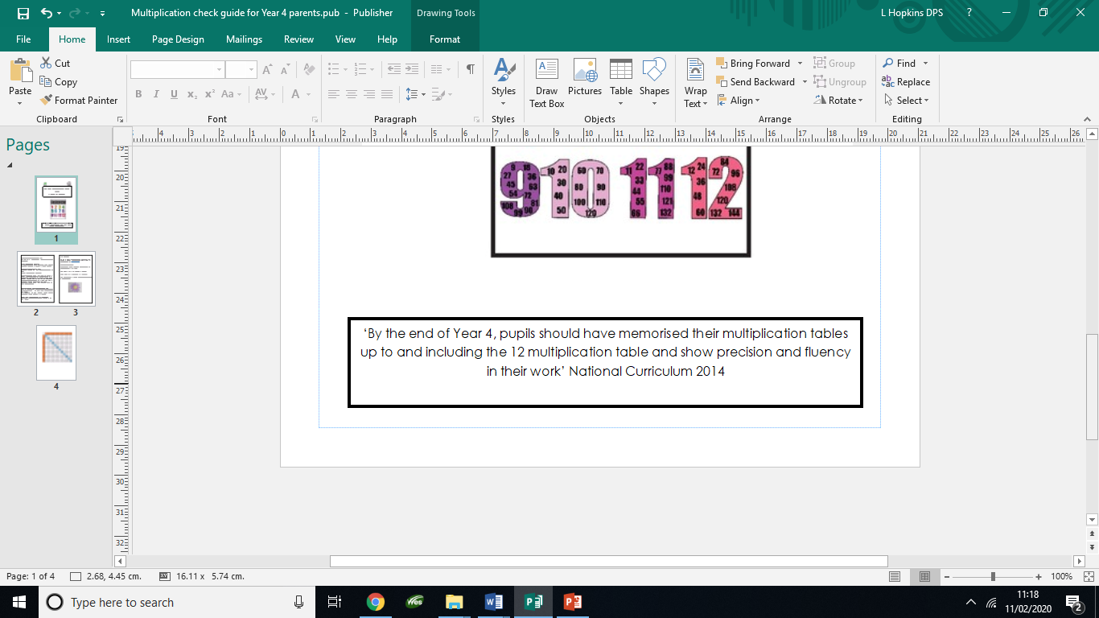
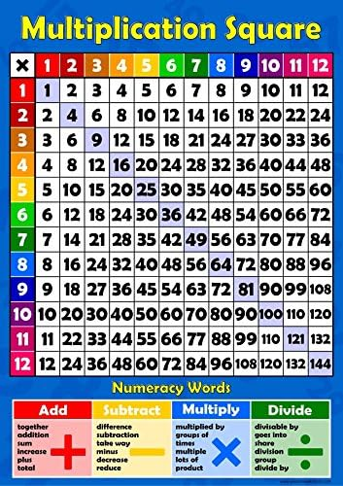
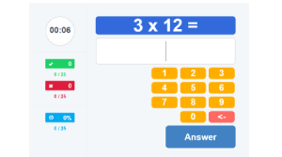

Slide 3
What is the purpose of the Multiplication tables check?
The purpose of the test is to determine if a Year 4 child can fluently recall their multiplication tables up to 12, which helps with future success in maths.
There is no pass mark and results can show teachers who may need extra support with times tables.

Slide 4

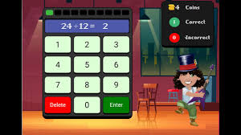

Times Tables Rock Stars https://ttrockstars.com/
Practise Gig, Garage, Studio and Soundcheck
https://play.ttrockstars.com/ttrs/online/gamel/home/list/single

Slide 5
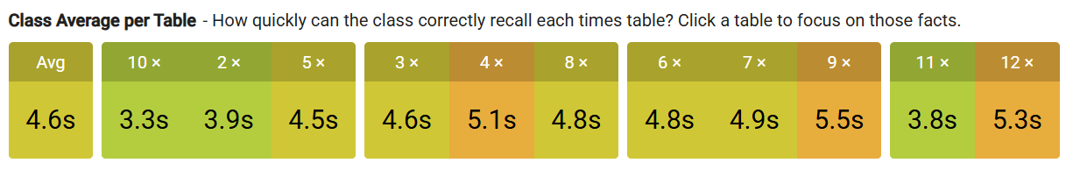
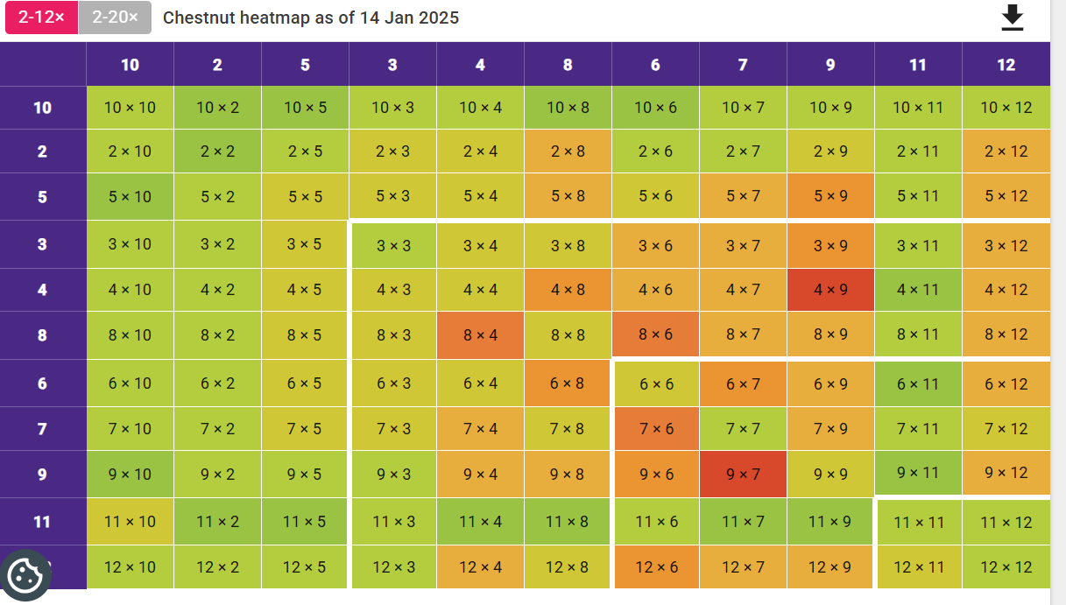

Slide 6
When will the Multiplication tables check happen?
The test will be administered during a 3 week period. This will be in June and you will be notified of the dates once they have been confirmed.
Schools will have unlimited access to a ‘try it out’ area from April. They can use this to make sure pupils have the necessary support to access the check. This includes opportunities for pupils to familiarise themselves with the check application and try out any access arrangements that may be required.

Slide 7
What does the Multiplication tables check look like?
The Multiplication times table check is an online, on-screen digital assessment that consists of 25 timed questions worth one mark each.
There is a time limit of 6 seconds per question. The check will take each child less than 5 minutes to complete and it will be automatically scored.
Your child will need to input their answer using a keyboard/mouse/onscreen number pad. After the 6 seconds for the question expires there will be a 3 second delay until the next question appears.
All multiplication facts will be tested up to 12 x 12 but there will be emphasis on the 6,7,8,9 and 12 times table facts.
Children will have 3 practise questions before hand.

Slide 8
What will happen when my child takes the Multiplication tables check?
Before they complete the test they can practise and familiarise themselves with the format of the test in a ‘have a go area’ and then they can complete the test when they feel ready.
It can be administered in small groups, as a whole class or individually. This decision will be made by your child’s class teacher and the Headteacher.

Slide 9
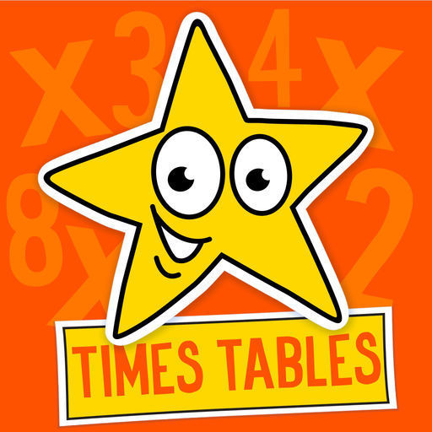
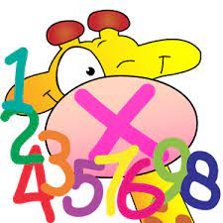
How will the result of the Multiplication tables check be reported to me?
Individual scores for the Multiplication tables check will be reported to you in the end of year report

Slide 10
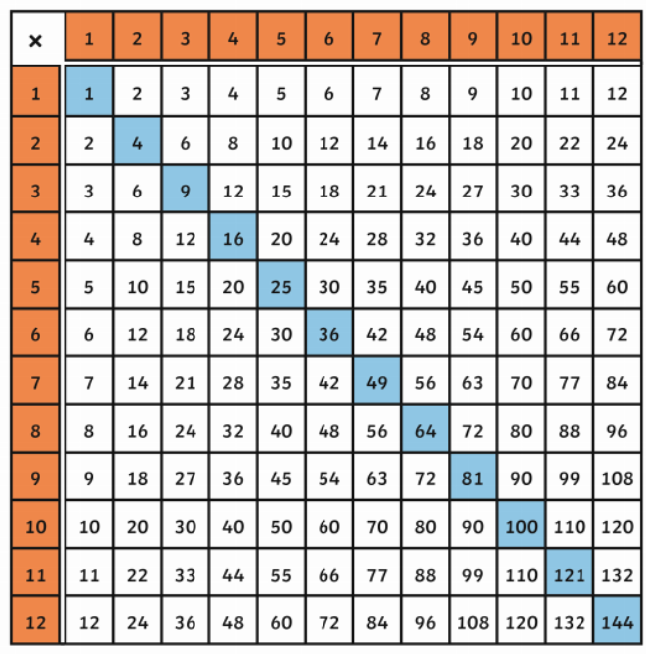
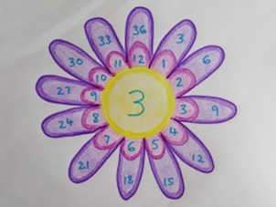
How can I help at home?
Your child has been sent home with a username and password for Times Tables Rock Stars. This website is designed specifically to develop the fluency of recalling multiplication facts.
Quick fire multiplication questions
Multiplication games e.g. turning over cards and answering multiplication questions, recording the time and trying to beat it .
Teach them tips and tricks e.g. using a known fact to find another fact
Listen to fun songs about times tables, there are lots on the internet.
Draw a multiplication flower and then use this to develop fluency in recalling the facts in a limited amount of time

