Slide 1

KS1 SATs & Teacher Assessment
Budbrooke Primary School
Mrs Jayne Lavelle
Meeting: Thursday 12th February 2026
Budbrooke Primary School | KS1 SATs Meeting | 12 Feb 2026

Slide 2
Tonight’s aims
Explain what KS1 SATs are (and what they are not)
Show the format of the assessments in Reading and Maths (and optional GPS)
Explain how results contribute to teacher assessment
Share how you can support at home (without pressure)
Budbrooke Primary School | KS1 SATs Meeting | 22 Jan 2026

Slide 3
What are KS1 SATs?
Budbrooke Primary School | KS1 SATs Meeting | 22 Jan 2026

Slide 4
What are KS1 SATs?
National curriculum assessments at the end of Year 2
Taken in school, in a calm and familiar way
Used alongside everyday classwork to support teacher judgement
Marked internally by teachers
Key message: SATs are just one piece of information — not the whole picture.
Budbrooke Primary School | KS1 SATs Meeting | 22 Jan 2026

Slide 5
When do they happen?
Assessments take place in May (usually over a small number of sessions)
Not strictly timed — children can take breaks if needed
We follow usual routines so it feels like normal classroom work
Budbrooke Primary School | KS1 SATs Meeting | 22 Jan 2026

Slide 6
What will children do?
Budbrooke Primary School | KS1 SATs Meeting | 22 Jan 2026

Slide 7
Overview of KS1 assessments
Subject | Paper(s) | Approx. time
Reading | Paper 1 & Paper 2 | 30 mins + 40 mins (not strictly timed)
Maths | Arithmetic & Reasoning | 20 mins + 35 mins (not strictly timed)
GPS (optional) | Spelling & Grammar/Punctuation/Vocab | 15 mins + 20 mins (not strictly timed)
Writing | Teacher assessment (no test) | Across the year
Budbrooke Primary School | KS1 SATs Meeting | 22 Jan 2026

Slide 8

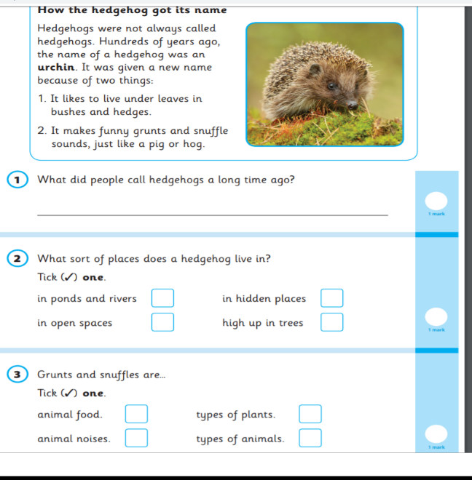

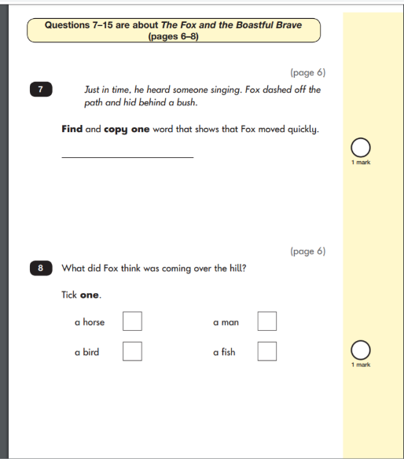
Reading
Budbrooke Primary School | KS1 SATs Meeting | 22 Jan 2026

Slide 9
Reading test: what it looks like
Two short papers with a range of fiction, non-fiction and poetry
Questions include: retrieval, vocabulary, sequencing and simple inference
Teachers can read questions to children if needed
Budbrooke Primary School | KS1 SATs Meeting | 22 Jan 2026

Slide 10
Expected standard: reading behaviours
Reads aloud fluently and accurately (approx. 90 words per minute)
Checks reading makes sense; self-corrects
Answers questions and begins to infer from the text
Budbrooke Primary School | KS1 SATs Meeting | 22 Jan 2026

Slide 11
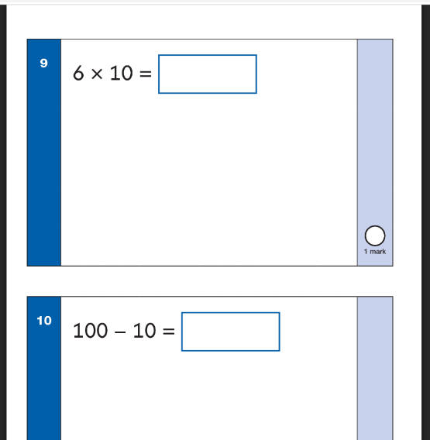
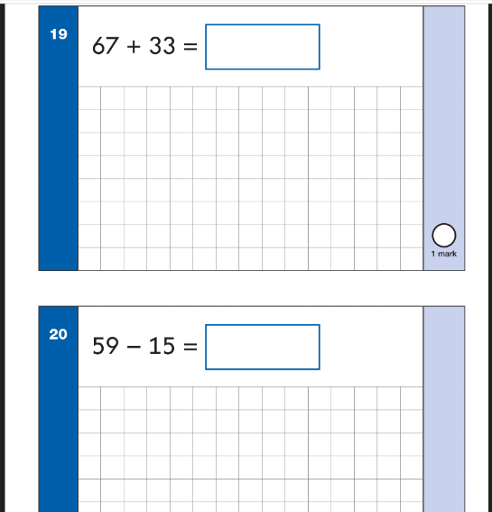
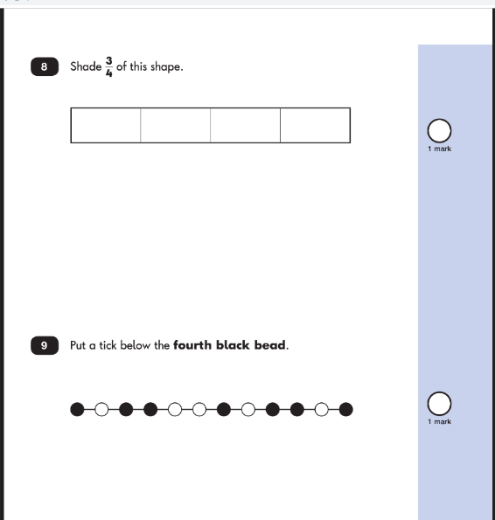
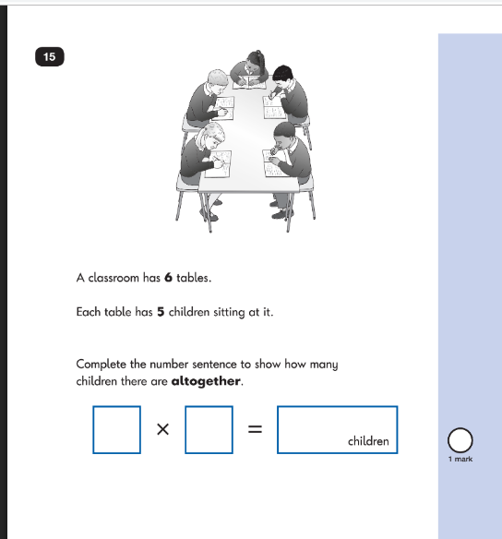
Maths
Budbrooke Primary School | KS1 SATs Meeting | 22 Jan 2026

Slide 12
Maths tests: what it looks like
Paper 1: arithmetic (calculations)
Paper 2: reasoning (problem solving and explaining)
Includes a small number of aural questions
Budbrooke Primary School | KS1 SATs Meeting | 22 Jan 2026

Slide 13
Expected standard: key skills
Add and subtract 2-digit numbers (including crossing tens)
Know multiplication/division facts for 2, 5 and 10
Tell the time to the nearest 15 minutes; read scales
Work with money (coins) and simple fractions
Budbrooke Primary School | KS1 SATs Meeting | 22 Jan 2026

Slide 14
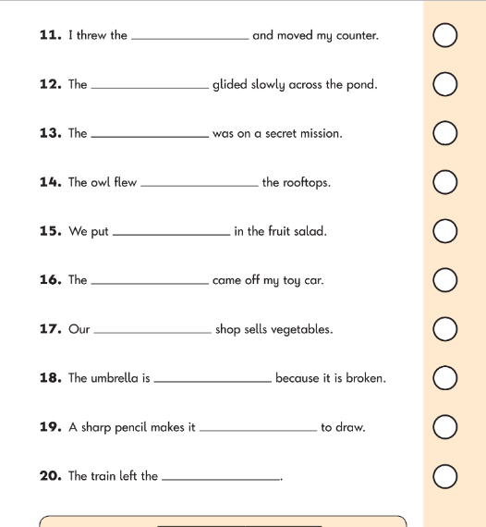
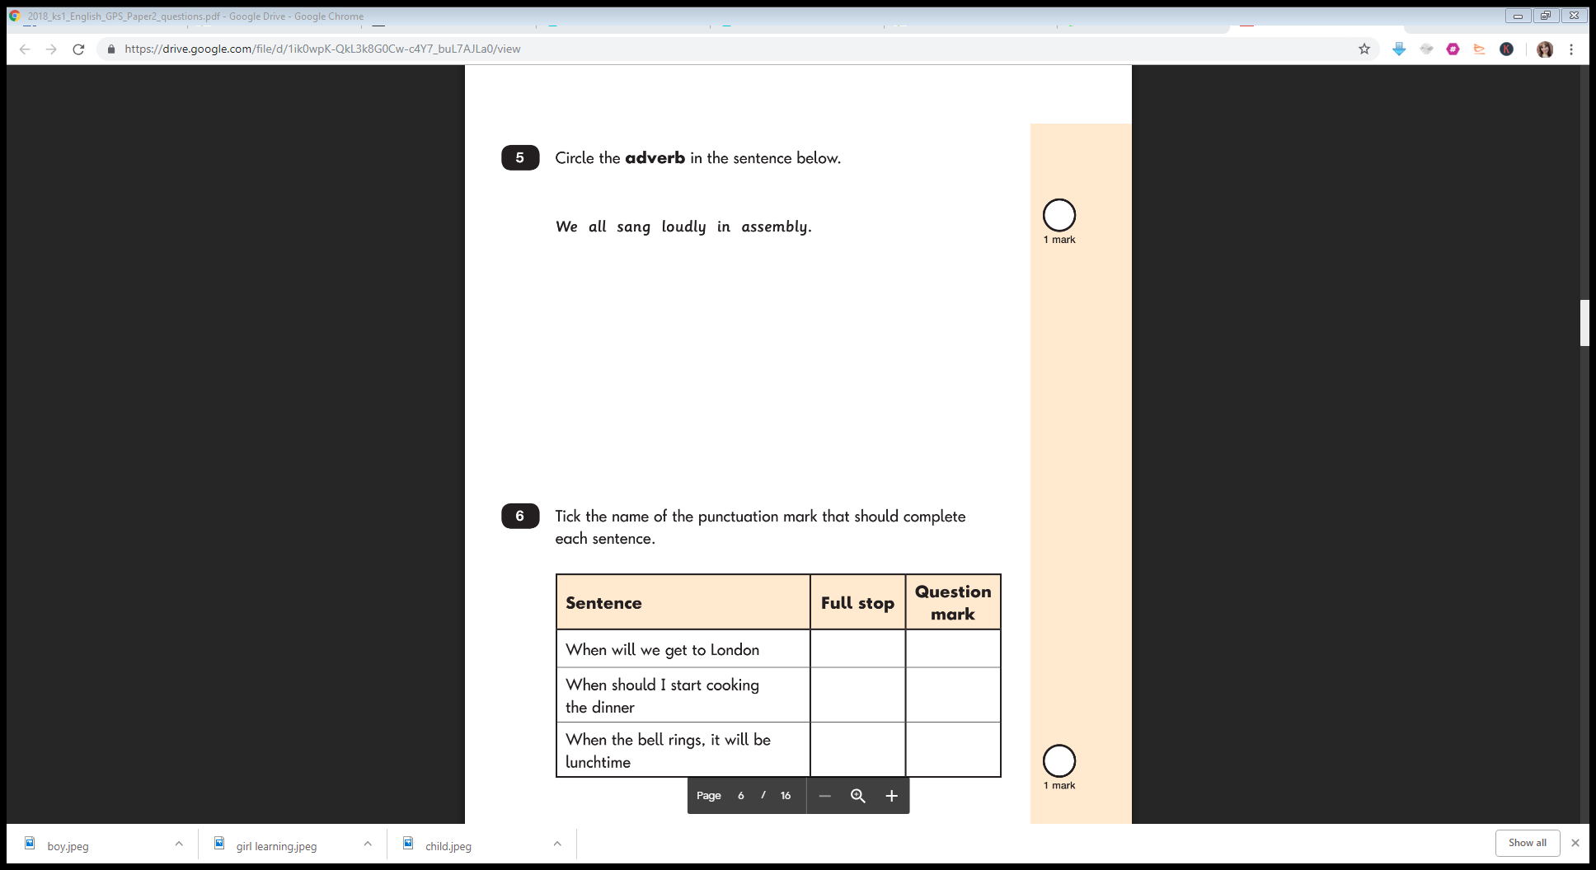
GPS & Writing
Budbrooke Primary School | KS1 SATs Meeting | 22 Jan 2026

Slide 15
GPS (Spelling, Punctuation & Grammar)
Optional in Year 2, but we administer it to inform writing judgements
Spelling: 20 words in sentences
Grammar/punctuation/vocabulary: short questions in a booklet
Budbrooke Primary School | KS1 SATs Meeting | 22 Jan 2026

Slide 16
Writing teacher assessment
No SATs writing test
Teachers assess writing across the year using independent work
Evidence includes: punctuation, spelling, sentence structure and handwriting
Budbrooke Primary School | KS1 SATs Meeting | 22 Jan 2026

Slide 17
Results & reporting
Budbrooke Primary School | KS1 SATs Meeting | 22 Jan 2026

Slide 18
How are results reported?
Outcomes are described as: Working Towards / Working At Expected / Greater Depth
Test raw scores can be converted to ‘scaled scores’ (100 = national standard)
The final judgement is based on a range of evidence across the year
Moderation may take place to ensure judgements are consistent across schools.
Budbrooke Primary School | KS1 SATs Meeting | 22 Jan 2026

Slide 19
How you can help
Budbrooke Primary School | KS1 SATs Meeting | 22 Jan 2026

Slide 20
The most helpful things you can do
Keep routines calm: good sleep, breakfast, punctuality and attendance
Praise effort — avoid ‘high stakes’ language
Read little and often; talk about books and new vocabulary
Practise spellings in short bursts; write for real purposes (lists, notes, cards)
Use maths in real life: cooking, coins, time, games
Budbrooke Primary School | KS1 SATs Meeting | 22 Jan 2026

Slide 21
Useful websites
BBC Bitesize
ICT Games / Topmarks
White Rose Maths (parent guidance)
NRICH maths at home
Budbrooke Primary School | KS1 SATs Meeting | 22 Jan 2026

Slide 22
Any questions?
Thank you for coming.
We’re happy to answer questions and share sample papers after the meeting.
Budbrooke Primary School | KS1 SATs Meeting | 22 Jan 2026

