Slide 1


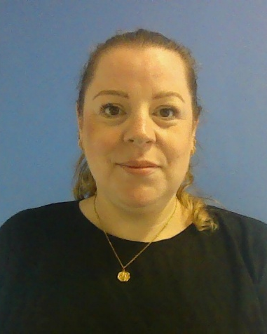
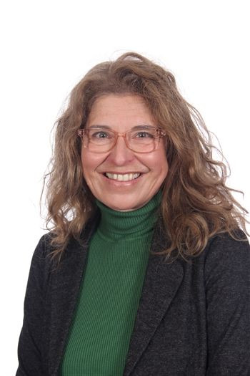
Welcome to Year 5
Mrs Prestidge
Mrs Medlock
Notes:
Welcome parents and introduce yourself, your LSA and any other adults that will be working in your class.

Slide 2

New Academic Year… New start…
Notes:
Children find the first few weeks of any new year group a challenge due to the change in a routine they are familiar with, change of classroom, Teacher and Higher Level Teaching Assistant.
We expect all children to be in school on time (8.45am), if children are late this can unsettle them at the start of the day and they may miss vital information or interventions. Please ensure that your child is in school on time, everyday. Attendance is monitored weekly and half termly and we will be sharing and discussing this with you on a regular basis.

Slide 3
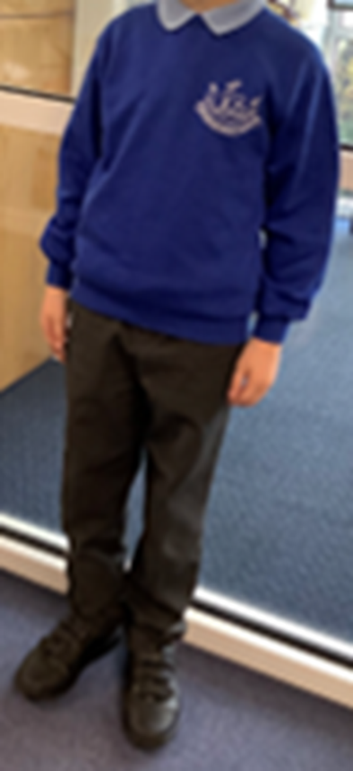
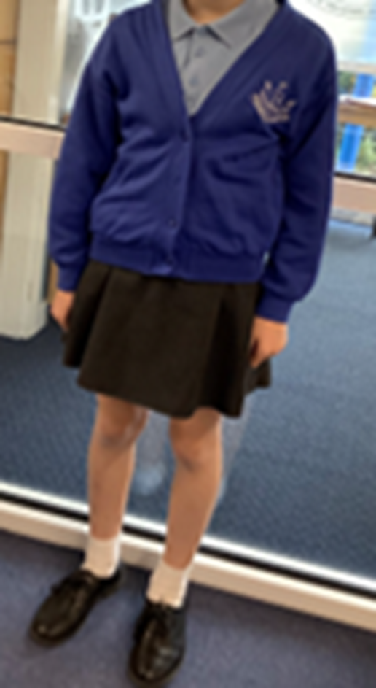
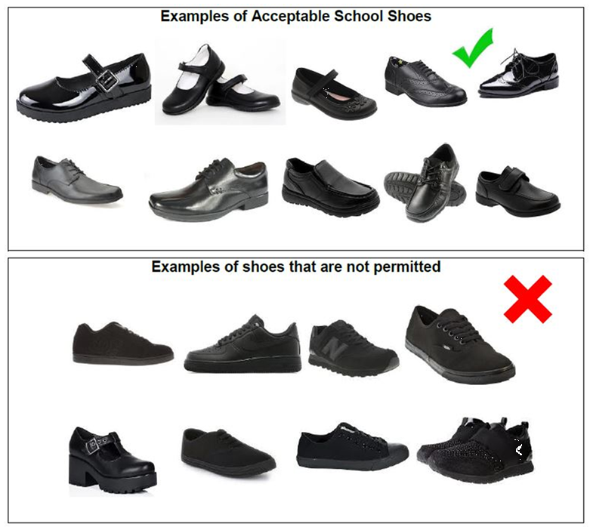
School Uniform
We expect all the children to wear the school uniform which is simple, practical and available from most chain stores at reasonable prices.
School uniform is also available from “Brigade” website: www.brigade.uk.com or My Clothing: www.myclothing.com.
Please make sure all items are labelled
Notes:
The school uniform consists of school sweatshirt with the white logo, light blue polo shirt, black trousers or skirt. Blue and white gingham summer dress can be worn in the latter part of the Spring term and in the Summer term. All children are expected to wear school shoes.
Book bag or small rucksack for reading book and home learning book are required.
All belongings labelled

Slide 4
School Uniform – PE Kit
House colour T-shirt with school logo (blue, green or red)
Navy blue shorts
Navy blue jogging bottoms for outdoor games in cold weather
Navy blue hoodie for outdoor games in cold weather (school sweatshirt can be worn as an alternative)
Black pumps for indoor PE, black plain trainers for outdoor PE
Named draw stringed pump bag
Notes:
Read through the slide

Slide 5

Curriculum
Core subjects-English, Maths and Science
Foundation subjects-Design Technology, History, Computing, Geography, Music, Art, PE and Personal, Social, Health and Citizenship Education (PSHCE)
Notes:
Discrete lessons are taught in each year group but we try to make cross curricular links to the termly topic
Sometimes sessions may be blocked so that a day a half term is for Art or DT, but this varies depending on the topic and subject.

Slide 6
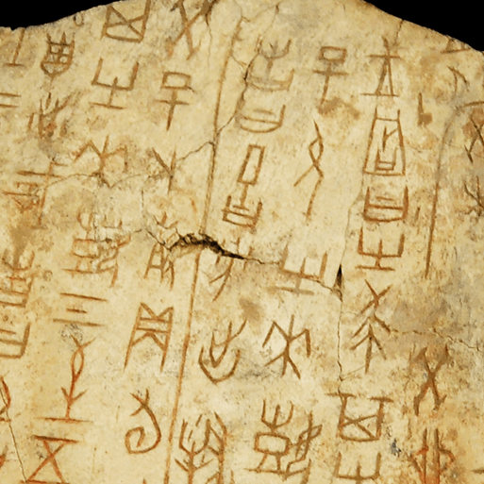
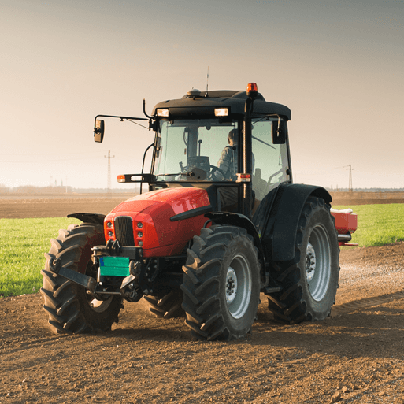
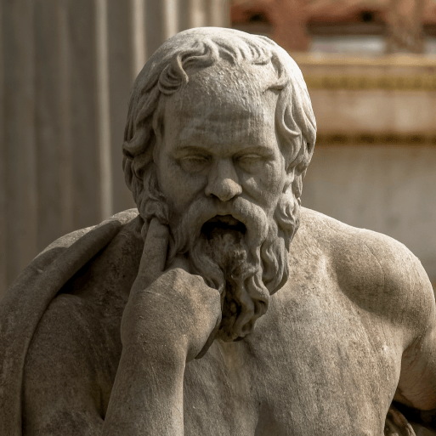

Topics
Autumn – Dynamic Dynasties
Spring – Sow, Grow and Farm
Summer – Groundbreaking Greeks
Notes:
As in all classes, each term has a different theme. You will receive a curriculum letter each term that details what your children will be learning.

Slide 7


Home learning and reading
Home learning and Reading will be sent home regularly with your child.
Home learning will be set on a Thursday to be handed in on a Tuesday
Notes:
Home learning is sent home on a Thursday and needs to be returned, completed the following Tuesday. It will take approximately 30 minutes for children to complete.
Each week it will alternate between a maths based activity linked to their learning and the following week an English based activity. These activities could be research, making something, drawing or writing.
Please hear your child read daily for at least 10 minutes. Reading underpins a child’s access to the whole curriculum and is vital to their continued progress.
No home learning will be set at the end of a half term for the holidays. The children need to have quality family time, fun and time to rest and recover from a very busy half term of learning.

Slide 8


Notes:
Thank you for coming this afternoon. It was lovely to meet you all and I look forward to working with you and your child next year. If you have any questions then please feel free to come and see me.

