Slide 1

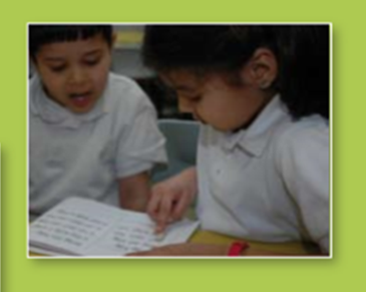
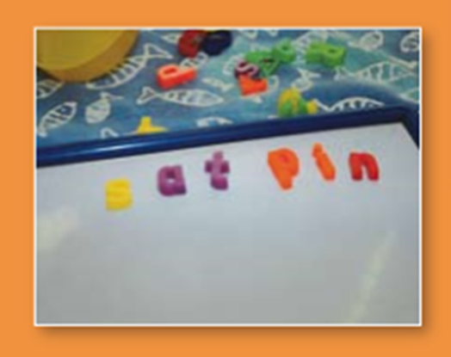
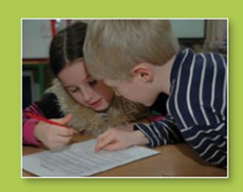

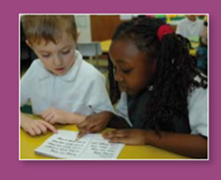

Phonic Screening Test
June 2024
Cale Green Primary School

Slide 2

Overview
What is the screening test?
What will happen during the test?
What happens with the results?
Ways to support your child at home
Questions

Slide 3
Why a Phonics Screening?
The phonics screening check will be taken individually by all children in Year 1 in England from Monday 10th June until Friday 14th June 2024.
It is designed to give teachers and parents information on how your child is progressing in phonics.
It will help to identify whether your child needs additional support at this stage so that they do not fall behind in this vital early reading skill.

Slide 4
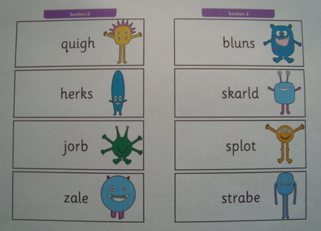
What Will the Phonic Screening Look Like?
There will be two sections in this 40-word check and it will assess phonics skills and knowledge learned through Reception and Year 1.
Your child will be expected to read 20 real words and 20 nonsense words which are referred to as pseudo-words.
It will check that your child can:
Sound out and blend graphemes (sounds letters make) in order to read simple words.
Read phonically decodable one-syllable and two-syllable words, e.g. chat, sand, windmill.

Slide 5


What Are Pseudo Words?
These are words that are phonically decodable but are not actual words e.g. quigh, skarld and zale. Pseudo words are included in the check specifically to assess whether your child can decode a word using phonics skills and not their memory.
The pseudo words will be shown to your
child with a picture of a monster/alien
and they will be asked to read the
monster’s/alien’s name.
This not only makes the check a bit more fun, but provides the children with a context for the nonsense word which is independent from any existing vocabulary they may have. Crucially, it does not provide any clues, so your child just has to be able to decode it. Children generally find nonsense amusing so they will probably enjoy reading these words.

Slide 6
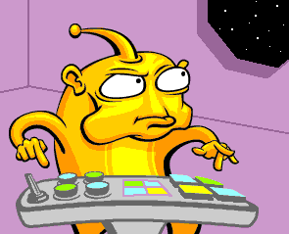
I am called
F a p e

Slide 7
What Will Happen With the Results?
The check is not about passing or failing but checking appropriate progress is being made. Each year the test will have a slightly different threshold for the expected level ranging from 31 to 34 out of 40. In recent years the threshold mark has been 32.
If children do not reach the required standard, then the school will discuss plans and offer additional, tailored support to ensure that the child can catch up.
Children progress at different speeds so not reaching the threshold score does not necessarily mean there is a serious problem. Your child will re-sit the check the following summer term when they are in Year 2.

Slide 8

Here are just some of the sounds your child will need to be able to recognise:
“ai” as in rain
ai ay a a-e
“ee” as in peel
ee ea y e e-e ie
“igh” as in high
y ie I i-e igh
“s” as in sun
s ss c
“oa” as in boat
oa ow o o-e ou
“oo” as in soon
oo ue ew ou u-e

Slide 9
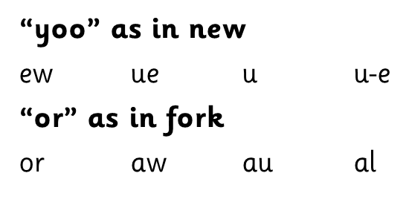
“j” as in jam
j g
“k” as in key
c k ck ch
“sh” as in shed
sh ch
“u” as in under
u er ou o
“oo” as in book
u oul oo
“ar” as in car
ar a (father)

Slide 10
“e” as in egg
e ea
“f” as in fin
f ff ph
“w” as in win
w wh
“ow” as in down
ow ou
“I” as in ink
i y
“ur” as in fur
er ir ur or
“ear” as in fear
ear eer ere

Slide 11
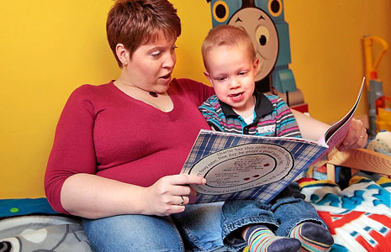

How Can You Support Your Child at Home?
When listening to your child read at home ask them to find words with various diagraphs /trigraphes in. For example “Can you find me a word with the “oy” sound in”. This will support them in recognising the letters needed to make certain sounds.
Make flash cards with the sounds learnt so far, ask your child to identify these letters and tell you the sound they make.
There are lots of online games to support the children’s learning of phonics, these are just a few which we use with our classes:
https://www.phonicsplay.co.uk/resources
https://ictgames.com/mobilePage/forestPhonics/index.html
https://www.bbc.co.uk/bitesize/topics/zd63xyc/articles/zdp4pg8
Praise and hugs! Most importantly, remember that your child will learn much faster with encouragement, praise and hugs

Slide 12

Many thanks for coming this afternoon. Please feel free to have a good look at the resources and past papers.
Please feel free to come and ask us any questions.

