Slide 1

Meet the Teachers:
Tuesday 26th September
Key Stage 1
Cedar, Cherry and Chestnut Class

Slide 2
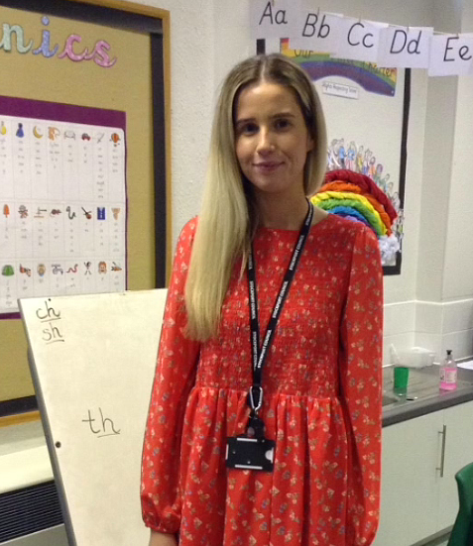
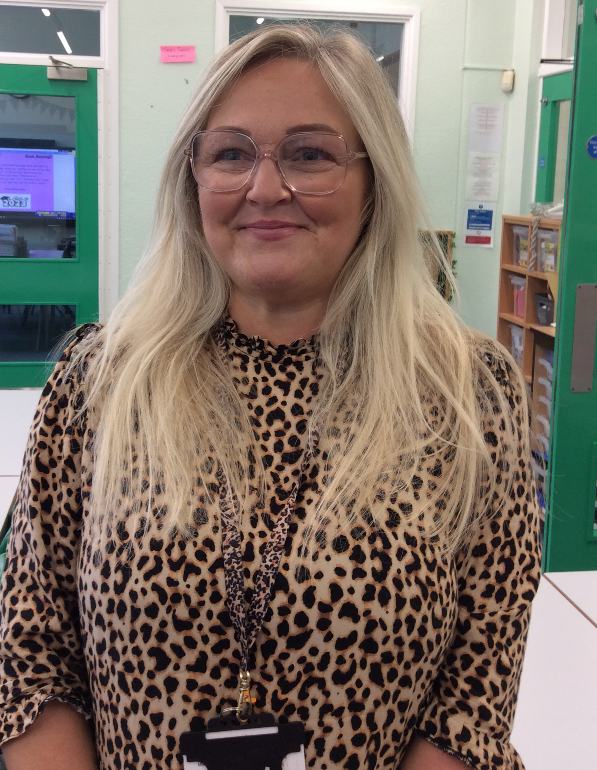
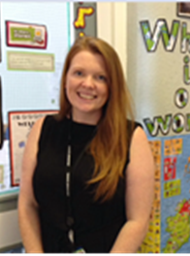
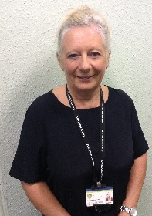
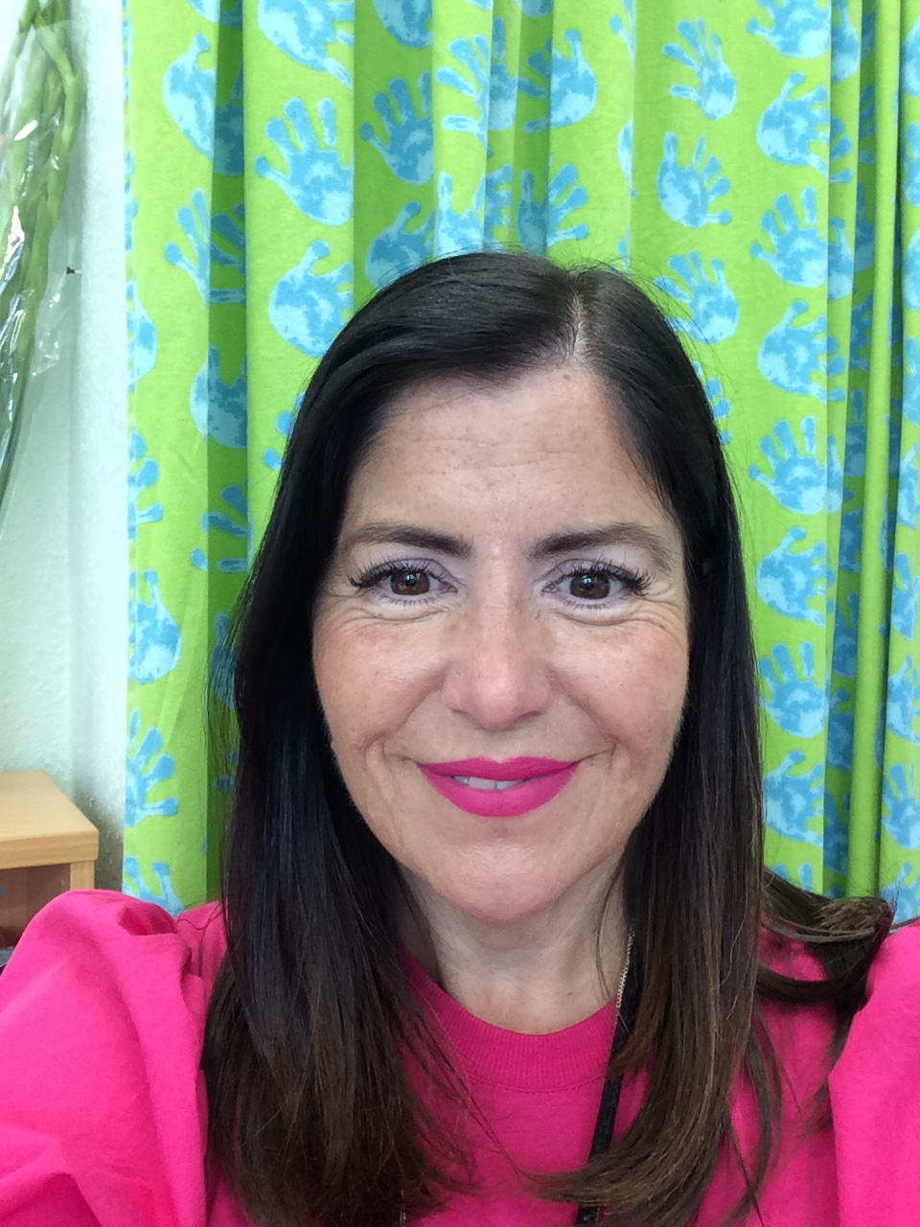
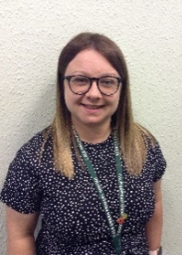
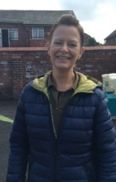
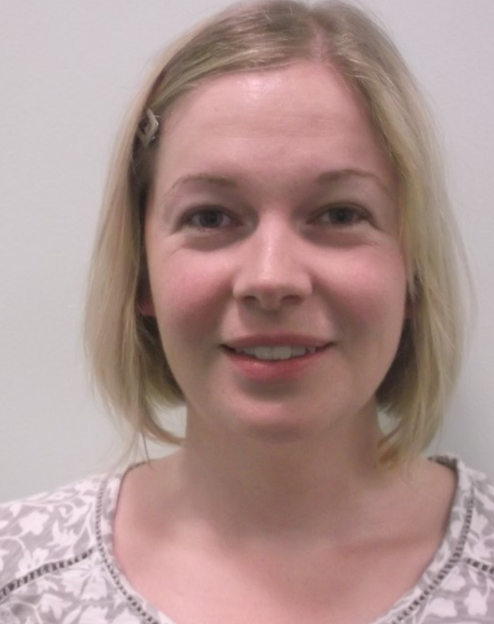
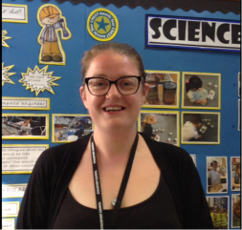
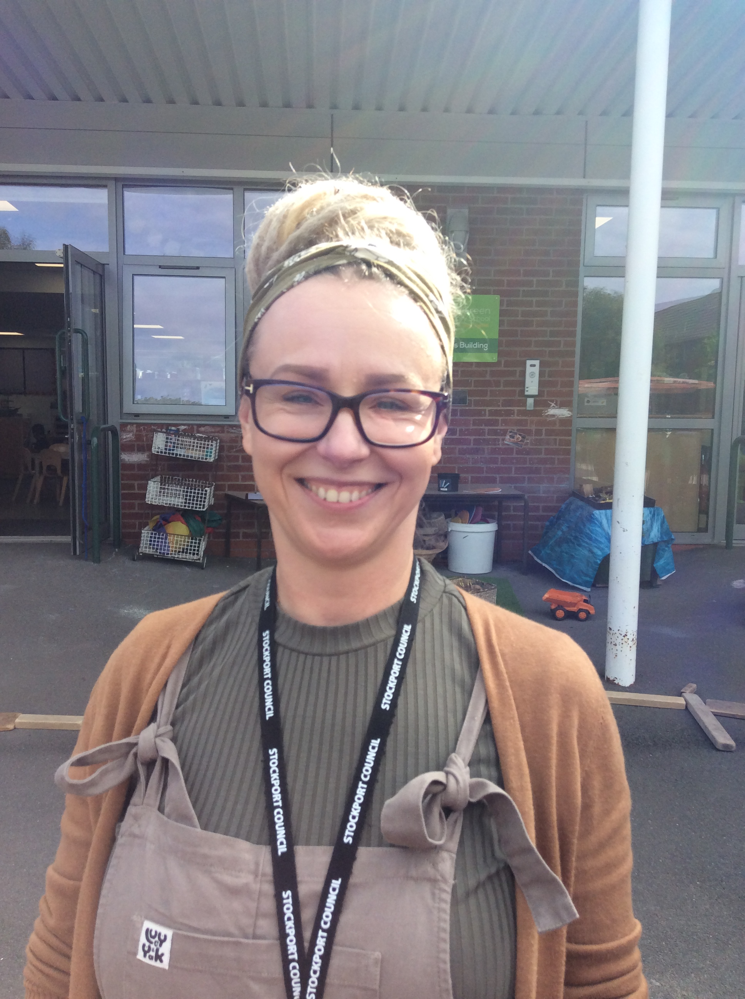

Meet the staff
Cherry Class:
Cedar Class:
Chestnut Class:

Slide 3
Ways to contact us/Messages
There are various ways to get in touch:
Via the member of staff outside on the hall door in the morning
Email school: schooladmin@calegreen.stockport.sch.uk
Call school – 0161 480 2715
Via your child’s Reading Record (not recommended if urgent)
School’s Twitter account @CaleGreenPS
Update your contact details on Parent Pay
Letters and permission slips are always available on our website and are emailed home

Slide 4
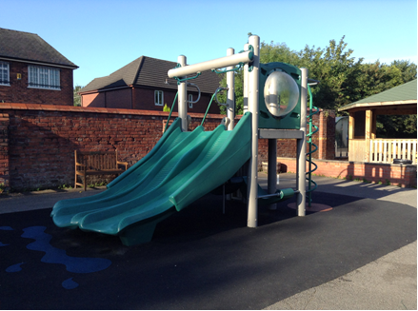
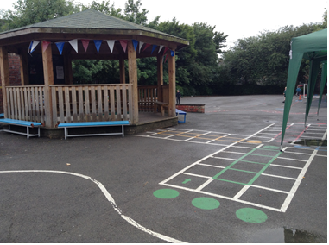
Daily routines
8.40 -8.50am - Children enter through the hall, go to their classroom to complete a morning challenge. This may include fix it tasks or reading with an adult. Please bring book bag, reading book and reading diary into school daily.
8.50am – Register; children who arrive after 8:50am will be marked as late.
9am-10:10am- Lesson 1 (Usually English or maths)
10:0am-10:25am- Break
10:25am-11:30am- Lesson 2 (Usually English or maths)
11:30am-12:30pm-Lunch
12:30pm-1pm- Phonics (Children split up into phases)
1pm-1:30pm- Mastering number/Times tables recall
1:30pm-1:50pm- Break
1:50pm-2:50pm- Lesson 3
2:50pm- 3:10pm- Story/Get ready for home
3.10pm - Collect the children from the infant door (nearest the Early Years building)

Slide 5
Assemblies
Family assembly is every Friday. Families are invited to attend in person or you can join online from an link on the school newsletter.
On Monday at 9am, Mrs McHugh holds an assembly virtually each week. (children only)
On Wednesday at 9am, Mrs Lewis holds a singing assembly in the hall for all children. (children only)

Slide 6

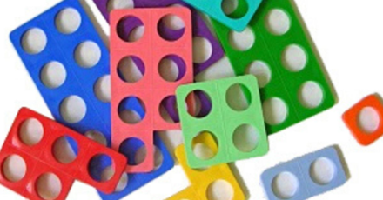
Maths
We follow the White Rose Maths scheme and will begin by ensuring children are confident with the skills from the Early Years Foundation Stage. We use lots of resources to help with our learning such as base ten, tens frames and Numicon.
Learning objectives are split into Year 1 and 2. This is largely built into each lesson.
For example:
In the first place value block, Year 1s to work with numbers from 1-20, and Year 2s to work with numbers from 1-100.

Slide 7
Phonics
Children are grouped according to their ability across 5 phonics groups to ensure that teaching is matched to their level.
We currently have 5 different groups
Phase 2 – taught by Mrs Cronshaw, Mrs Lee, Mrs Withy and Ms Rogers
Phase 3 – taught by Mrs Cartwright
Phase 4 – taught by Mrs Hammami
Phase 5a- Phase 5a mastery- Miss Shaw
Phase 5a- Phase 5a spelling recap- Miss Burns
Children may not be taught by their class teacher/TA during their phonic session, and phonics groups are likely to change regularly to ensure they receive the correct level of support and challenge
If you would like to know which group your child is in then please speak to your class teacher.

Slide 8
Phonics
For phonics teaching, we follow a Systematic Synthetic Phonics scheme to ensure that children become fluent, able readers who can segment and decode words for reading.
The scheme we follow is called ‘Unlocking Letters and Sounds’.

Slide 9
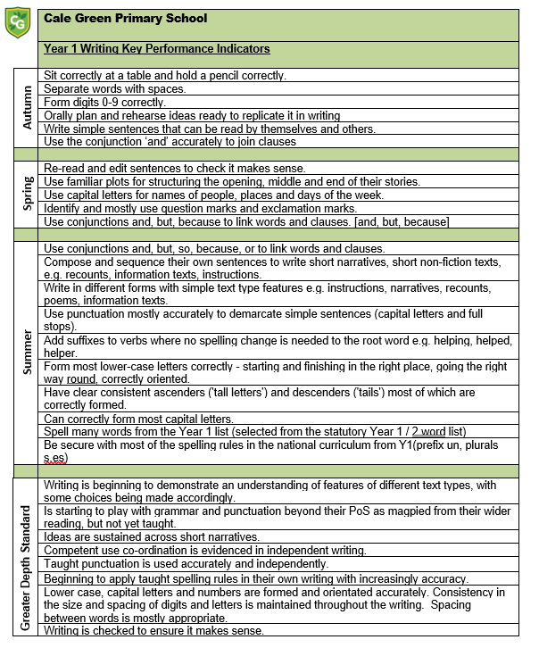
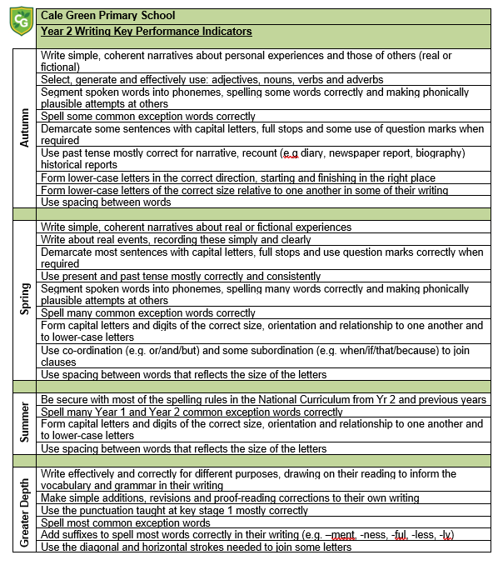
English
Children will write various pieces of fiction and non-fiction throughout the year. All writing will be inspired by a high-quality text and we give children plenty of opportunities to develop their ideas through drama, role play and visitors to school. In your hand outs, you have a copy of the breakdown of year 1 and year 2 objectives that are taught termly.

Slide 10
New Reading Scheme
Last year, school purchased over 2000 new, decodable books that match up to the new phonics scheme. All children will receive a book matched to their phonics group level.
Children will need to read their reading book at least 3 times before it is changed. This is to develop fluency, expression and intonation. It is proven that reading a book more than once helps the child to become a more fluent reader, spell more words correctly as well as deepen their understanding of the world.
Books will only be changed on a Friday as we need to make sure books are matched to the graphemes they have learnt that week. Your child will receive 1 or 2 books a week depending on how often they are reading at home.
It is expected that your child reads every night to a grown up.

Slide 11
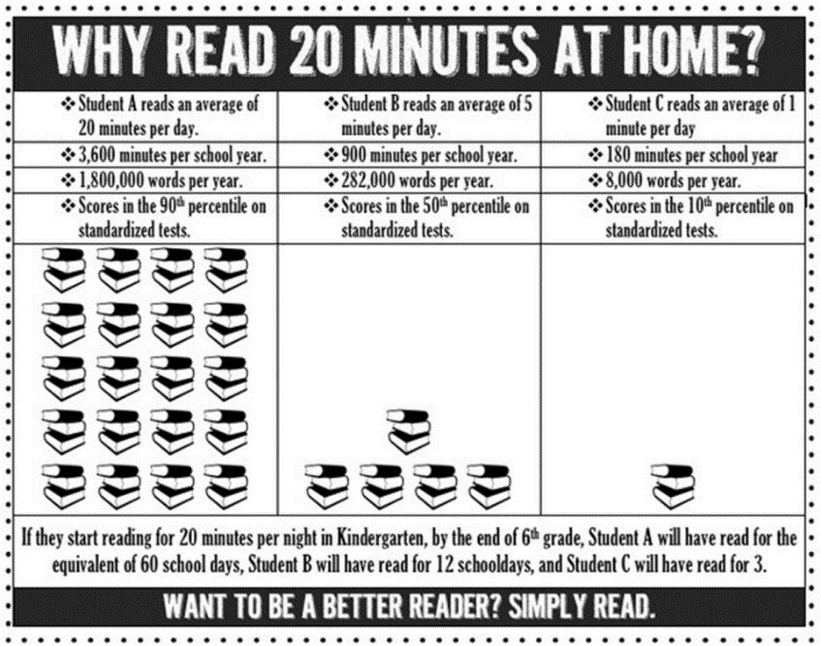
Reading
Children will have lots of opportunities to read through the school day:
Individual reading sessions, group reading sessions, story time, reading bingo books, school library, Phonics/English lessons
It is important that children read daily at home as this will help develop your child’s fluency.
Please ask your child questions about what they have read to check their understanding.
Talk to them about the book asking questions such as :
What has happened so far?
What do think will happen next?
Why did that character say that?
How is this character feeling and why?
How do you know this?
How would you feel if you were ....?
How can I find information about…?
Please make sure that reads are recorded in
the reading diaries. Reading books and diaries
are expected to be in school daily.
https://www.unlockinglettersandsounds.co.uk/institute/teacher/courseview/13/view

Slide 12
This year…
In class this year, we will cover 4 themes.
They are:
How did the Flickering Flames stop the Rascal Rats? This theme focuses on the historical events of The Plague and The Great Fire of London.
Shall we jump aboard the Naughty Bus? In this theme children will compare different areas of the United Kingdom.
Where will your compass take you? In this theme we will study significant explores and learn about the continents and oceans.
How does Pointe a Pierre compare to Stockport? In this theme we will compare Stockport to a small area of Trinidad.

Slide 13
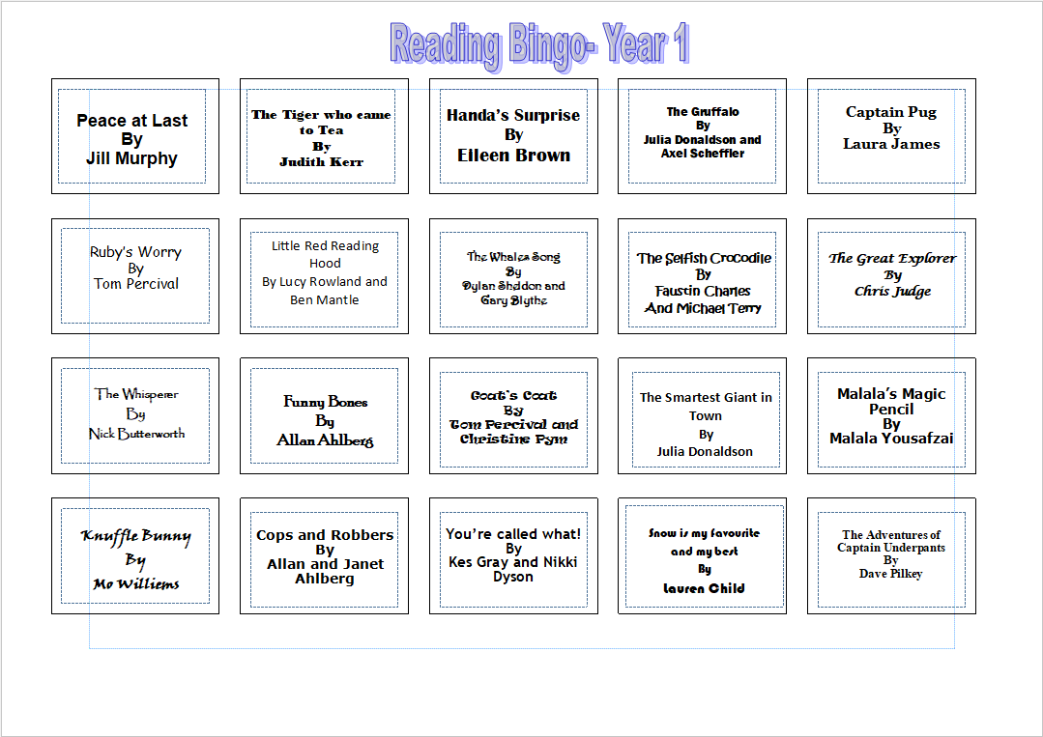
Reading – Year 1 Reading Bingo

Slide 14
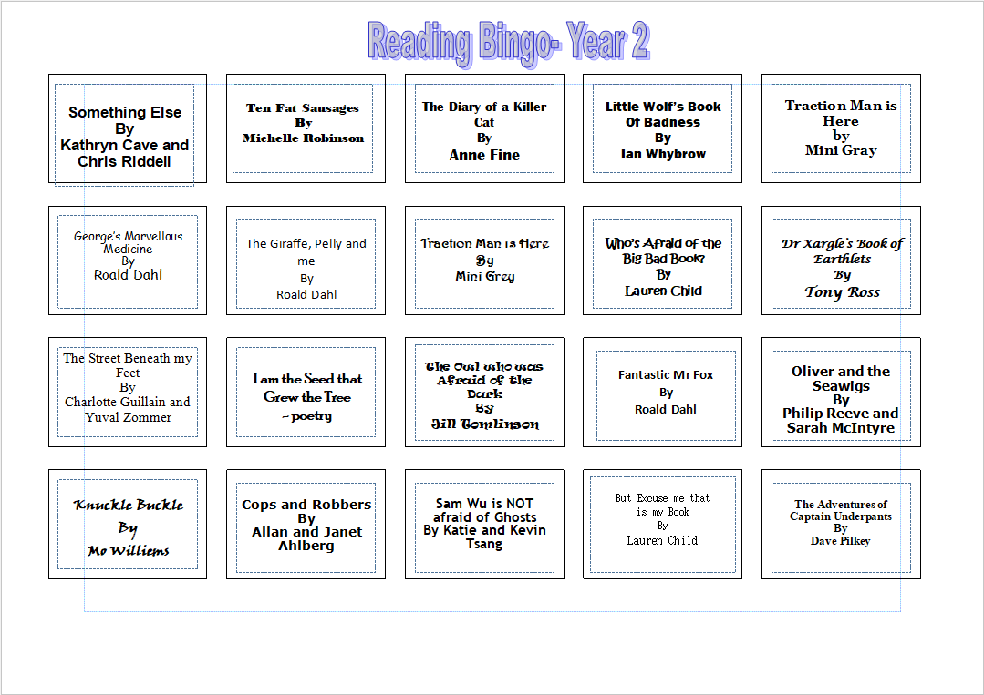
Reading – Year 2 Reading Bingo

Slide 15
Other Information
Healthy Eating
Free fruit is provided for children daily to have at break time but your child may want to bring their own healthy snack (no crisps or chocolate bars please)
Water
Please ensure your child brings in a named bottle of water for use in the classroom. Please do not send in juice. If a child spills juice, it is much more difficult to clean.
P.E
P.E is on a Monday and Friday. Please ensure your child comes into school wearing:
Green school jumper or black school hoodie.
A white t-shirt or polo shirt.
Black joggers, shorts or leggings.
Suitable shoes such as trainers.
No jewellery- earrings to be removed or covered at home.
Other
Please check your child's hair regularly for head lice.

Slide 16
Any questions?
Thank you for all the positive messages and a great start to the year.
If you have any questions please speak to your child’s class teacher.

