Slide 1
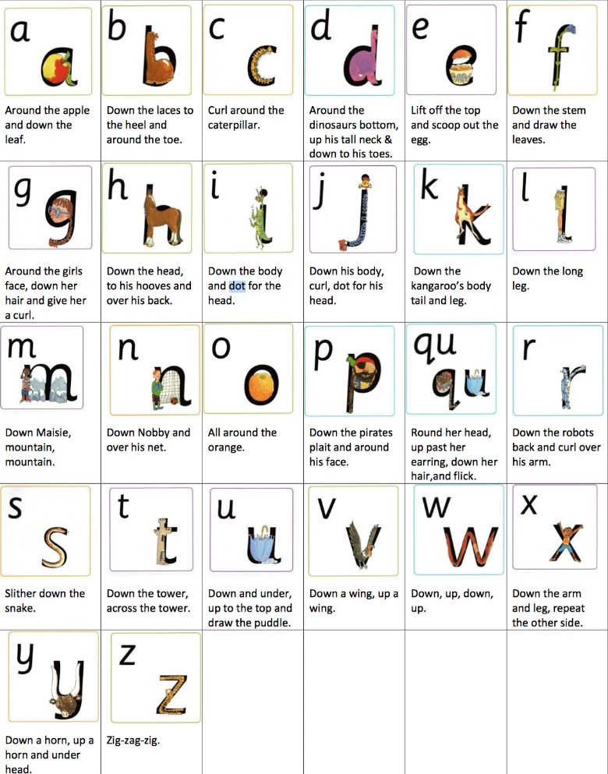
Read, Write, Inc Letter Formation Rhymes

