Slide 1

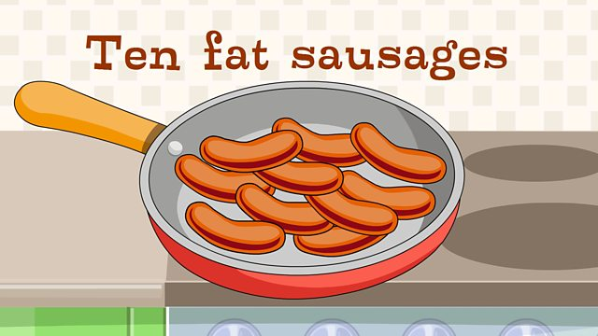
Ten fat sausages
Ten fat sausages sizzling in the pan,
Ten fat sausages sizzling in the pan.
If one went pop and the other went bang,
There’d be nine fat sausages sizzling in the pan.
Repeat with:
Eight.
Six
Four
Two
https://www.youtube.com/watch?v=YNNBHQTfb8k.

Slide 2
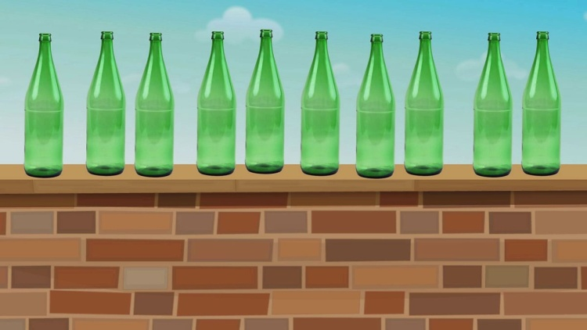
Ten green bottles
Ten green bottles hanging on the wall.
Ten green bottles hanging on the wall.
And if one green bottle should accidentally fall,
There’d be nine green bottles hanging on the wall.
Repeat with:
Nine.
Eight.
Seven.
Six
Five
Four
Three
Two
One.
https://www.youtube.com/watch?v=T0ooQv7oHvw

Slide 3
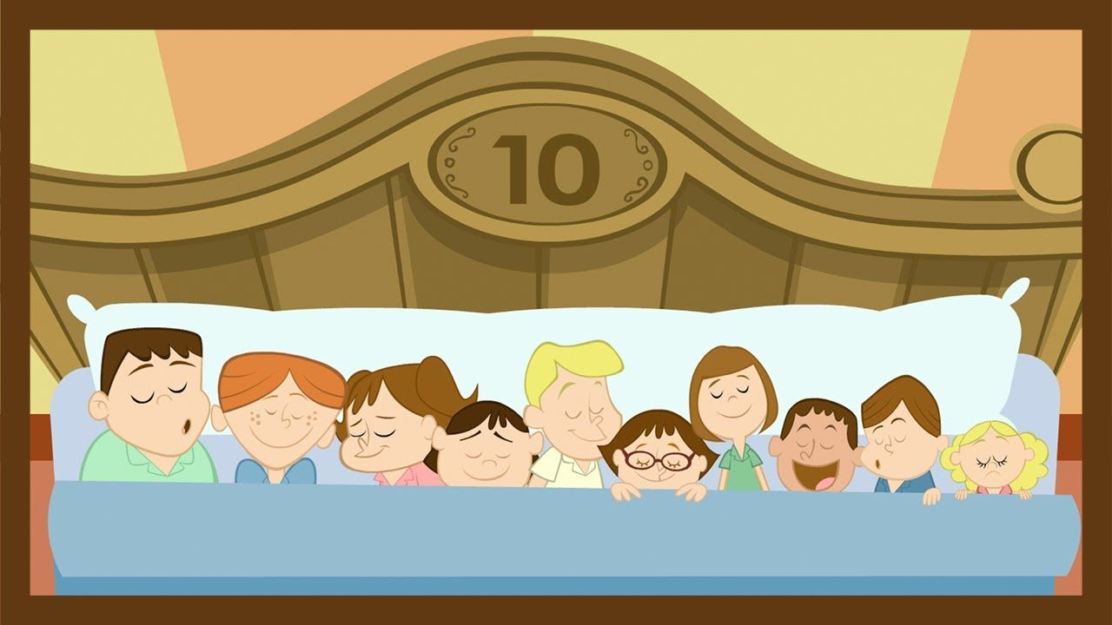
Ten in the bed
There were ten in the bed and the little one said “roll over, roll over”
So they all rolled over and one fell out.
Repeat with:
Nine.
Eight.
Seven.
Six
Five
Four
Three
Two
One.
https://www.youtube.com/watch?v=d7gL8TrMUks

Slide 4
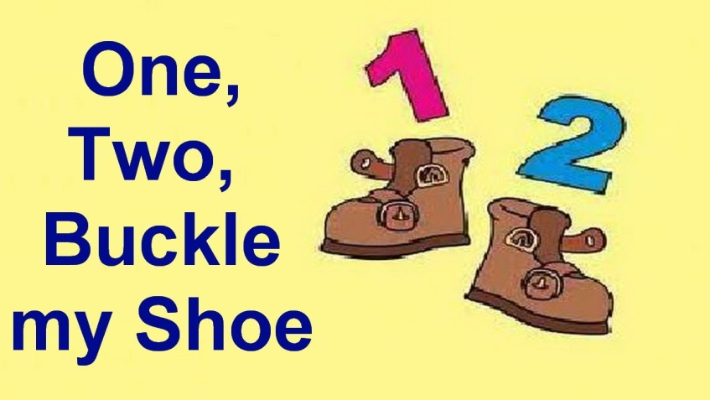
One, two buckle my shoe
One, two, Buckle my shoe;
Three, four, Knock at the door;
Five, six, Pick up sticks;
Seven, eight, Lay them straight:
Nine, ten, A big fat hen;
Eleven, twelve, Dig and delve;
Thirteen, fourteen, Maids a-courting;
Fifteen, sixteen, Maids in the kitchen;
Seventeen, eighteen, Maids a-waiting
Nineteen, twenty, My plate’s empty
https://www.youtube.com/watch?v=Otf4_UEvnQ8

Slide 5
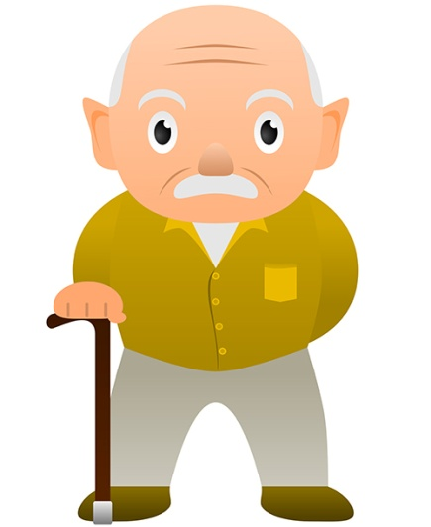
This old man
This old man, he played one, He played knick-knack on my thumb;
Knick-knack paddywhack, Give a dog a bone, This old man came rolling home.
This old man, he played two, He played knick-knack on my shoe;
Knick-knack paddywhack, Give a dog a bone, This old man came rolling home.
This old man, he played three, He played knick-knack on my knee;
Knick-knack paddywhack, Give a dog a bone, This old man came rolling home.
This old man, he played four, He played knick-knack on my door;
Knick-knack paddywhack, Give a dog a bone, This old man came rolling home.
This old man, he played five, He played knick-knack on my hive;
Knick-knack paddywhack, Give a dog a bone, This old man came rolling home
https://www.youtube.com/watch?v=Otf4_UEvnQ8.

Slide 6
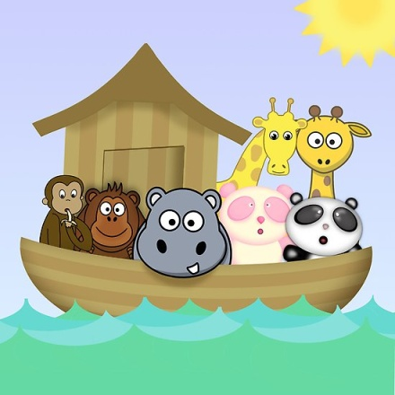
Old Noah’s ark
The animals went in two by two, hurrah! hurrah!
The animals went in two by two, hurrah! hurrah!
The animals went in two by two, the elephant and the kangaroo
And they all went into the ark, for to get out of the rain.
https://www.youtube.com/watch?v=IuQjR2lsYl0

Slide 7
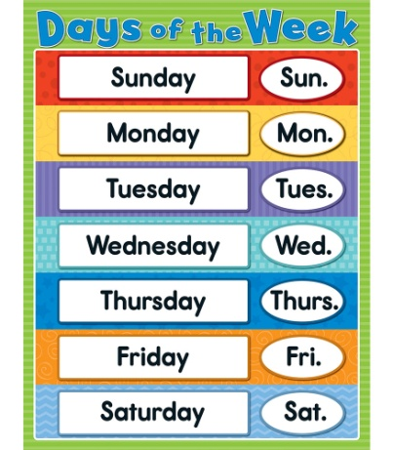
Days of the week
Days of the week (click, click)
Days of the week (click, click)
Days of the week, days of the week, days of the week (click, click).
There’s Sunday and there’s Monday,
There’s Tuesday and there’s Wednesday,
There’s Thursday and there’s Friday
And then there’s Saturday.
Days of the week (click, click)
Days of the week (click, click)
Days of the week, days of the week, days of the week (click, click)
https://www.youtube.com/watch?v=HtQcnZ2JWsY.

Slide 8
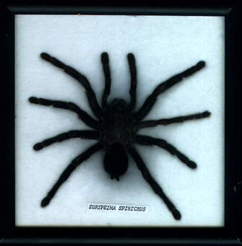
There’s a spider
There’s a spider on the floor, on the floor,
There’s a spider on the floor, on the floor.
There’s a spider on the floor, tell me, are there any more?
There’s a spider on the floor, on the floor!
There’s a spider on my knee, on my knee,
There’s a spider on my knee, on my knee,
There’s a spider on my knee and it's very tickly.
There’s a spider on my knee, on my knee.
There’s a spider on my arm, on my arm,
There’s a spider on my arm, on my arm.
There’s a spider on my arm but it won’t do any harm.
There’s a spider on my arm, on my arm.
https://www.youtube.com/watch?v=7kdT8dKTRQA

Slide 9
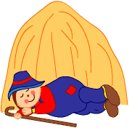
Little boy blue
Little Boy Blue come blow your horn,
The sheep’s in the meadow the cow’s in the corn.
But where’s the boy who looks after the sheep?
He’s under a haystack fast asleep.
Will you wake him? No, not I – for if I do, he’s sure to cry.
https://www.youtube.com/watch?v=PbvlzUjjLsI

Slide 10
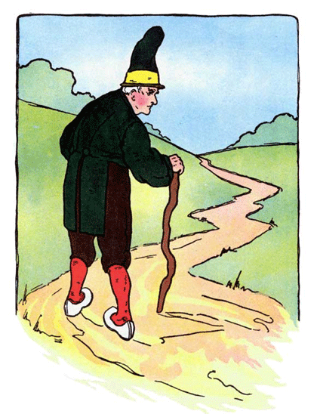
There was a crooked man
There was a crooked man and he had a crooked smile
He had a crooked sixpence and he walked a crooked mile.
He had a crooked cat and a crooked little mouse,
They all lived together in a crooked little house.
https://www.youtube.com/watch?v=thk1iIpc-C4

Slide 11
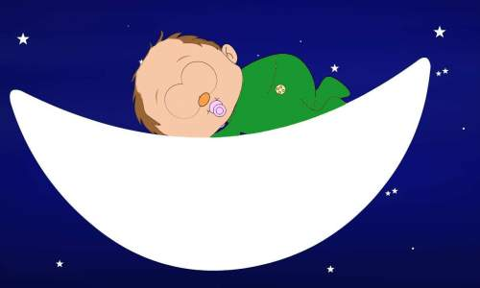
Hush little baby
Hush, little baby, don't say a word, Mama's gonna buy you a mockingbird.
And if that mockingbird don't sing, Mama's gonna buy you a diamond ring.
And if that diamond ring turns brass, Mama's gonna buy you a looking glass.
And if that looking glass gets broke, Mama's gonna buy you a billy goat,
And if that billy goat doesn't pull, Mama's gonna buy you a cart and bull.
And if that cart and bull turn over, Mama's gonna buy you a dog named Rover.
And if that dog named Rover won't bark, Mama's gonna buy you a horse and cart.
And if that horse and cart fall down, Well you'll still be the sweetest baby in town.
https://www.youtube.com/watch?v=NOCx4D7KoGo

Slide 12
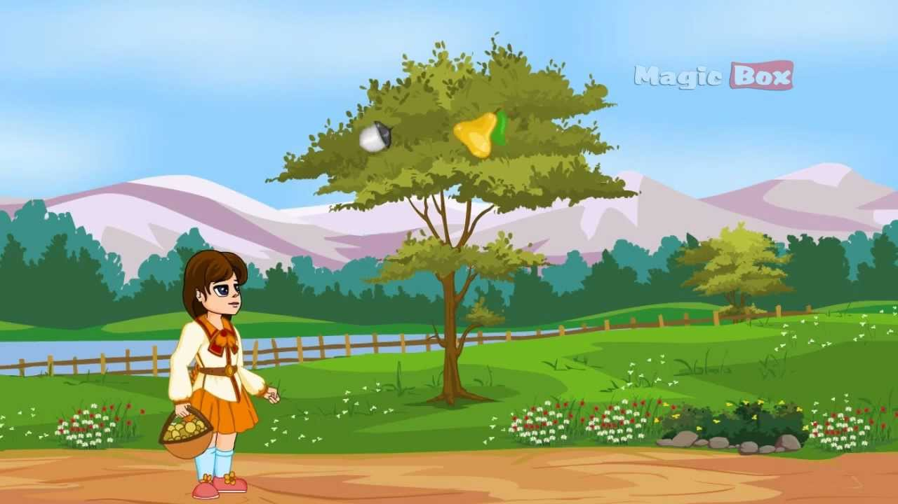
I had a little nut tree
I had a little nut tree
Nothing would it bear
But a silver nutmeg
And a golden pear
The King of Spain's daughter
Came to visit me,
And all for the sake
Of my little nut tree
https://www.youtube.com/watch?v=8C7p32oe3cQ

Slide 13
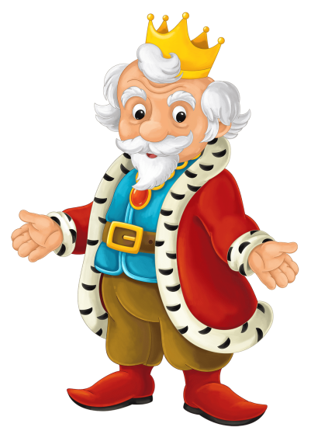
Old King Cole
Old King Cole
Was a merry old soul,
And a merry old soul was he;
He called for his pipe,
And he called for his bowl,
And he called for his fiddlers three!
And every fiddler, he had a fine fiddle,
And a very fine fiddle had he.
“Twee tweedle dee, tweedle dee, went the fiddlers.
Oh, there’s none so rare
As can compare
With King Cole and his fiddlers three.
https://www.youtube.com/watch?v=_z5mN9_bAaI

Slide 14
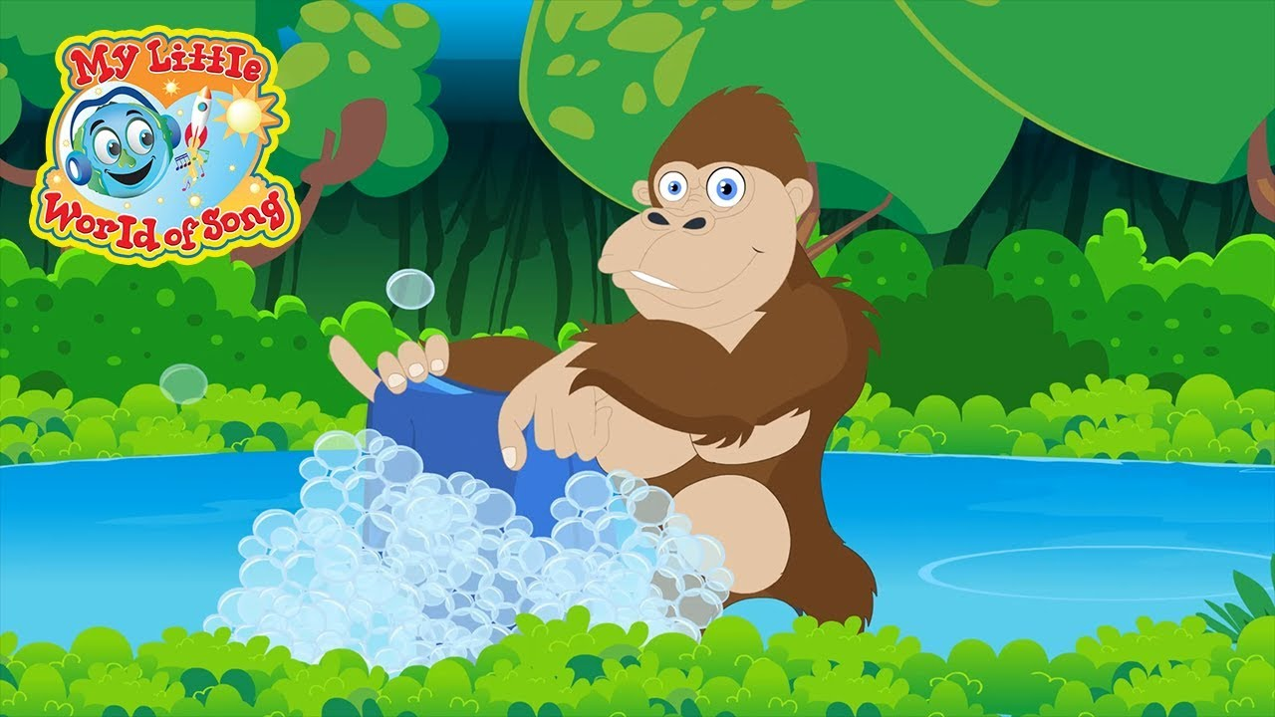
Down in the jungle
Down in the jungle where nobody goes,
There’s a great big gorilla washing his clothes,
With a rub-a-dub here,
And a rub-a-dub there,
That’s the way he washes his clothes.
Boom ba da boogie, boogie woogie, woogie
Boom ba da boogie boogie woogie, woogie
That’s the way, that’s the way,
That’s the way he washes his clothes.
https://www.youtube.com/watch?v=YDojuPkb2-Q

Slide 15
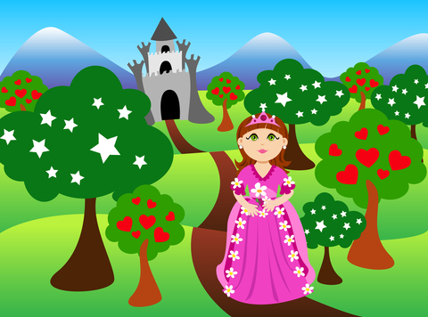
There was a princess long ago
There was a princess
Long ago, long ago, long ago;
There was a princess long ago,
Long, long ago.
And she lived in a big high tower,
A big high tower, a big high tower;
And she lived in a big high tower,
Long, long ago.
https://www.youtube.com/watch?v=51VSFbEshGA

Slide 16
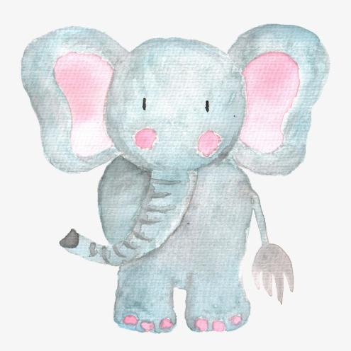
One little elephant
One elephant went out to play,
Upon a spiders web one day,
He / she had such tremendous fun,
That he called for another elephant to come.
Repeat with two, three and four.
Five elephants went out one day,
Upon a spiders web to play,
They had such tremendous fun,
But the web it broke and they all fell down.
https://www.youtube.com/watch?v=wQf6yWEScB8

Slide 17
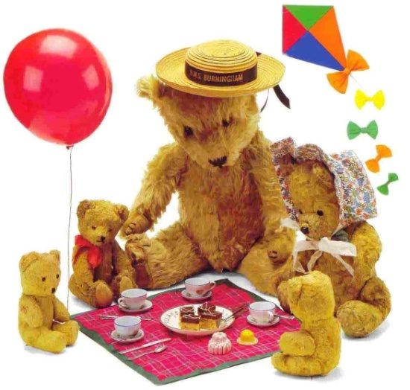
Teddy bear’s picnic
If you go down in the woods today
You're sure of a big surprise
If you go down in the woods today
You'd better go in disguise!
For every bear that ever there was
Will gather there for certain
Because today's the day the
Teddy Bears have their picnic
https://www.youtube.com/watch?v=uxFIGWm9M6w

Slide 18

I can sing a rainbow
Red and yellow and pink and green
Purple and orange and blue
I can sing a rainbow
Sing a rainbow
Sing a rainbow too
Listen with your eyes
Listen with your ears
And sing everything you see
I can sing a rainbow
Sing a rainbow
Sing along with me
https://www.youtube.com/watch?v=4g0NbaukkQc

Slide 19
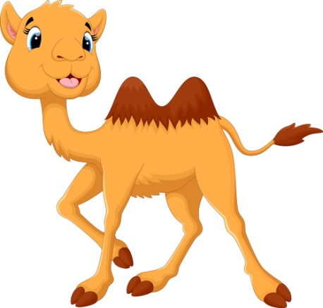
Alice the camel
Alice the camel has five humps.
Alice the camel has five humps.
Alice the camel has five humps.
So go, Alice, go.
Repeat with four, three, two and one hump.
Alice the camel has no humps.
Alice the camel has no humps.
Alice the camel has no humps.
Now Alice is a horse.
https://www.youtube.com/watch?v=YcswhLNjdDk

Slide 20
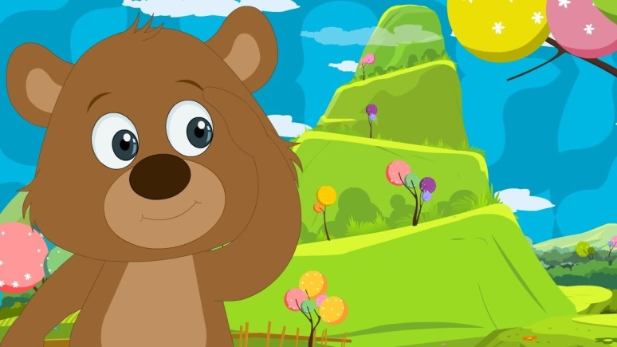
The bear went over the mountain
The bear went over the mountain;
The bear went over the mountain
The bear went over the mountain, to see what he could see.
But all that he could see, and all that he could see
Was the other side of the mountain,
The other side of the mountain
The other side of the mountain, was all that he could see..
https://www.youtube.com/watch?v=PGJuoodm_BM

Slide 21
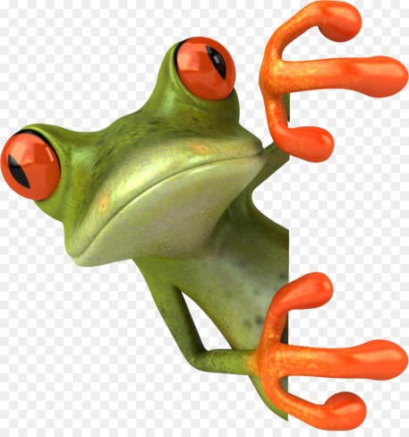
Little green frog
Mm mm went the little green frog one day, Mm mm went the little green frog Mm mm went the little green frog one day, And the frog went mm mm mm.
But we know frogs go tra la la la la Tra la la la la, Tra la la la la, We know frogs go tra la la la la And they don’t go mm, mm,mm!
https://www.youtube.com/watch?v=QjYkG8jDsJU

Slide 22
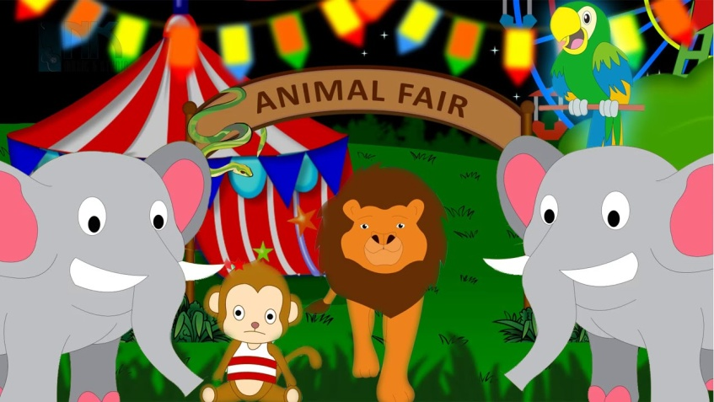
The animal fair
I went to the Animal Fair,
The birds and the beasts were there.
The big baboon by the light of the moon,
Was combing his auburn hair.
The monkey fell out of the bunk,
And fell down the elephant's trunk.
The elephant sneezed and fell on his knees,
And what became of the monkey, monkey, monk?
https://www.youtube.com/watch?v=kbcKvW-mjfA

Slide 23
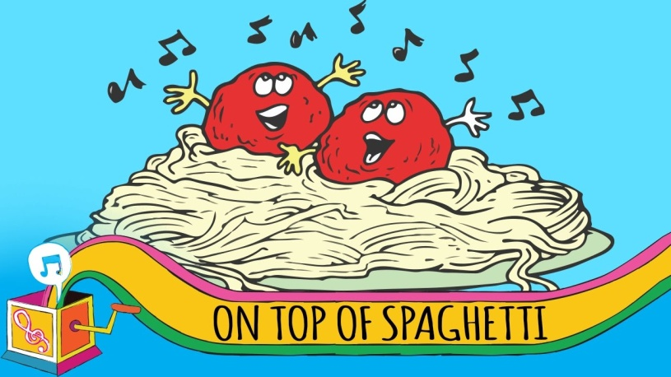
On top of spaghetti
On top of spaghetti all covered with cheese
I lost my poor meatball when somebody sneezed
It rolled off the table, it rolled on the floor
And then my poor meatball rolled out of the door
It rolled in the garden and under a bush
And then my poor meatball was nothing but mush.
https://www.youtube.com/watch?v=yU2GqcjJcdM

Slide 24
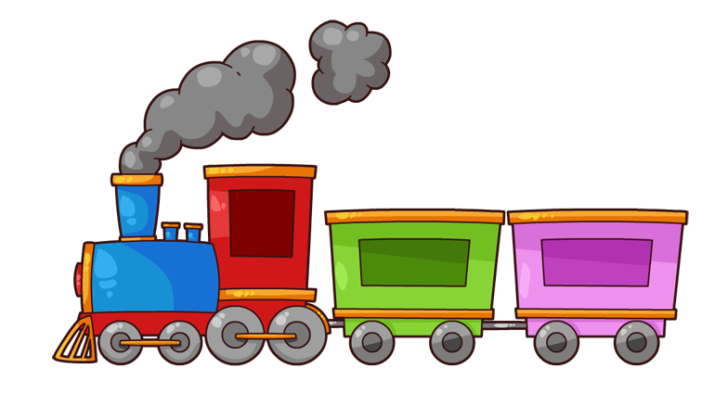
Menu train
Coffee, coffee x2
Cheese and biscuits x4
Plums and custard x4
Beef and carrots x4
Fish and chips x8
Soooooup!
https://www.youtube.com/watch?v=gRuSrltuTKs

Slide 25
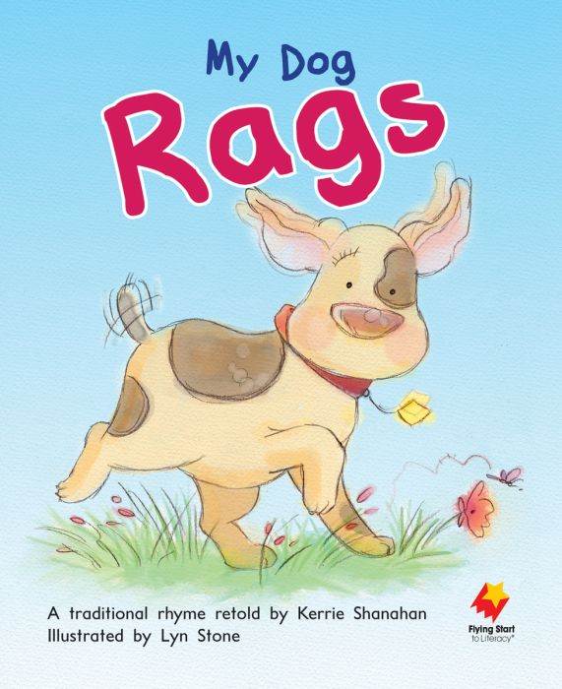
My dog rags
I have a dog his name is Rags;
He eats so much his tummy sags,
His ears flip flop his tail wig wags
And when he walks, he walks zig zag
He goes flip flop, wig wag, zig zag;
He goes flip flop, wig wag, zig zag;
He goes flip flop, wig wag, zig zag;
I love Rags and he loves me!
https://www.youtube.com/watch?v=-KDPAB4pqQ8&t=3s

Slide 26
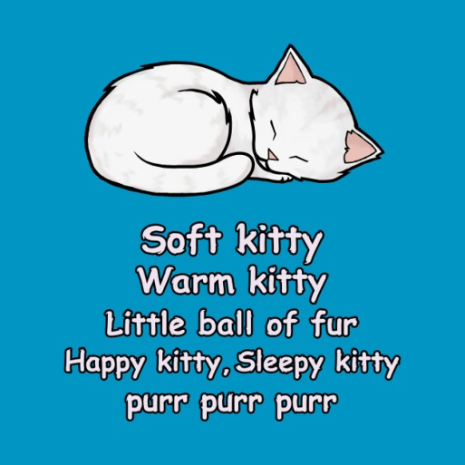
Soft kitty
Soft kitty, warm kitty
Little ball of fur
Happy kitty, sleepy kitty
Purr, purr, purr
Soft bunny, warm bunny
Floppy ears up top
Happy bunny, sleepy bunny
Hop, hop, hop
Hard turtle, wet turtle
Where did your head go?
Happy turtle, sleepy turtle
Slow, slow, slow…
https://www.youtube.com/watch?v=szDIgwsiJm4

Slide 27
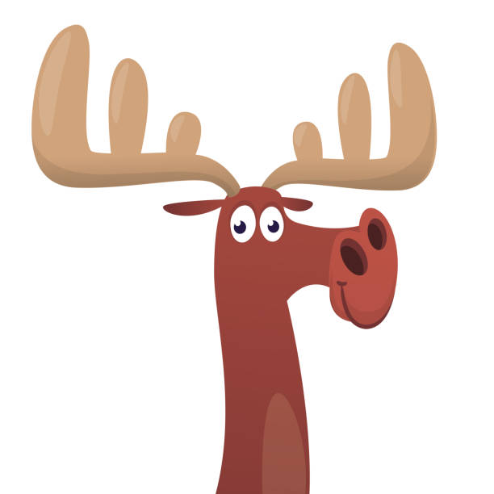
There was a crazy moose
There was a moose, there was a moose,
And he drank a lot of juice, and he drank a lot of juice.
There was a moose, there was a moose,
And he drank a lot of juice, and he drank a lot of juice.
Singing way o way o, singing way o way o,
Way o, way o, way o, way o
Singing way o way o, singing way o way o,
Way o, way o, way o, way o
https://www.youtube.com/watch?v=oHmzOMVBcgU
…

Slide 28

Skidamarink
Skidamarink a dink a dink,
Skidamarink a doo,
I love you.
Skidamarink a dink a dink,
Skidamarink a doo,
I love you.
I love you in the morning
And in the afternoon,
I love you in the evening
And underneath the moon;
Oh, Skidamarink a dink a dink,
Skidamarink a doo,
I love you!
https://www.youtube.com/watch?v=ug1pI-Ephns

Slide 29
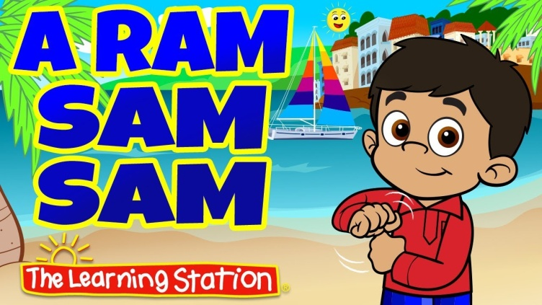
A ram sam sam
A ram sam sam, a ram sam sam
Guli guli guli guli guli ram sam sam
A ram sam sam, a ram sam sam
Guli guli guli guli guli ram sam sam
A rafi, a rafi
Guli guli guli guli guli ram sam sam
A ralfi, a ralfi
Guli guli guli guli guli ram sam sam
https://www.youtube.com/watch?v=zBttxAMxaXE

Slide 30
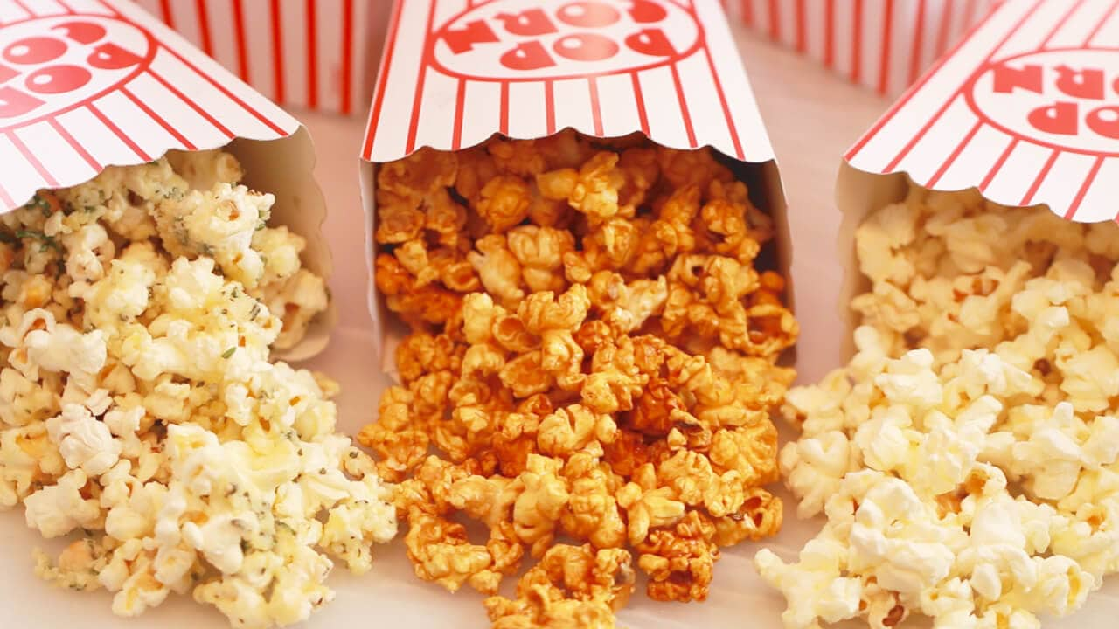
Popcorn song
First you poor in the oil (pour in the oil)
Sprinkle in the popcorn (sprinkle in the popcorn)
Cover up the pan (cover up the pan)
Turn up the heat (turn up the heat)
(Together, while rubbing hands together):
Sizzle, sizzle, sizzle, sizzle,
Sizzle, sizzle, sizzle, sizzle,
Sizzle, sizzle, sizzle, sizzle, POP!
(Students in the middle who were crouching stand up and start jumping around the circle while everyone else sings):
The popcorn’s in the popper, let it pop pop pop
The popcorn’s in the popper, let it pop pop pop (repeat)
Pop, pop, pop, pop,
Now it’s time to STOP (everyone freezes).
https://www.youtube.com/watch?v=Koi-EDhYixA

