Slide 1
Helping our children to achieve in maths
Maths: Information For Parents
Tuesday 14th November 2017

Slide 2
Our aims for today
To outline the maths curriculum .
To learn how children complete calculations at St. Ambrose.
To share some of the activities that we do in school
To provide ideas on how you can support your child at home
To show that maths is fun

Slide 3
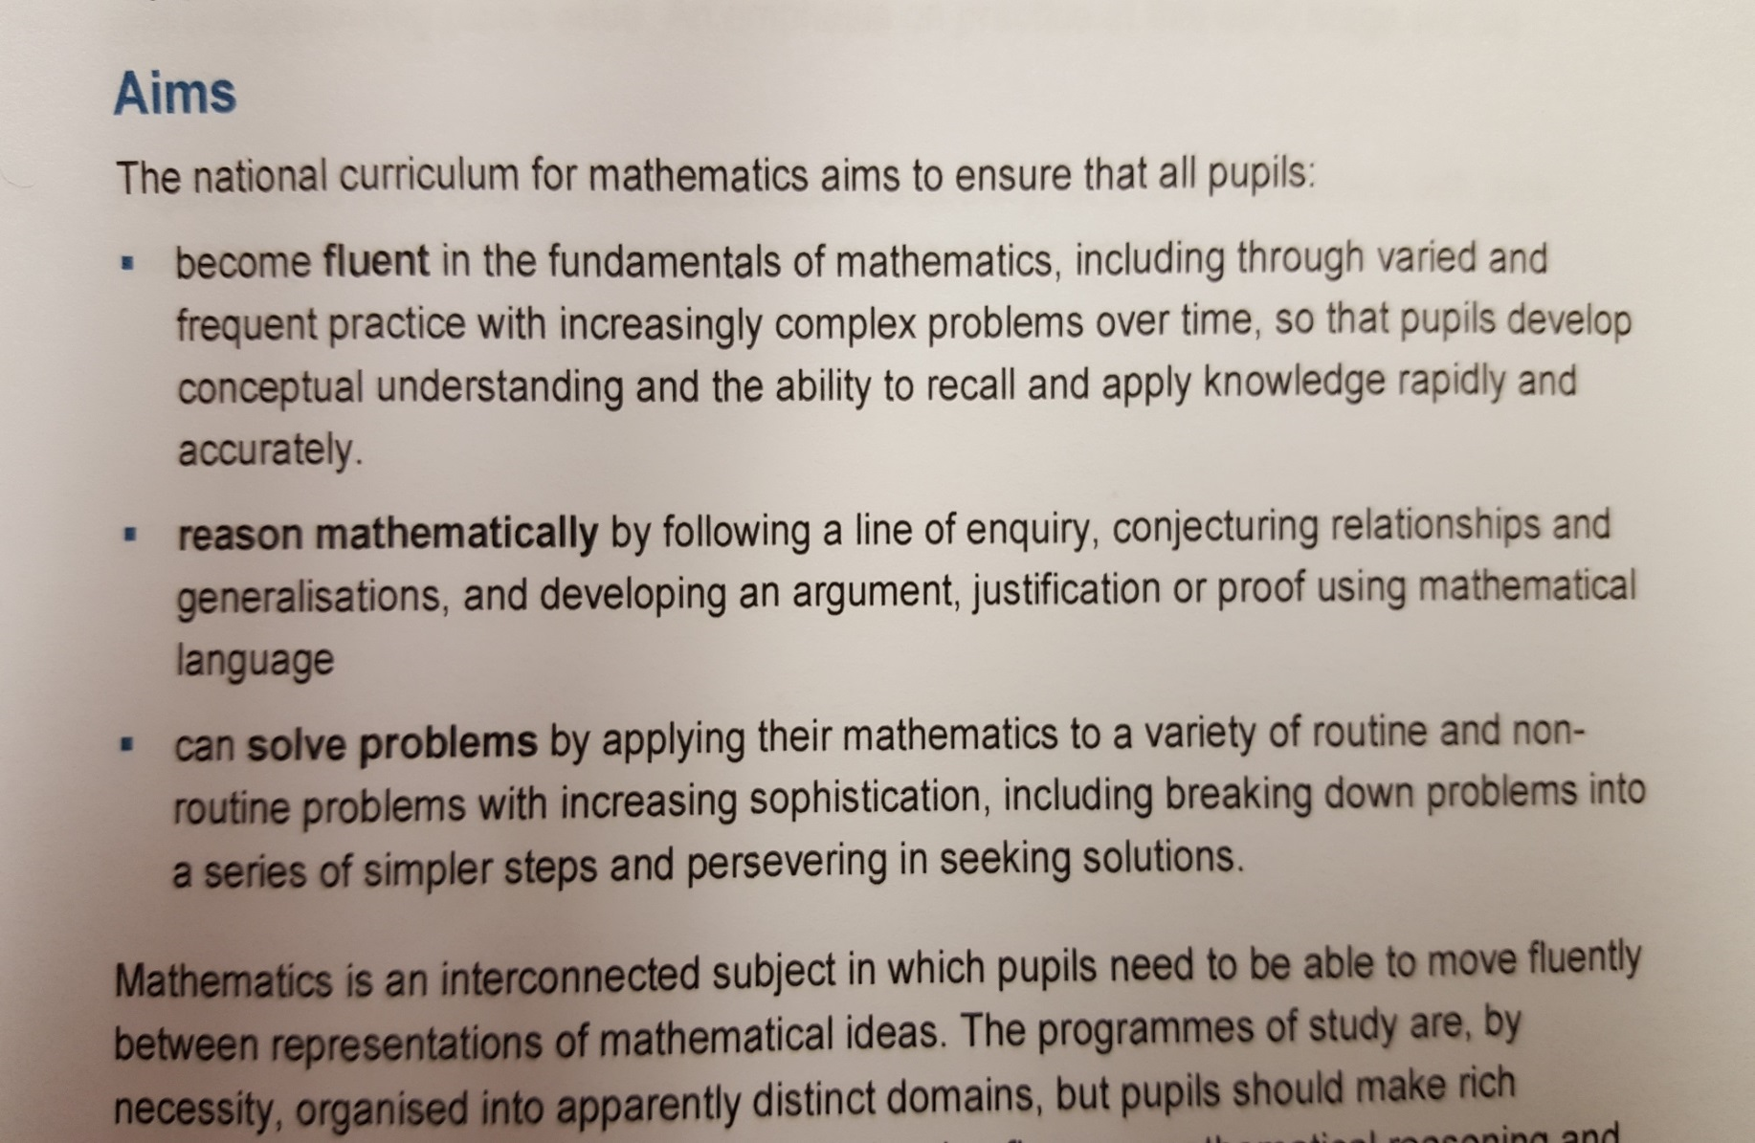
National Curriculum Aims

Slide 4
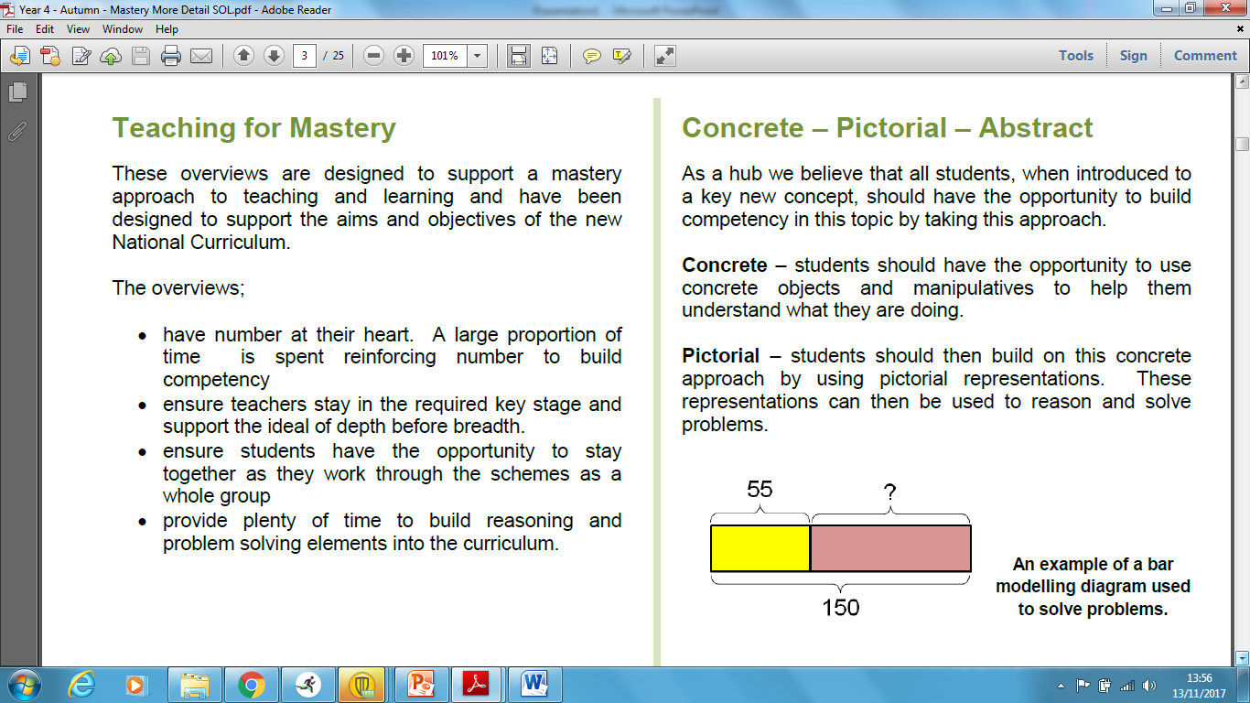
Maths Curriulum

Slide 5
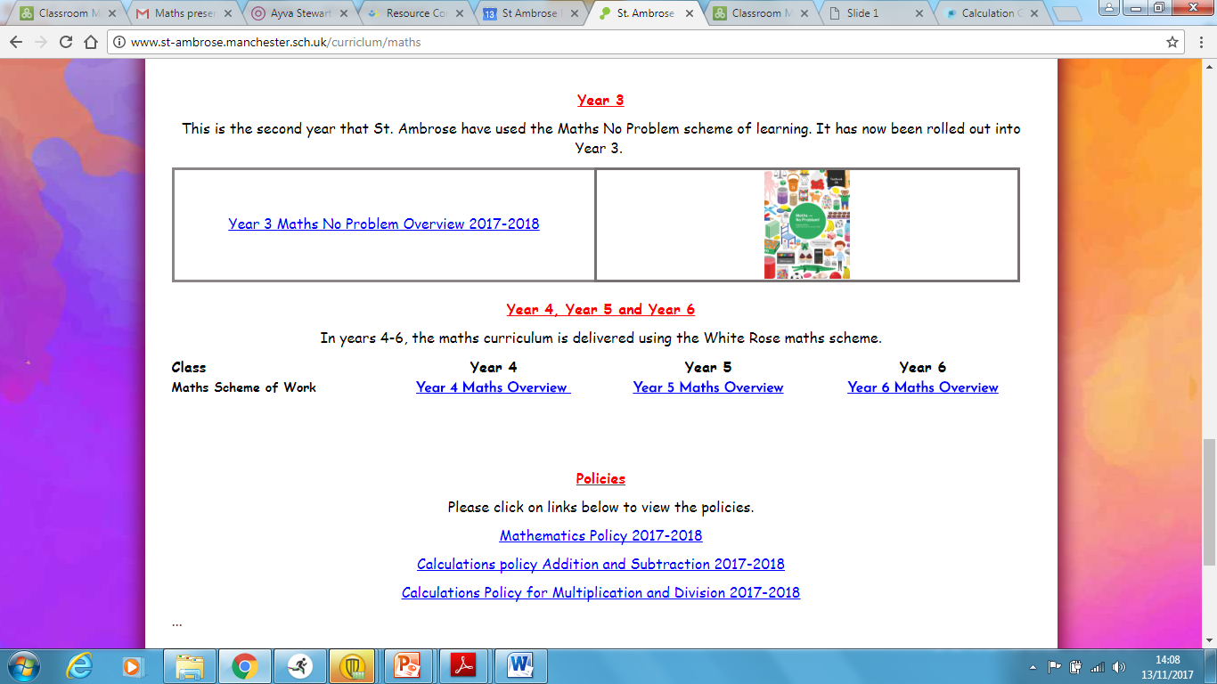
Calculation Policies

Slide 6
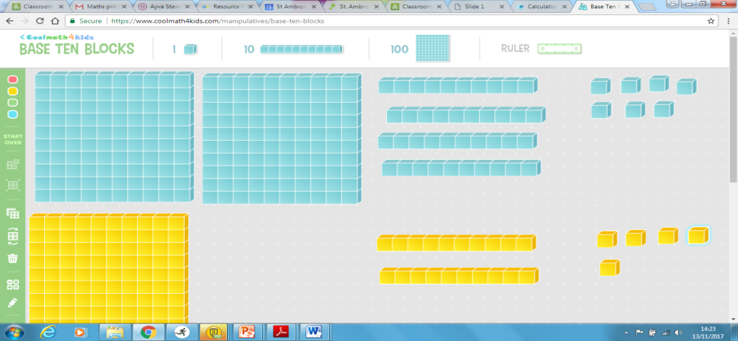
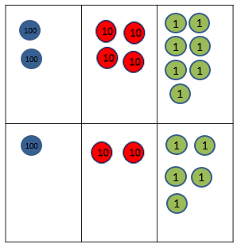
Addition and Subtraction
Addition
247 +125 =
C P
A 247
+125
372
1

Slide 7
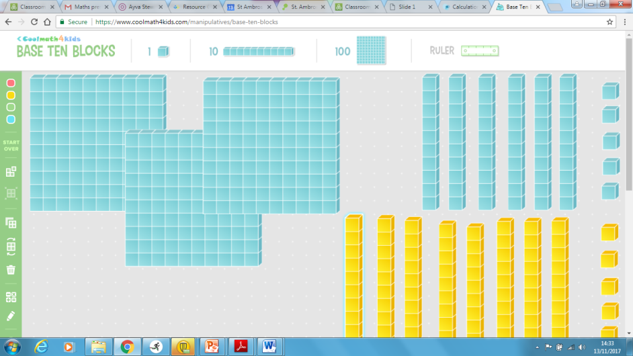
Addition and Subtraction
Addition
365 +85 =
C P
A 365
+ 85
440
1
1

Slide 8
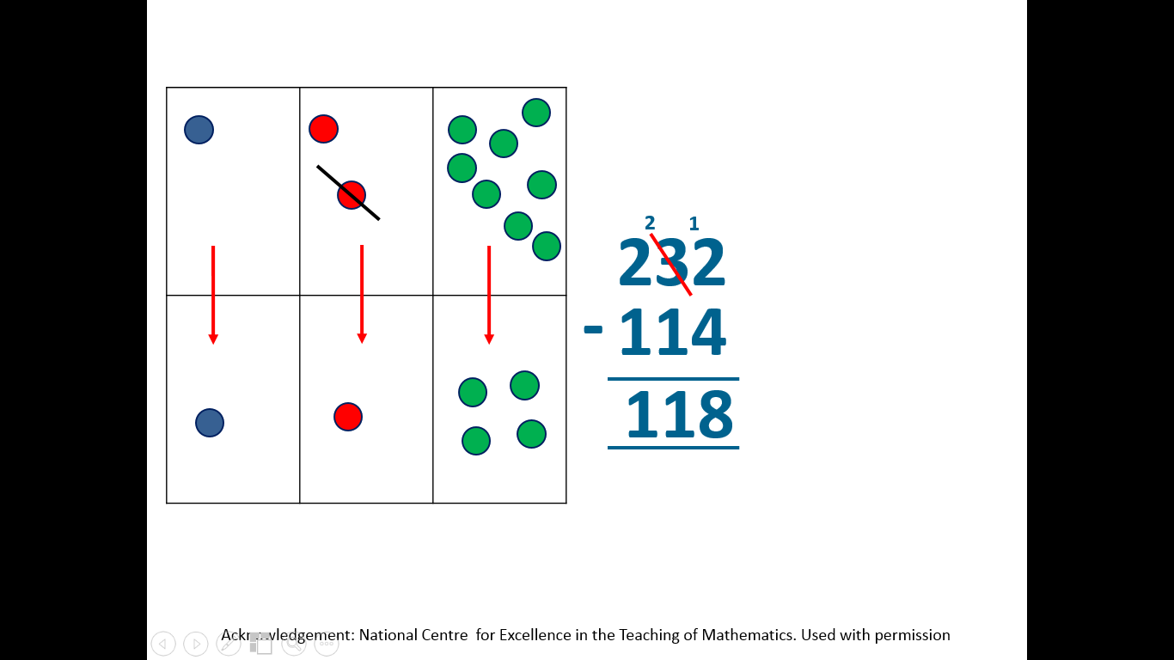
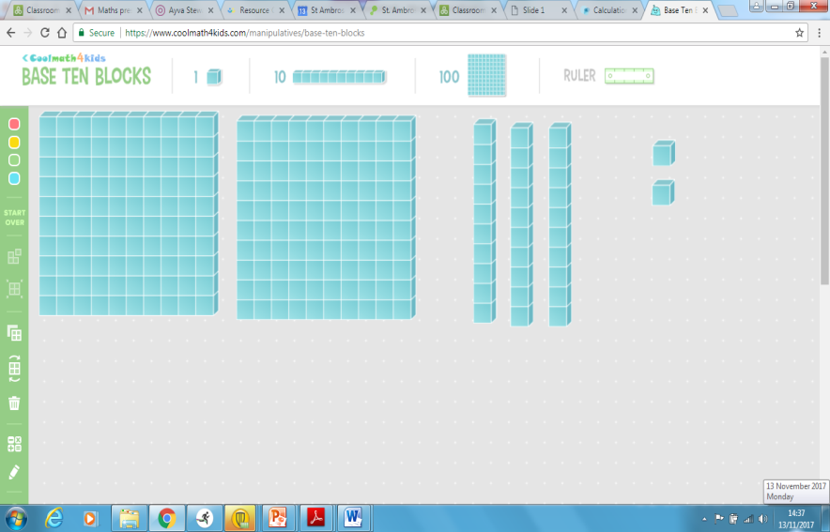
Subtraction
232 – 114 =
C P
A

Slide 9
Subtraction
Try 408 – 255 =

Slide 10
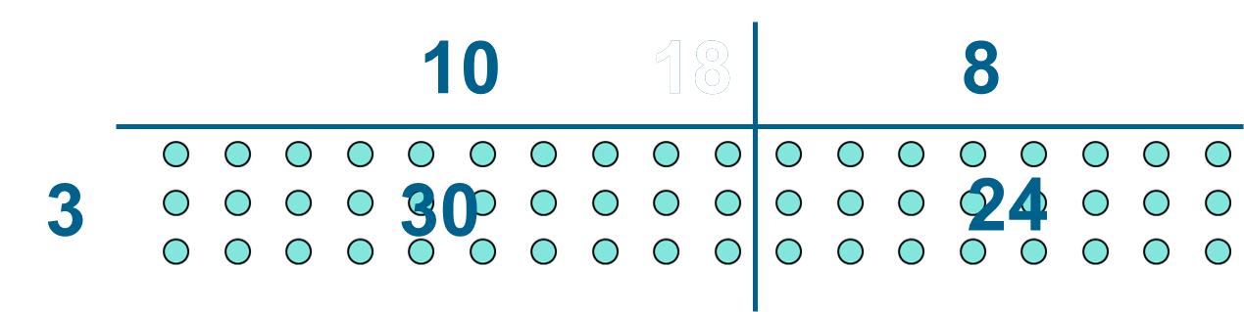
Multiplication
18 x 3 =
C P
A 18
x 3
54
2

Slide 11
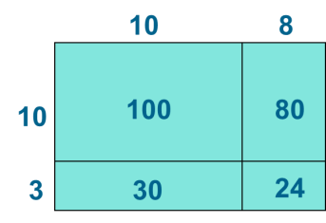
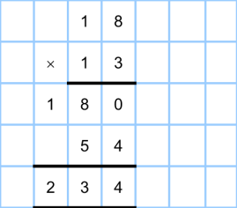
Long multiplication
P
A
5
4
1
8
0

Slide 12
Multiplication
Try
16 x 4 = and 16 x 24 =

Slide 13
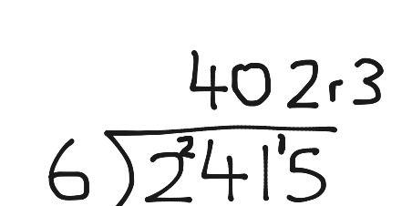
Division
48 divided by 4 =
2415 divided by 6 =
1830 divided by 15

Slide 15
Division
68 divided by 4 =
1415 divided by 6 =
1230 divided by 15

Slide 16
Problem Solving

Slide 17
Problem Solving Types
There are 5 problem types that need to be taught. Each of these involve different reasoning and thinking skills.
Finding all
possibilities
Pattern
problems
and puzzles
Word
problems
Logic /
deduction
Problems
Diagram /
visual
problems

Slide 18
Maths Hunt
The children complete a maths hunt aimed at their ability.
Children start at different questions, and then calculate the answer to the problem. This answer is at the top of another problem which signifies to the children they got the answer correct. They then complete the next problem and so on until they complete all the problems.
See example.

Slide 19
Our aims for today
To outline the maths curriculum .
To learn how children complete calculations at St. Ambrose.
To share some of the activities that we do in school
To provide ideas on how you can support your child at home
To show that maths is fun

Slide 20

Helping at home
…And Some Don’ts!
Some Dos…
Don't expect them to understand after you've explained it once
It is normal for a child to 'get it' one day, and then in a different context not know how to find an answer
Don't tell them you are hopeless at maths
You may remember maths as being hard, but you were probably not hopeless, and even if you were, that implies to your child, “I was hopeless at maths, and I'm a successful adult, therefore maths is not important”
Don't get into an argument over homework
It will be something that your child has covered in class, and if they really can't do it without a lot of tears and frustration, leave it and LET US KNOW!
Play (maths) with your child
There are opportunities for impromptu learning in games with real people that you can't get from a DS or Xbox
Let your child win or be better than you
Otherwise all they learn is that you are better at maths than them
Recognise that there is more than one way of doing calculations
You may have learned one method, but children are actively encouraged to seek out alternative methods in school and choose one which works for them, no matter how long winded
Be an actor
Get excited about maths and your child will get excited too

Slide 21
Feedback
Please complete the feedback form

