Slide 1

Welcome to Year 5

Slide 2
Meet the Staff
Year 5 Teaching
Support Staff
Miss Campbell
Year 5 Teacher
Miss Kemp
Mr Warburton
PE Teacher
Mr Leonard
Music Teacher

Slide 3

Year 5 Daily Timetable
8:45 - School starts. It is vital your child is on time as they are learning from the moment they come through the door.
10:30 – 10:45 – Morning break
12:15-13:15 – Lunch time
15:15 – Day finishes. Please wait until your child has been dismissed by the class teacher.
PE will be on Monday and Thursday

Slide 4


Snacks and Water
Children are only allowed to bring in fruit as a snack for break time. We are a healthy school and there are children who have significant allergies in school.
Please ensure school dinners have been ordered using the School Grid webpage.
Children need water bottles (preferably clear) from home and St Ambrose Bottles can be purchased from the office.
Water can be drunk during the day – no flavoured water, fruit juice or fizzy drinks are allowed.
Milk can be ordered from Coll Milk if you wish your child to have milk.

Slide 5
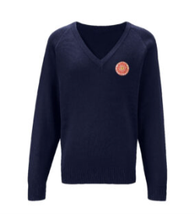

School Uniform
Children are to wear the correct uniform every day, including appropriate footwear, black shoes (not trainers or boots). Dark coloured tights when the weather gets colder.
PE uniform: Children must wear black/navy shorts and a white T-shirt. They will not be allowed to go on apparatus unless wearing shorts. No leggings or tights (in winter socks need to be put into the PE bag if they are wearing tights). Track suit bottoms can be worn in the winter for outdoor games.
Jewellery - no hooped or dangly earrings. No nail varnish please. No bows or hair accessories, just plain bobbles.
Forest school – outdoor clothes and footwear that you don’t mind getting muddy. Waterproof for when it is raining. Warm for when it is cold.

Slide 6

Behaviour Expectations

Slide 7
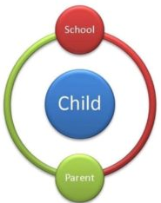
Behaviour for Learning
100% effort is required in all learning and this includes effort in home-learning as well.
Practise makes permanent.
We know that learning is hard- it is meant to be.
We are here to help the children with their learning but not to do it for them.
We are aiming to develop resilient learners who recognise that mistakes are a key part of the learning process. We can learn from them. Our partnership with you is crucial to the progress your child makes.
As you know, regular bedtimes and plenty of sleep are paramount to good concentration and great work! There is evidence to show that if a child is on a device an hour before bedtime then this increases brain activity during the night and does not lead to a restful sleep.

Slide 8
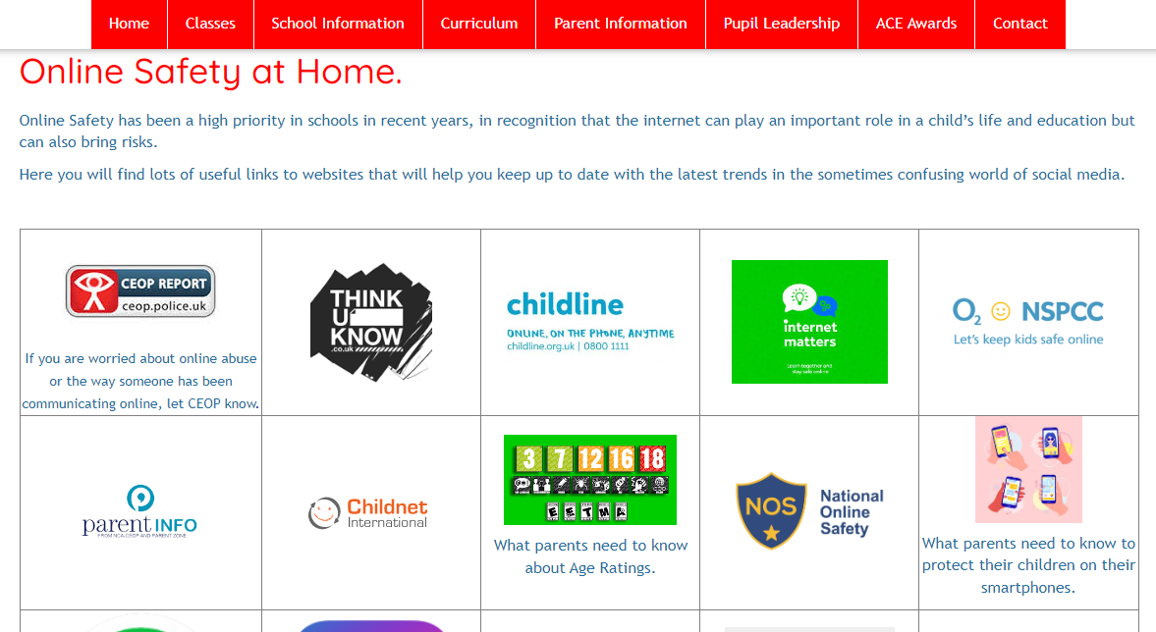
Internet Safety
Advice for parents regarding apps and games which your child may use can be found on the school’s safeguarding page

Slide 9
Home Learning
Daily reading is extremely important. We expect you to listen to your child read every day for 5-10 minutes at home. Please sign their reading record every time you read with them. Reading records are checked daily.
Practising and learning their times and division tables is crucial to making their learning in maths easier. Your child needs to practise times tables and related division facts each night up to 12 x 12. . Mathletics is another daily home learning for Year 5s.
Home learning is sent out at the start of the half term. There will be opportunities during the year to celebrate this with you. There will be a paper copy, you will be sent an electronic copy and there will be a copy on the class web page.

Slide 10

Recognising Positive Behaviour:
“It’s what we do at St Ambrose.”
House Points
Postcards for going above and beyond
Conversations, phone calls
ACE Assembly
Children are awarded a certificate for either their achievement, commitment or effort.

Slide 11

New Daily Planner

Slide 12
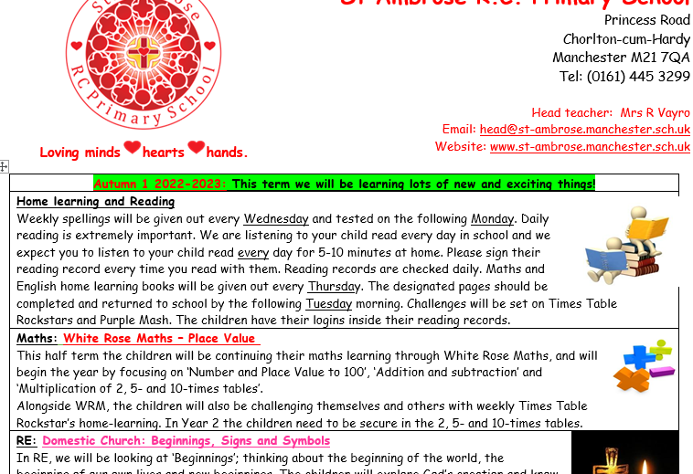

Sharing Our Learning
Each half term, a letter will be shared electronically with parents about what the children will focus on in each subject. This will also be available on the class page.

Slide 13

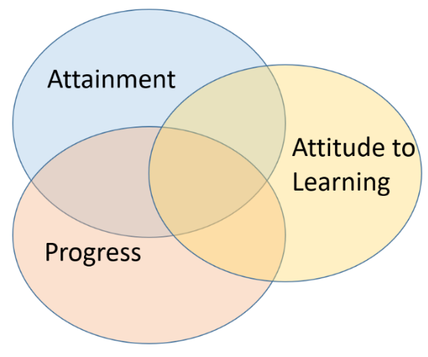
Attainment and
Progress
Assessments will be done throughout the year to keep track of each child’s progress and attainment.
There will be two Parents’ Evenings (October and April) to communicate each child’s progress and attainment.

Slide 14

Extra Curriculum
There are clubs for Year 5, that children can attend this academic year:
Monday Multi- sports
Tuesday
Wednesday Star Dance
Thursday Girls and Boys Football

Slide 15
Ghyll Head
Wednesday 18th March
More information will be shared

Slide 16


Birthdays
When it is your child’s birthday they will be allowed to come into school in their own clothes. (If it is during the holidays, they can come in their own clothes the final day before the holiday)
Please do not bring in or give them out on the playground sweets or birthday treats as we have many dietary requirements and food allergies in school.

Slide 17






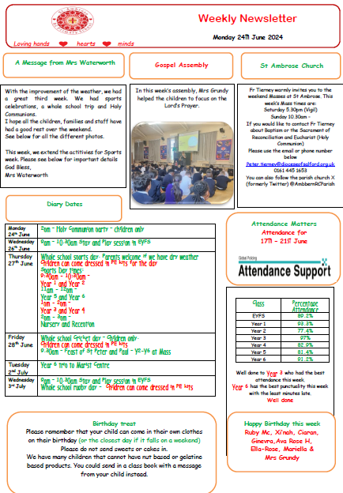



How we communicate with you.
Postcards
Conversations
Daily Planner
Phone Calls
Weekly Newsletters
Text Messages
School Spider Texts
Phone calls
Share in our Learning letters
Class Webpage
Letters

Slide 18
Tiered Communication
Tiered approach for communication Please find below, a tiered approach if any conversations need to take place about your child.
Tier 1 – all academic, personal, social and friendship discussions to take place, initially with the class teacher/teaching support staff. The class teacher/teaching support staff will communicate anything to you as they feel the need. Parents – You can contact these staff members face-to-face, through a telephone call or an email to the school office stating ‘FAO Class teacher name.’
Tier 2 – There are lead teachers in school: Mrs Grundy, Mrs Stevenson and Mrs Hoban (SENCO) If you or we find that discussions with the class teacher need to be explored further, the contacts are the lead teachers or the SENCO.
Tier 3 – After Tier 1 and 2 have been exhausted, Mrs Murphy (Acting Deputy Headteacher) and/or Mrs Waterworth (Head teacher) would be the next line of communication.
Depending on the level of need for communication it may be necessary for the initial tiers to be bypassed.
SAFEGUARDING: In the event of any safeguarding concerns communication will need to take place between Mrs Waterworth or Mrs Murphy and parents or carers with parental responsibility.

Slide 19


