Slide 1

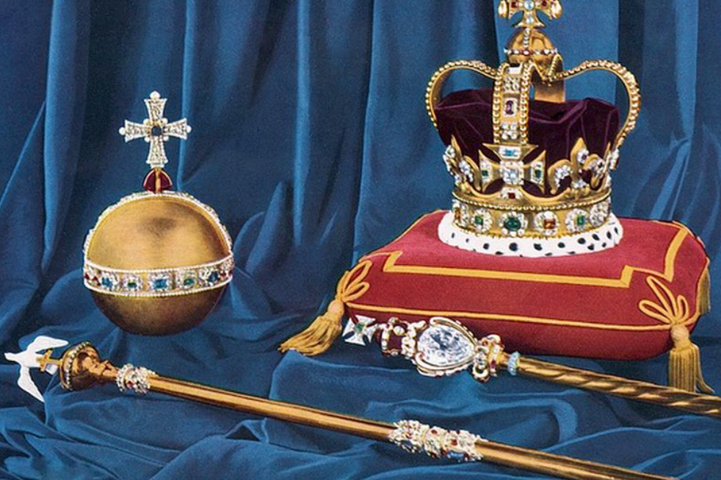
Everyone has a crown
What jewels are in our crowns?
What jewel will you choose to put in your crown today?
Worship reflection 15th September 2022

