Slide 1
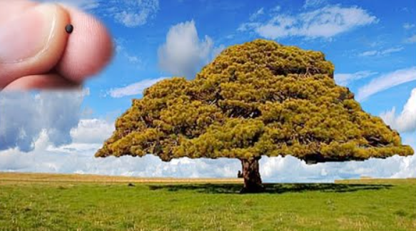
The Parable of the mustard seed
Are you big or small at Astbury School?
What will help you to grow into a tree?
Worship reflection 8th September 2022

