Slide 1

Crime and Consequences

Slide 2


What crimes do you think are most common in your area?

Slide 3

The Police respond to…
Suspicious people or incidents
Car
accidents
Missing
People
Fires
Criminal
Damages
Neighbour
disputes
Fights
Sudden
deaths
Knife crime
Assaults

Slide 4

What do you think about when you hear
Knife Crime?

Slide 5
Do you think many young people carry knives?
Actually……..
  99% of people aged between 10 and 29 years DO NOT carry a knife

Slide 6
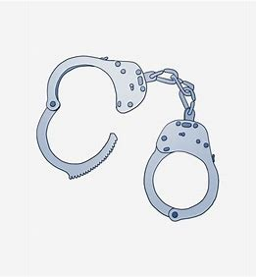
Knife crime in your area is not a common crime but sometimes what we see on social media and hear from our friends makes us worry more than we need to….
Don’t be the 1%
The odd one out,
it NEVER ends well

Slide 7
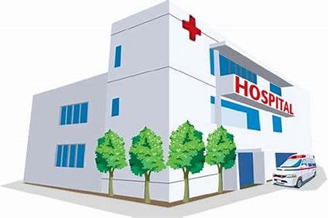

Anyone who carries a knife is more likely to end up in hospital
Or have their own knife used against them

Slide 8
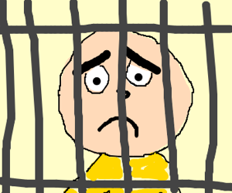
How long could you go to prison for if you carry a knife?
EVEN IF YOU DON’T USE IT…..
FOUR YEARS!

Slide 9
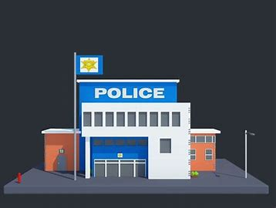
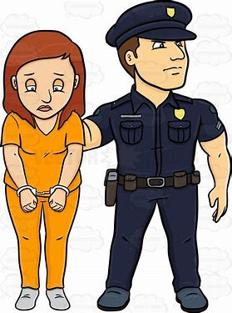
If you carry a knife what could happen?
You could be arrested
You could be interviewed at the Police Station
The adults you live with would be told
You may get a criminal record
Teachers may be told
You may lose friends

Slide 10

If someone you are with is carrying a knife,
you could get into just as much trouble.
This is called Joint Enterprise
If you know someone has a knife you have to make the right choice!
Notes:
Joint Enterprise means that if a knife is used and you were there you will be in as much trouble as them. The only way to avoid this is to show that you have tried to intervene. This would mean that you have tried to call the police or physically intervened in the fight to stop it. If you have not had any involvement in the knife crime but were there and did nothing to stop it you could be arrested and the police will treat you the whole group equally.

Slide 11


What could you do if a friend does something you don’t like?
Tell somebody that you trust
Walk away from the situation
Try and tell them why you think it is wrong
Make an excuse to leave if you feel scared
Make new friends if they carry on
Choose a different area to hang out

Slide 12

PEER PRESSURE
As you get older you might be asked to do something you don’t want to do.
Sometimes young people feel pressured into making bad choices
You might be the only person who says NO

Slide 13

Activity
Draw around your hand and on each finger think about who you could talk to if you were worried about ANYTHING
Someone you can trust

Slide 14

Any Questions

