Slide 1


Whilst You’re At Home
We are going to stay in touch
2nd March 2021

Slide 2



Slide 3
Positive Message of the Week
Hi everyone, we hope you have all had a great week off during half term, and worked on staying positive even though you may be missing your school friends.
This may be our last weekly presentation and so with all our fingers and toes crossed most of you will be back in School next week, how exciting is that!
This week we are going to have a look at Our Mental Health and ways to keep it healthy, plus we will take another look at On-line Safety as this too can affect the way we feel.
There will be a few activities to get involved with too.
If you are worried about anything please remember to talk
to someone you trust.
Have a GREAT week everyone.

Slide 4
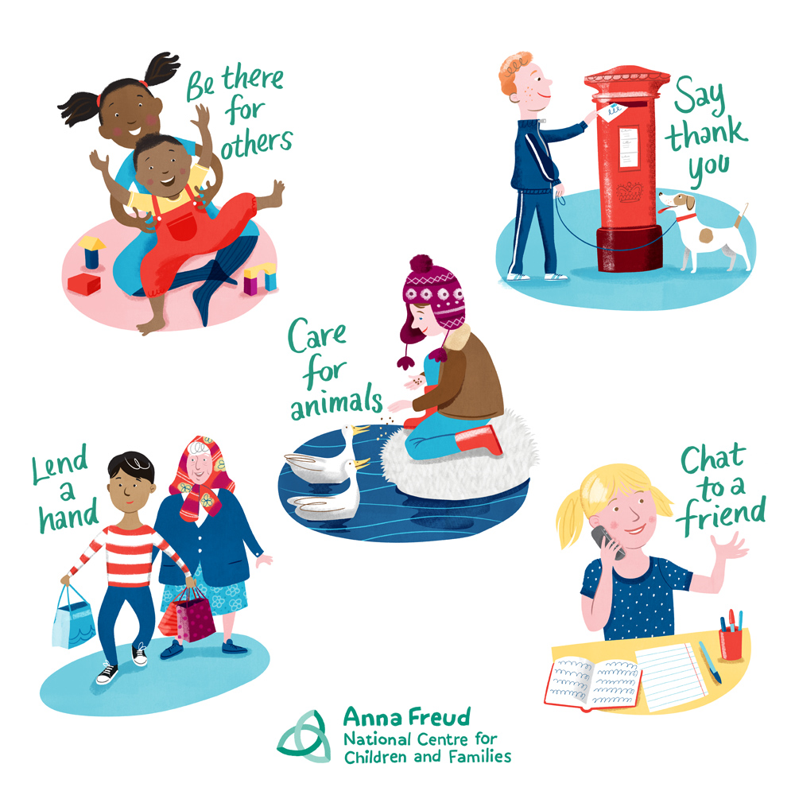
Taking Care of Your
Mental Health
Our brain can be very complex but helping it stay Healthy and Happy can be fairly easy for a Child to do.
Lets look at some ways
If you are worried about something, ANYTHING - Speak to someone you trust. This can be someone who cares for you. Maybe a teacher or a police officer. Talking usually helps all of us feel better.
Being kind or helpful to people around us or On-line is also very good for our brain.
Choose friends that make us feel good about ourselves and avoid those that cause us to feel worried.
Also being outside, enjoying nature as much as you can.
Remind yourself EVERY day that you are an Amazing Child, because you are.

Slide 5




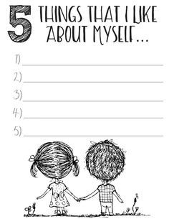





Positive Mental Health
Activities
THINGS THAT I LIKE
ABOUT MYSELF
1
2
3
4
5

Slide 6


This is Me
ALL ABOUT ME
Activity
Things I like to do
My Family
My Favourite
Subject
Food
Place to go
Book
Movie
Animal
My favourite colour is…
Things that make me worried or sad
My Friends

Slide 7



Staying safe On-line
Think carefully about What information you share with anyone On-line
Tell NOBODY where you live
Please NEVER share images of yourself Online
Stay Safe and keep your Passwords Private
If someone scares or worries you On-line, Tell an Adult
Z
Z
Z
Z

Slide 8







What sort of message are you likely to send?
Hi You
Hey You
Hi Whose this?
Hi whose this?
For me to know and you to find out
Really like your hair
Hey thanks, waw I feel a million bucks
All I’m sayin
I don’t like you

Slide 9



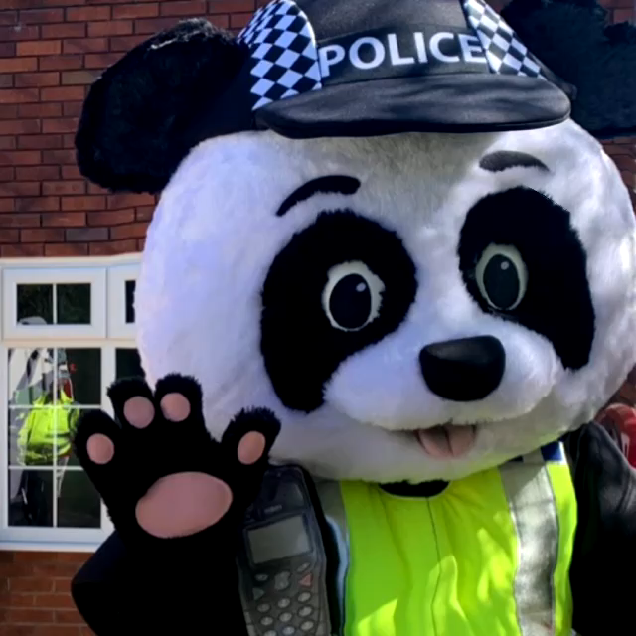
Hippo Birdie 2 Ewe!
What goes up but never comes down?
Your age!
What did the Pirate say on his Eightieth Birthday?
Aye Matey!
Press Play

Slide 10

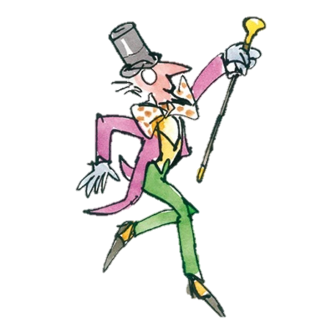

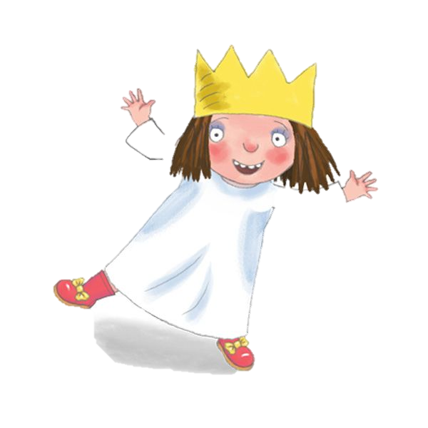

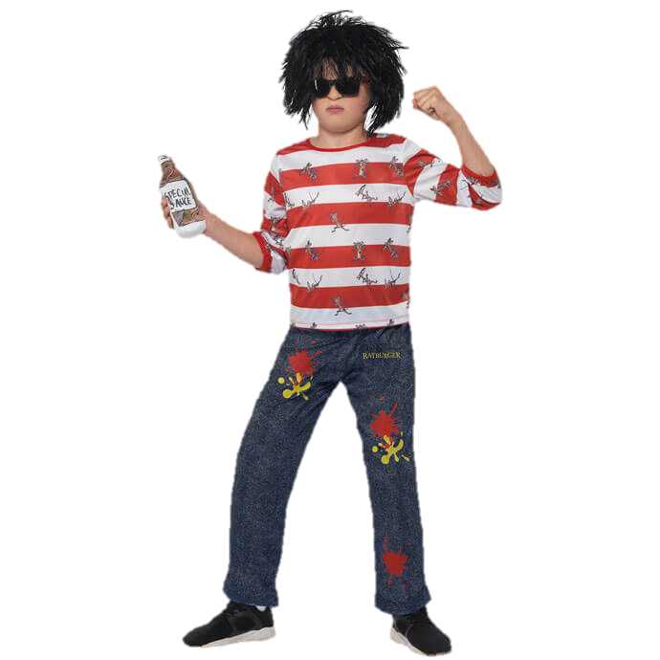
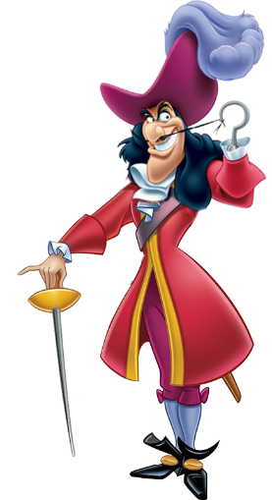

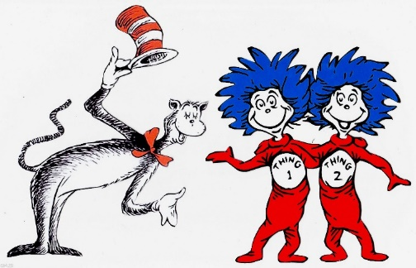
.
.

Slide 11


Useful Links and Services
Useful Links and Services
Childline
https://www.childline.org.uk
Get help and advice about a wide range of issues, call us on 0800 1111, talk to a counsellor online, send Childline an email or post on the message boards
https://www.o2.co.uk/help/nspcc/helpline
NHS 111
Your local
Doctors surgery
Well-being
officer in School
NSPCC Helpline
0808 800 5000

