Slide 1

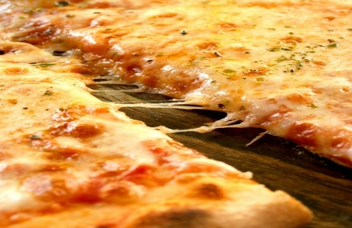
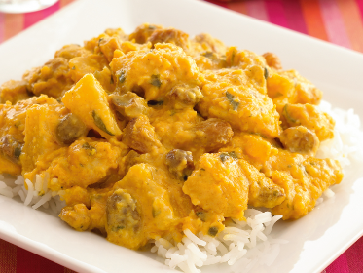
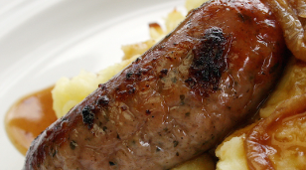
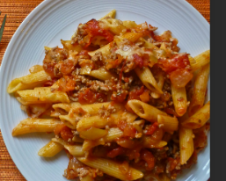

Your Menu This Week
Week 1 Commencing
2024
Please note, that our menus could be subject to change due to nationwide supply issues.
Main Dish
Main Dish
Main Dish
Dessert
Monday
Homemade pizza with potato wedges and beans
Homemade pizza with potato wedges and beans
Jackets with Cheese or Beans
served with salad
Shortbread biscuit served with a wedge or orange
Week
Commencing:
19th Feb
4th March
18th March
Allergens & Intolerances:
G=Gluten
MK=milk
M=mustard
S=soya
SE=Sesame
E=Egg
SD=Sulphur dioxide
C=Celery
F=Fish
Tuesday
Fruit chicken curry with rice and mixed vegetables
Halal fruity chicken curry with rice and mixed vegetables
Jackets with Cheese or Tuna
served with salad
Fruity jelly and cream
Or fresh fruit
Wednesday
Pork sausage with mash potato & mixed vegetables
Halal sausage with mash potato mixed vegetables
Jackets with Cheesy beans
served with salad
Marbled sponge & custard
Thursday
Pasta Bolognaise
Halal Pasta bolognaise
Mascarpone Pasta
Digestive biscuit with cheese or Fresh Fruit
Friday
Battered cod with oven chips and peas
Vegetarian sausage roll with chips and peas
Sandwich with Cheese, Tuna or Ham
Fruit platter or Yoghurt

Slide 2
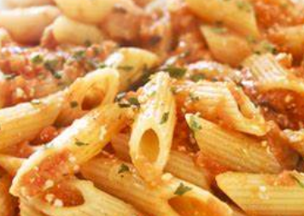
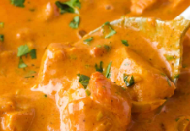
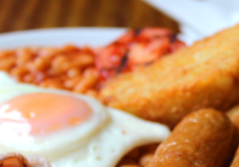
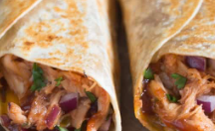
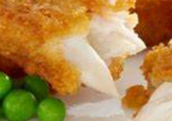
Your Menu This Week
Week 2 Commencing
2024
Please note, that our menus could be subject to change due to nationwide supply issues.
Main Dish
Main Dish
Main Dish
Dessert
Monday
Tomato Pasta served with homemade garlic bread & sweetcorn
Vegetarian chicken stir fry
Jackets with Cheese or Beans served with salad
Flapjack with an apple slice
Week
Commencing:
26th Feb
11th March
25th March
Allergens & Intolerances:
G=Gluten
MK=milk
M=mustard
S=soya
SE=Sesame
E=Egg
SD=Sulphur dioxide
C=Celery
F=Fish
Tuesday
Butter chicken curry with rice and mixed vegtables
Halal butter chicken curry with rice and mixed vegetables
Tomato Pasta
Chocolate crunch with a wedge of orange
Wednesday
All day breakfast
Halal all day breakfast
Jackets with Cheesy beans served with salad
Melting moment with a slice of melon
Thursday
BBQ chicken wrap with potato wedges and sweetcorn
Halal BBQ chicken wrap with potato wedges and sweetcorn
Jackets with Cheese or Tuna served with salad
Anzac biscuit or fruit
Friday
Jumbo fishfinger with chips and peas
Vegetarian burger in a bun with chips and peas
Sandwich with Cheese, Tuna or Ham
Fruit Platter or Yoghurt

