Slide 1
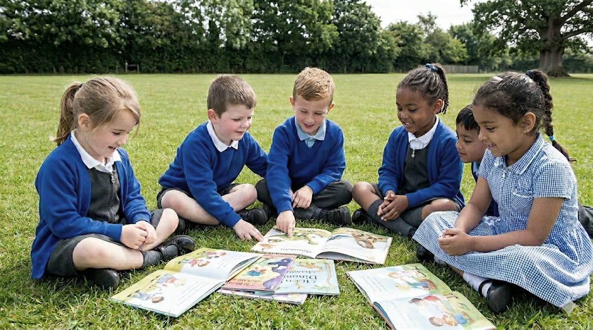
Welcome to Outwood Primary School!
Please enjoy a refreshment and we will start our presentation shortly.
In the meantime:
Please collect your information pack.
Mrs Moon is available to deal with any administration queries.

Slide 2






Welcome to Outwood Primary School!
Mrs Maude - Headteacher

Slide 3


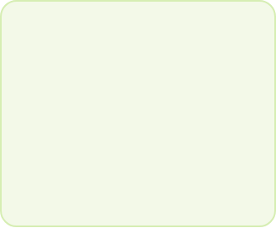







What our school offers
A rich and engaging curriculum.
Happy children who reach their full potential
A safe and caring environment.

Slide 4






Our ACORN Values
A – Aspirational learners who embrace learning throughout their lives.
C – Curious and inquisitive minds that explore the world around them.
O – Open minded individuals who seize all opportunities with enthusiasm.
R – Respectful and resilient global citizens who excel in a rich and diverse curriculum.
N – Nurturing and caring individuals who make a positive contribution to society.

Slide 5
We would like to introduce:
Deputy Head and Inclusion Lead
The Governors
The PTA
Breakfast & After School Club Manager
The Office Team
Catering Team
EYFS Leader

Slide 6
The Transition within Outwood EYFS
In The Foundation Stage we learn through structured play. Challenges and expectations increase with your child’s development as they progress from FS1 (Nursery) to FS2 (Reception).
FS1 children focus highly on the prime areas of learning and spend much of their learning time in our excellent EYFS provision.
FS2 children use the main playground at lunchtime, attend school celebration assemblies and join in with more whole school activities.

Slide 7
What will my child be learning?
The EYFS framework outlines seven areas of learning and development that form our educational programmes and curriculum.
There are three prime areas of learning, which are particularly important for your child’s development and future learning: communication and language (CL); personal, social and emotional development (PSED), physical development (PD)
There are four specific areas of learning, through which the prime areas are strengthened and applied: literacy (L), maths (M), understanding the world (UW), expressive arts and design (EAD)
Early years practitioners also use your child’s needs and interests to plan challenging and enjoyable activities and experiences.

Slide 8

What does the curriculum look like?
Play based provision for all children to support attainment of seven areas of learning and development.
Focused activities to ensure children receive a broad and balanced curriculum.
Enhanced provision to support the characteristics of effective learning.
High quality adult interactions to ensure a strong foundation for learning.
Ongoing formative assessment with termly summative checkpoints.
Strong systematic synthetic phonics programme.

Slide 9

How will I know how my child is doing?
We use an online learning journal called Class Dojo to record, track and share your child’s learning during their time in the EYFS. This enables staff to take photographs, videos and make written observations of the activities your child completes at school. You will then have access to this information through the Class Dojo app so that you can celebrate their learning at home too. Parents/carers can also add their own photos and comments to the portfolio from home.
Parents Evenings
Reports
EYFS practitioners use their professional knowledge to assess your child’s level of development. We will raise any queries regarding your child’s progress with you immediately.
There are formal assessments that take place during FS2
Reception Baseline Assessment (autumn 1)
Early Years Foundation Stage Profile (summer 2)

Slide 10

Settling In
Parents/Carers are encouraged to come into the classroom with their child to aid transition.
If a child needs longer to settle, we encourage the parent/carer to stay for a short time. If required, we will work with you to create an individual plan of for your child to settle in.

Slide 11
Settling in
New nursery starters are welcome to attend a stay and play session on Monday 13th July or Tuesday 14th July either 10:00 - 11:30 or 1:30 – 3:00. Please ensure you have booked a session with Mrs Moon.
New reception children are invited to a Teddy Bear’s Picnic – Thursday 16th July 2026 at 9:00 – 11:30. They are welcome to bring a teddy.
Would you like a home visit? If so, please see Mr Millward to arrange.
‘All about me’ poster

Slide 12
Transition Schedule
Wednesday 24th June 2026 – Transition Welcome Evening
Wednesday 1st July 2026 - Parent/Carer Appointment with Mr Millward
Monday 13th July – Thursday 16th July – Stay and play sessions.
Home visits can also be arranged upon request.
Please ensure you return your starter forms as soon as possible.

Slide 13
FS1 transition in September
Our new nursery children will start nursery week commencing Monday 7th September 2026.
Once the children have visited nursery we will confirm your child’s start date by letter.
We always work with the children, but we aim to have the children in nursery as quickly as possible.
Please ensure you return your starter forms as soon as possible.

Slide 14
FS2 transition in September
Thursday 3rd September 2026 – First day of school
FS2 will be in school from 08:40am – 3:20pm.
If you feel it would benefit your child, you can request a half day session for Thursday 3rd September and Friday 4th September which would be 8:40 – 11:50am.

Slide 15
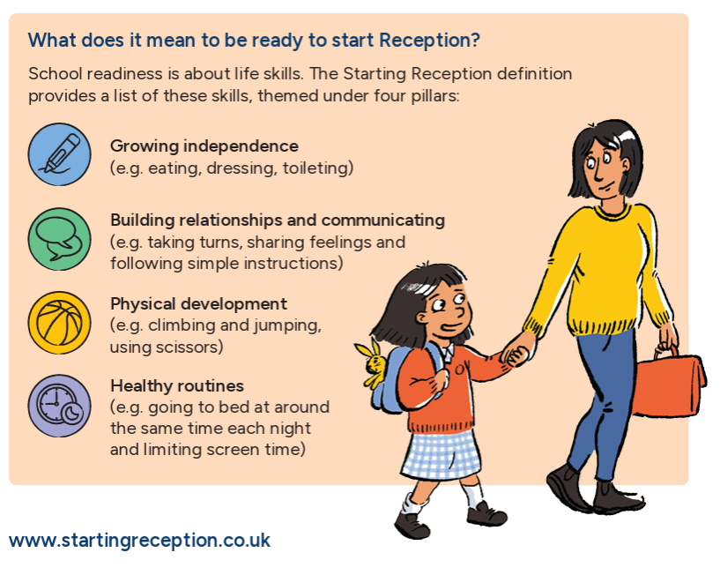
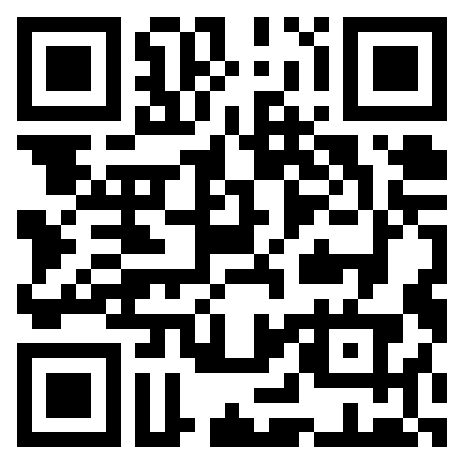
Support for Families
https://startingreception.co.uk/

Slide 16

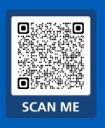
Support for Families

Slide 17
What do the children wear?
  Girls: white shirt or polo shirt, school sweatshirt or cardigan; grey skirt/pinafore (in the summer, girls may choose to wear a blue summer dress) white/grey socks or tights, black shoes (no trainers unless for PE sessions) Velcro fastenings are best for ease.
  Boys: white shirt or polo shirt, school sweatshirt; grey/black trousers (elastic wasted are best) grey socks, black shoes (not trainers) Velcro fastenings are best for independence .
  PE kit: white T-shirt, black shorts and black pumps/trainers. Long hair - tied back with a bobble. FS2 children wear their PE kit on the day of their PE session. FS2 PE kits are donated by Edgeley FC who we are proud to work closely with.
  Main suppliers are Debonair School Wear
  No jewellery.
  Wet days – labelled wellies and waterproofs to stay in school .

Slide 18
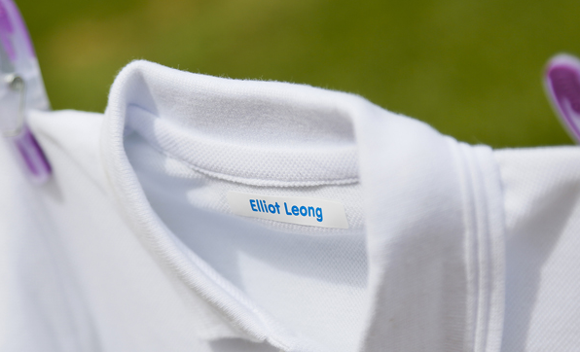

Please label all belongings!

Slide 19
What do children bring to school?
Book bags (FS2) Bring labelled book bags, reading books & diaries into school every day.
Named water bottles. Please send a full water bottle into school daily.

Slide 20

School lunches
Unless you are entitled to FSM, FS1 children pay for a school lunch. FS2 children are entitled to a universal free school meal. School meals are £2.83.
There are always three choices for your child to choose from; this includes a vegetarian and a halal option.
The children pick their choices with you at home.
Menus are available on the school website for you to use in advance so you can help guide their choice if needed.
Your child can bring a healthy packed lunch if you wish.

Slide 21

Communication
ClassDojo - day to day communication, important messages, child portfolio.
Social media – celebration of learning externally.
School Website – Newsletter, all links to Startwell & HYMS, what to expect in EYFS information

Slide 22
Working Together
You will be invited to come into school and discuss your child’s progress over the year.
We hold a transition meeting in the first half term to explain how our day is structured. At this meeting, we share how we teach reading, writing and maths - and suggest ways for you to support this.
We pride ourselves on having an ‘open door policy’. At the beginning of every session you are welcome to come into the classroom and speak to the team.
Sign up for Class Dojo and get regular updates on your child’s school life.
Join the PTA, come along to coffee mornings etc.

Slide 23
Housekeeping
Children should be dropped off and collected from the EYFS playground at the beginning and end of the school day.
The classroom door is opened at 8:40am and registration begins at 8:50am.
The end of the school day is 3:20pm. We open the school gates from 3:10pm.
A healthy snack is provided daily. Water is available throughout the day but they can bring in their own labelled water bottle to drink from when needed.
Milk - Free 1/3 pint of milk is available through a government initiative for under 5’s. Parents need to apply on line at www.coolmilk.com. Apply to Cool Milk directly for your 5 year old to receive a daily milk allowance.

Slide 24
Attendance matters
We want your child in 100% of the time, however, if your child is absent from school, please ring the school office on the first day of absence.
We currently use School Spider as a communication and payment system for you to receive information via emails and to pay for lunches, trips etc.
Breakfast Club must arrive between 7:30am – 8.15am (£4), Early adopters (free for FS2) is available from 8.15am.
After School Club is available Monday – Thursday, cost £7.50 per day.

Slide 25
Thank you for listening!
Any questions?
Let’s visit the wonderful EYFS provision together.

