Slide 1
Children’s Mental Health Week
Children’s Mental Health Week | Find Your Brave

Slide 3
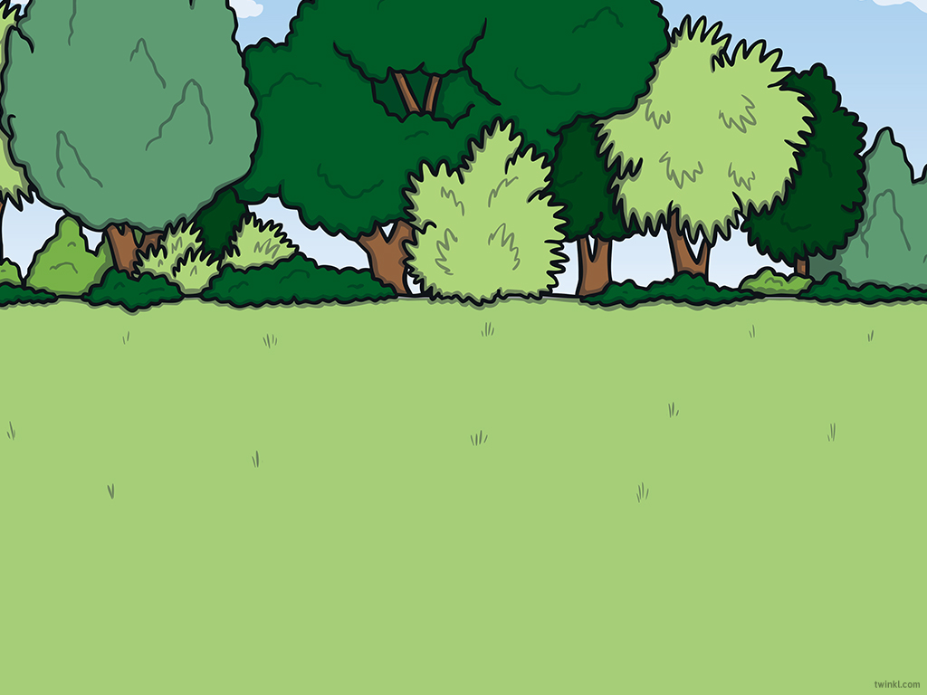

Aim
To explore what ‘being brave’ really means.

Slide 4
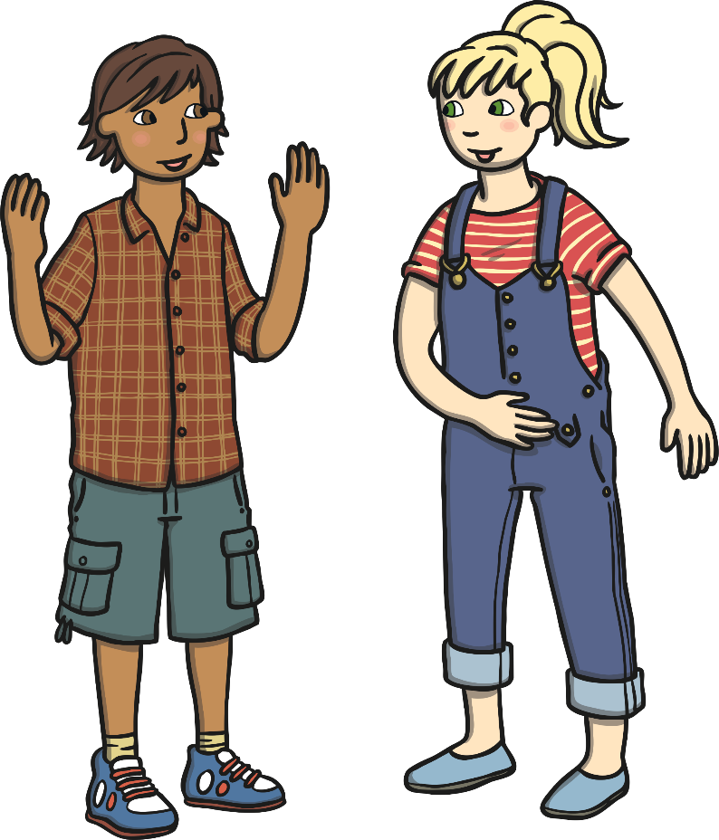
Finding Your Brave
Bravery is when someone shows mental or moral strength to face danger, fear or tricky times
What does 'being brave' mean to you?

Slide 5
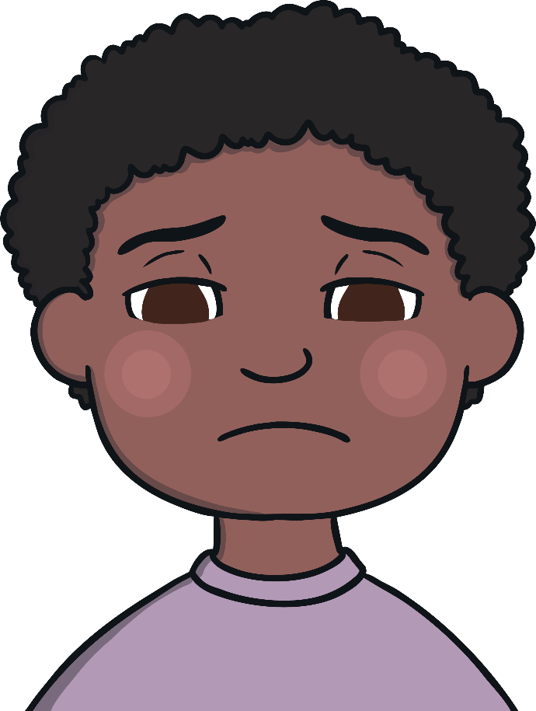
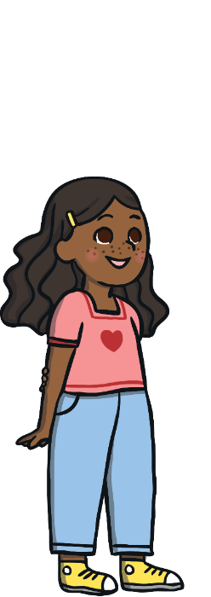

Finding Your Brave
We can all try to 'find our brave' during hard times.
Being brave during tough times doesn’t mean
holding it all in, not crying or pretending you are OK.
It means talking to an adult you trust about how
you are really feeling, sharing any worries you
have and asking for help. This is one of the
bravest things you can do.

Slide 6
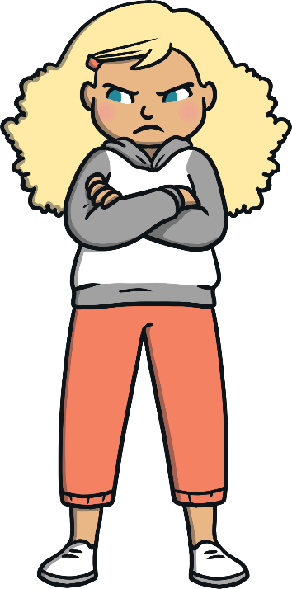
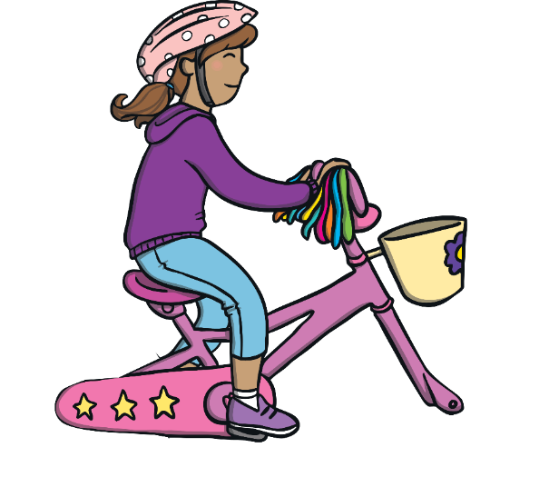


Finding Your Brave
We can all try to 'find our brave' during hard times.
Being brave can also mean saying ‘no’ to something
that isn’t good for our physical or mental health.
No!
Being brave can also mean you have a go at
something new. Maybe that could be joining a
new sports club or learning a new skill.

Slide 7
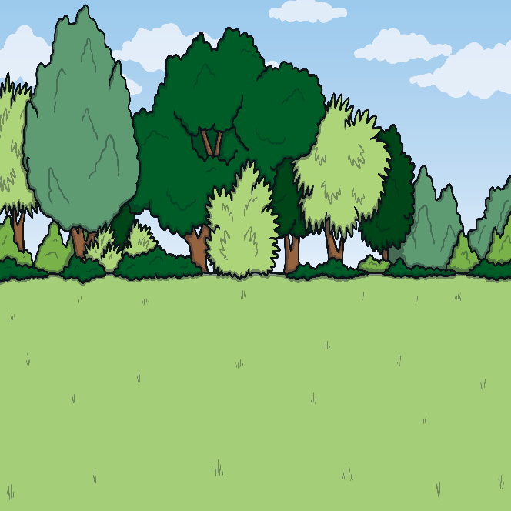
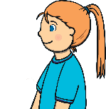
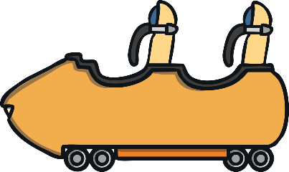

Finding Your Brave
We can all try to 'find our brave' during hard times.
It can also mean stepping outside of your comfort zone and challenging yourself.

Slide 8
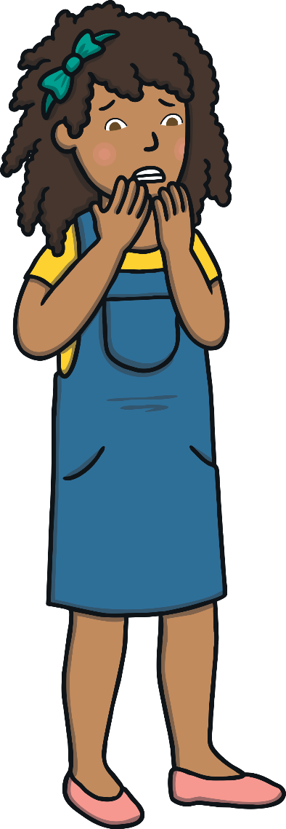

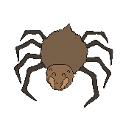
Finding Your Brave
Being brave during worrying times can help us feel better and feel good about ourselves.
Remember, it is not about dealing with tricky times alone or not facing them at all.
It is about asking for help, sharing our worries and fears and working with others to find a positive way forward to overcome any challenges we face.
Being brave when we are worried can help us feel better and feel good about ourselves.
Remember, it is not about dealing with tricky times alone or not facing them at all.

Slide 9
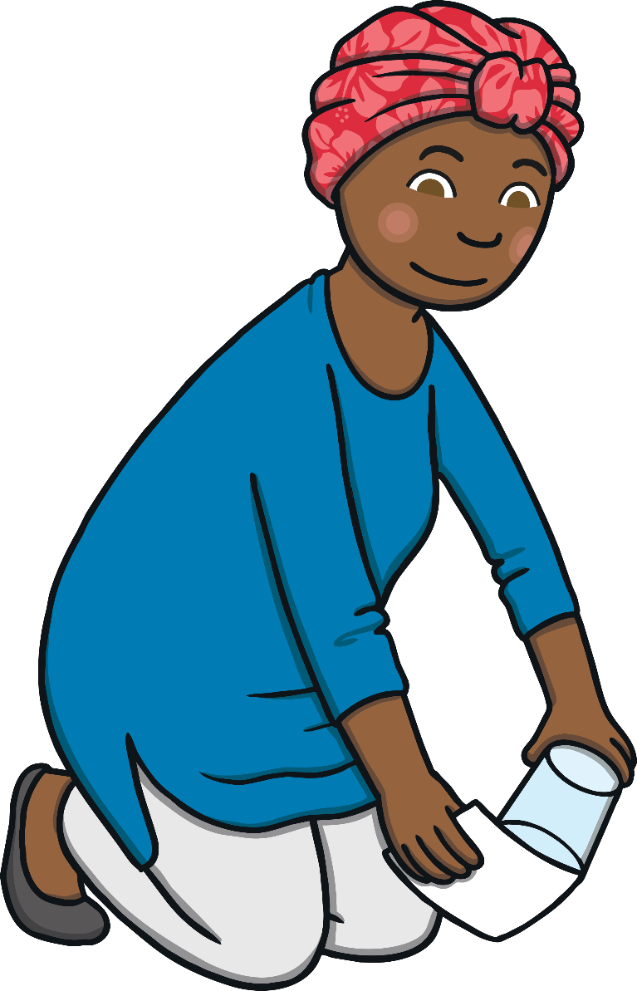
Finding Your Brave
It is about sharing our worries and fears, asking for help and working with others to find a positive way forward to overcome any challenges we face.

Slide 10
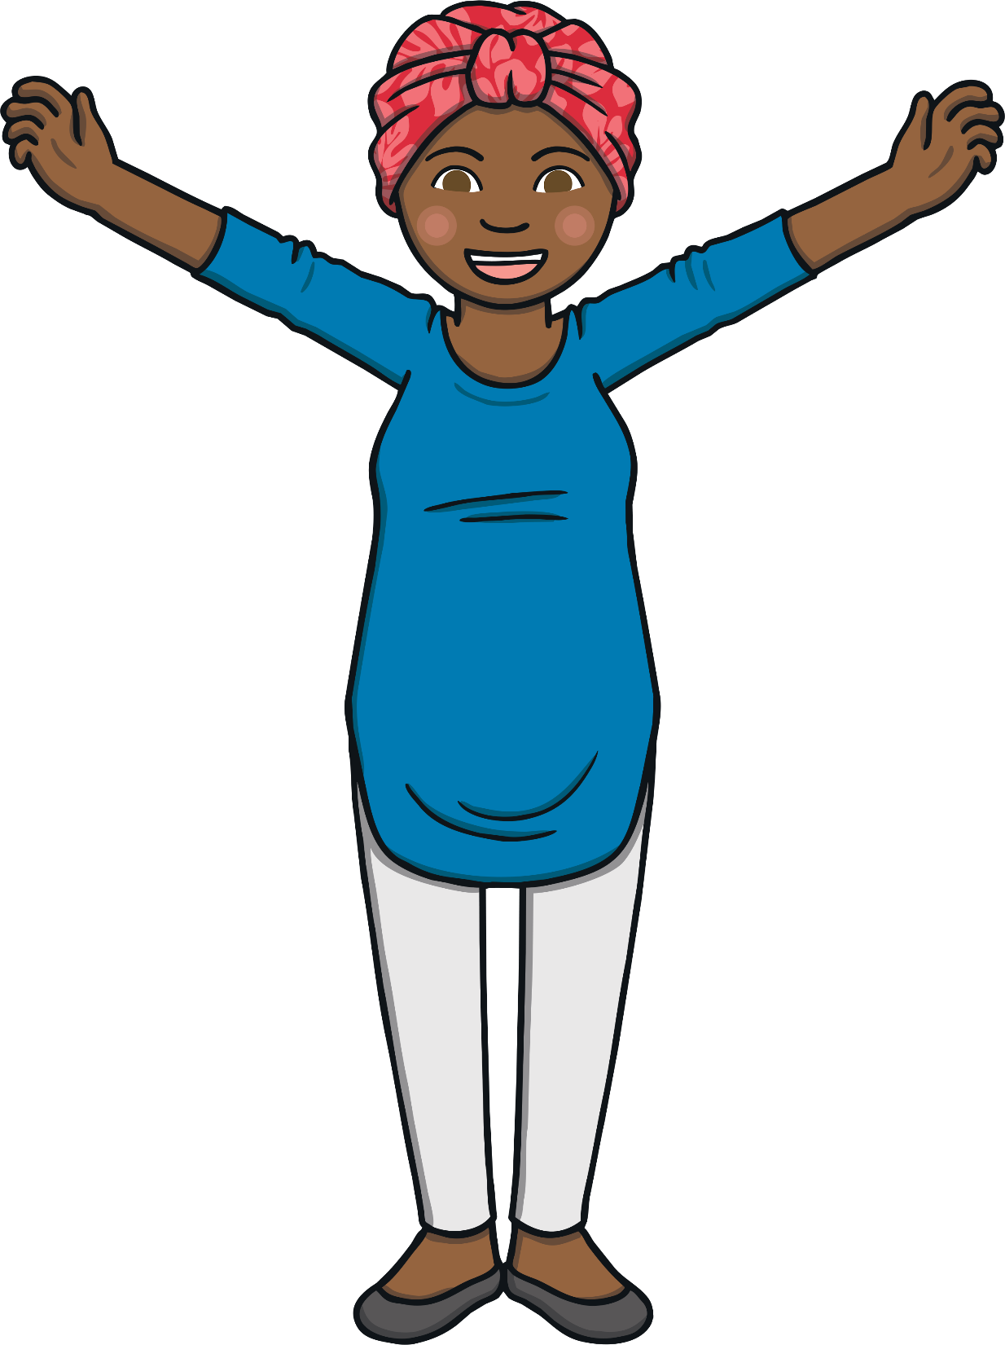

Finding Your Brave
Being brave during worrying times can help us feel better and feel good about ourselves.
Remember, it is not about dealing with tricky times alone or not facing them at all.
It is about asking for help, sharing our worries and fears and working with others to find a positive way forward to overcome any challenges we face.
It is about asking for help, sharing our worries and fears and working with others to find a positive way forward to overcome any challenges we face.

Slide 11
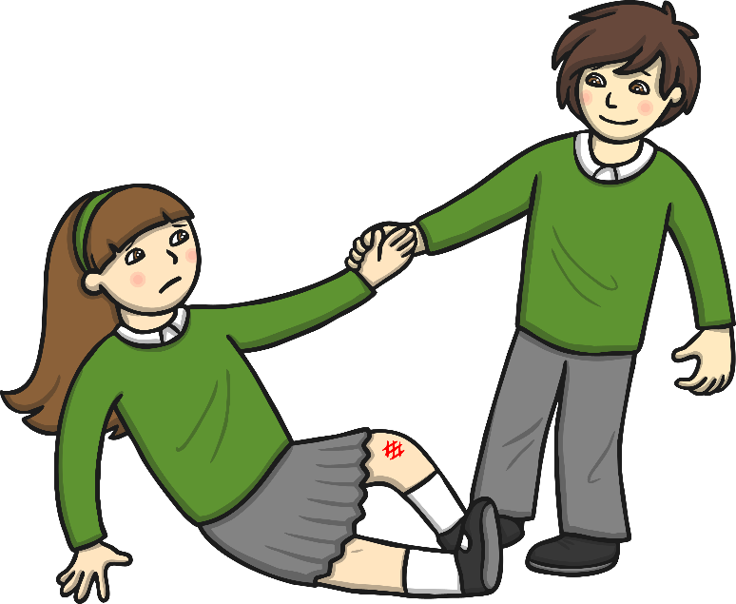
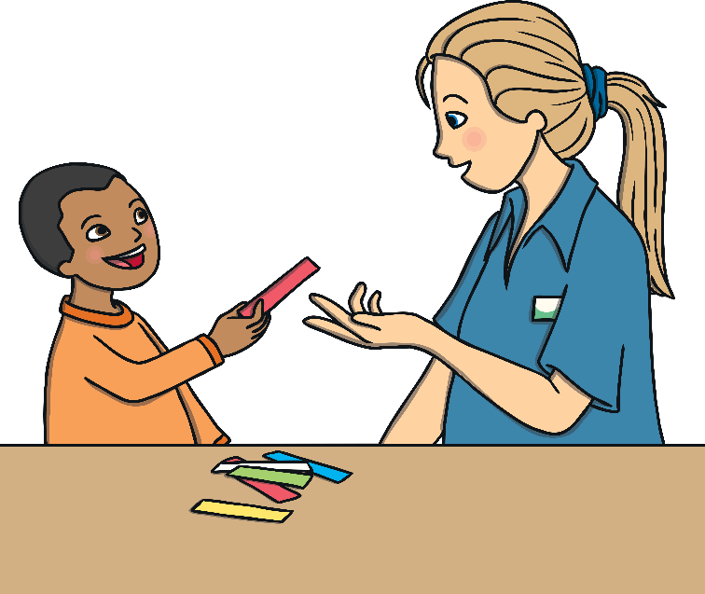
Helping Others to
Find Their Brave
It feels good to give and receive help.
What could we do to help the people we know to ‘find their brave’?

Slide 12
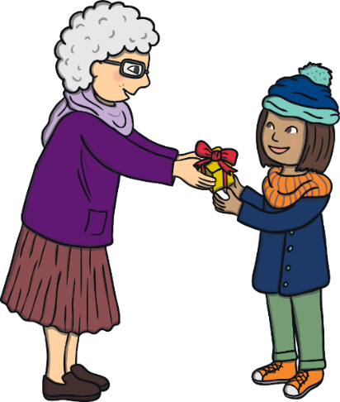
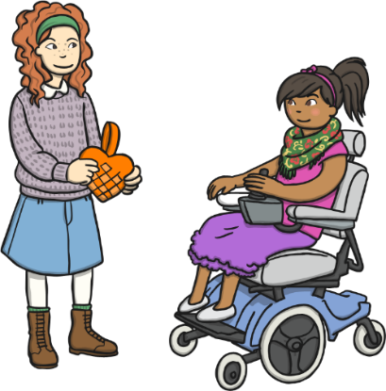
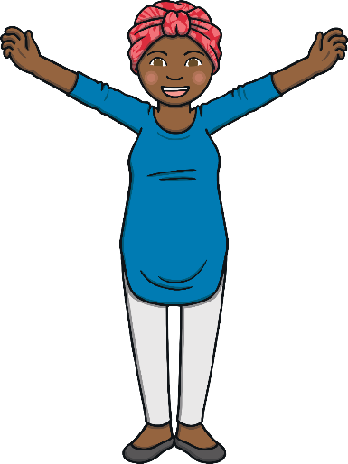

Reflection
In this moment of quiet:
think about anyone you know that
you could show kindness to;
think about anyone you know that you could help in order for them to overcome any challenges they are facing;
think about anything tricky that you would like to
‘find your brave’ with and think of someone you
could talk to about this.

Slide 13


