Slide 1
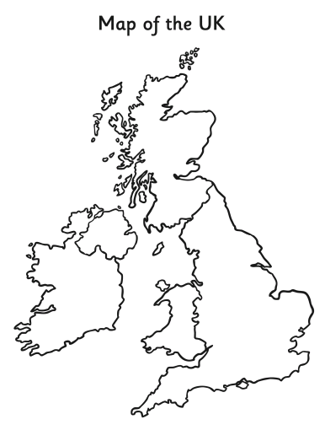

http://10.23.82.250/espresso/modules/t1_mapping/int_map/act_int_exp.html

Slide 2
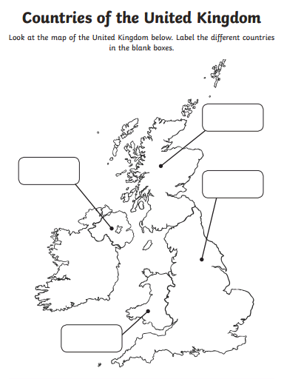
Key words
England
Wales
Scotland
Northern Ireland
Derby
Derby

Slide 3
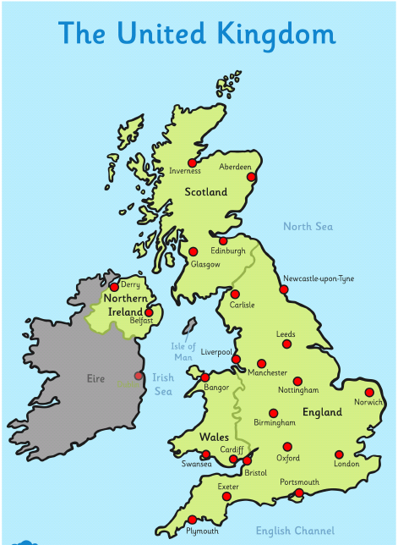
What are the names of the capital cities of the UK?
The capital cities
England - London
Wales - Cardiff
Scotland - Edinburgh
Northern Ireland - Belfast

Slide 4
What are the names of the seas around the UK?
Atlantic Ocean
Key words
North sea
Irish sea
English Channel
Atlantic ocean

